Slide 1
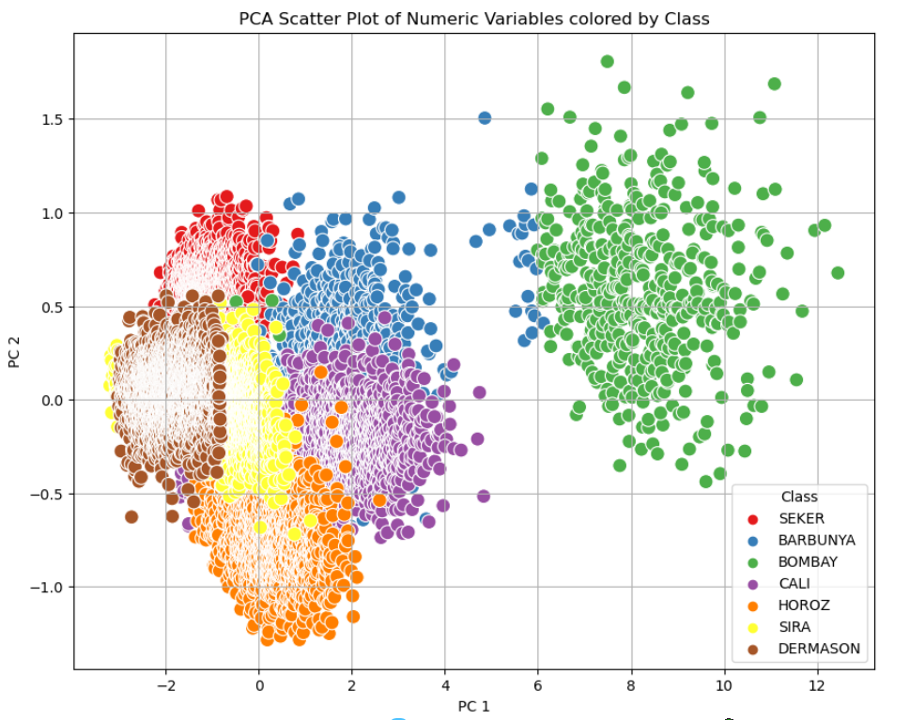
Group - 6
Sarthak Bhargava | 2022DC04226
Abhishek A Bevinagidad | 2022DC04004
Arnab Basak | 2022DC04463
Shinde Nidhi Bhanudas | 2022DC04429
Problem Statement –
Dataset: Dry Bean Dataset
Classification Exercise: Predict the Type of Dry Bean Based on Features.

Slide 2
Feature Engineering
Feature Engineering is the process of creating new features or transforming existing features to improve the performance of a machine-learning model.
Improve Model Performance: The quality of the features can greatly impact the accuracy and generalization of the model. Good features can improve the predictive power of the model.
Handle Complexities in Data: Feature engineering encapsulates various data engineering techniques such as selecting relevant features, handling missing data, encoding the data, and normalizing it. These techniques help to highlight the most important patterns and relationships in the data, which in turn helps the machine learning model to learn from the data more effectively.
Encoding the categorical labels
Normalizing the features
Standardization of the features
Feature selection using PCA etc.

Slide 3
Model Comparison
Model | Strength | Weakness
XGBoost | High Accuracy | Delicate to overfitting
 | Handles Complexities in data
 | Regularization and control to obstruct overfitting and enhance generalization | Needs careful parameter tuning
 | Parallel Processing and computational efficacy
 | Efficiently handles missing data | Memory intensive
KNN | Robust to noisy training data | Classification is slow
 | Effective if Training data is large | Need to determine value of K
 | Requires no training time | Which type of distance is indeterminant

Slide 4
Outcome Analysis
Before Regularization and Hyper parameter tuning
After Regularization and Hyper parameter tuning
 | KNN | XGBoost
Accuracy | 0.924 | 0.934
Precision | 0.936 | 0.946
Recall | 0.937 | 0.946
F1 Score | 0.936 | 0.946
 | KNN | XGBoost
Accuracy | 0.945 | 0.957
Precision | 0.946 | 0.958
Recall | 0.946 | 0.958
F1 Score | 0.946 | 0.958

Slide 5
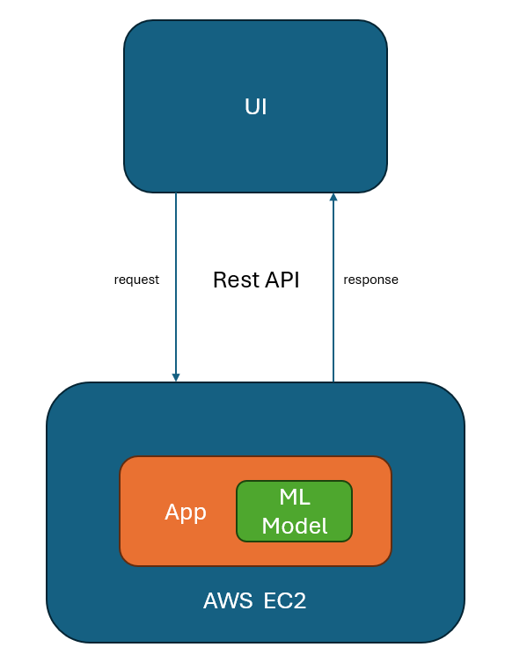
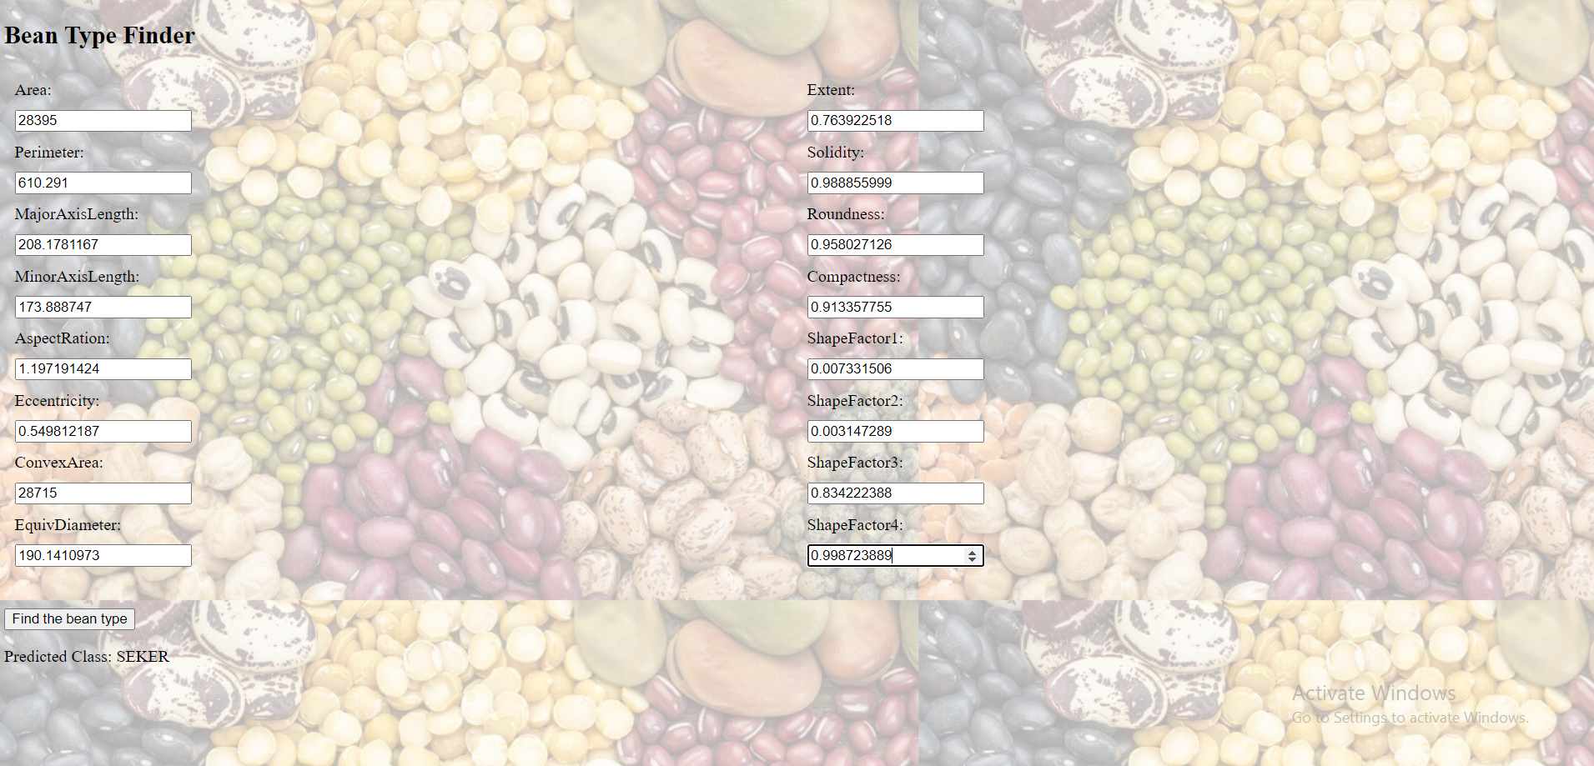
Model Deployment
URL - https://eb80-65-0-134-26.ngrok-free.app/
*app availability depends on AWS EC2 Server status

