Slide 1
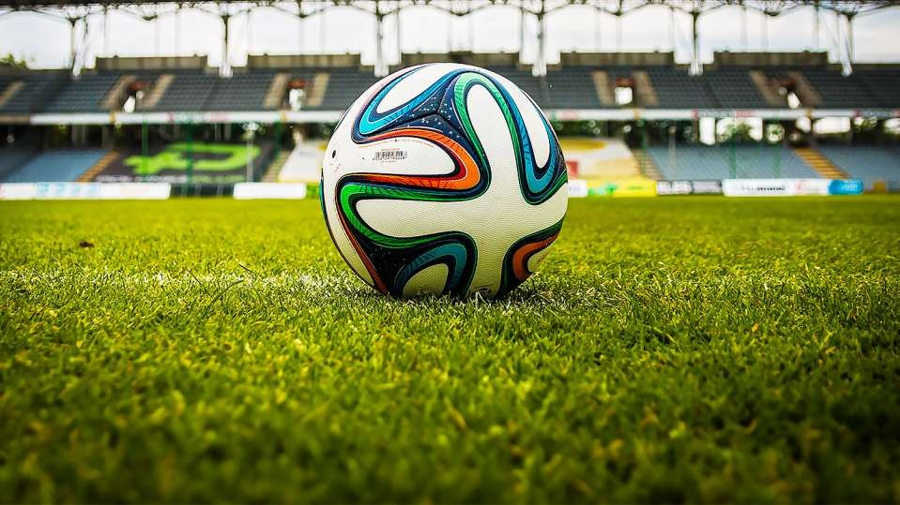

SPORTS
IN OUR LIFE
ALLPPT.com _ Free PowerPoint Templates, Diagrams and Charts

Slide 2


SPORTS IN OUR LIFE
1.DEFINITION OF SPORTS:
The Word 'Sport' comes from the old French word called Desport which means "Leisure", but this word has changed its connotation with the passing time. Now sports are no longer believed to be practiced only in leisure time. Today they are one of the major parameters to judge a country's development and growth and are fast becoming great career options for the future generations.
A sport is commonly defined as an organized, competitive, and skillful physical activity requiring commitment and fair play. It is governed by a set of rules or customs. In a sport the key factors a re the physical capabilities and skills of the competitor when determining the outcome (winning or losing)
. The physical activity involves the movement of people, animals and/or a variety of objects such as balls a nd machines. In contrast, games such as card games and board games, though these could be called mind sports, require only mental skills. Non-competitive activities such as jogging and rock-climbing are usuall y classified as recreations.

Slide 3

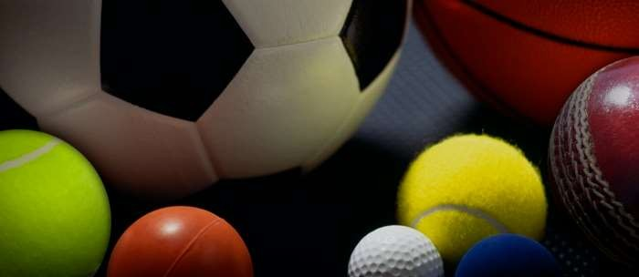
SPORTS IN OUR LIFE
DEFINITION OF SPORTS
SportAccord uses the following criteria, determining that a s
port should:
Have an element of competition.
Be in no way harmful to any living creature.
not rely on equipment provided by a single supplier (excluding propr
ietary games such as arena football)
Not rely on any "luck" element specifically designed into the sport.

Slide 4
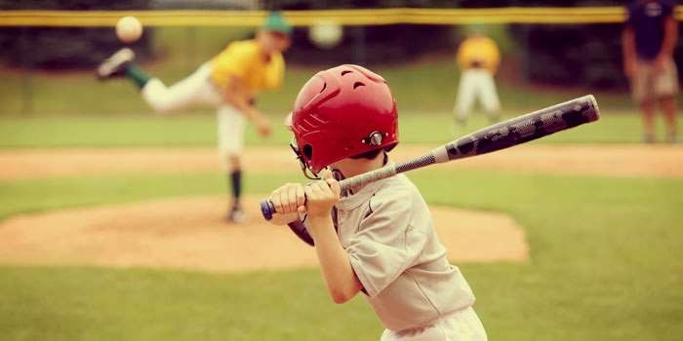

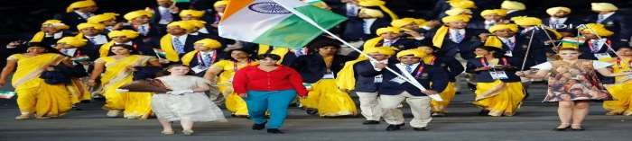
SPORTS IN OUR LIFE
India at Major International Sports Events
1. Olympics [India at Olympics]
India first participated at the Olympic Games in 1900, with a lone athlete (Norman Pritchard) winning two me dals- both silver- in athletics. The nation first sent a team to the Summer Olympic Games in 1920, and has par ticipated in every Summer Games since then. India has also competed at several Winter Olympic Games begin ning in 1964. Indian athletes have won a total of 26 medals, all at the Summer Games. For a period of time, In dia national field hockey team was dominant in Olympic competition, winning eleven medals in twelve Olympi cs between 1928 and 1980.

Slide 5


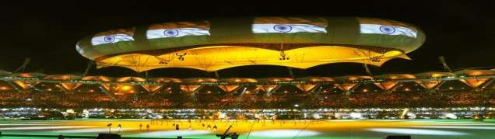
SPORTS IN OUR LIFE
India at Major International Sports Events
2. Common wealth Games [India at common wealth games]
India has competed in fourteen of the eighteen previous Commonwealth Games; star ting at the second Games in 1934 hosted the games one time. India hosted the Game s in2010, at Delhi. India is the fourth most successful country with a total of 436 med als including 156 gold medals.
It was India's most successful Commonwealth Games to date with Indian athletes wi
nning 38 gold, 27 silver and 36 bronze medals.

Slide 6
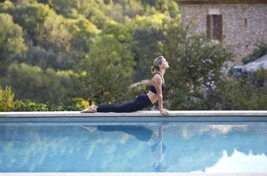

SPORTS IN OUR LIFE
India at Major International Sports Events
3. Asian Games [India at Asian games]
India hosted the Asian Games in 1951 and 1982 at New Delhi. India is the sixth most successful country winning 602 medals including 139 gold. India has won the gold medal in Kabbadi ever since its inception
.
India is a member of the South Asian Zone of the Olympic Council of Asia (OCA), and has participated in the Asian Games since their inception in 1951. The Indian Olympic Association, established in 1927, and recognised in the same year by the International Olympic Committee, is the National Olympic Committe e for India.
Medals by Games
India is one of the only seven countries that have competed in all the editions of the Asian Games. The ot her six are Indonesia, Japan, the Philippines, Sri Lanka, Singapore and Thailand. India has won at least o ne gold medal at every Asian Games, and always ranked within the top 10 nations of the medal table exce pt in the 1990 Asian Games.

Slide 7

SPORTS IN OUR LIFE
IMPORTANCE AND BENEFITS OF SPORTS:
Have you ever thought why people do sports?
Absolutely, many people seem not to know the reasons. As a anecdote, there are many people who do sports for nothing around us. Every day we can encounter wi th these people. They regularly do sports; however, none of them realizes the bene fits and importance of sports. In fact, vice versa, some people want to be fit and at tractive, look smart. Unfortunately, these people can’t consider other benefits of s ports. In my opinion, there are several benefits of sports that people often do not consider: sports are required to be healthy people, are needed for enjoyment, and are great market for countries’ economies.
The first advantage of sports for people is that they help people be healthy, and be fit.
The second advantage of sports for people is that they are required for our daily
lives and competing at the international area because of enjoyment of sports.
The final and least advantage of sports is that they are the huge market for coun try’s economy.

Slide 8
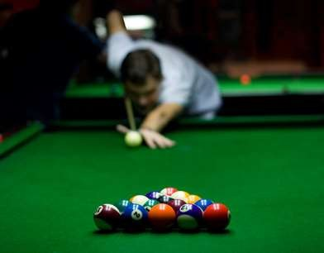

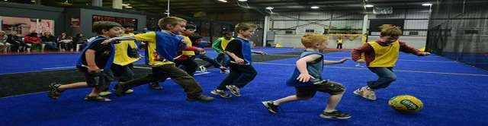
SPORTS IN OUR LIFE
3. CATEGORIZATION OF SPORTS
INDOOR SPORTS:
Whenever one uses the phrase “sports and games” it is common human mentality to associate it with th e likes of Football, Tennis, Baseball, etc. Especially in a country like India, where the spectrum of sports is occupied by cricket alone (leaving little space for recognition of other sports) the recognition of indoo r sports and games is almost absent. The only indoor game we have to boast about is Chess and Badmin ton (to an extent!).
However, when it comes to the world at large, indoor games are just as important as outdoor games an d sports are. Be it in the Olympics or other international tournaments, indoor games are held in great regard worldwide.

Slide 9
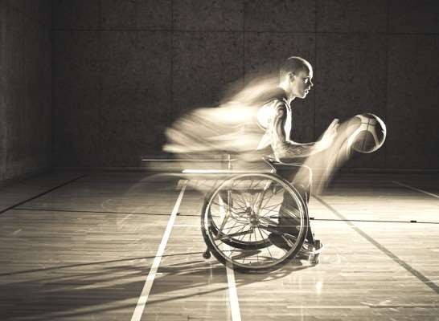

SPORTS IN OUR LIFE
OUTDOOR SPORTS:
We play some games in the open air. These are called outdoor games. The Indian games like Hadu-du also called Kabadi, Dandaguli, etc. are outdoor games. We pl ay these games in an open field. Football, cricket, hockey, tennis, etc. are also outd oor games. These are western games. These games were introduced into our count ry by the English. We have learnt to play these games quite well.
Outdoor games are now part of our education in the school. Formerly it was not s
o. At present many schools have their own playgrounds. The students of the schoo ls take part in outdoor games. Youngman of India is now taking great interest in outdoor games.

Slide 10
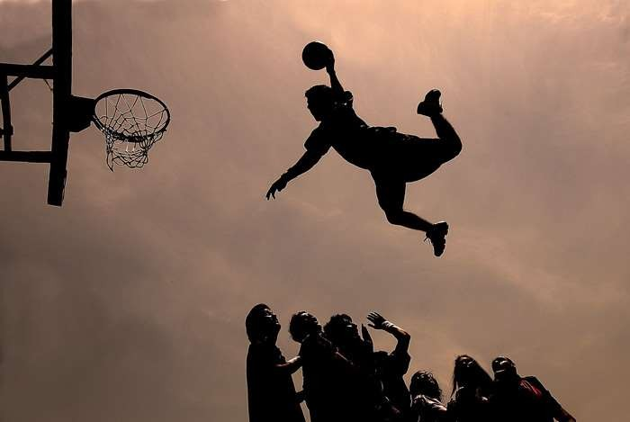



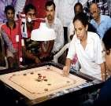







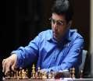
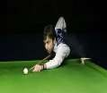
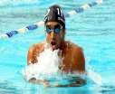
SPORTS IN OUR LIFE
INDOOR SPORTS
Badminton
Boxing
Chess
Table tennis
Squash
Billiards
Bowling
Kabaddi
Swimming
Carroms
Futsal

Slide 11
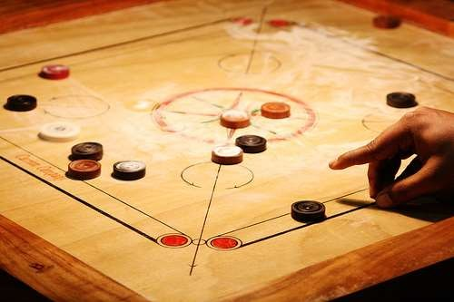




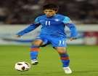






SPORTS IN OUR LIFE
OUTDOOR SPORTS
Cricket
Soccer
Hockey
Tennis
Motor sports
Basket ball
Wrestling
Golf
Rugby
Volley ball
Baseball

Slide 12

SPORTS IN OUR LIFE
SCREENSHOTS

Slide 13


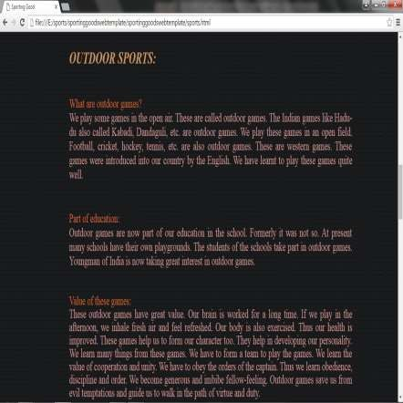
SPORTS IN OUR LIFE

Slide 14
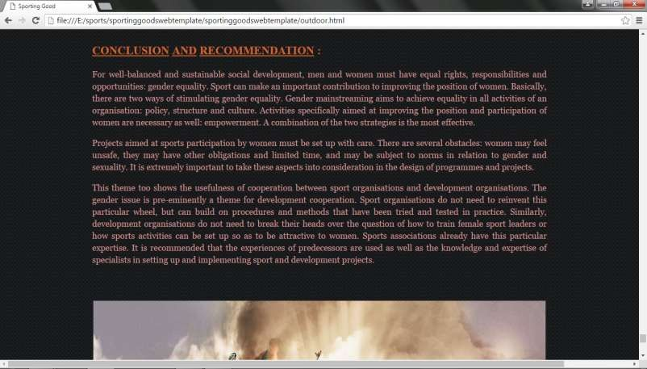
SPORTS IN OUR LIFE

Slide 15

SPORTS IN OUR LIFE
Conclusion:
For well-balanced and sustainable social development, men and women must have e qual rights, responsibilities and opportunities: gender equality. Sport can make an im portant contribution to improving the position of women. Basically, there are two way s of stimulating gender equality. Gender mainstreaming aims to achieve equality in all activities of an organisation: policy, structure and culture. Activities specifically aimed at improving the position and participation of women is necessary as well: empower ment. A combination of the two strategies is the most effective.
Projects aimed at sports participation by women must be set up with care. There are several obstacles: women may feel unsafe, they may have other obligations and limit ed time, and may be subject to norms in relation to gender and sexuality. It is extrem ely important to take these aspects into consideration in the design of
programmes and projects.

