Slide 1
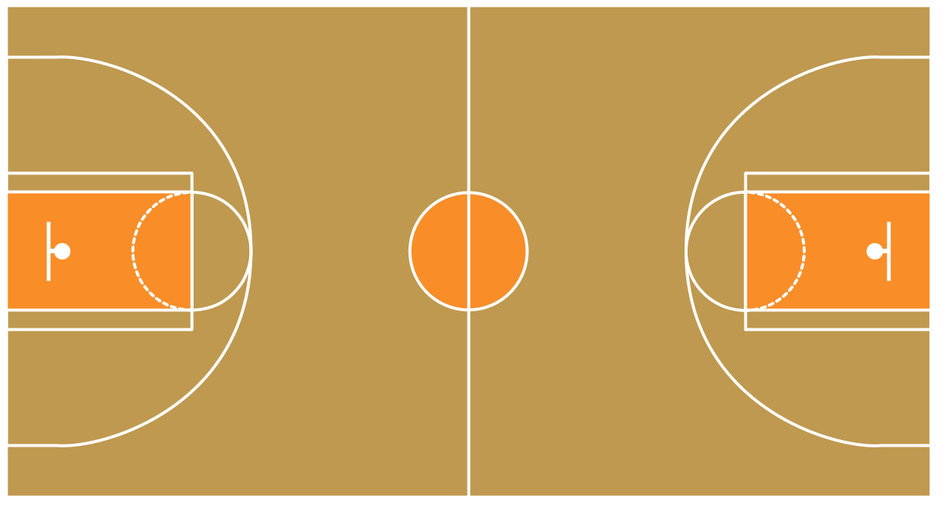

Basketball Captain’s Meeting
Spring 2017

Slide 2
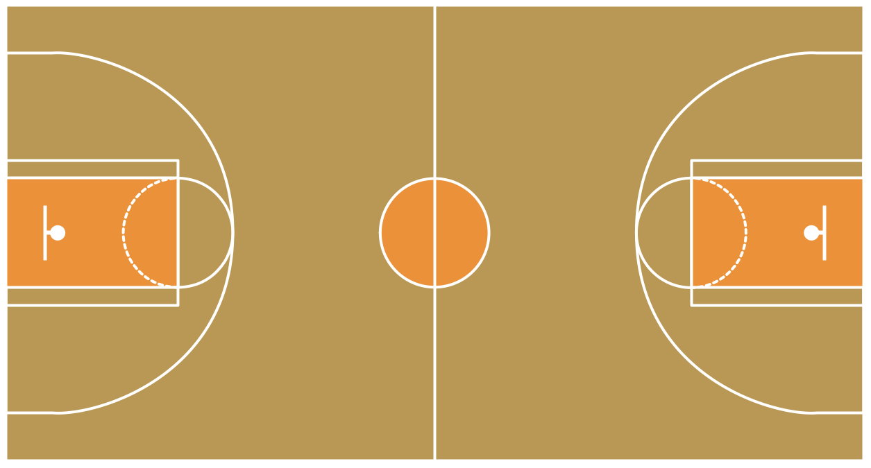

Who Are You Talking To?
Jonathan Elliott
Assistant Director of Club and Intramural Sports
Brooke Cochran
Coordinator of Club and Intramural Sports
Ryan Marsh
Graduate Assistant of Intramural Sports
Supervisors
Red Polos on the courts
They are there to help you!

Slide 3
imsports@uark.edu

Slide 4
Captain’s Expectations
Attend this Captain’s Meeting to be eligible for playoffs
Congrats, you’re already here!
Next meeting is Friday Jan. 27 at 4:30pm
Choose an appropriate team name
We will change your name if we deem it inappropriate
FILL YOUR ROSTER
If you fail to do this by your first game you will be charged
the Forfeit Fine

Slide 5
Captain’s Expectations
Register your team on Fusion IM
Serve as your team’s “voice” on the field/court
Communicate with IM Sports Staff for various issues
Forfeits
Defaults
Reschedules
Etc.
Serve as the news source for your team
Sport Rules
Policy and Procedure info
Game information
Playoff Draft
General updates

Slide 6
Captain’s Expectations
Talk to and ask questions of the officials and supervisors
They are there to help you, but will not tolerate disrespect
Verify score and sportsmanship at the end of every game
Have Fun!

Slide 7
Extramural Tournaments
Take your team to the next level and compete with teams from across the country!
http://play.nirsa.net/basketball/regional-championships/
University of Houston Regional Basketball Tournament
March 3-5
Middle Tennessee State University Basketball Regional
March 17-19
National Basketball Tournament- The Ohio State University

Slide 8
Fusion IM
Register your team via “Member Services” on urec.uark.edu
Make sure your roster has met the MINIMUM number of players to begin a game
Basketball
Roster Minimum = 3 people
Roster Max= 10
Use the filters on the side of the page to assist you in choosing your League and then your Division
Leagues= Men’s D1, Men’s D2, Women’s etc.
Divisions= Monday 6:30pm, Wednesday 8:30pm etc.

Slide 9

Defaults
Defaults = GOOD
Team receives a loss and sportsmanship is unaffected
Telling IM Sports BEFORE your game that your team will not be able to attend
Avoids the Forfeit Fine
“DEFAULT” via Fusion IM
Keep in mind….2 DEFAULTS = 1 FORFEIT and the Forfeit Fine

Slide 10
Forfeits
Forfeits = BAD
Team receives a loss, lower sportsmanship and must pay the $50 Forfeit Fine
Forfeits can be but are not limited to:
Not showing up for your game
Not having the minimum number of players to begin a game
Multiple technical fouls, unsportsmanlike penalties etc.

Slide 11
Sportsmanship
1-10 Scale
Need an average of a 7.0 to be eligible for playoffs
8-10: Exceptional
7: Average
5-6: Below Average
3-4: Poor
0-2: Unacceptable

Slide 12
All-University Cup
Complete the Google Doc
IM Sports will track your team’s points all year to crown the ultimate IM Sports Champion at the conclusion of sports during spring semester
Award- All-University Cup trophy
Picture on the Wall of Champions
Spot on IM Sports social media accounts

Slide 13
Greek Cup
For Greek Organizations ONLY
ONE team per organization is allowed in the Fraternity/Sorority division
If due to lack of teams in these divisions, teams may enter multiple
Team Names must be your Greek Org letters, name abbreviations etc.
Complete the Google Doc
https://goo.gl/forms/eS6uwavhPXi0P0Xd2
Let us know who your representatives are so we can send them important IM information

Slide 14
Sport Specific Information
You must PROVIDE YOUR OWN JERSEYS
IM pennies will ONLY be provided for emergency situations such as blood
Same color
Numbers
0-5, no higher than 55, avoid having repeating numbers on your team!

Slide 15
Sport Specific Information
Timing
2, 20 minute halves
Running clock
Until the final 2 minutes of the 2nd half
Clock will stop at the officials whistle
2 time-outs per half
Mercy Rule
30 or more points at 5 minutes
20 points at or under 2 minutes

Slide 16
Sport Specific Information
Rosters
Minimum of 4
5 on the court at a time
Maximum of 10 on your roster
5-Minute Rule
At game time, if one team does not meet the minimum to begin a game 5 minutes will begin.
The team who is prepared will earn 3 points for each minute that passes.

Slide 17
Sport Specific Information
Technical Fouls and Unsportsmanlike Behavior
2 Unsportsmanlike technical Fouls on 1 player = ejection
3 Unsportsmanlike technical fouls on a team = forfeit
Administrative technical fouls (jewelry, not checking into the game etc.) will not count toward ejection or forfeiture
ALL technical fouls count towards an individual player’s foul count and the team foul count

Slide 18
Questions?

