Slide 1
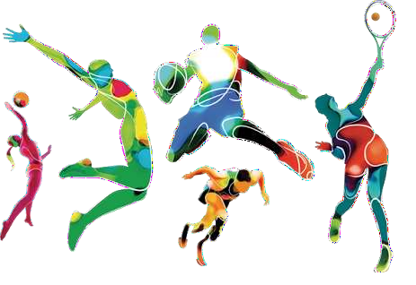
SPORTS
AN INTRODUCTION

Slide 2
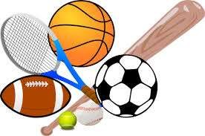
Sports
- is an activity that requires physical actions and skills where individuals or teams compete under a set of rules.

Slide 3

Types of Sports

Slide 4

Sport is classified into:
Individual sports
Dual sports
Team sports
Individual sports | are played by one participant on each competing side
Dual Sports | are played by two competing pairs
Team Sports | are played by three or more players

Slide 5
What is the difference of individual/dual sports vs. team sports?
Individual sports
foster a higher amount of discipline, self-confidence, focus, and passion
Team sports
many variables are considered to determine the success or failure of the team. It
depends on the collective effort of all its players

Slide 6
What does one need to know in playing
sports?

Slide 7
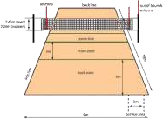
Some of the important aspects to consider in learning a sport:
History
Court Dimensions/ Venue
Equipment and Gear
Technical and Tactical Skills
Rules of the Game
Officiating

Slide 8
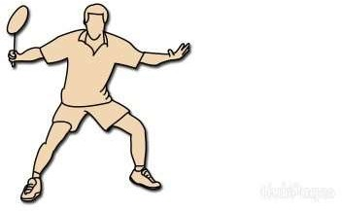
Individual/ Dual Sports

Slide 9
Table Tennis
Grip
Shakehand Grip
Penhold Grip
Ready Position
Forehand and Backhand
Basic hitting
Topsin Serve
Basic Position, Forehand and Backhand Drive
Forehand and Backhand Push

Slide 10
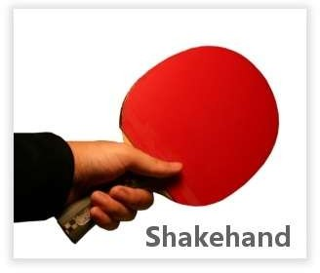
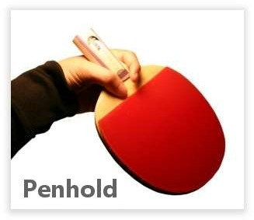
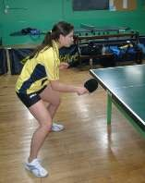
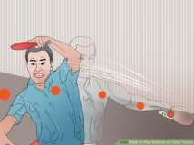
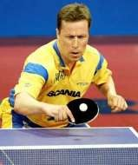
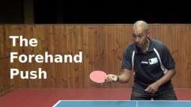

Slide 11
Badminton
1. Grip 4.
Forehand and Backhand
Overhead Stroke
Forehand and Backhand Clear
Forehand and Backhand Drop
Forehand and Backhand Smash
Forehand and Backhand Drive
Handshake Grip (forehand and backhand)
2.
3.
Ready Position and footwork
Serve
Long serve
Short serve (forehand and
backhand)

Slide 12
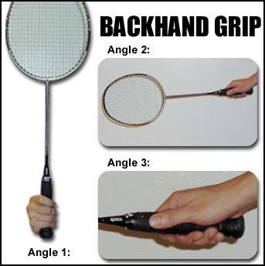
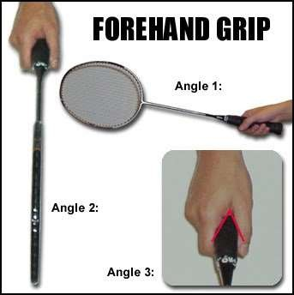


Slide 13
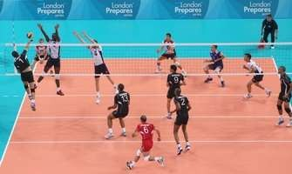
Team Sports

Slide 14
Basketball
Footwork
Pivoting
Catching the Ball
Dribbling
Passing
Shooting
Rebounding

Slide 15
Softball
Throwing
Catching
Fielding Flyballs and Ground Balls
Playing Catcher
Pitching
Batting
Baserunning
Sliding

Slide 16
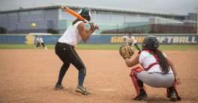
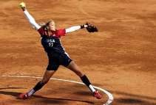
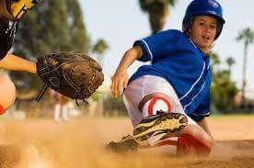
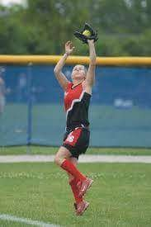
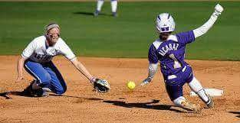
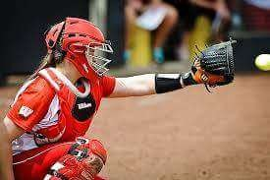
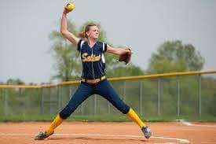
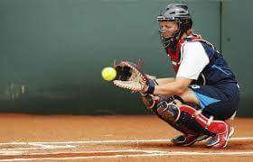
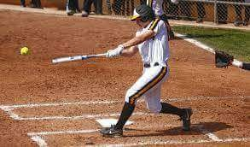
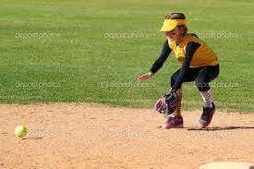

Slide 17
Volleyball
Stance (ready position of the body and foot)
Service (Underhand, sidearm, and overhand serve)
Tossing (underhand and overhand or finger toss)
Passing/receiving (Forearm pass, Overhand, and dig pass)
Attacking
Blocking
Defensive skills (Rolling/Sliding)

Slide 18
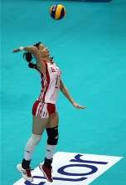
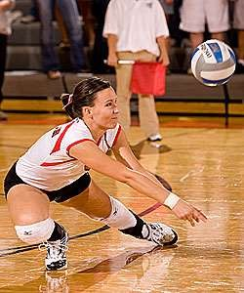
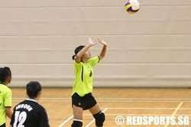
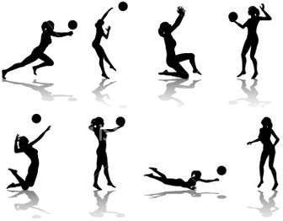
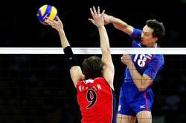
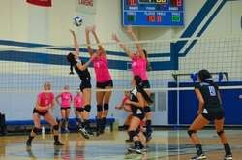

Slide 19
Technical and Tactical Skills in
Playing Sports

Slide 20
Technical Skills
-These are basic or fundamental skills needed to play the game.
Examples of Technical Skills:
In basketball (dribbling, passing, and shooting)
In volleyball (ball reception, attacking/spiking, and setting)

Slide 21
Tactical Skills
-These are the decision-making skills or strategies used in different situations during the game
-A basic example is the use of quick pass and movement against a taller but slower opponent in basketball
-The use of tactical decision during a game is called game sense

Slide 22
Five Steps in Teaching Tactical skills
Distinguishing the important decision
Establishing essential knowledge for athletes
Recognizing the signals in situations
Giving appropriate tactical options
Planning a Practice Game

Slide 23
Planning a Practice Game
1. Preparation/Planning
Date, time, and duration of training/practice
Objectives/Goals
Equipment needed during training/practice
2. Training Proper
Warm-up/Stretching
Teaching new skills/practice of previously taught skills
Scrimmage/Practice game
Cool down and assessment

Slide 24
CHOOSING A
SPORT

Slide 25
Some of the considerations that will guide an individual in their choice of sports include:
Weather extremities(hot or cold) for am activity.
Enjoyment derived from he activity.
Previous activities tried and enjoyed.
outdoor sports
4. Financial capacity or budget. Activities like skating, golf, and scuba diving require financial investment on equipment and actual activity.

Slide 26
5. State of health and level of fitness. Demand of physical activity may be excessive for the body, having a conditioning is recommended.
6. Other alternative activities that will give motivation.

Slide 27
What are the health-related and skill- related fitness in sports/physical activity ?
Health-related physical fitness – are the aerobic capacity, muscular strength, muscular endurance, flexibility, and body composition of an individual .
Skill-related physical fitness- sometimes called sports fitness or motor fitness.
One of the factors that influence skill-related performance is heredity; however, most fitness skills can be developed and improved.

Slide 28
Skill- Related Fitness Component | Examples of Sports | Movement
Agility | Basketball Tennis | Changing directions to escape a defender Changing directions to hit the ball
Balance | Cycling Gymnastics | Riding a bicycle Performing on the balance beam
Coordination | Table Tennis Baseball Soccer | Hitting the ball Catching a ball Kicking a soccer ball

Slide 29
Reaction Time | Swimming Basketball | Start to jump/dive on the pool when the signal start Getting the rebound
Speed | Athletics Badminton Baseball | Running the 100m event Receiving a drop shot Stealing a base
Power | Baseball Powerlifting | Throwing a fast ball Lifting weights

Slide 30
What are the safety measures to avoid unnecessary injuries in playing games or sports?
Safety Equipment
Hydration
Perform moderate-intensity physical activity
Weather Condition

