Slide 1
Data Structure and Algorithms
Lecture 3 : Array

Slide 2
Things to cover
Multidimensional Array:
  Initialization
  Pass array to a function
  Memory storage
  Operations : Transpose
  Sparse Matrix

Slide 3
Initialization
#include <stdio.h>
int main() {
// Create and initialize an array with 3 rows
// and 2 columns
int arr[3][2] = { { 0, 1 }, { 2, 3 }, { 4, 5 } };
// Print each array element's value
for (int i = 0; i < 3; i++) {
for (int j = 0; j < 2; j++) {
printf("arr[%d][%d]: %d ", i, j, arr[i][j]);
}
printf("\n");
}
return 0;
}
int arr[2][3];
int arr[2][3] = {0,1,2,3,4,5};
int arr[2][3] = {{0,1,2},{3,4,5}};

Slide 4
Passing Array to a function
#include <stdio.h>
// Funtion that takes 2d array as parameter
void print(int arr[3][3], int n, int m) {
for (int i = 0; i < n; i++) {
for (int j = 0; j < m; j++)
printf("%d ", arr[i][j]);
printf("\n");
}
}
int main() {
int arr[3][3] = {{1, 2, 3},
{4, 5, 6},
{7, 8, 9}};
// Passing the array along with the
// size of rows and columns
print(arr, 3, 3);
return 0;
}
int arr[][3]
As Pointer to an Array : int (*arr)[3]

Slide 5
Passing Array to a function
#include <stdio.h>
// Funtion that takes 2d array as parameter
void print(int arr[3][3], int n, int m) {
for (int i = 0; i < n; i++) {
for (int j = 0; j < m; j++)
printf("%d ", arr[i][j]);
printf("\n");
}
}
int main() {
int arr[3][3] = {{1, 2, 3},
{4, 5, 6},
{7, 8, 9}};
// Passing the array along with the
// size of rows and columns
print(arr, 3, 3);
return 0;
}
int arr[][3]
As Pointer to an Array : int (*arr)[3]
As Single Level Pointer : int *arr
print( (int *)arr, 3, 3 );

Slide 6
How Stored in memory
Address of A[I][J] = B + W * ((I – LR) * N + (J – LC))
I = Row Subset of an element whose address to be found,
J = Column Subset of an element whose address to be found,
B = Base address,
W = Storage size of one element store in an array(in byte),
LR = Lower Limit of row/start row index of the matrix(If not given assume it as zero),
LC = Lower Limit of column/start column index of the matrix(If not given assume it as zero),
N = Number of column given in the matrix.
Address of A[I][J] = B + W * ((J – LC) * M + (I – LR))
M = Number of rows given in the matrix.
Row Major Order
Column Major Order

Slide 7
Row-major

Slide 8
Column-major

Slide 9
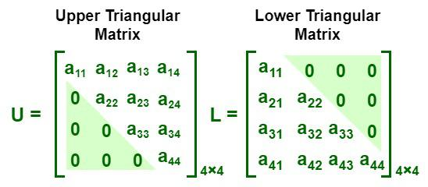
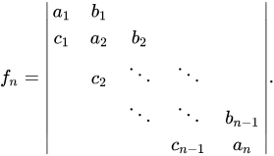
Sparse Matrix

Slide 10

Sparse Matrix

