Slide 1
Switching Circuit & Logic Design
Lecture 1 : Introduction

Slide 2
Things to cover
Digital Logic Families
Switching theory
Logic circuits
Sequential Circuits
ASM chart

Slide 3
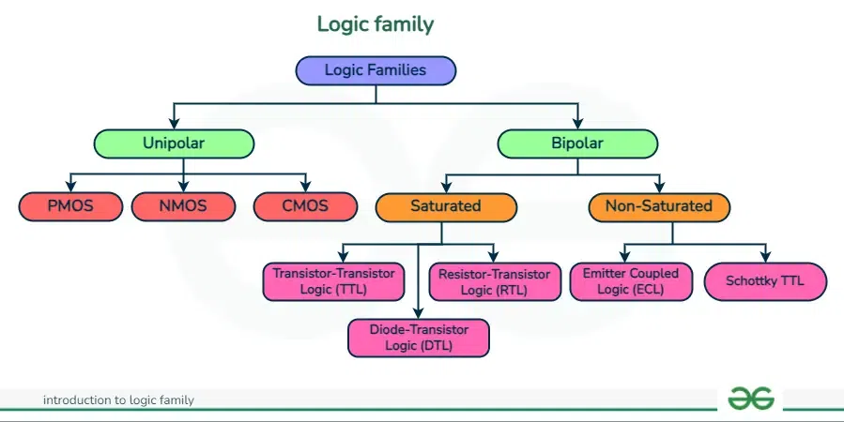
Digital Logic Families
Taken from here

Slide 4
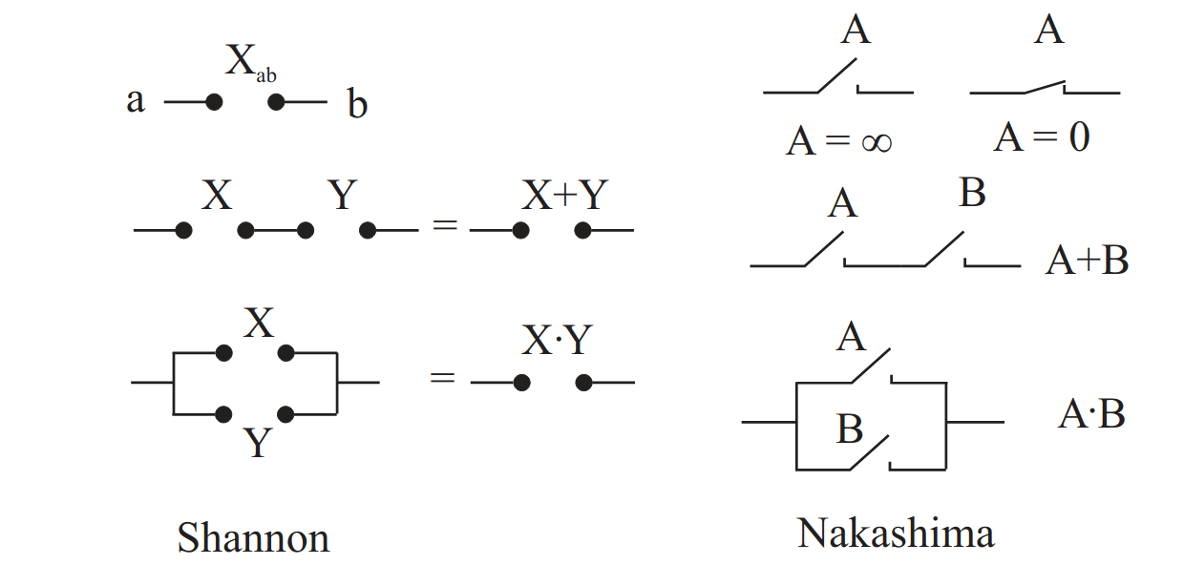
Switching Theory
Akira Nakashima from Japan (1936)
Claude Shannon from US (1938)
Victor Sheshtakov from Soviet Union (1938 Ph.D. Thesis published in 1941)
Link

Slide 5
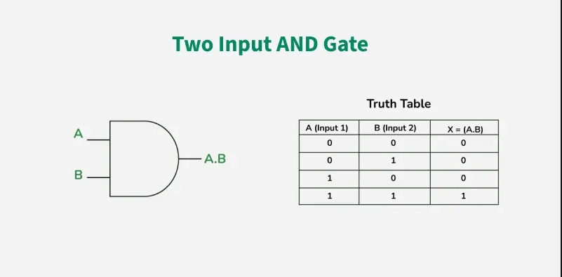
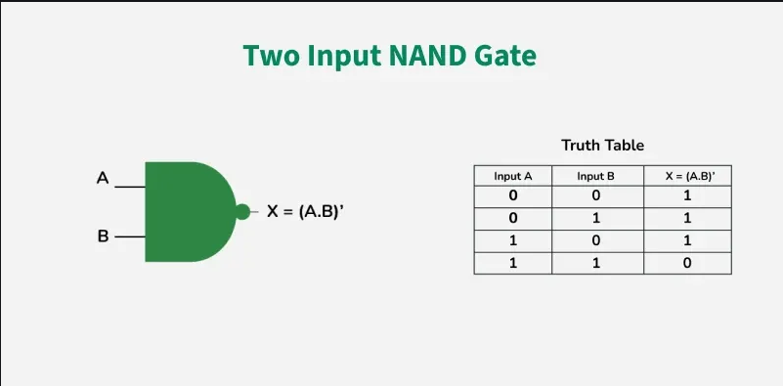
Logic Circuits
Decoder
Multiplexer
ROM
PLA
FPGA
Etc.

Slide 6
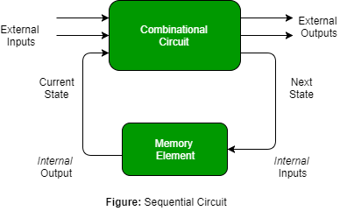
Sequential Circuits
Synchronous vs. Asynchronous
Flip-flop
Latch
Counter
Shift Register
Finite-state machine
Etc.

Slide 7
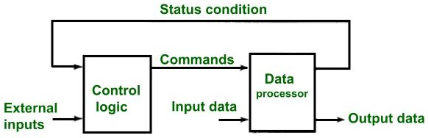
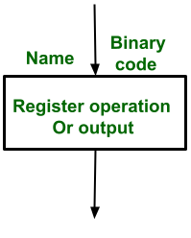
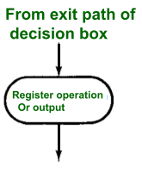
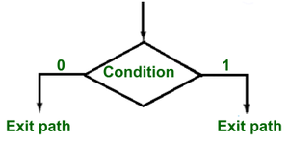
Algorithmic State Machine charts
State box
Decision box
Conditional o/p box

