Slide 1
Switching Circuit & Logic Design
Lecture 1 : Characteristics of Logic Families

Slide 2
Things to cover
Introduction to Logic family
What is Fan-out ?
What is Noise Margin ?

Slide 3
Introduction to Logic Families
RTL – Resistor Transistor Logic
DTL – Diode Transistor Logic
TTL – Transistor Transistor Logic
ECL – Emitter Coupled Logic
CMOS – Complementary Metal-oxide Semiconductor

Slide 4
Introduction to Logic Families
Fan out
Voltage Levels
Speed
Power Consumption
Noise Margin

Slide 5
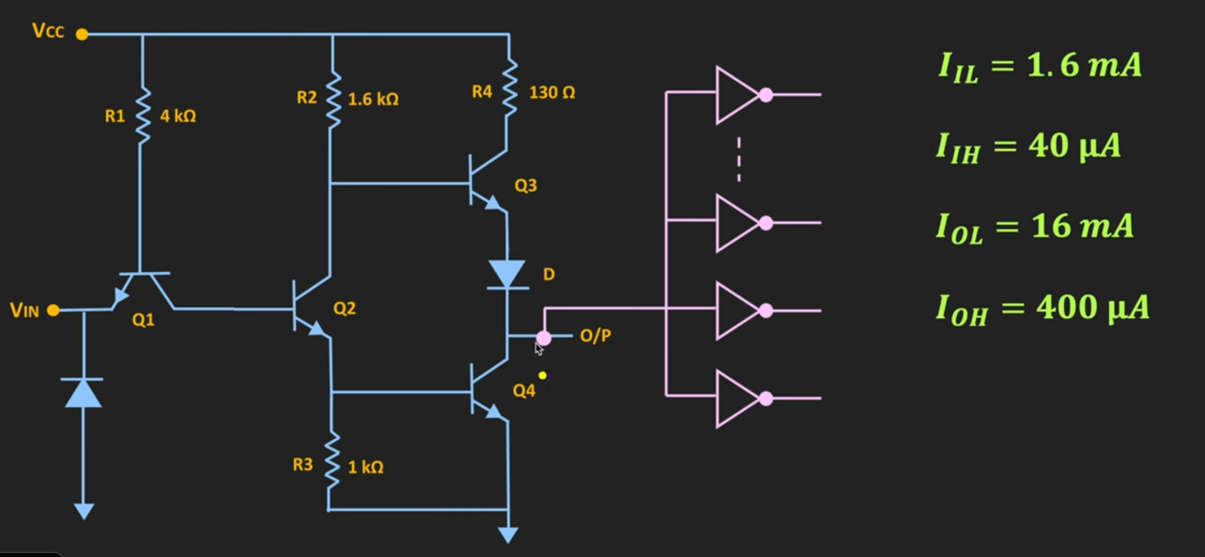
Fan-out

Slide 6
Fan-out: Current Sink
FOL = IOL / IIL

Slide 7
Fan-out: Current Source
FOH = IOH / IIH

Slide 8
Noise Margin
VOH
VIH
VIL
VOL

Slide 9
Noise Margin
Output
Input
VOH
VOH
- VIH
VIH
VIL
-VOL
VIL
VOL

Slide 10
Resistor Transistor Logic (RTL)
Vcc
C
A
B
GND
GND

