Slide 1
Switching Circuit & Logic Design
Lecture 21 : Flip-Flop

Slide 2
Gated SR Latch – SR Flip-Flop
S
Q
S
Q
S
Enable
Enable
Latch
(NAND)
R
R
Q’
R
Q’

Slide 3
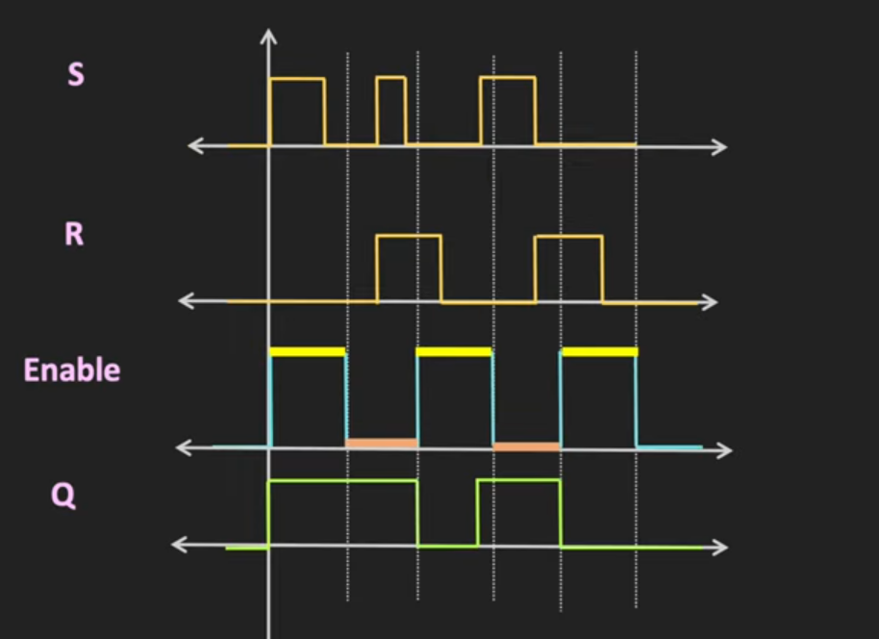
Gated SR Latch – SR Flip-Flop

Slide 4
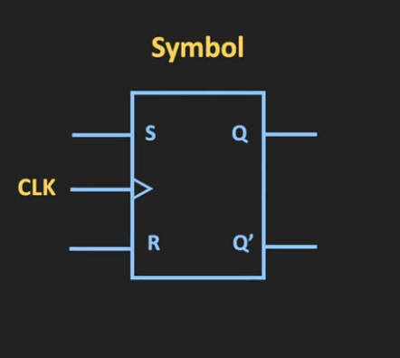
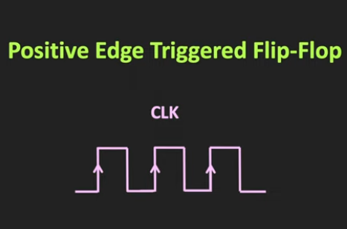
SR Flip-Flop

Slide 5
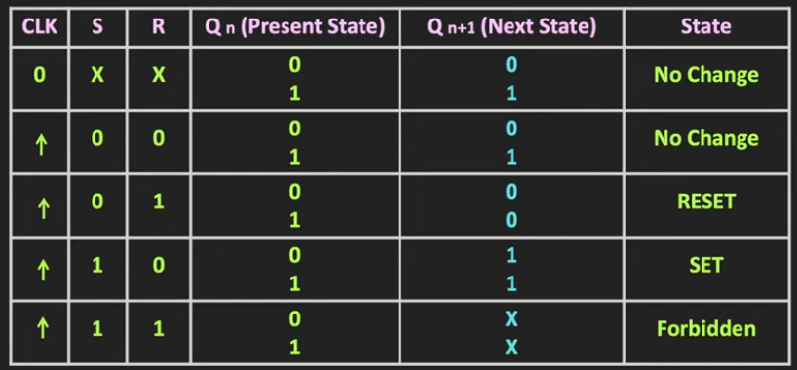

Slide 6
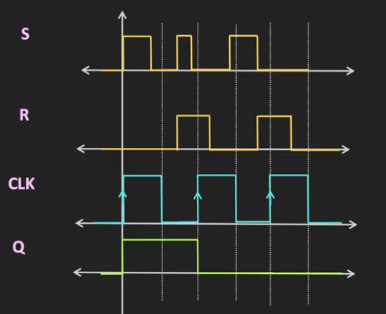
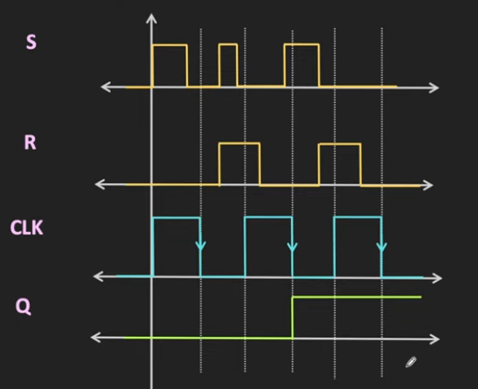

Slide 7
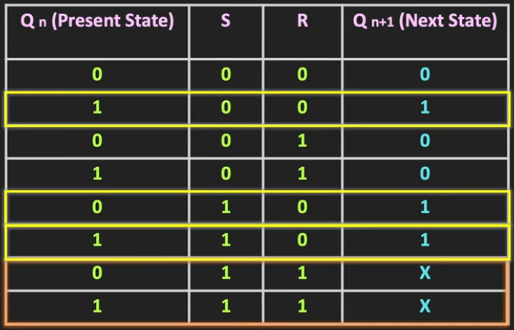
Characteristic Equation of SR FF
Qn+1 = F(Qn,S,R)

Slide 8
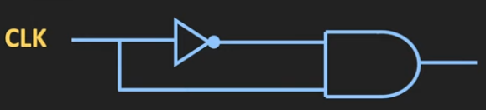

Clock Transition Detection Circuit

Slide 9
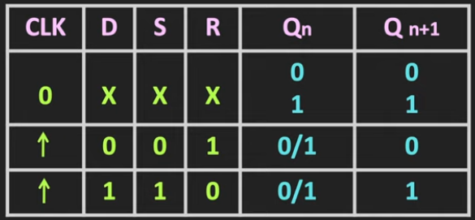
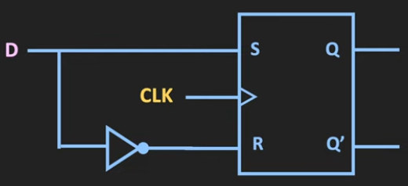
D Flip-Flop

