Slide 1
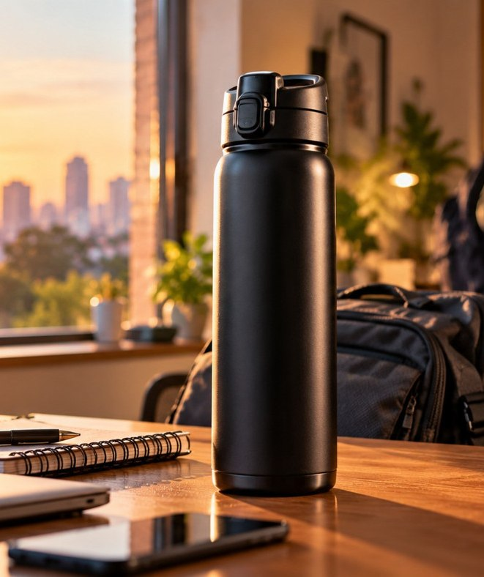
AI IN ACTION / MODULE 03
From Idea to Film
THE ART OF AI VIDEO CREATION
One product. One story.
Real moving footage. Human-sounding voice.
Milton Atlantis Thermosteel · Concept ad
01
Notes:
Introduce the real-product advertising challenge and connect to earlier Chengmari film as quality benchmark. State it is independent educational concept, not official Milton advertisement. No visible session duration.

Slide 2
AI IN ACTION / MODULE 03
The Creative Challenge
A REAL PRODUCT • A SIMPLE, EMOTIONAL STORY
PRODUCT
Milton Atlantis Thermosteel
GOAL
Make everyday journeys memorable
STORY
Morning → Journey → Product close
02
Notes:
Explain client brief: bottle black 750ml, correct facts from official Milton page. Ask: what can audience relate to? Everyday travel. Emphasize no misleading product claims.

Slide 3
AI IN ACTION / MODULE 03
The Production Journey
PLAN → GENERATE → FINISH
01 Plan
Brief, story, narration & JSON shots
02 Generate
Storyboard frames → real motion → audio
03 Finish
Edit, brand, review & export
03
Notes:
Connect every stage to one user-visible output, but keep sequencing guidance in notes. Explain image still vs video footage distinction.

Slide 4
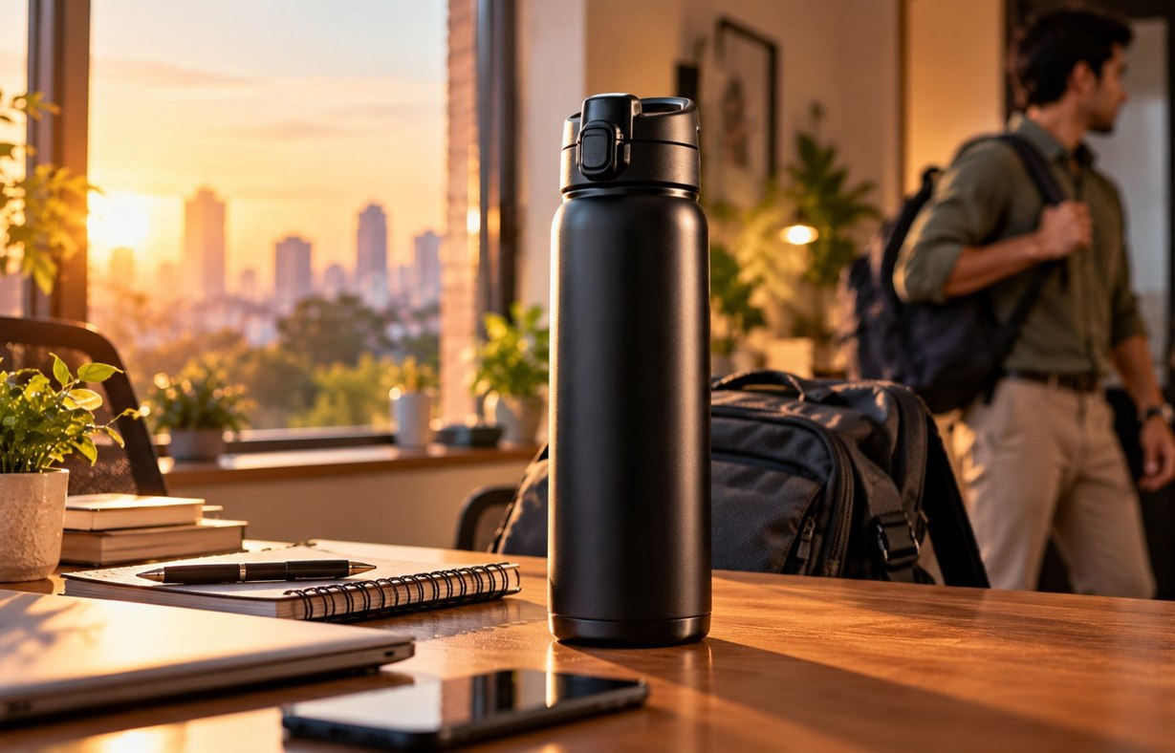
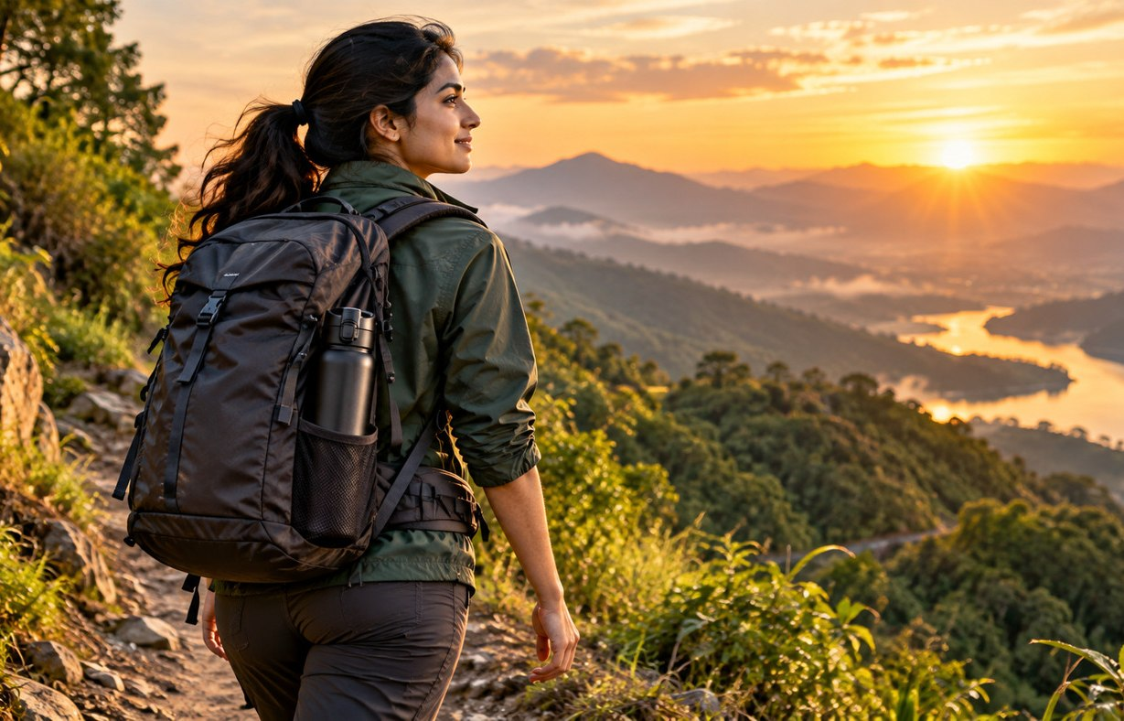

AI IN ACTION / MODULE 03
One Story, Three Cinematic Shots
AN ORIGINAL 20-SECOND EDUCATIONAL CONCEPT
A New Day
Into the World
Product Moment
00–08 seconds · Scene 1
08–16 seconds · Scene 2
16–20 seconds · Scene 3
Illustrative concept frames · Actual moving Veo clips created separately
04
Notes:
Describe first human action, second walking action, third product hero motion. Film duration is fine to show; module instruction minutes must not be shown.

Slide 5
AI IN ACTION / MODULE 03
Give AI Clear Creative Direction
A BEAUTIFUL RESULT STARTS WITH A SPECIFIC PROMPT
WHO + WHAT
HOW IT MOVES
Adult, product, physical action
Tracking shot, hand action, breeze
HOW IT LOOKS
WHAT MUST NOT CHANGE
Golden light, lens, cinematic colour
Same actor, cap, outfit, proportions
05
Notes:
Show example prompt anatomy: real action, camera tracking, lighting and continuity. Explain one physical action per clip. Read a shortened example from detailed prompt library.

Slide 6
AI IN ACTION / MODULE 03
Generate the Reference Frames
STORYBOARD IMAGES ≠ FINAL VIDEO
Generate one approved still per scene.
Keep character + product DNA consistent.
Verify the bottle against an authorised reference.
06
Notes:
Open ChatGPT Images; use continuity bible and JSON scene spec to generate one keyframe per scene. Do not show manufacturer logo as generated true brand image. Before moving on approve plausible hands, shapes, clothing.

Slide 7
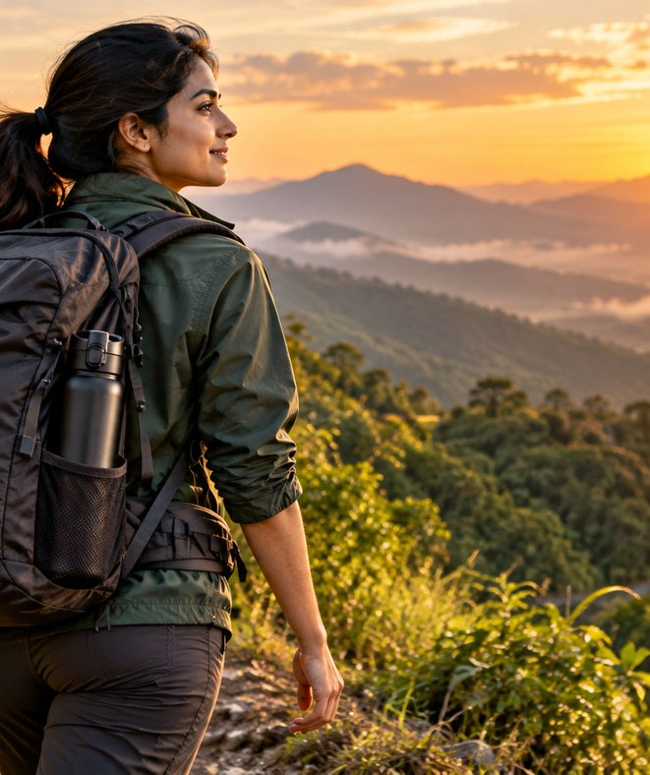
AI IN ACTION / MODULE 03
Turn Frames into Motion
GOOGLE VIDS · VEO IMAGE-TO-VIDEO
Person walks • Clothing moves • Camera tracks
No slideshow zooms.
No distorted hands or changing bottle shape.
07
Notes:
Live instructions: Google Vids desktop -> Create AI videos -> Animate or Image to video. Upload approved JPG/PNG. Prompt a single motion with physically believable action; generate and preview clip; genuine action is essential. Availability differs by plan.

Slide 8
AI IN ACTION / MODULE 03
Make the Voice Sound Human
MINIMAX SPEECH OR ELIGIBLE GOOGLE VIDS VOICEOVER
“Every journey begins with a moment.
From busy mornings to open horizons...”
WARM
CONTROLLED
CREDIBLE
Natural Indian English
Small pauses, no rushing
Expressive, not robotic
08
Notes:
Stress listening to auditions; robotic voices must be rejected. The TTS narration is separate from music and video-native dialogue. Ask audience which tone fits the product and why.

Slide 9
AI IN ACTION / MODULE 03
Music Turns Clips into a Film
MINIMAX MUSIC OR GOOGLE VIDS AI MUSIC
Quiet opening → gentle lift → clean product reveal
NARRATION
Lead track — always intelligible
MUSIC
Instrumental — lower during speech
AMBIENCE
Realistic room and outdoor sounds
09
Notes:
Show instrumental prompt. Make sure no lyrics. Discuss ducking under voiceover, slight ambience from video shots, and separate tracks.

Slide 10
AI IN ACTION / MODULE 03
Edit. Brand. Export.
GOOGLE VIDS EDITING TIMELINE
MORNING · 8s
JOURNEY · 8s
PRODUCT · 4s
Narration track
Instrumental + ambience
10
Notes:
Show 8+8+4 visual regions. Final title overlay in editor with approved logo. Then export MP4 after QA. If there are no rendered clip assets, do not falsely present still preview as a generated movie.

Slide 11
AI IN ACTION / MODULE 03
The Quality Test
A REAL MOVING AD, NOT A SLIDESHOW
✓ Genuine actor and camera motion
✓ Consistent person and exact product
✓ Human-sounding voice + balanced soundtrack
✓ Accurate text, authorised assets, checked claims
✓ Finished MP4 plays correctly with audio
11
Notes:
Final checklist; show one reliable moving clip if access. Discuss quality standards: actor movement, product accuracy, natural voice, licensed audio and approved wording. Distinguish education vs brand endorsement.

Slide 12
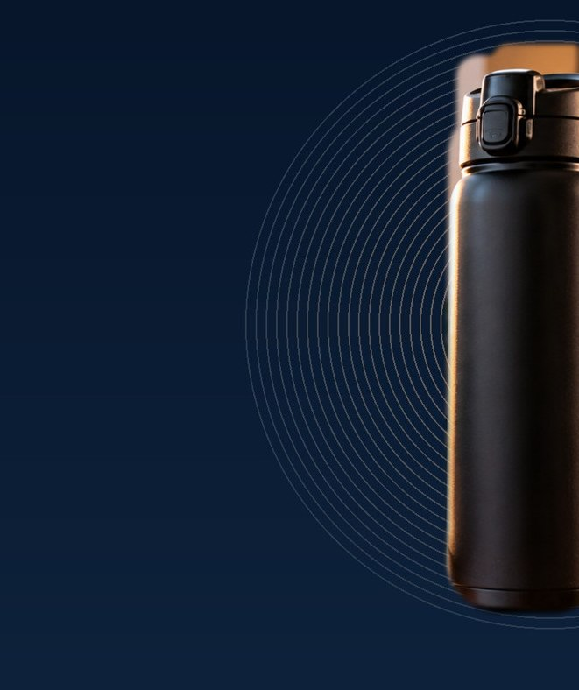
AI IN ACTION / MODULE 03
Now You Can Create
ONE IDEA → REALISTIC SHOTS → A COMPLETE FILM
Choose a real product.
Tell a simple story.
Make the movement believable.
12
Notes:
Bridge naturally into AI Can Help Me Build. Ask: what everyday product would you choose and what motion would you show? Do not present unfinished film as final.

Slide 13
AI IN ACTION / MODULE 03
Trainer Quick Controls
PRIVATE • PRESENTER REFERENCE ONLY
Client brief → ChatGPT → Images → Vids Animate
→ MiniMax Voice → Music → Google Vids Edit → QC
13
Notes:
Hidden trainer slide: use control sheet, verify tool access and approved product rights. Contingency if live gen fails: play genuine prerecorded moving Veo, not an artificial slideshow.

Slide 14
AI IN ACTION / MODULE 03
Trainer Backups
PRIVATE • NOT FOR AUDIENCE DISTRIBUTION
Use one genuine previously rendered moving clip if live generation stalls.
Reject robotic voices. Verify rights, brand and captions.
14
Notes:
Private notes: public distribution deck excludes this slide. No actual Veo clips or voice files are supplied in the source pack. Create and approve before classroom delivery.

