Slide 1

AI IN ACTION / MODULE 03
From Idea to Film
THE ART OF AI VIDEO CREATION
One product. One story.
Real moving footage. Human-sounding voice.
Milton Atlantis Thermosteel · Concept ad
01

Slide 2
AI IN ACTION / MODULE 03
The Creative Challenge
A REAL PRODUCT • A SIMPLE, EMOTIONAL STORY
PRODUCT
Milton Atlantis Thermosteel
GOAL
Make everyday journeys memorable
STORY
Morning → Journey → Product close
02

Slide 3
AI IN ACTION / MODULE 03
The Production Journey
PLAN → GENERATE → FINISH
01 Plan
Brief, story, narration & JSON shots
02 Generate
Storyboard frames → real motion → audio
03 Finish
Edit, brand, review & export
03

Slide 4
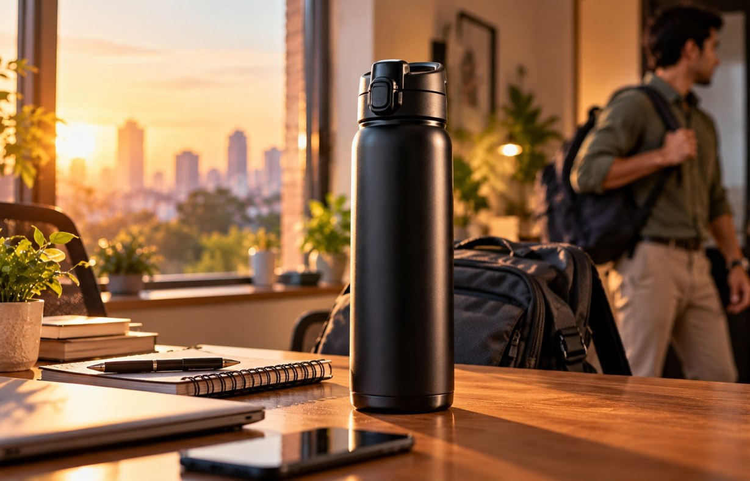


AI IN ACTION / MODULE 03
One Story, Three Cinematic Shots
AN ORIGINAL 20-SECOND EDUCATIONAL CONCEPT
A New Day
Into the World
Product Moment
00–08 seconds · Scene 1
08–16 seconds · Scene 2
16–20 seconds · Scene 3
Illustrative concept frames · Actual moving Veo clips created separately
04

Slide 5
AI IN ACTION / MODULE 03
Give AI Clear Creative Direction
A BEAUTIFUL RESULT STARTS WITH A SPECIFIC PROMPT
WHO + WHAT
HOW IT MOVES
Adult, product, physical action
Tracking shot, hand action, breeze
HOW IT LOOKS
WHAT MUST NOT CHANGE
Golden light, lens, cinematic colour
Same actor, cap, outfit, proportions
05

Slide 6
AI IN ACTION / MODULE 03
Generate the Reference Frames
STORYBOARD IMAGES ≠ FINAL VIDEO
Generate one approved still per scene.
Keep character + product DNA consistent.
Verify the bottle against an authorised reference.
06

Slide 7

AI IN ACTION / MODULE 03
Turn Frames into Motion
GOOGLE VIDS · VEO IMAGE-TO-VIDEO
Person walks • Clothing moves • Camera tracks
No slideshow zooms.
No distorted hands or changing bottle shape.
07

Slide 8
AI IN ACTION / MODULE 03
Make the Voice Sound Human
MINIMAX SPEECH OR ELIGIBLE GOOGLE VIDS VOICEOVER
“Every journey begins with a moment.
From busy mornings to open horizons...”
WARM
CONTROLLED
CREDIBLE
Natural Indian English
Small pauses, no rushing
Expressive, not robotic
08

Slide 9
AI IN ACTION / MODULE 03
Music Turns Clips into a Film
MINIMAX MUSIC OR GOOGLE VIDS AI MUSIC
Quiet opening → gentle lift → clean product reveal
NARRATION
Lead track — always intelligible
MUSIC
Instrumental — lower during speech
AMBIENCE
Realistic room and outdoor sounds
09

Slide 10
AI IN ACTION / MODULE 03
Edit. Brand. Export.
GOOGLE VIDS EDITING TIMELINE
MORNING · 8s
JOURNEY · 8s
PRODUCT · 4s
Narration track
Instrumental + ambience
10

Slide 11
AI IN ACTION / MODULE 03
The Quality Test
A REAL MOVING AD, NOT A SLIDESHOW
✓ Genuine actor and camera motion
✓ Consistent person and exact product
✓ Human-sounding voice + balanced soundtrack
✓ Accurate text, authorised assets, checked claims
✓ Finished MP4 plays correctly with audio
11

Slide 12

AI IN ACTION / MODULE 03
Now You Can Create
ONE IDEA → REALISTIC SHOTS → A COMPLETE FILM
Choose a real product.
Tell a simple story.
Make the movement believable.
12

