Slide 1

AI IN ACTION • MODULE 3
AI CAN HELP
ME CREATE
From a simple idea to a finished promotional video
SmartLife • A fictional creative project

Slide 2
AI IN ACTION / LEARN • CREATE • BUILD
02
A Client Gives Us a Simple Brief
Create a short, friendly promotional film for a fictional planning product.
THE CHALLENGE
People feel overwhelmed by tasks and deadlines.
THE IDEA
SmartLife helps organise tasks and priorities.
THE MESSAGE
Plan clearer. Live brighter.
Fictional product • Concept demonstration • No real product claims

Slide 3

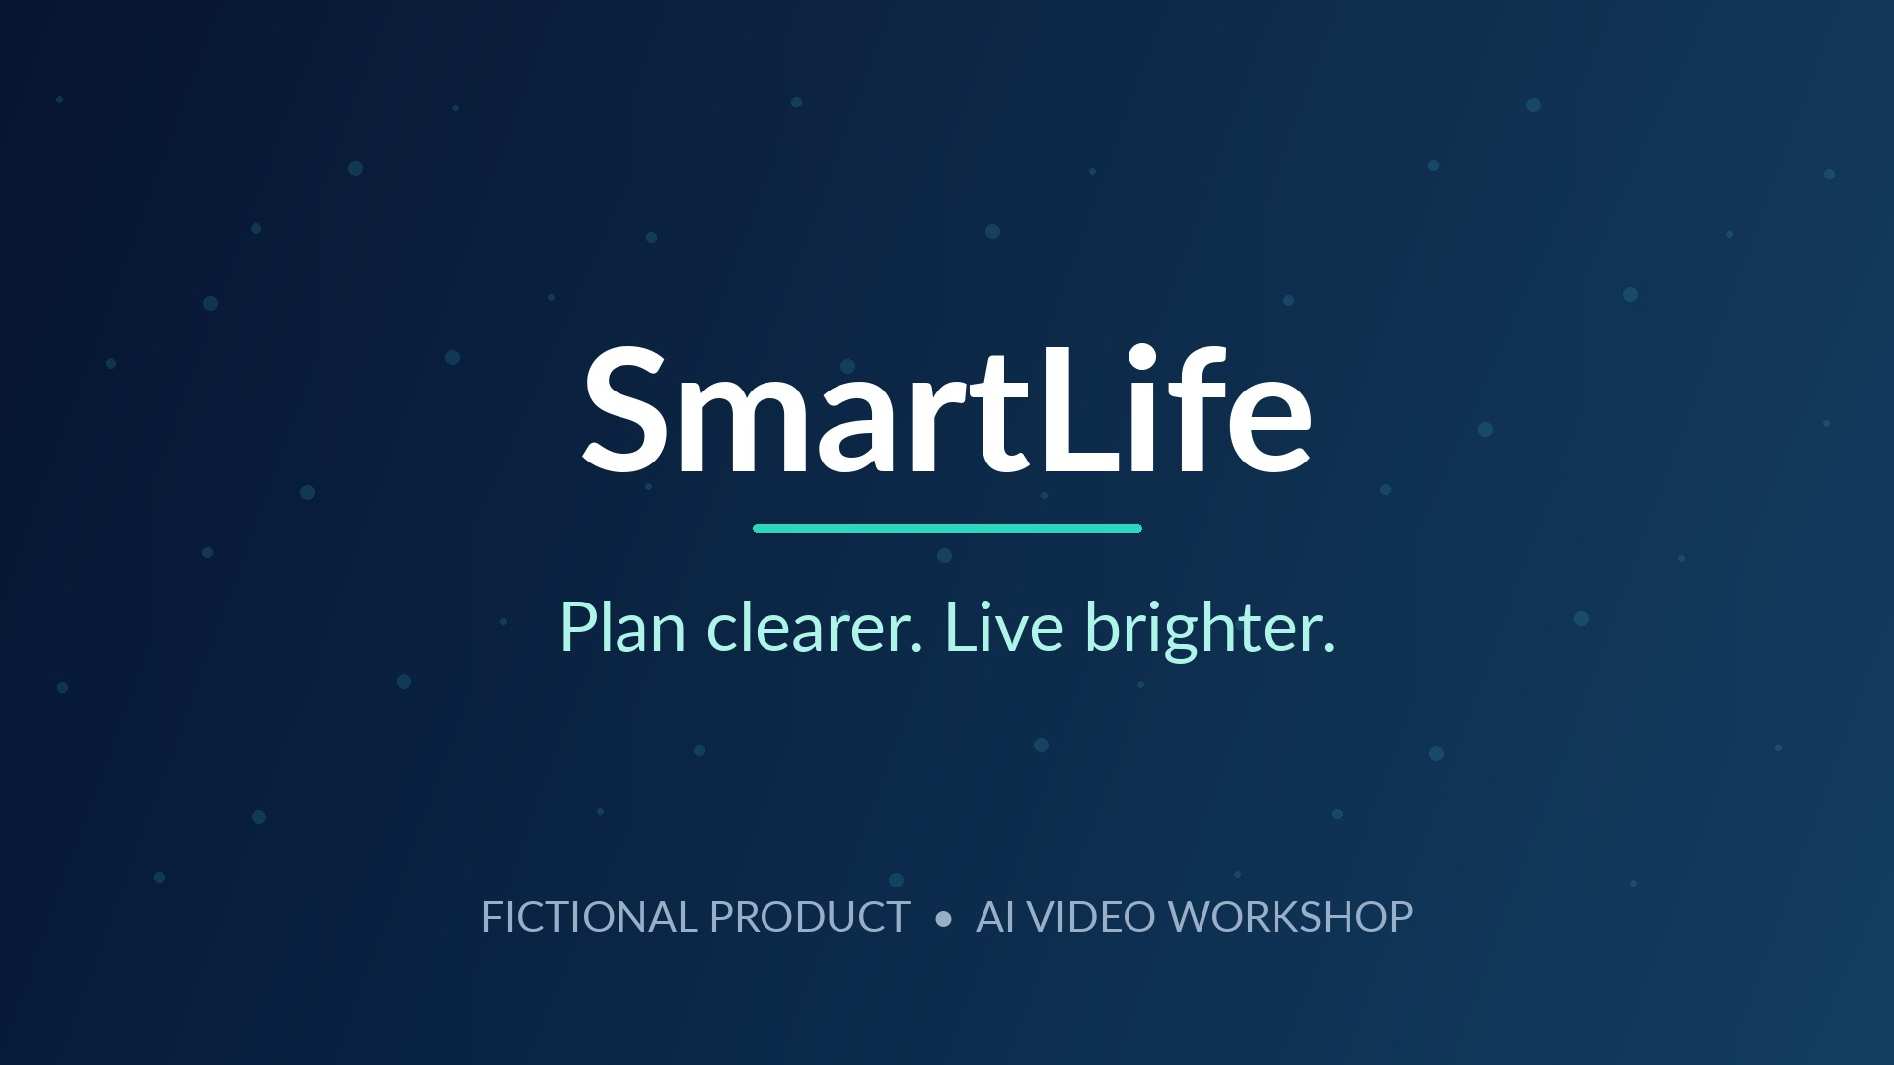
AI IN ACTION / LEARN • CREATE • BUILD
03
One Story. Two Scenes. One Closing Message.
A compact story is easier to create, refine and understand.
01 THE PROBLEM
02 THE SOLUTION
03 THE BRAND
Busy day, too many tasks.
The same person feels organised.
A simple closing message.

Slide 4
AI IN ACTION / LEARN • CREATE • BUILD
04
First, Describe the Image
Good prompts help AI understand the scene you want to create.
WHO?
The main person or product
WHERE?
The room, setting, objects
WHAT?
Expression, action and goal
HOW?
Lighting, mood and camera
AVOID
Strange hands, text and logos
📷 Text prompt → Original image

Slide 5
AI IN ACTION / LEARN • CREATE • BUILD
05
Generate the Original Scene Images
Start with the first image, then reuse its visual identity as a reference.
THE CHALLENGE
THE BETTER WAY

Slide 6
AI IN ACTION / LEARN • CREATE • BUILD
06
Turn Both Images into Moving Video
Use an image as a starting point, then describe natural movement.
→
IMAGE
ANIMATED CLIP

Slide 7
AI IN ACTION / LEARN • CREATE • BUILD
07
Give Your Video a Voice and Music
AI narration makes the story clear. Music sets its emotional tone.
🎙️ AI NARRATION
🎼 BACKGROUND MUSIC
“Too many tasks, too little time?
Meet SmartLife...”
Choose an uplifting, licensed
instrumental track. Keep it
softer than the narration.

Slide 8
AI IN ACTION / LEARN • CREATE • BUILD
08
Assemble and Export the Finished Film
Two video clips, one closing title, a voice and background music.
SCENE 1
SCENE 2
CLOSING
AI-GENERATED NARRATION
INSTRUMENTAL MUSIC
Canva editing timeline → Export MP4

Slide 9
CREATE WITH IMAGINATION.
SHARE WITH RESPONSIBILITY.
Consent • Copyright • Accurate claims • Human review
NEXT → AI CAN HELP ME BUILD

