Slide 1

AI IN ACTION • MODULE 3
AI CAN HELP
ME CREATE
From a simple idea to a finished promotional video
SmartLife • A fictional creative project
Notes:
PRIVATE • Open by asking who has ever seen a product promotion created using AI. Clarify all characters and the SmartLife brand are fictional. 1 minute.

Slide 2
AI IN ACTION / LEARN • CREATE • BUILD
02
A Client Gives Us a Simple Brief
Create a short, friendly promotional film for a fictional planning product.
THE CHALLENGE
People feel overwhelmed by tasks and deadlines.
THE IDEA
SmartLife helps organise tasks and priorities.
THE MESSAGE
Plan clearer. Live brighter.
Fictional product • Concept demonstration • No real product claims
Notes:
PRIVATE • Read fictional brief, pause for one participant to identify the problem and call-to-action. Avoid claiming the product exists. 2–3 minutes.

Slide 3

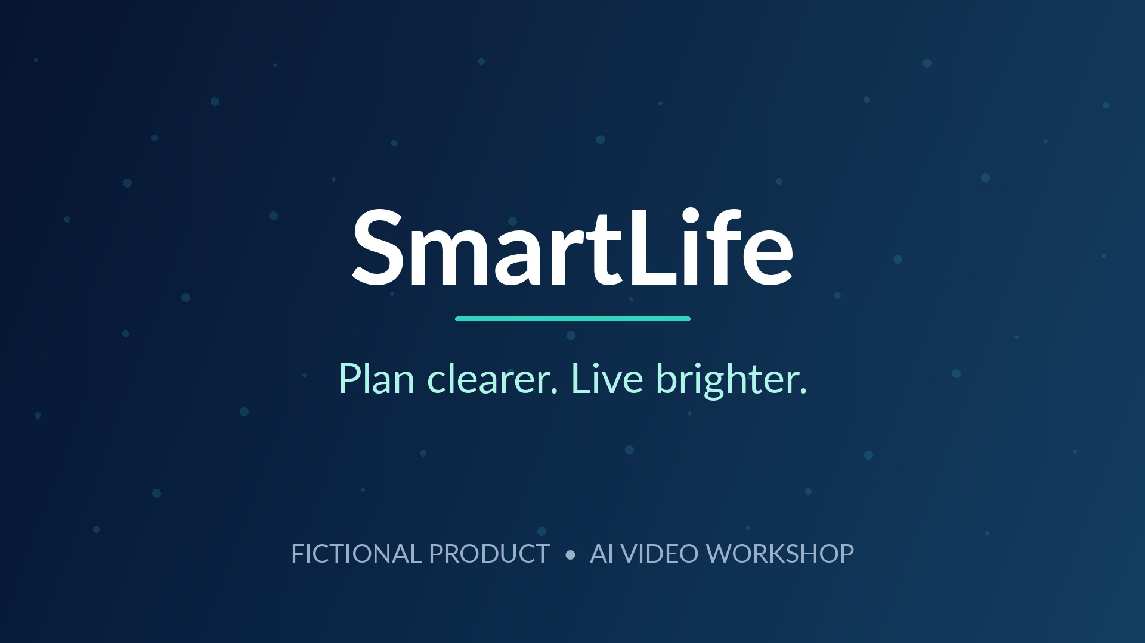
AI IN ACTION / LEARN • CREATE • BUILD
03
One Story. Two Scenes. One Closing Message.
A compact story is easier to create, refine and understand.
01 THE PROBLEM
02 THE SOLUTION
03 THE BRAND
Busy day, too many tasks.
The same person feels organised.
A simple closing message.
Notes:
PRIVATE • Explain 3 visual parts but only 2 AI video generations: two 8-second clips plus closing card. Do not display these internal timings. 2 minutes.

Slide 4
AI IN ACTION / LEARN • CREATE • BUILD
04
First, Describe the Image
Good prompts help AI understand the scene you want to create.
WHO?
The main person or product
WHERE?
The room, setting, objects
WHAT?
Expression, action and goal
HOW?
Lighting, mood and camera
AVOID
Strange hands, text and logos
📷 Text prompt → Original image
Notes:
PRIVATE • Explain prompts encode subject, setting, action, camera and exclusions. Use private control card for exact image generation. No advance asset is required for the primary workflow. 4–6 minutes.

Slide 5
AI IN ACTION / LEARN • CREATE • BUILD
05
Generate the Original Scene Images
Start with the first image, then reuse its visual identity as a reference.
THE CHALLENGE
THE BETTER WAY
Notes:
PRIVATE • In Flow choose Image and generate Scene 1, then Scene 2 with Scene 1 as reference where possible; use prepared stills ONLY as openly disclosed fallback. 5–8 minutes.

Slide 6
AI IN ACTION / LEARN • CREATE • BUILD
06
Turn Both Images into Moving Video
Use an image as a starting point, then describe natural movement.
→
IMAGE
ANIMATED CLIP
Notes:
PRIVATE • Animate Scene 1 and Scene 2 using Flow video/animate; avoid rushing generation. If unavailable, explain and continue using prepared preview. Show subtle realistic motion. 5–8 minutes.

Slide 7
AI IN ACTION / LEARN • CREATE • BUILD
07
Give Your Video a Voice and Music
AI narration makes the story clear. Music sets its emotional tone.
🎙️ AI NARRATION
🎼 BACKGROUND MUSIC
“Too many tasks, too little time?
Meet SmartLife...”
Choose an uplifting, licensed
instrumental track. Keep it
softer than the narration.
Notes:
PRIVATE • Google AI Studio text-to-speech: use the private voiceover script and single warm voice. Use Canva free appropriately licensed background music. AI Studio or Canva availability may vary. 4–7 minutes.

Slide 8
AI IN ACTION / LEARN • CREATE • BUILD
08
Assemble and Export the Finished Film
Two video clips, one closing title, a voice and background music.
SCENE 1
SCENE 2
CLOSING
AI-GENERATED NARRATION
INSTRUMENTAL MUSIC
Canva editing timeline → Export MP4
Notes:
PRIVATE • Canva: two clips, title card, generated narration, licensed instrumental; trim 8+8+4 and export. Locally assembled illustrative video is a non-Flow preview with basic synthetic narration, not a completed Flow production. 5–7 minutes.

Slide 9
CREATE WITH IMAGINATION.
SHARE WITH RESPONSIBILITY.
Consent • Copyright • Accurate claims • Human review
NEXT → AI CAN HELP ME BUILD
Notes:
PRIVATE • Discuss rights, originality, transparency, misleading claims, and checking captions. Bridge to Build module. 2 minutes.

Slide 10
AI IN ACTION / LEARN • CREATE • BUILD
PRIVATE TRAINER REFERENCE
1 Present the client brief.
2 Generate two AI images in Flow.
3 Animate both images in Flow.
4 Produce narration in AI Studio.
5 Edit images/clips, narration and music in Canva.
6 Export MP4; play the finished concept.
Notes:
Only for trainer. Use LIVE_DEMO_CONTROL_CARD_PRIVATE.md for prompts, time estimates and fallback. The 20-second illustrated MP4 in this pack is locally created from stills with offline synthetic speech, NOT Flow or AI Studio output.

