Slide 1
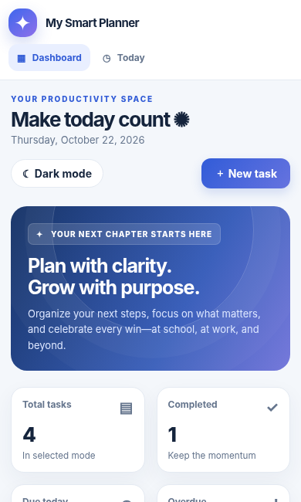
MODULE 04
AI Can Help Me Build
From an idea to a working application
Describe • Build • Test • Improve
MY SMART PLANNER
One app. Useful for study and work.
Practical, interactive demonstration
Notes:
Open by saying: “AI can help you create software, not just write text or generate pictures.” This is a beginner-friendly demonstration; participants do not need coding knowledge. Explain that the app's behavior should be tested. Suggested 1–2 minutes. Transition to a relatable problem.

Slide 2
MODULE 4 · AI CAN HELP ME BUILD
A familiar problem. A useful idea.
Good software begins with a problem worth solving.
What could an app do?
“I have too many things to remember—and I need to know what matters next.”
✓
Remember tasks and deadlines
◎
Show priorities at a glance
✦
Celebrate visible progress
THE OPPORTUNITY
02
Notes:
Ask: “What would you expect a daily task planner to do?” Invite 1–2 answers. Do not spend time on advanced programming concepts. Point out these suggestions are requirements that must become test cases. Suggested 1–2 minutes.

Slide 3
MODULE 4 · AI CAN HELP ME BUILD
From simple words to working software
You define the outcome. AI can help assemble the first version.
💡
✍
▣
✓
✦
→
→
→
→
IDEA
PROMPT
BUILD
TEST
IMPROVE
Identify the problem
Describe what it must do
Open an interactive app
Check the real behaviour
Refine through conversation
A visually attractive screen is not enough: every feature must work.
03
Notes:
Explain the complete loop Idea → Prompt → Build → Test → Improve. Point out that this is AI-assisted development: the running planner is conventional software logic, not necessarily an LLM-powered assistant. Ask: “If the app adds a task but does not save it, is it finished?” Suggested 1–2 minutes.

Slide 4
MODULE 4 · AI CAN HELP ME BUILD
Our project: My Smart Planner
One inclusive tool for learners and professionals.
📝
Task management
📅
Deadlines & priority
🎓
Study / Work modes
Create, edit, complete and delete tasks
See what matters and when
Different contexts, same app
📊
Progress insights
🔎
Search & filter
☾
Personalisation
Totals, completion and overdue work
Find the right task quickly
Dark and light layouts
04
Notes:
This slide translates the brief into observable features. Confirm that Study/Work modes do not imply separate cloud user accounts; here they are merely two sets of tasks in the same local data store. Point to task storage as a separate requirement. Suggested 2 minutes.

Slide 5
MODULE 4 · AI CAN HELP ME BUILD
A good prompt is a mini product brief
The stronger the specification, the easier the result is to test.
Build an interactive “My Smart Planner” app.
Role
Product designer + engineer
✓ Allow task creation, editing and completion
✓ Include deadlines, priorities and progress
Output
✓ Support Study and Work modes
Interactive preview
✓ Make it responsive and accessible
✓ Show the WORKING app—not only code
Evidence
Testable behaviours
05
Notes:
Open the separate private all-in-one guide and copy PROMPT 1, which spells out the entire application specification. Don’t paste only the five summarized bullets shown here. Ask Claude for an interactive Artifact. If the app preview is not offered immediately, request “Create an interactive Artifact, not just code.” Estimated demo creation may vary by account and network; do not promise a fixed completion time.

Slide 6
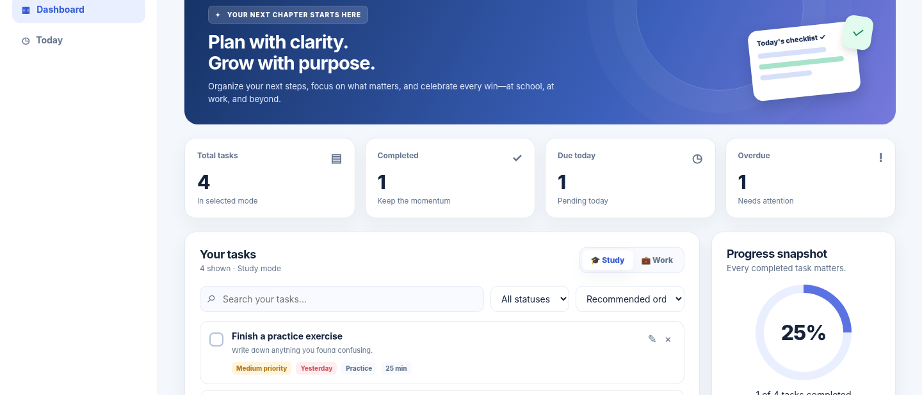
MODULE 4 · AI CAN HELP ME BUILD
Meet the working planner
A responsive dashboard you can actually click and use.
✦
Real
controls
not a
mockup
06
Notes:
Open the generated Claude preview if ready. In parallel, demonstrate the tested offline HTML as a dependable backup: Add a task, edit its deadline and priority, mark completed, switch study/work. The screenshot is from the prepared offline app and should not be misrepresented as output Claude generated in the live session. Explain this distinction clearly. Suggested 5–8 minutes for hands-on.

Slide 7
MODULE 4 · AI CAN HELP ME BUILD
One application, two different contexts
The same workflow adapts to study and work without rewriting the app.
🎓 Study mode
💼 Work mode
□ Review a concept
□ Prioritise a project
□ Finish an assignment
□ Prepare a client update
□ Prepare a presentation
□ Document decisions
07
Notes:
Demonstrate Study and Work modes. They should display separate tasks. Discuss how this makes the same learning project audience-neutral for academic institutions and corporate sessions. Ask one participant to suggest a task for the chosen mode.

Slide 8
MODULE 4 · AI CAN HELP ME BUILD
Your progress changes as you work
Useful software makes its calculations visible and verifiable.
4
1
25%
Total
Completed
Progress
Complete one more task → 2 out of 4 completed → 50% progress
08
Notes:
Use the visible counts to show progress = completed/total × 100. Counts must update after clicking Complete or Reopen. Ask the audience: “If all 4 are completed, what should the display show?” Answer 100%. Empty mode should show 0%, not NaN or a broken display. Suggested 1 minute.

Slide 9
MODULE 4 · AI CAN HELP ME BUILD
Test before you trust
A beautiful interface must still behave correctly.
✓
Add and edit a task
✓
Reopen a completed task
✓
Switch between modes
✓
Try an empty title
✓
Filter overdue tasks
✓
Check saved-data behaviour
09
Notes:
Prompt 3 from private guide reviews and tests all major behaviors. Do NOT claim generated app passed tests without evidence. Show 2–3 fast manual checks: create, complete, mode switch. Explain local storage in the supplied HTML sample; hosted Claude Artifact persistence may differ by product/account. Mention inputs must be safely escaped and data should not contain personal secrets.

Slide 10
MODULE 4 · AI CAN HELP ME BUILD
A follow-up prompt can improve the app
One enhancement at a time. Re-test the original features.
Iterate safely
“Add a dark mode and show a celebration when all tasks are completed. Keep every existing feature working.”
1
Change one thing
2
Test the change
3
Check old features
10
Notes:
Read follow-up prompt 4 from the private guide. Invite a small enhancement from the audience if time allows. Demonstrate dark mode toggle in the offline app. If Claude modifies the Artifact, verify older features still work. This is incremental improvement and is easier to evaluate than asking for ten new features at once.

Slide 11
MODULE 4 · AI CAN HELP ME BUILD
Build responsibly. Know the limits.
A demo can be impressive without pretending to be production-ready.
✓ What our demo does
× What it does NOT do
• Runs in a browser
• Sync between devices
• Manages tasks and progress
• Send real notifications
• Offers local JSON backup
• Call AI for every task
• Works without paid APIs
• Replace production testing
AI accelerates the first draft. People make it reliable.
11
Notes:
Stress that the packaged HTML uses localStorage when available, no server, no real reminders, and no runtime AI calls. The app was created as a standalone educational example and should not be presented as a saved Claude Artifact. Do not enter real confidential information. Claude sharing can require an account and depend on plan and permissions; use official docs if asked.

Slide 12
YOU HAVE NOW SEEN…
Learn. Create. Build.
Three ways AI can turn curiosity into meaningful work.
💡 Describe your idea
🧩 Build a prototype
🧪 Test the result
🚀 Improve with feedback
Next: Reflect • Quiz • Feedback
Notes:
End with the core takeaway: software prototyping is easier with AI, but responsibility stays with the builder. Transition to Module 5 for quiz, takeaways and participant feedback. Do not state audience-facing timings.

