Slide 1
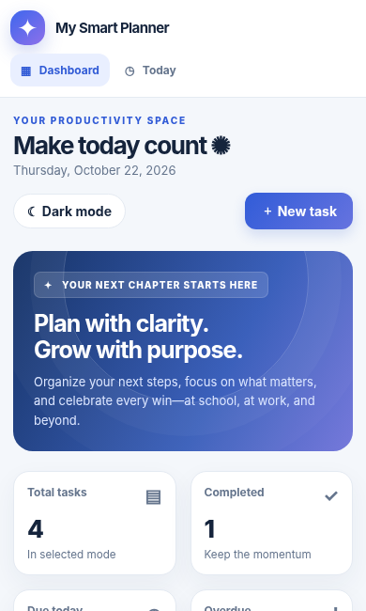
MODULE 04
AI Can Help Me Build
From an idea to a working application
Describe • Build • Test • Improve
MY SMART PLANNER
One app. Useful for study and work.
Practical, interactive demonstration

Slide 2
MODULE 4 · AI CAN HELP ME BUILD
A familiar problem. A useful idea.
Good software begins with a problem worth solving.
What could an app do?
“I have too many things to remember—and I need to know what matters next.”
✓
Remember tasks and deadlines
◎
Show priorities at a glance
✦
Celebrate visible progress
THE OPPORTUNITY
02

Slide 3
MODULE 4 · AI CAN HELP ME BUILD
From simple words to working software
You define the outcome. AI can help assemble the first version.
💡
✍
▣
✓
✦
→
→
→
→
IDEA
PROMPT
BUILD
TEST
IMPROVE
Identify the problem
Describe what it must do
Open an interactive app
Check the real behaviour
Refine through conversation
A visually attractive screen is not enough: every feature must work.
03

Slide 4
MODULE 4 · AI CAN HELP ME BUILD
Our project: My Smart Planner
One inclusive tool for learners and professionals.
📝
Task management
📅
Deadlines & priority
🎓
Study / Work modes
Create, edit, complete and delete tasks
See what matters and when
Different contexts, same app
📊
Progress insights
🔎
Search & filter
☾
Personalisation
Totals, completion and overdue work
Find the right task quickly
Dark and light layouts
04

Slide 5
MODULE 4 · AI CAN HELP ME BUILD
A good prompt is a mini product brief
The stronger the specification, the easier the result is to test.
Build an interactive “My Smart Planner” app.
Role
Product designer + engineer
✓ Allow task creation, editing and completion
✓ Include deadlines, priorities and progress
Output
✓ Support Study and Work modes
Interactive preview
✓ Make it responsive and accessible
✓ Show the WORKING app—not only code
Evidence
Testable behaviours
05

Slide 6
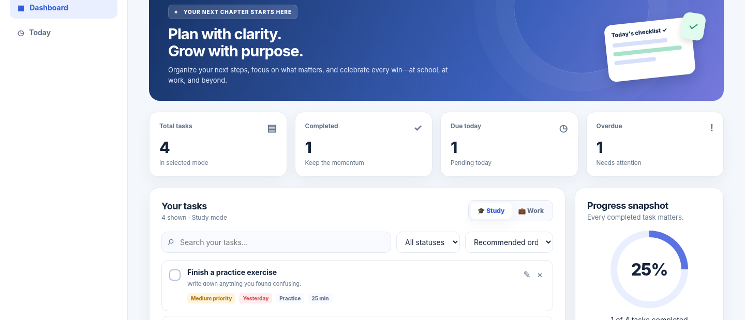
MODULE 4 · AI CAN HELP ME BUILD
Meet the working planner
A responsive dashboard you can actually click and use.
✦
Real
controls
not a
mockup
06

Slide 7
MODULE 4 · AI CAN HELP ME BUILD
One application, two different contexts
The same workflow adapts to study and work without rewriting the app.
🎓 Study mode
💼 Work mode
□ Review a concept
□ Prioritise a project
□ Finish an assignment
□ Prepare a client update
□ Prepare a presentation
□ Document decisions
07

Slide 8
MODULE 4 · AI CAN HELP ME BUILD
Your progress changes as you work
Useful software makes its calculations visible and verifiable.
4
1
25%
Total
Completed
Progress
Complete one more task → 2 out of 4 completed → 50% progress
08

Slide 9
MODULE 4 · AI CAN HELP ME BUILD
Test before you trust
A beautiful interface must still behave correctly.
✓
Add and edit a task
✓
Reopen a completed task
✓
Switch between modes
✓
Try an empty title
✓
Filter overdue tasks
✓
Check saved-data behaviour
09

Slide 10
MODULE 4 · AI CAN HELP ME BUILD
A follow-up prompt can improve the app
One enhancement at a time. Re-test the original features.
Iterate safely
“Add a dark mode and show a celebration when all tasks are completed. Keep every existing feature working.”
1
Change one thing
2
Test the change
3
Check old features
10

Slide 11
MODULE 4 · AI CAN HELP ME BUILD
Build responsibly. Know the limits.
A demo can be impressive without pretending to be production-ready.
✓ What our demo does
× What it does NOT do
• Runs in a browser
• Sync between devices
• Manages tasks and progress
• Send real notifications
• Offers local JSON backup
• Call AI for every task
• Works without paid APIs
• Replace production testing
AI accelerates the first draft. People make it reliable.
11

Slide 12
YOU HAVE NOW SEEN…
Learn. Create. Build.
Three ways AI can turn curiosity into meaningful work.
💡 Describe your idea
🧩 Build a prototype
🧪 Test the result
🚀 Improve with feedback
Next: Reflect • Quiz • Feedback

