Slide 1
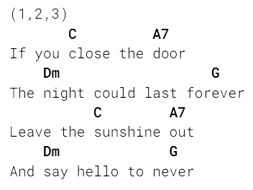
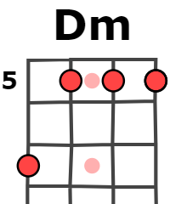
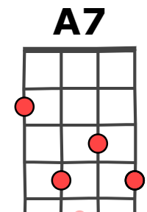
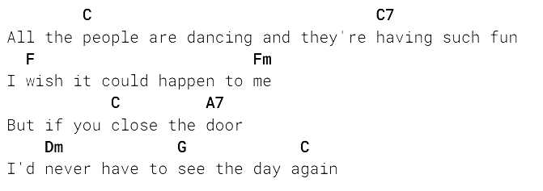
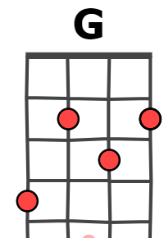
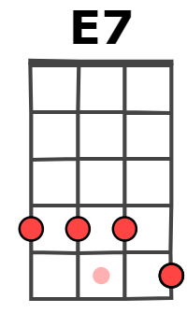
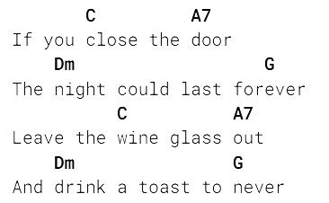
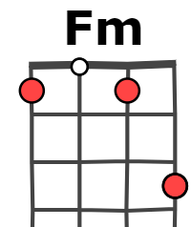
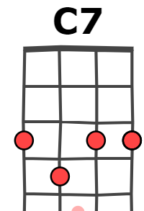
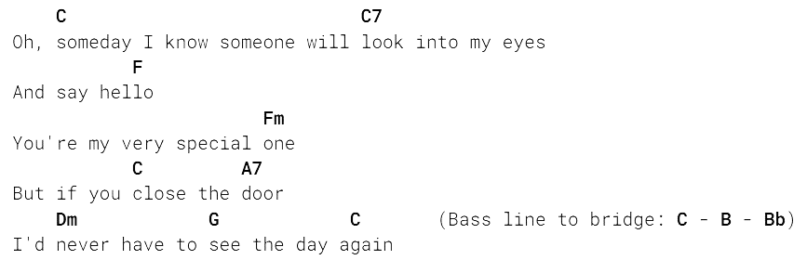
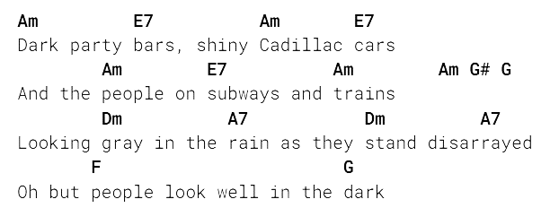
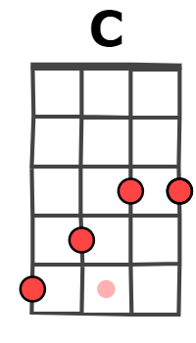
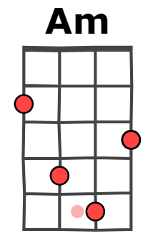

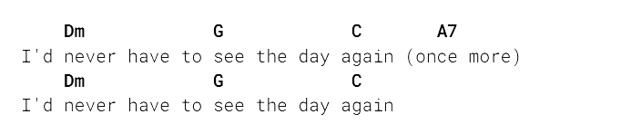
After hours - The Velvet Underground
(1969)
Chorus A
121 BPM
Verse 1
Chorus B
Verse 2
Bridge
. Chorus A
. Verse 1
Merci à tabs.ultimate-guitar.com !

Slide 2
If You Close The Door - The Velvet Underground
one two three
if you close the door
the night could last forever
leave the sunshine out
and say hello to never
all the people are dancing
and theyre having such fun
i wish it could happen to me
but if you close the door
id never have to see the day again
if you close the door
the night could last forever
leave the wine glass out
and drink a toast to never
oh someday i know someone will look into my eyes
and say hellooo
youre my very special one
but if you close the door
id never have to see the day again
dark party bars
shiny cadillac cars
and the people on subways and trains
looking gray in the rain
as they stand disarrayed
all but people look well in the dark
and if you close the door
the night could last forever
leave the sunshine out
and say hello to never
all the people are dancing
and theyre having such fun
i wish it could happen to me
cause if you close the door
id never have to see the day again
id never have to see the day again
once more
id never have to see the day again
121 BPM

Slide 3
x
x
x
x
x
x
x

