Slide 1
Introduction to ECE 454 Computer Systems Programming
Cristiana Amza
Topics:
  Vision and Motivation of the course
  Staff, text, and policies

Slide 2
A bit about myself
Joined UofT in Oct 2003
Research in Distributed and Parallel Systems
Taught both ECE 419 and ECE 454 (2007-2009)
Previous ECE 454 offerings: 2007S, 2008S, 2009S and F,2014F
More info on my Web page (see ECE 454 link under Teaching)

Slide 3
Vision for the Course
ECE 454 – course I introduced in spring 2007. Here is why.
  Software applications are more demanding than ever
    E.g., games (frames per second)
  Hardware is becoming more complex than ever
E.g.,: We need you to make the game run faster ☺!
  to understand the relationship between hardware and the performance of the software running on it
    impact of memory hierarchy and cache coherence on your code
    how to write code in an architecture-aware fashion
  to exploit basic techniques for software optimization

Slide 4
Motivation for the Course
Exponential growth of hardware performance
  known as Moore’s law (e.g., processor speed)
Software writers could be lazy
  waited for new generation of processors
  processor faster → auto-magically speeds up code
Bad news: The free lunch is (almost over)
  Processor frequency is not increasing any more
  Software applications cannot rely on processors getting faster any more
  How do we get more frames per second ?

Slide 5
Moore’s Law
Gordon Moore (in 1965):
  the complexity of semiconductor components had doubled each year since 1959
  exponential growth!
this became known as Moore’s Law

Slide 6
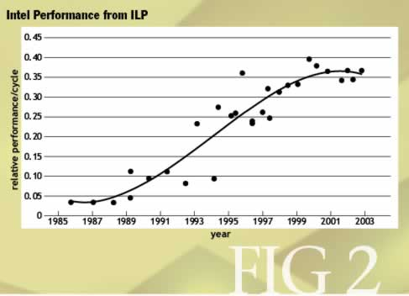
Intel Processor Performance per Cycle
(Olukotun 2005)

Slide 7
Important Role of Programmer
  How should I write my programs, given that I have a good, optimizing compiler?
Don’t: Smash Code into Oblivion
  Hard to read, maintain, & assure correctness
Do:
  Select best algorithm
  Write code that’s readable & maintainable
    Procedures, recursion
    Even though these factors can slow down code
Focus on Bottlenecks or Inner Loops (Profiling)
  Do detailed optimizations where code will be executed repeatedly
  Will get most performance gain here

Slide 8
Another New Path: Parallelism
Lower development cost:
  combine processor cores
Tolerate defects:
  disable any faulty processor
Processors
P
P
C
C
Caches
C
Chip Multiprocessor (CMP)
many advantages
Notes:
One potential new path is thread-level parallelism.
An easy way to think about a microarchitecture that supports concurrent threads is a chip multiprocessor
(or CMP), where we have more than one processor core on a chip, and probably some hierarchy of caches.
But this simple design has many advantages:
we take care of our cross-chip wire latency problem, since now our wires are more localized.
it is definitely much cheaper to stamp out several simple processor cores than it is to design and verify a large superduperscalar processor of the same size.
and as more of a bonus, we can easily save power by turning off idle processors, and we can tolerate defects by simply disabling deffective processors and creating a cheaper line of microprocessors.
in fact, there will be companies that disable processors on purpose just to create a cheaper line of microprocessor, but that’s another story.

Slide 9
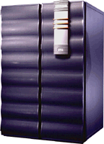
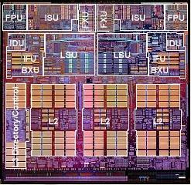
Modern Parallel Architectures
Proc
Proc
Proc
Cache
Cache
Simultaneous-
Multithreading
(SMT)
Chip Multiprocessor
(CMP)
Supercomputers
(large-scale multiprocessors)
improvements through full/partial hw replication !
Notes:
and this isn’t science fiction, this is happening now.
multithreading is working its way down the food chain, from what was once the domain of supercomputers
to dual processor PC configurations, and most recently on a single chip.
The example chip here with two processors is the IBM power4---note that we do not have to sacrifice performance to have multiple processors on a chip: at the time of its release, a single processor on an IBM power4 chip was the fastest thing around.
other current examples include the SUN majc and sibyte 1250 (and sibyte isn’t major player, they make network processors).
Another form of multithreading is called simultaneous multithreading, where we can issue instructions from multiple threads of control at the same time (rather than context switching), and upcoming intel xeons and the ex-alpha 21464 featured this technology.
In the near future, nearly every high-performance processor chip will be multithreaded. But what can we do with them?

Slide 10
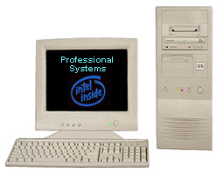
Improvements by Thread Parallelism
Threads
Proc
Proc
Proc
Cache
Cache
Desktops
Simultaneous-
Multithreading
(SMT)
Supercomputers
Chip Multiprocessor
(CMP)
multithreading in every scale of machine!
Notes:
and this isn’t science fiction, this is happening now.
multithreading is working its way down the food chain, from what was once the domain of supercomputers
to dual processor PC configurations, and most recently on a single chip.
The example chip here with two processors is the IBM power4---note that we do not have to sacrifice performance to have multiple processors on a chip: at the time of its release, a single processor on an IBM power4 chip was the fastest thing around.
other current examples include the SUN majc and sibyte 1250 (and sibyte isn’t major player, they make network processors).
Another form of multithreading is called simultaneous multithreading, where we can issue instructions from multiple threads of control at the same time (rather than context switching), and upcoming intel xeons and the ex-alpha 21464 featured this technology.
In the near future, nearly every high-performance processor chip will be multithreaded. But what can we do with them?

Slide 11
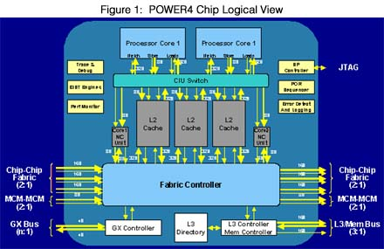
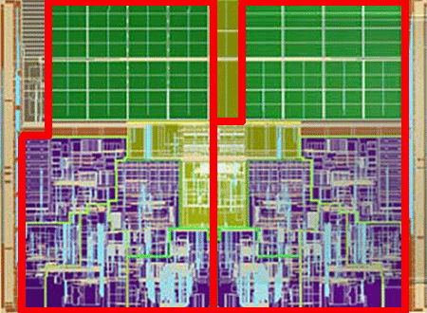
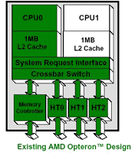
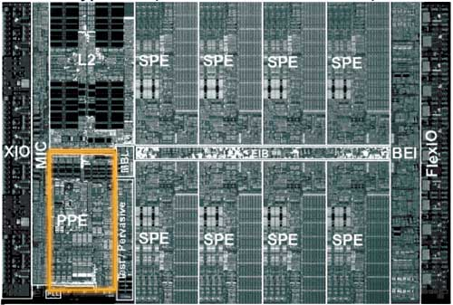
Chip Multi-Processors (CMP)
IBM:
  Power 5 (2-core)
  Power 6 …
Intel:
  Montecito (2-core Itanium)
  Kentsfield (4-core P4)…
AMD:
  dual-core Opteron, Athlon X2
  Quad-core Opteron
Sun:
  UltraSparc T1: 32 cores
  UltraSparc T2: 64 cores
Sony, Toshiba, IBM:
  Cell:9 cores
… …
Power 5
dual-core Intel chip
dual-core Opteron
Cell
abundant cores in Chip Multiprocessors
Notes:
We are interested in improving the performance of a single application, using the abundant CMP resources (which most of would stay idle most of the time) search for die photos

Slide 12
Hyperthreaded (SMT) Architectures
Intel: (Hyperthreading)
  Xeon processors can do 2-way SMT
IBM Power5
  4-processor CMP, each processor is 2-way SMT
Sun Niagara
  8 cores each 2-way SMT

Slide 13
Course philosophy
I will teach you basic concepts and techniques for program optimization
  For sequential code – optimizations for memory hierarchy
  Parallel code and optimizations
You will apply them in short programming assignments

Slide 14
Logistics: Teaching staff
  Instructor
    Cristiana Amza (open door policy in addition to set office hours, usually right after lectures or by appointment)
    Official Prof Office hours: Fri 1-3 p.m.
  Five Official TA’s: Xu Zhao (head TA), Yongle Zang, Peter Yi Sun, Junji Zhi, Jack Yu Luo
  Two volunteer TA’s will be helping out as well
  TA will always be in GB 243 for the middle hour of each PRA
    The TA will announce when they are in the lab in person and/or on piazza
    If you are in GB 251, please go to GB 243 if you need help
    If nobody asks for help, TA may leave after one hour
These are the nominal office hours. Come talk to us anytime!
(Or phone or send email)

Slide 15
Recommended Textbook
Randal E. Bryant and David R. O’Hallaron,
  “Computer Systems: A Programmer’s Perspective”, Prentice Hall 2003.
Textbook is not required
  We will follow only parts of it somewhat closely (e.g., dynamic memory allocation)
  The entire text-book is posted + what you need to read
  However, I believe it is a useful book for the computer system programmer (if you have the money)
  Order it on Amazon (probably better deal)
  If you absolutely need me to, I can order some for you

Slide 16
Course Components
Lectures
  Higher level concepts
Tutorials (one to three)
  Held during lecture time, announced in advance
  Introduction to profiling tools, other tools and skills for labs, clarifications
Labs
  2 or 3 weeks each
  Provide in-depth understanding of an aspect of system
  Programming and measurement
    Few lines of code, but need to put some thought into it
    Some code given, profiling and optimizations required

Slide 17
Getting Help
Web
  Portal – first releases of Lecture notes, assignments, annoucements
  My Web page (under Teaching): condensed info
    Syllabus, copies of lectures, assignments, exams, solutions
Piazza
  Clarifications to assignments, general discussion
  https://piazza.com/utoronto.ca/fall2015/ece454/home
Personal help policy
  Professor: door open means come on in (no appt necessary), can also e-mail to set up appt.
  TAs: See “TA schedule by week” on my Web page 454 menu, please e-mail the TA in charge first.

Slide 18
Policies: Assignments
Work groups
  You have to work in groups of two for all labs !
    form groups from now (working individually only by permission from instructor)
Hand-ins
  Assignment release dates posted on Portal only
  Due dates posted on Portal, hand-out, my Web page
    at 11:59pm on specified due date.
  Electronic hand-ins only (UG submit).
  Submit procedure (will also be specified in lab handout)
    submitece454f labno file-name on one of the UG machines.

Slide 19
Policies: Grading
Exams (65%)
  Midterm (25%)
  Final (40%)
  All exams are closed book/notes.
Piazza answers and in-class 3-5 Quizzes (2%)
Labs (35%)
  5 labs (15%, 20%, 25%, 20%, 20%)
Grading Characteristics
  Labs are generally not heavyweight
    (very) small percentage of each lab can be open-ended/reserved for student-driven ideas and optimizations
  Lab scores should be high
    Serious handicap if you don’t hand a lab in

Slide 20
Facilities
Assignments will use UG Lab machines
Labs are GB 243 and GB 251
  See course Web page for info
  Please direct questions to your TAs

Slide 21
Cheating
Cheating is a serious offence, will be punished harshly
  0 grade for assignment, potential for official letter in file.
What is cheating?
  Sharing code: either by copying, retyping, looking at, or supplying a copy of a file.
What is NOT cheating?
  Helping others use systems or tools.
  Helping others with high-level design issues.
  Helping others debug their code.

Slide 22
Memorable Quotes (historical)
“You should let people know what they are getting into. This is a hard course”. (Elena Kon, class of 2007).

Slide 23
The CSP Pledge (now ancient history)
I will not cheat,
I will not lie,
I will not cry about my mark.
I will not gripe,
I will not blame,
I will stop this senseless game.

Slide 24
The CSP Pledge (contd.)
I will work hard, participate,
And push my limits to create.
Because what I do matters,
Because who I am counts.
This is a core Engineering course.
These are the core Engineering values.

