Slide 1
Introduction to ECE 454 Computer Systems Programming
Cristiana Amza
Topics:
  Lecture topics and assignments
  Profiling rudiments
  Lab schedule and rationale

Slide 2
Lecture Topics
Module 1
  code optimization principles, and profiling, (also - measuring time on a computer)
Module 2
  the memory hierarchy, caches, locality
Module 3
  virtual memory, dynamic memory allocation
Module 4
  threads, parallel programming
Module 5
  Concurrency and the Architecture, other programming models (if time)

Slide 3
Performance (1)
Topics
  code optimization principles, measuring time on a computer and profiling
Assignments
  L1: Code Performance Profiling, bottleneck determination

Slide 4
The Memory Hierarchy (2)
Topics
  Code optimization rules of thumb
  Memory technology, memory hierarchy, caches, locality
  Includes aspects of architecture and OS.
Assignments
  L2: Optimizing Code Performance

Slide 5
Virtual memory (3)
Topics
  Virtual memory, dynamic memory allocation
  Includes aspects of architecture and OS
Assignments
  L3: Writing your own malloc package

Slide 6
Concurrency (4)
Topics
  concurrency, threads.
  includes some aspects of networking, OS, and architecture.
Assignments
  L4: Code parallelization for improved performance.

Slide 7
Concurrency and the Architecture (5)
Topics
  The connection between lock/mutex and cache coherence
  Various lock-based and lock-free parallelization schemes and standards
  Other parallel programming standards
Assignments
  L5: Parallel Code Optimization (game code)

Slide 8
  Module 1: code optimization principles, and profiling

Slide 9
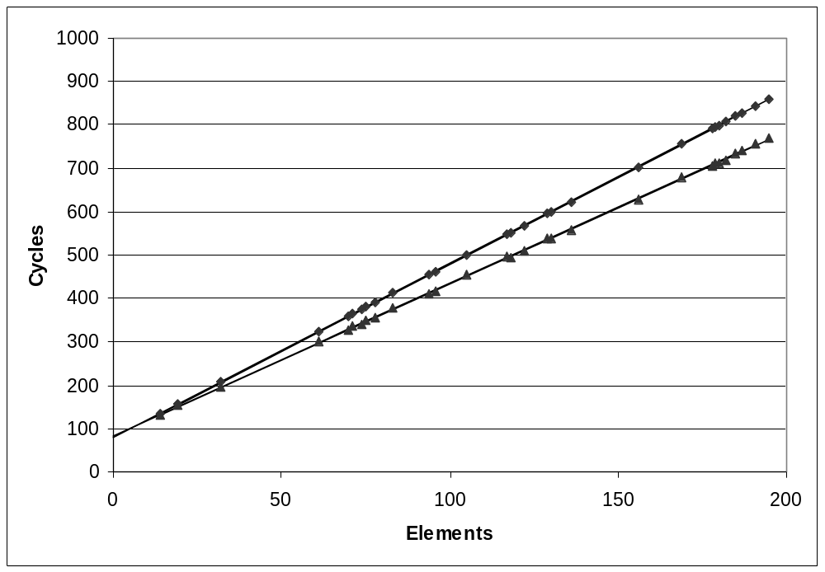
Convention: Cycles Per Element
  Convenient way to express performance of program that operates on vectors or lists
  Length = n
  T = CPE*n + Overhead
vsum1
Slope = 4.0
vsum2
Slope = 3.5

Slide 10
Clock Cycles
Most computers controlled by high frequency clock
  Examples
    100 MHz
      10⁸ cycles per second
      Clock period = 10ns
    2 GHz
      2 X 10⁹ cycles per second
      Clock period = 0.5ns

Slide 11
Role of Optimizing Compilers
Provide efficient mapping of program to machine
  register allocation
  code selection and ordering
  eliminating minor inefficiencies
Don’t (usually) improve asymptotic efficiency
  up to programmer to select best overall algorithm
  big-O savings are (often) more important than constant factors
    but constant factors also matter

Slide 12
Role of Optimizing Compilers
Provide efficient mapping of program to machine
  register allocation
  code selection and ordering
  eliminating minor inefficiencies
Don’t (usually) improve asymptotic efficiency
  up to programmer to select best overall algorithm
  big-O savings are (often) more important than constant factors
    but constant factors also matter
Have difficulty overcoming “optimization blockers”
  potential memory aliasing
  potential procedure side-effects

Slide 13
Limitations of Optimizing Compilers
Operate Under Fundamental Constraint
  Must not cause any change in program behavior under any possible condition
  Often prevents it from making optimizations when would only affect behavior under pathological conditions.
Most analysis is performed only within procedures
  whole-program analysis is too expensive in most cases
Most analysis is based only on static information
  compiler has difficulty anticipating run-time inputs
When in doubt, the compiler must be conservative

Slide 14
Role of Programmer
  How should I write my programs, given that I have a good, optimizing compiler?
Don’t: Smash Code into Oblivion
  Hard to read, maintain, & assure correctness
Do:
  Select best algorithm
  Write code that’s readable & maintainable
    Procedures, recursion
    Even though these factors can slow down code
  Eliminate optimization blockers
    Allows compiler to do its job
Focus on Inner Loops
  Do detailed optimizations where code will be executed repeatedly
  Will get most performance gain here

Slide 15
Performance (1) Tools
Measurement
  Accurately compute time taken by code
    Most modern machines have built in cycle counters
    Using them to get reliable measurements is tricky
  Profile procedure calling frequencies
    Unix tool gprof

Slide 16
Code Profiling Example
Task
  Count word frequencies in text document
  Produce sorted list of words from most frequent to least
Steps
  Convert strings to lowercase
  Apply hash function
  Read words and insert into hash table
    Mostly list operations
    Maintain counter for each unique word
  Sort results
Data Set
  Collected works of Shakespeare
  946,596 total words, 26,596 unique
  Initial implementation: 9.2 seconds
  Shakespeare’s
  most frequent words
29,801 | the
27,529 | and
21,029 | I
20,957 | to
18,514 | of
15,370 | a
14010 | you
12,936 | my
11,722 | in
11,519 | that

Slide 17
Code Profiling
Augment Executable Program with Instrumentation
  Computes (approximately) amount of time spent in each function
  Time computation method
    Periodically (~ every 10ms) interrupt program
    Determine what function is currently executing
    Increment its timer by interval (e.g., 10ms)
  Also maintains counter for each function indicating number of times called

Slide 18
Code Profiling
Augment Executable Program with Instrumentation
  Computes (approximately) amount of time spent in each function
  Time computation method
    Periodically (~ every 10ms) interrupt program
    Determine what function is currently executing
    Increment its timer by interval (e.g., 10ms)
  Also maintains counter for each function indicating number of times called
Using
  gcc –O2 –pg prog.c –o prog
  ./prog
    Executes in normal fashion, but also generates file gmon.out
  gprof prog
    Generates profile information based on gmon.out

Slide 19
Profiling Results
% cumulative self self total
time seconds seconds calls ms/call ms/call name
86.60 8.21 8.21 1 8210.00 8210.00 sort_words
5.80 8.76 0.55 946596 0.00 0.00 lower1
4.75 9.21 0.45 946596 0.00 0.00 find_ele_rec
1.27 9.33 0.12 946596 0.00 0.00 h_add
Call Statistics
  Number of calls and cumulative time for each function
Performance Limiter
  Using inefficient sorting algorithm
  Single call uses 87% of CPU time

Slide 20
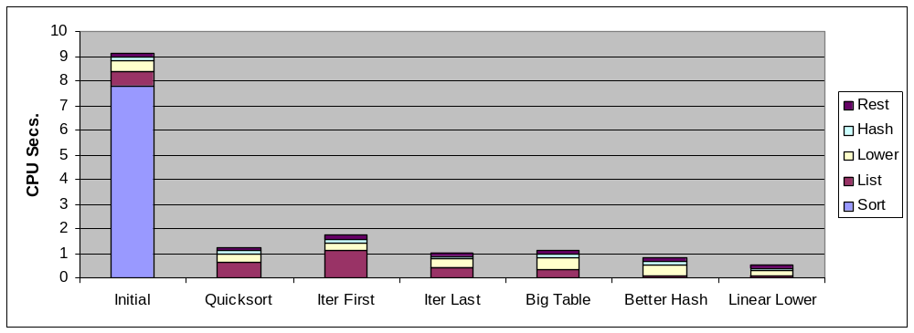
Code Optimizations
  First step: Use more efficient sorting function
  Library function qsort

Slide 21
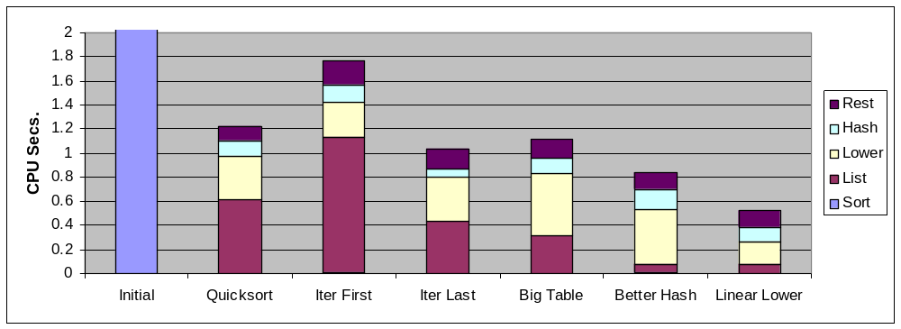
Further Optimizations
  Iter first: Use iterative function to insert elements into linked list
    Causes code to slow down
  Iter last: Iterative function, places new entry at end of list
    Tend to place most common words at front of list
  Big table: Increase number of hash buckets
  Better hash: Use more sophisticated hash function
  Linear lower: Move strlen out of loop

Slide 22
Profiling Observations
Benefits
  Helps identify performance bottlenecks
  Especially useful when have complex system with many components
Limitations
  Only shows performance for data tested
  E.g., linear lower did not show big gain, since words are short
    Quadratic inefficiency could remain lurking in code
  Timing mechanism fairly crude
    Only works for programs that run for > 3 seconds

Slide 23
Lab Rationale
Each lab well-defined goal such as determining the bottleneck of a program or a specific optimization.
  A (small) portion of some labs will be awarded for winning a performance contest or student-driven optimizations.
  We try to use competition in a fun and healthy way.
  Set a threshold for full credit.
  Might post some results (anonymized) on Web page for glory!

Slide 24
Lab Rationale
Doing a lab should result in new skills and concepts
  Profiling Lab: basic performance profiling, finding the bottleneck.
  Programming for cache: profiling, measurement, locality enhancements.
  Malloc Lab: understanding dynamic memory allocation
  Code Parallelization: multithreading of simple code.
  Parallel Code Optimization: putting all techniques together on simple game code parallelization

Slide 25
Good Luck!

