Slide 1
Programming for Cache Performance
Topics
  Impact of caches on performance
  Blocking
  Loop reordering

Slide 2
Cache Memories
Cache memories are small, fast SRAM-based memories managed automatically in hardware.
  Hold frequently accessed blocks of main memory
Transparent to user/compiler/CPU.
Except for performance, of course.

Slide 3
Uniprocessor Memory Hierarchy
size
access time
memory
128Mb-...
25-100 cycles
256-512k
L2 cache
3-8 cycles
32-128k
L1 cache
1 cycle
CPU

Slide 4
Typical Cache Organization
Caches are organized in “cache lines”.
Typical line sizes
  L1: 16 bytes (4 words)
  L2: 128 bytes

Slide 5
Typical Cache Organization
tag
array
data
array
tag
index
offset
address
cache line
=?

Slide 6
Typical Cache Organization
Previous example is a direct mapped cache.
Most modern caches are N-way associative:
  N (tag, data) arrays
  N typically small, and not necessarily a power of 2 (3 is a nice value)

Slide 7
Cache Replacement
If you hit in the cache, done.
If you miss in the cache,
  Fetch line from next level in hierarchy.
  Replace the current line at that index.
  If associative, then choose a line within that set Various policies: e.g., least-recently-used

Slide 8
Bottom Line
To get good performance
  Have to have a high hit rate (hits/references)
Typical numbers
  3-10% for L1
  < 1% for L2, depending on size

Slide 9
Locality
Locality (or re-use) = the extent to which a processor continues to use the same data or “close” data.
Temporal locality: re-accessing a particular word before it gets replaced
Spatial locality: accessing other words in a cache line before the line gets replaced
Useful Fact: arrays in C laid out in row-major order.

Slide 10
Writing Cache Friendly Code
Repeated references to variables are good (temporal locality)
Stride-1 reference patterns are good (spatial locality)
Examples:
  cold cache, 4-byte words, 4-word cache lines
int sumarrayrows(int a[M][N])
{
int i, j, sum = 0;
for (i = 0; i < M; i++)
for (j = 0; j < N; j++)
sum += a[i][j];
return sum;
}
int sumarraycols(int a[M][N])
{
int i, j, sum = 0;
for (j = 0; j < N; j++)
for (i = 0; i < M; i++)
sum += a[i][j];
return sum;
}
Miss rate =
Miss rate =

Slide 11
Writing Cache Friendly Code
Repeated references to variables are good (temporal locality)
Stride-1 reference patterns are good (spatial locality)
Examples:
  cold cache, 4-byte words, 4-word cache lines
int sumarrayrows(int a[M][N])
{
int i, j, sum = 0;
for (i = 0; i < M; i++)
for (j = 0; j < N; j++)
sum += a[i][j];
return sum;
}
int sumarraycols(int a[M][N])
{
int i, j, sum = 0;
for (j = 0; j < N; j++)
for (i = 0; i < M; i++)
sum += a[i][j];
return sum;
}
Miss rate =
Miss rate =

Slide 12
Blocking/Tiling
Traverse the array in blocks, rather than row-wise (or column-wise) sweep.

Slide 13
Example (before)

Slide 14
Example (afterwards)

Slide 15
Achieving Better Locality
Technique is known as blocking / tiling.
Compiler algorithms known.
Few commercial compilers do it.
Learn to do it yourself.

Slide 16
Matrix Multiplication Example
Description:
  Multiply N x N matrices
  O(N3) total operations
/* ijk */
for (i=0; i<n; i++) {
for (j=0; j<n; j++) {
for (k=0; k<n; k++)
c[i][j] += a[i][k] * b[k][j];
}
}

Slide 17
Matrix Multiplication Example
Variable sum
held in register
/* ijk */
for (i=0; i<n; i++) {
for (j=0; j<n; j++) {
sum = 0.0;
for (k=0; k<n; k++)
sum += a[i][k] * b[k][j];
c[i][j] = sum;
}
}

Slide 18
Miss Rate Analysis for Matrix Multiply
Assume:
  Line size = 4 words
  Cache is not even big enough to hold multiple rows
Analysis Method:
  Look at access pattern of inner loop
k
j
j
i
k
i
A
B
C

Slide 19
Miss Rate Analysis for Matrix Multiply
Assume:
  Line size = 4 words
  Cache is not even big enough to hold multiple rows
Analysis Method:
  Look at access pattern of inner loop
k
j
j
i
k
i
A
B
C

Slide 20
Matrix Multiplication (ijk)
/* ijk */
for (i=0; i<n; i++) {
for (j=0; j<n; j++) {
sum = 0.0;
for (k=0; k<n; k++)
sum += a[i][k] * b[k][j];
c[i][j] = sum;
}
}
Inner loop:
(*,j)
(i,j)
(i,*)
A
B
C
Row-wise
Column-
wise
Fixed
Misses per Inner Loop Iteration:
  A B C

Slide 21
Matrix Multiplication (ijk)
/* ijk */
for (i=0; i<n; i++) {
for (j=0; j<n; j++) {
sum = 0.0;
for (k=0; k<n; k++)
sum += a[i][k] * b[k][j];
c[i][j] = sum;
}
}
Inner loop:
(*,j)
(i,j)
(i,*)
A
B
C
Row-wise
Column-
wise
Fixed
Misses per Inner Loop Iteration:
  A B C

Slide 22
Loop reordering (jik)
/* jik */
for (j=0; j<n; j++) {
for (i=0; i<n; i++) {
sum = 0.0;
for (k=0; k<n; k++)
sum += a[i][k] * b[k][j];
c[i][j] = sum
}
}
Inner loop:
(*,j)
(i,j)
(i,*)
A
B
C
Row-wise
Column-
wise
Fixed
Misses per Inner Loop Iteration:
  A B C

Slide 23
Loop reordering (jik)
/* jik */
for (j=0; j<n; j++) {
for (i=0; i<n; i++) {
sum = 0.0;
for (k=0; k<n; k++)
sum += a[i][k] * b[k][j];
c[i][j] = sum
}
}
Inner loop:
(*,j)
(i,j)
(i,*)
A
B
C
Row-wise
Column-
wise
Fixed
Misses per Inner Loop Iteration:
  A B C

Slide 24
Matrix Multiplication (kij)
/* kij */
for (k=0; k<n; k++) {
for (i=0; i<n; i++) {
r = a[i][k];
for (j=0; j<n; j++)
c[i][j] += r * b[k][j];
}
}
Inner loop:
(i,k)
(k,*)
(i,*)
A
B
C
Fixed
Row-wise
Row-wise
Misses per Inner Loop Iteration:
  A B C

Slide 25
Matrix Multiplication (kij)
/* kij */
for (k=0; k<n; k++) {
for (i=0; i<n; i++) {
r = a[i][k];
for (j=0; j<n; j++)
c[i][j] += r * b[k][j];
}
}
Inner loop:
(i,k)
(k,*)
(i,*)
A
B
C
Fixed
Row-wise
Row-wise
Misses per Inner Loop Iteration:
  A B C

Slide 26
Matrix Multiplication (ikj)
/* ikj */
for (i=0; i<n; i++) {
for (k=0; k<n; k++) {
r = a[i][k];
for (j=0; j<n; j++)
c[i][j] += r * b[k][j];
}
}
Inner loop:
(i,k)
(k,*)
(i,*)
A
B
C
Fixed
Row-wise
Row-wise
Misses per Inner Loop Iteration:
  A B C

Slide 27
Matrix Multiplication (ikj)
/* ikj */
for (i=0; i<n; i++) {
for (k=0; k<n; k++) {
r = a[i][k];
for (j=0; j<n; j++)
c[i][j] += r * b[k][j];
}
}
Inner loop:
(i,k)
(k,*)
(i,*)
A
B
C
Fixed
Row-wise
Row-wise
Misses per Inner Loop Iteration:
  A B C

Slide 28
Matrix Multiplication (jki)
/* jki */
for (j=0; j<n; j++) {
for (k=0; k<n; k++) {
r = b[k][j];
for (i=0; i<n; i++)
c[i][j] += a[i][k] * r;
}
}
Inner loop:
(*,k)
(*,j)
(k,j)
A
B
C
Column -
wise
Fixed
Column-
wise
Misses per Inner Loop Iteration:
  A B C

Slide 29
Matrix Multiplication (kji)
/* kji */
for (k=0; k<n; k++) {
for (j=0; j<n; j++) {
r = b[k][j];
for (i=0; i<n; i++)
c[i][j] += a[i][k] * r;
}
}
Inner loop:
(*,k)
(*,j)
(k,j)
A
B
C
Column-
wise
Fixed
Column-
wise
Misses per Inner Loop Iteration:
  A B C

Slide 30
Summary of Matrix Multiplication
ijk (& jik):
kij (& ikj):
jki (& kji):
for (i=0; i<n; i++) {
for (j=0; j<n; j++) {
sum = 0.0;
for (k=0; k<n; k++)
sum += a[i][k] * b[k][j];
c[i][j] = sum;
}
}
for (k=0; k<n; k++) {
for (i=0; i<n; i++) {
r = a[i][k];
for (j=0; j<n; j++)
c[i][j] += r * b[k][j];
}
}
for (j=0; j<n; j++) {
for (k=0; k<n; k++) {
r = b[k][j];
for (i=0; i<n; i++)
c[i][j] += a[i][k] * r;
}
}

Slide 31
Summary of Matrix Multiplication
ijk (& jik):
kij (& ikj):
jki (& kji):
for (i=0; i<n; i++) {
for (j=0; j<n; j++) {
sum = 0.0;
for (k=0; k<n; k++)
sum += a[i][k] * b[k][j];
c[i][j] = sum;
}
}
for (k=0; k<n; k++) {
for (i=0; i<n; i++) {
r = a[i][k];
for (j=0; j<n; j++)
c[i][j] += r * b[k][j];
}
}
for (j=0; j<n; j++) {
for (k=0; k<n; k++) {
r = b[k][j];
for (i=0; i<n; i++)
c[i][j] += a[i][k] * r;
}
}

Slide 32
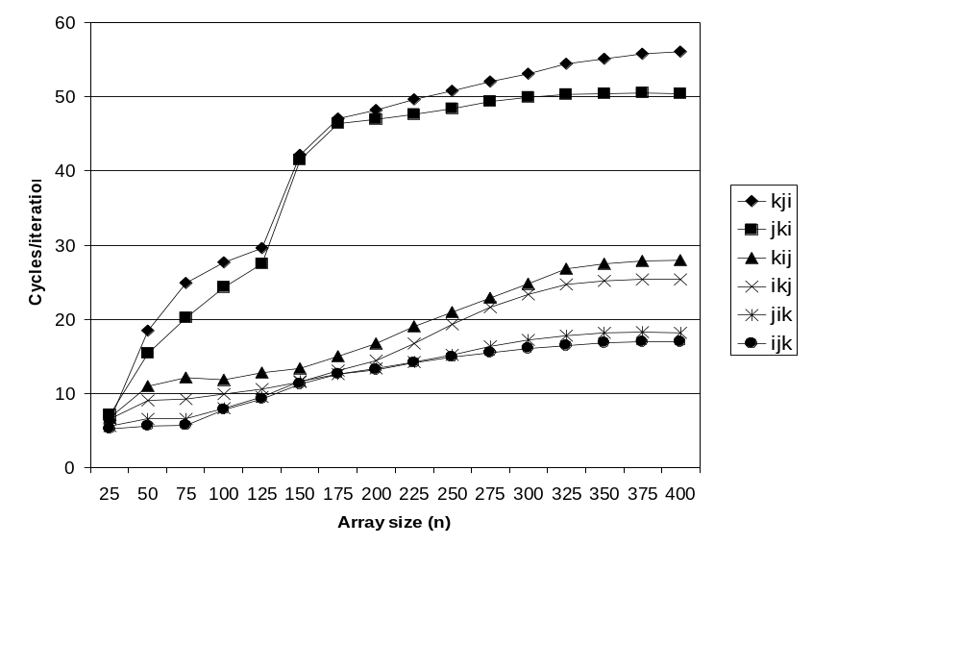
Pentium Matrix Multiply Performance
Miss rates are helpful but not perfect predictors.
    Code scheduling matters, too.

Slide 33
Improving Temporal Locality by Blocking
Example: Blocked matrix multiplication
A₁₁ A₁₂
A₂₁ A₂₂
B₁₁ B₁₂
B₂₁ B₂₂
C₁₁ C₁₂
C₂₁ C₂₂
X
=
Key idea: Sub-blocks (i.e., A_{xy}) can be treated just like scalars.
C₁₁ = A₁₁B₁₁ + A₁₂B₂₁ C₁₂ = A₁₁B₁₂ + A₁₂B₂₂
C₂₁ = A₂₁B₁₁ + A₂₂B₂₁ C₂₂ = A₂₁B₁₂ + A₂₂B₂₂

Slide 34
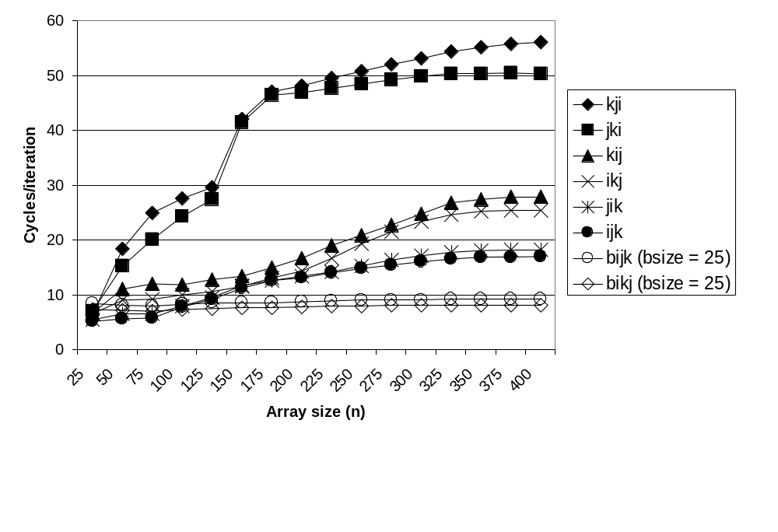
Pentium Blocked Matrix
Multiply Performance
Blocking (bijk and bikj) improves performance by a factor of two over unblocked versions (ijk and jik)
  relatively insensitive to array size.

Slide 35
Concluding Observations
Programmer can optimize for cache performance
  How data structures are organized
  How data are accessed
    Nested loop structure
    Blocking is a general technique
All systems favor “cache friendly code”
  Getting absolute optimum performance is very platform specific
    Cache sizes, line sizes
  Can get most of the advantage with generic code
    Keep working set reasonably small (temporal locality)
    Use small strides (spatial locality)

Slide 36
Blocked/Tiled Matrix Multiplication
for (i = 0; i < n; i+=T)
for (j = 0; j < n; j+=T)
for (k = 0; k < n; k+=T)
/* T x T mini matrix multiplications */
for (i1 = i; i1 < i+T; i1++)
for (j1 = j; j1 < j+T; j1++)
for (k1 = k; k1 < k+T; k1++)
c[i1][j1] += a[i1][k1]*b[k1][j1];
}
j1
c
a
b
+=
*
i1
Tile size T x T
Notes:
bigger pic:

Slide 37
Big picture
+=
*
First calculate C[0][0] – C[T-1][T-1]
Notes:
miss: each tile: M1: T^2/8
For c[0][0] – c[t-1][t-1]: M1 * (n/T + n/T) --- A and B.

Slide 38
Big picture
+=
*
Next calculate C[0][T] – C[T-1][2T-1]
Notes:
Note, the tile of A and B later will be evicted and re-fetched on other elements.

Slide 39
Detailed Visualization
c
a
b
+=
*
Still have to access b[] column-wise
But now b’s cache blocks don’t get replaced
Notes:
Note, the tile of A and B later will be evicted and re-fetched on other elements.

Slide 40
Blocked Matrix Multiply 2 (bijk)
for (jj=0; jj<n; jj+=bsize) {
for (i=0; i<n; i++)
for (j=jj; j < min(jj+bsize,n); j++)
c[i][j] = 0.0;
for (kk=0; kk<n; kk+=bsize) {
for (i=0; i<n; i++) {
for (j=jj; j < min(jj+bsize,n); j++) {
sum = 0.0
for (k=kk; k < min(kk+bsize,n); k++) {
sum += a[i][k] * b[k][j];
}
c[i][j] += sum;
}
}
}
}

Slide 41
Blocked Matrix Multiply 2 Analysis
  Innermost loop pair multiplies a 1 X bsize sliver of A by a bsize X bsize block of B and accumulates into 1 X bsize sliver of C
  Loop over i steps through n row slivers of A & C, using same B
for (i=0; i<n; i++) {
for (j=jj; j < min(jj+bsize,n); j++) {
sum = 0.0
for (k=kk; k < min(kk+bsize,n); k++) {
sum += a[i][k] * b[k][j];
}
c[i][j] += sum;
}
Innermost
Loop Pair
kk
jj
jj
kk
i
i
A
B
C
row sliver accessed
bsize times
Update successive
elements of sliver
block reused n times in succession

Slide 42
SOR Application Example
for( i=0; i<n; i++ )
for( j=0; j<n; j++ )
temp[i][j] = 0.25 * (grid[i+1][j]+grid[i-1][j]+
grid[i][j-1]+grid[i][j+1]);
for( i=0; i<n; i++ )
for( j=0; j<n; j++ )
grid[i][j] = temp[i][j];

Slide 43
SOR Application Example (part 1)
for( i=0; i<n; i++ )
for( j=0; j<n; j++ )
grid[i][j] = temp[i][j];

Slide 44
After Loop Reordering
for( j=0; j<n; j++ )
for( i=0; i<n; i++ )
grid[i][j] = temp[i][j];

Slide 45
SOR Application Example (part 2)
for( i=0; i<n; i++ )
for( j=0; j<n; j++ )
temp[i][j] = 0.25 * (grid[i+1][j]+grid[i-1][j]+
grid[i][j-1]+grid[i][j+1]);

Slide 46
SOR Application Example (part 2)
for( i=0; i<n; i++ )
for( j=0; j<n; j++ )
temp[i][j] = 0.25 * (grid[i+1][j]+grid[i-1][j]+
grid[i][j-1]+grid[i][j+1]);

Slide 47
Access to grid[i][j]
First time grid[i][j] is used: temp[i-1,j].
Second time grid[i][j] is used: temp[i,j-1].
Between those times, 3 rows go through the cache.
If 3 rows > cache size, cache miss on second access.

Slide 48
Fix
Traverse the array in blocks, rather than row-wise sweep.
Make sure grid[i][j] still in cache on second access.

Slide 49
Example 3 (before)

Slide 50
Example 3 (afterwards)

Slide 51
Achieving Better Locality
Technique is known as blocking / tiling.
Compiler algorithms known.
Few commercial compilers do it.
Learn to do it yourself.

Slide 52
The Memory Mountain
Read throughput (read bandwidth)
  Number of bytes read from memory per second (MB/s)
Memory mountain
  Measured read throughput as a function of spatial and temporal locality.
  Compact way to characterize memory system performance.

Slide 53
Memory Mountain Test Function
/* The test function */
void test(int elems, int stride) {
int i, result = 0;
volatile int sink;
for (i = 0; i < elems; i += stride)
result += data[i];
sink = result; /* So compiler doesn't optimize away the loop */
}
/* Run test(elems, stride) and return read throughput (MB/s) */
double run(int size, int stride, double Mhz)
{
double cycles;
int elems = size / sizeof(int);
test(elems, stride); /* warm up the cache */
cycles = fcyc2(test, elems, stride, 0); /* call test(elems,stride) */
return (size / stride) / (cycles / Mhz); /* convert cycles to MB/s */
}

Slide 54
Memory Mountain Main Routine
/* mountain.c - Generate the memory mountain. */
#define MINBYTES (1 << 10) /* Working set size ranges from 1 KB */
#define MAXBYTES (1 << 23) /* ... up to 8 MB */
#define MAXSTRIDE 16 /* Strides range from 1 to 16 */
#define MAXELEMS MAXBYTES/sizeof(int)
int data[MAXELEMS]; /* The array we'll be traversing */
int main()
{
int size; /* Working set size (in bytes) */
int stride; /* Stride (in array elements) */
double Mhz; /* Clock frequency */
init_data(data, MAXELEMS); /* Initialize each element in data to 1 */
Mhz = mhz(0); /* Estimate the clock frequency */
for (size = MAXBYTES; size >= MINBYTES; size >>= 1) {
for (stride = 1; stride <= MAXSTRIDE; stride++)
printf("%.1f\t", run(size, stride, Mhz));
printf("\n");
}
exit(0);
}

Slide 55
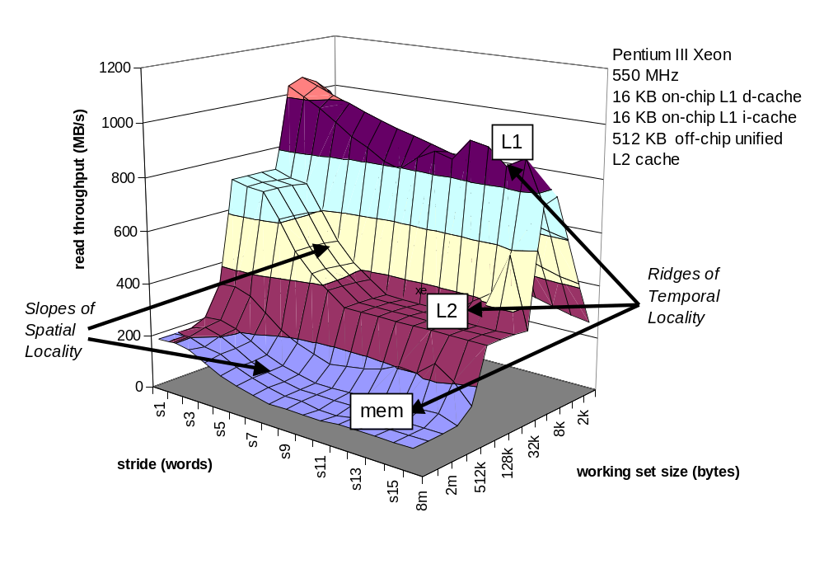
The Memory Mountain

Slide 56
The Memory Mountain

Slide 57
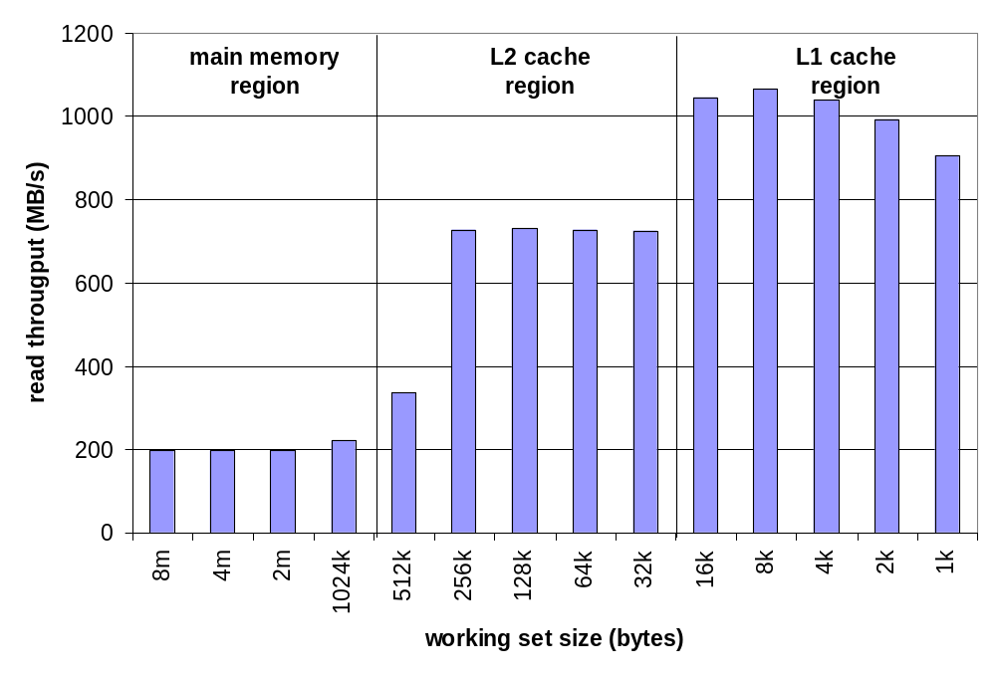
Ridges of Temporal Locality
Slice through the memory mountain with stride=1
  illuminates read throughputs of different caches and memory

Slide 58
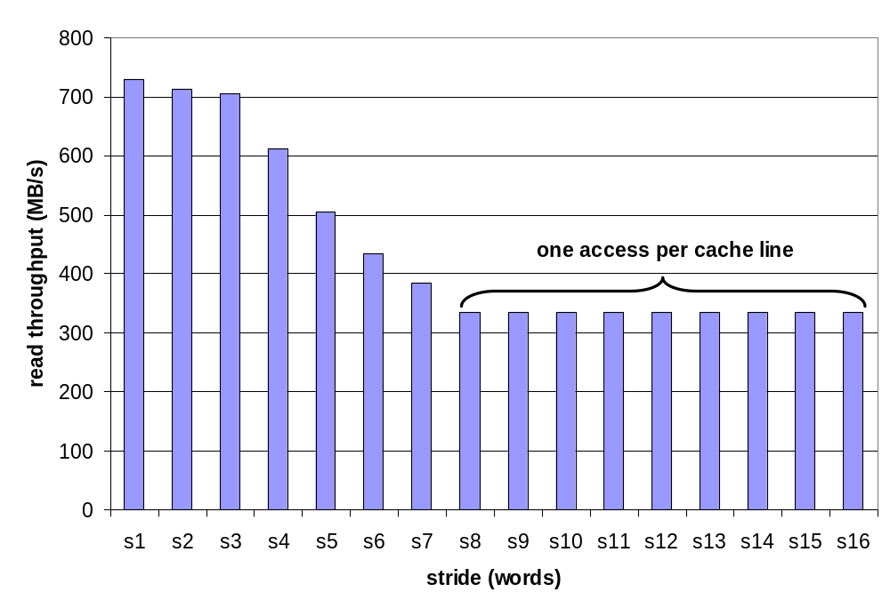
A Slope of Spatial Locality
Slice through memory mountain with size=256KB
  shows cache block size.

