Slide 1
More on Locks: Case Studies
Topics
  Case Study of two Architectures
    Xeon and Opteron
  Detailed Lock code and Cache Coherence

Slide 2
Putting it all together
Background: architecture of the two testing machines
A more detailed treatment of locks and cache-coherence with code examples and implications to parallel software design in the above context

Slide 3
Two case studies
48-core AMD Opteron
80-core Intel Xeon

Slide 4
48-core AMD Opteron
C
C
C
C
C
C
L1
L1
…6x…
L1
L1
L1
…6x…
L1
…8x…
(motherboard)
LLC
LLC
cross-socket!
6-cores per die
6-cores per die
RAM
Last level cache (LLC) NOT shared
Directory-based cache coherence

Slide 5
80-core Intel Xeon
C
C
C
cross-socket
C
C
C
L1
L1
…10x…
L1
L1
L1
…10x…
L1
…8x…
(motherboard)
Last Level Cache (LLC)
10-cores per die
10-cores per die
RAM
LLC shared
Snooping-based cache coherence

Slide 6
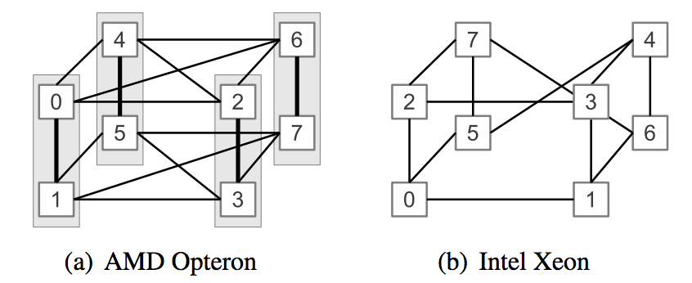
Interconnect between sockets
Cross-sockets communication can be 2-hops

Slide 7
Performance of memory operations

Slide 8
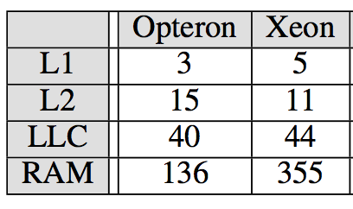
Local caches and memory latencies
Memory access to a line cached locally (cycles)
  Best case: L1 < 10 cycles
  Worst case: RAM 136 – 355 cycles

Slide 9
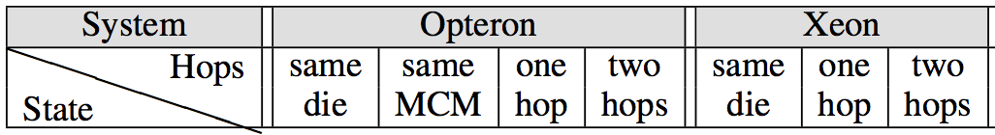
Latency of remote access: read (cycles)
Ignore
“State” is the MESI state of a cache line in a remote cache.
Cross-socket communication is expensive!
  Xeon: loading from Shared state is 7.5 times more expensive over two hops than within socket
  Opteron: cross-socket latency even larger than RAM
Opteron: uniform latency regardless of the cache state
  Directory-based protocol (directory is distributed across all LLC)
Xeon: load from “Shared” state is much faster than from “M” and “E” states
  “Shared” state read is served from LLC instead from remote cache
Notes:
Intel Xeon: the cache state (shared) and ownership is stored in LLC
Opteron: the directory is distributed across all LLC --- so if you’re unlucky, your dir lookup may be expensive
These computers may be the future

Slide 10
Latency of remote access: write (cycles)
Ignore
“State” is the MESI state of a cache line in a remote cache.
Cross-socket communication is expensive!
Opteron: store to “Shared” cache line is much more expensive
  Directory-based protocol is incomplete
    Does not keep track of the sharers
    Equivalent to broad-cast and have to wait for all invalidations to complete
Xeon: store latency similar regardless of the previous cache line state
  Snooping-based coherence
Notes:
Intel Xeon: the cache state (shared) and ownership is stored in LLC
Opteron: the directory is distributed across all LLC --- so if you’re unlucky, your dir lookup may be expensive

Slide 11
Detailed Treatment of Lock-based synchronization

Slide 12
Synchronization implementation
Hardware support is required to implement synchronization primitives
  In the form of atomic instructions
  Common examples include: test-and-set, compare-and-swap, etc.
  Used to implement high-level synchronization primitives
    e.g., lock/unlock, semaphores, barriers, cond. var., etc.
  We will only discuss test-and-set here

Slide 13
Test-And-Set
The semantics of test-and-set are:
  Record the old value
  Set the value to TRUE
    This is a write!
  Return the old value
Hardware executes it atomically!

Slide 14
Test-And-Set
Read-exclusive (invalidations)
Modify (change state)
Memory barrier
  completes all the mem. op.
  before this TAS
  cancel all the mem. op.
  after this TAS
atomic!

Slide 15
Using Test-And-Set
Here is our lock implementation with test-and-set:
struct lock {
int held = 0;
}
void acquire (lock) {
while (test-and-set(&lock->held));
}
void release (lock) {
lock->held = 0;
}
Courtesy Ding Yuan

Slide 16
TAS and cache coherence
acq(lock)
Thread A:
Thread B:
Processor
Processor
Cache
Cache
State
Data
State
Data
Read-Exclusive
Shared Memory (held = 0)

Slide 17
TAS and cache coherence
acq(lock)
Thread A:
Thread B:
Processor
Processor
Cache
Cache
State
Data
State
Data
Dirty
held=1
Fill
Read-Exclusive
Shared Memory (held = 0)

Slide 18
TAS and cache coherence
acq(lock)
acq(lock)
Thread A:
Thread B:
Processor
Processor
Cache
Cache
State
Data
State
Data
Dirty
held=1
Read-Exclusive
invalidation
Shared Memory (held = 0)

Slide 19
TAS and cache coherence
acq(lock)
acq(lock)
Thread A:
Thread B:
Processor
Processor
Cache
Cache
State
Data
State
Data
Inval
held=1
update
Read-Exclusive
invalidation
Shared Memory (held = 1)

Slide 20
TAS and cache coherence
acq(lock)
acq(lock)
Thread A:
Thread B:
Processor
Processor
Cache
Cache
State
Data
State
Data
Inval
held=1
Dirty
held=1
Fill
Read-Exclusive
Shared Memory (held = 1)

Slide 21
What if there are contentions?
while(TAS(l))
;
while(TAS(l))
;
Thread A:
Thread B:
Processor
Processor
Cache
Cache
State
Data
State
Data
Shared Memory (held = 1)

Slide 22
How bad can it be?
TAS
Ignore
Store
Recall: TAS essentially is a Store + Memory Barrier

Slide 23
How to optimize?
When the lock is being held, a contending “acquire” keeps modifying the lock var. to 1
  Not necessary!
void test_and_test_and_set (lock) {
do {
while (lock->held == 1)
; // spin
}
} while (test_and_set(lock->held));
}
void release (lock) {
lock->held = 0;
}
Notes:
why is the “do.. while” necessary?

Slide 24
What if there are contentions?
Thread A:
Thread B:
Thread B:
holding lock
while(held==1)
;
Processor
Processor
Processor
Cache
Cache
Cache
State
Data
State
Data
State
Data
Dirty
held=1
Read request
Read
Shared Memory (held = 0)

Slide 25
What if there are contentions?
Thread A:
Thread B:
Thread C:
holding lock
while(held==1)
;
Processor
Processor
Processor
Cache
Cache
Cache
State
Data
State
Data
State
Data
Share
held=1
Share
held=1
update
Read request
Read
Shared Memory (held = 1)

Slide 26
What if there are contentions?
Thread A:
Thread B:
Thread C:
holding lock
while(held==1)
;
while(held==1)
;
Processor
Processor
Processor
Cache
Cache
Cache
State
Data
State
Data
State
Data
Share
held=1
Share
held=1
Share
held=1
Repeated read to “Shared” cache line: no cache coherence traffic!
Shared Memory (held = 1)
Notes:
6 times speed up!

Slide 27
Let’s put everything together
TAS
Ignore
Load
Write
Local access

Slide 28
Implications to programmers
Cache coherence is expensive (more than you thought)
  Avoid unnecessary sharing (e.g., false sharing)
    Avoid unnecessary coherence (e.g., TAS -> TATAS)
  Clear understanding of the performance
Crossing sockets is a killer
  Can be slower than running the same program on single core!
  pthread provides CPU affinity mask
    pin cooperative threads on cores within the same die
Loads and stores can be as expensive as atomic operations
Programming gurus understand the hardware
  So do you now!
  Have fun hacking!
More details in “Everything you always wanted to know about
synchronization but were afraid to ask”. David, et. al., SOSP’13

