Slide 1
Advanced Topics: MapReduce
ECE 454 Computer Systems Programming
Cristiana Amza
Topics:
  Reductions Implemented in Distributed Frameworks
  Distributed Key-Value Stores
  Hadoop Distributed File System

Slide 2
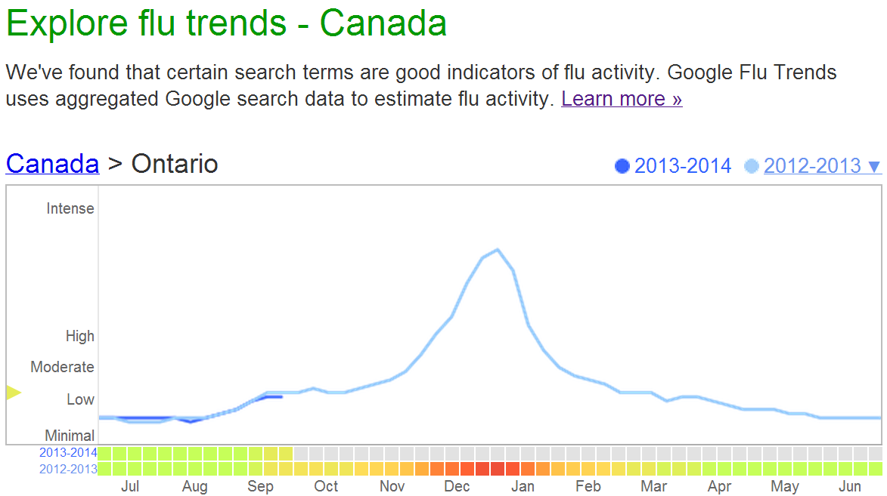

Motivation: Big Data Analytics
http://www.google.org/flutrends/ca/
(2012)
Average Searches Per Day:
5,134,000,000

Slide 3
Motivation: Big Data Analytics
Process lots of data
    Google processed about 24 petabytes of data per day in 2009.
A single machine cannot serve all the data
    You need a distributed system to store and process in parallel
Parallel programming?
    Threading is hard!
    How do you facilitate communication between nodes?
    How do you scale to more machines?
    How do you handle machine failures?

Slide 4

MapReduce
MapReduce [OSDI’04] provides
  Automatic parallelization, distribution
  I/O scheduling
    Load balancing
    Network and data transfer optimization
  Fault tolerance
    Handling of machine failures
Need more power: Scale out, not up!
    Large number of commodity servers as opposed to some high end specialized servers
Apache Hadoop:
Open source implementation of MapReduce

Slide 5
Typical problem solved by MapReduce
Read a lot of data
Map: extract something you care about from each record
Shuffle and Sort
Reduce: aggregate, summarize, filter, or transform
Write the results

Slide 6
MapReduce workflow
Input Data
Output Data
Worker
write
Output
File 0
local
write
Worker
Split 0
read
Split 1
Worker
Split 2
Output
File 1
Worker
Worker
remote
read,
sort
Map
extract something you care about from each record
Reduce aggregate, summarize, filter, or transform

Slide 7
Mappers and Reducers
Need to handle more data? Just add more Mappers/Reducers!
No need to handle multithreaded code ☺
  Mappers and Reducers are typically single threaded and deterministic
    Determinism allows for restarting of failed jobs
  Mappers/Reducers run entirely independent of each other
    In Hadoop, they run in separate JVMs

Slide 8
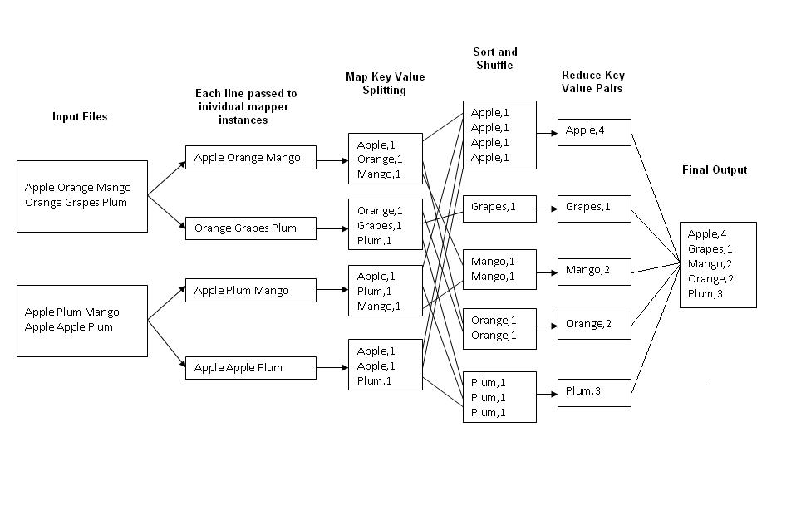

Example: Word Count
(2012)
Average Searches Per Day:
5,134,000,000
1000 nodes: each node will process 5,134,000 queries
http://kickstarthadoop.blogspot.ca/2011/04/word-count-hadoop-map-reduce-example.html

Slide 9
Mapper
Reads in input pair <Key,Value>
Outputs a pair <K’, V’>
  Let’s count number of each word in user queries (or Tweets/Blogs)
  The input to the mapper will be <queryID, QueryText>:
  <Q1,“The teacher went to the store. The store was closed; the store opens in the morning. The store opens at 9am.” >
  The output would be:
    <The, 1> <teacher, 1> <went, 1> <to, 1> <the, 1> <store,1> <the, 1> <store, 1> <was, 1> <closed, 1> <the, 1> <store,1> <opens, 1> <in, 1> <the, 1> <morning, 1> <the 1> <store, 1> <opens, 1> <at, 1> <9am, 1>

Slide 10
Reducer
Accepts the Mapper output, and aggregates values on the key
  For our example, the reducer input would be:
    <The, 1> <teacher, 1> <went, 1> <to, 1> <the, 1> <store, 1> <the, 1> <store, 1> <was, 1> <closed, 1> <the, 1> <store, 1> <opens,1> <in, 1> <the, 1> <morning, 1> <the 1> <store, 1> <opens, 1> <at, 1> <9am, 1>
  The output would be:
    <The, 6> <teacher, 1> <went, 1> <to, 1> <store, 3> <was, 1> <closed, 1> <opens, 1> <morning, 1> <at, 1> <9am, 1>
Notes:
Input is typically sorted, output is output exactly as is
All inputs with the same key must go to the same reducer!

Slide 11

MapReduce
Hadoop
Program
fork
fork
fork
Master
assign
map
assign
reduce
Input Data
Output Data
Transfer peta-scale data through network
Worker
write
Output
File 0
local
write
Worker
Split 0
read
Split 1
Worker
Split 2
Output
File 1
Worker
Worker
remote
read,
sort
Map
Reduce

Slide 12
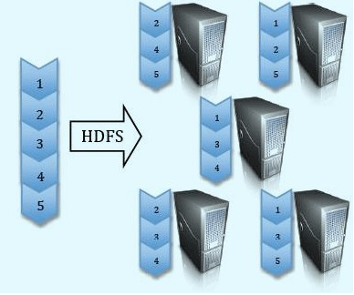
Google File System (GFS)
Hadoop Distributed File System (HDFS)
Split data and store 3 replica on commodity servers

Slide 13

MapReduce
HDFS
NameNode
Where are the chunks of input data?
Location of the chunks of input data
Master
assign
map
assign
reduce
Input Data
Output Data
Worker
write
Output
File 0
Split 0
local
write
Worker
Split 0
Split 1
Worker
Split 2
Split 1
Output
File 1
Worker
Worker
remote
read,
sort
Read from local disk
Split 2
Map
Reduce
Notes:
Master scheduling policy:
Asks GFS for locations of replicas of input file blocks
Map tasks scheduled so GFS input block replica are on same machine or same rack
Effect: Thousands of machines read input at local disk speed
Eliminate network bottleneck!

Slide 14
Locality Optimization
Master scheduling policy:
  Asks GFS for locations of replicas of input file blocks
  Map tasks scheduled so GFS input block replica are on same machine or same rack
Effect: Thousands of machines read input at local disk speed
  Eliminate network bottleneck!

Slide 15
Failure in MapReduce
Failures are norm in commodity hardware
Worker failure
  Detect failure via periodic heartbeats
  Re-execute in-progress map/reduce tasks
Master failure
  Single point of failure; Resume from Execution Log
Robust
  Google’s experience: lost 1600 of 1800 machines once!, but finished fine

Slide 16
Fault tolerance:
Handled via re-execution
On worker failure:
  Detect failure via periodic heartbeats
  Re-execute completed and in-progress map tasks
  Task completion committed through master
Robust: [Google’s experience] lost 1600 of 1800 machines, but finished fine

Slide 17
Refinement:
Redundant Execution
Slow workers significantly lengthen completion time
  Other jobs consuming resources on machine
  Bad disks with soft errors transfer data very slowly
  Weird things: processor caches disabled (!!)
Solution: spawn backup copies of tasks
  Whichever one finishes first "wins"
Notes:
Effect: Dramatically shortens job completion time

Slide 18
Refinement:
Skipping Bad Records
Map/Reduce functions sometimes fail for particular inputs
Best solution is to debug & fix, but not always possible
If master sees two failures for the same record:
  Next worker is told to skip the record

Slide 19
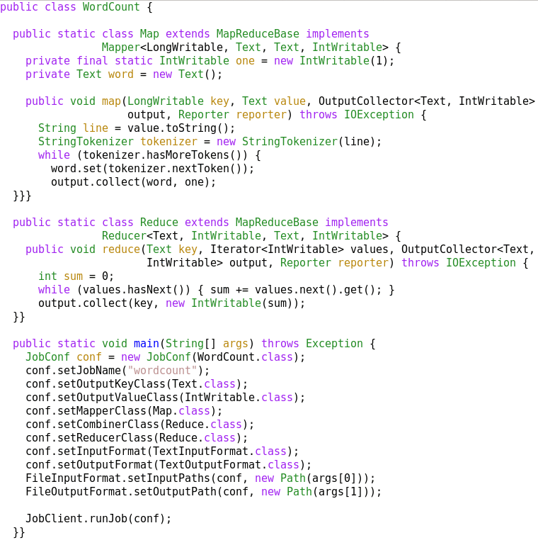
A MapReduce Job
Mapper
Reducer
Run this program as
a MapReduce job

Slide 20
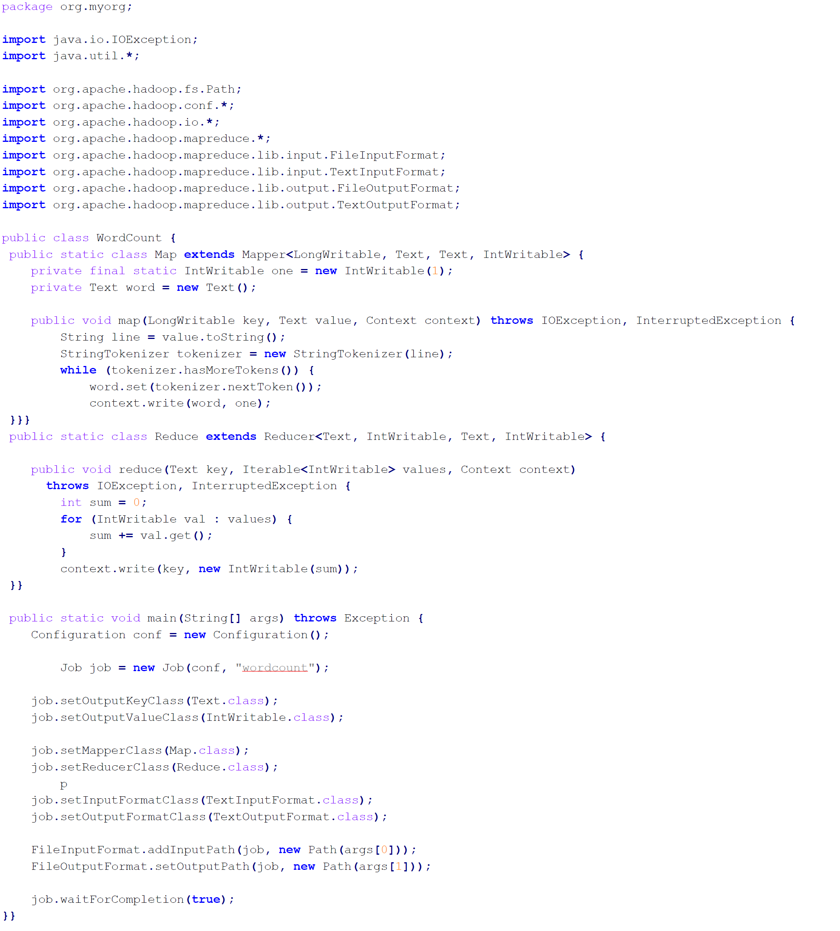
Mapper
Reducer
Run this program as
a MapReduce job

Slide 21
Summary
MapReduce
  Programming paradigm for data-intensive computing
  Distributed & parallel execution model
  Simple to program
    The framework automates many tedious tasks (machine selection, failure handling, etc.)

