Slide 1
Big Picture of
Architecture and Memory Access
Topics
  Virtual Memory (Answer to Why Question)
  End to End Memory Access (Review)
  Multiprocessor Architectures (Review)
  Multithreading Basics (Review)
  Connection between Memory Access, Memory Allocation and Cache Coherence
  Basics of Cache Coherence in Chip Multiprocessors

Slide 2
Why Virtual Memory ? Portability
Machine 1
Physical main memory
Machine 2
Physical main memory
programA:
stack
heap
.text
.data
…

Slide 3
Why Virtual Memory ? To Protect
Physical main memory
Process i
Process j
Why Virtual Memory ? To Share
Physical main memory
Process i
Process j

Slide 4
VM Solution: A Level Of Indirection
Virtual memory
Process 1
mapping
Physical memory
Virtual memory
Process n
Each process gets own private memory space, but can share physical memory pages (under OS Ctrl)
Can run if not enough total memory, and if not enough contiguous memory

Slide 5
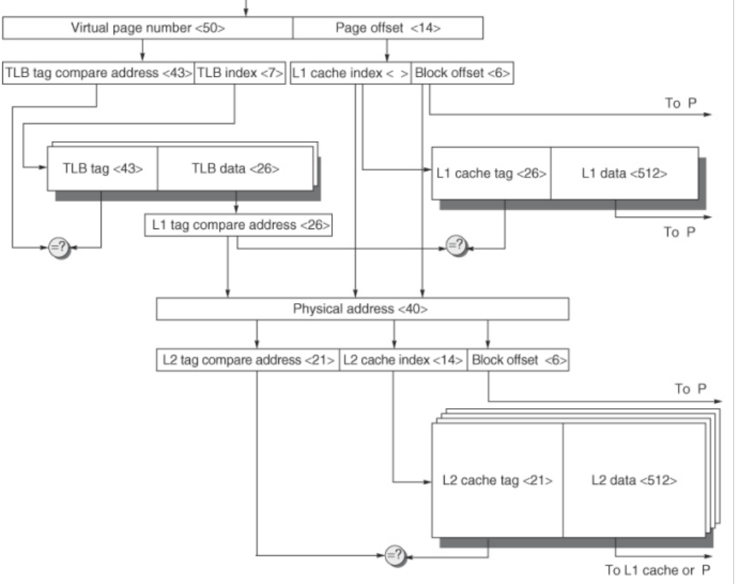
Big picture for Memory Access

Slide 6
Memory acts like a Cache for Disk
Exception
Page fault handler
4
CPU Chip
2
Cache/
Memory
Disk
Page Table
Victim page
MMU
PTE request
1
5
CPU
VA
PTE
7
3
New page
6
1) Processor sends virtual address to MMU
2-3) MMU fetches PTE from page table in memory
4) PTE absent so MMU triggers page fault exception
5) Handler identifies victim (and, if dirty, pages it out to disk)
6) Handler pages in new page and updates PTE in memory
7) Handler returns to original process, restarting faulting instruction

Slide 7
Multithreaded Machines Are Everywhere
Threads
P
P
P
P
C
C
P
P
P
C
C
C
C
C
C
C
C
C
C
C
Shared Memory
Shared Memory
SUN MAJC,
IBM Power5
ALPHA 21464
Dual Pentium
SGI Origin
How can we use them? Parallelism!
Notes:
Multithreaded machines are becoming more and more common.
For example,multiple processors are encorporated on a single chip in the Sun MAJC and IBM power4
Similarly, the upcoming alpha 21464 will be simultaneously multithreaded
At a larger scale, personal computers are lately being packaged in two or four processor configurations, while high-end multiprocessor machines have been around for a long time.
But how can we use these multithreaded machines to improve performance---
in particular, to improve the performance of a single application?
The answer is parallelism..

Slide 8
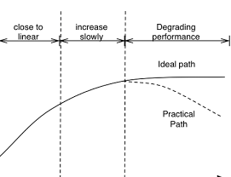
Big picture for Multithreading
We know that we need parallelism
Will more parallelization always yield better performance?
throughput
# of threads
Notes:
What if we do not create too many threads?
what if we only have same # of threads as cores?
why lock contention can have an adverse effect?
what if threads have no lock contention?

Slide 9
Big picture for Multithreading
Context switching overhead between threads in the OS !
throughput
# of threads
Notes:
What if we do not create too many threads?
what if we only have same # of threads as cores?
why lock contention can have an adverse effect?
what if threads have no lock contention?

Slide 10
Parallelism Within each Processor
void product(vec_ptr v, int *dest)
{
int length = vec_length(v);
int limit = length-1;
int *data = get_vec_start(v);
int x = 1; int i;
for (i = 0; i < limit; i+=2) {
x = x * (data[i] * data[i+1]);
}
…
*dest = x;
}
Optimization
  Multiply pairs of elements together
  And then update product
Performance
  CPE = 2

Slide 11


%edx.0
load
addl
%edx.1
load
cmpl
load
addl
jl
load
cmpl
jl
mull
tmp=data[i] *
data[i+1]
Still have the data dependency
But, one dependency every two elements
mull
mull
x=x*tmp
mull

Slide 12
Limitations
Number of Functional Units
Latency of Operation causing Dependency (Multiplier)
Registers to hold temporaries

Slide 13
Dynamic Memory Allocation
Traditional allocators focus on optimizing for
  Space utilization
  Time complexity on malloc/free
But what other problems should we consider?

Slide 14
Other challenges
“Memory-wall” – growing disparity of CPU and RAM speeds
  Caching effectiveness is important
  malloc can significantly impact caching effectiveness
    E.g., padding (internal fragmentation) is not cache-friendly
    Cannot allocate memory “efficiently”

Slide 15
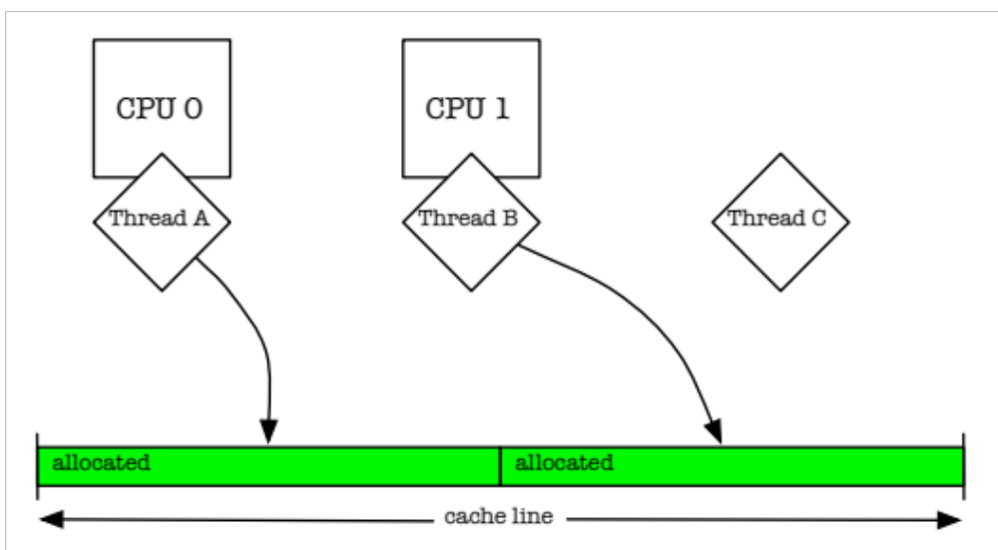
False sharing within a cache-line

Slide 16
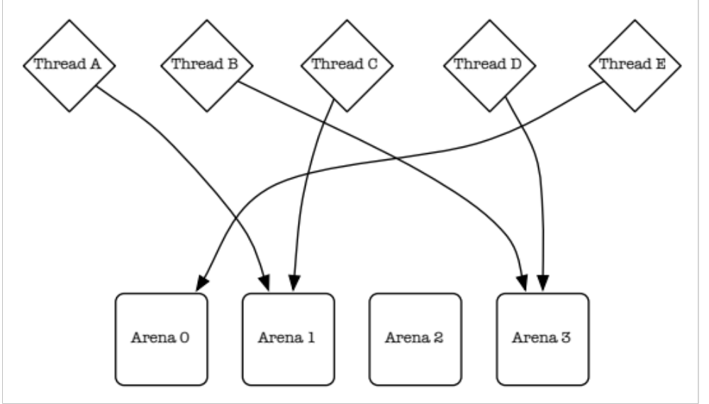
Solution
Memory arenas
  One thread only use memory from a single arena (continuous blocks of memory)

Slide 17
Shared Memory: Logical View
Shared memory space
proc1
proc2
proc3
procN

Slide 18
Shared Memory Machines
Small number of processors: shared memory with coherent caches (e.g., CMPs).

Slide 19
Physical Implementation
Shared memory
bus
cache1
cache2
cache3
cacheN
proc1
proc2
proc3
procN

Slide 20
Cache Coherence Protocol
We will discuss this later.
Annotations for now in example slides (next) gives intuition, not full algorithm

Slide 21
The Cache Coherence Problem
X = 0
bus
X=0
X=0
X=0
X=0
proc1
proc2
proc3
procN

Slide 22
The Cache Coherence Problem
X = 0
bus
X=0
Write X
X=0
X=0
proc1
proc2
proc3
procN

Slide 23
The Cache Coherence Problem
X = 0
bus
X=0
X=1
X=0
X=0
proc1
proc2
proc3
procN

Slide 24
The Cache Coherence Problem
X = 0
bus
Write X
X=1
X=0
X=0
proc1
proc2
proc3
procN

Slide 25
The Cache Coherence Problem
X = 1
bus
X=2
X=1
X=0
X=0
proc1
proc2
proc3
procN

Slide 26
False Sharing
Occurs when two or more processors access different data in same cache line, and at least one of them writes.
Leads to ping-pong effect (of ownership for cache line).

Slide 27
False Sharing: Example (1 of 3)
  parallel for loop (each processor writes a different element)
  for( i=0; i<n; i++ )
  a[i] = b[i];
Let’s assume:
  2 processes/threads
  cache line has can fit 8 elements of array a

Slide 28
False Sharing: Example (2 of 3)
cache line
a[0]
a[1]
a[2]
a[3]
a[4]
a[5]
a[6]
a[7]
Written by processor 0
Written by processor 1

Slide 29
False Sharing: Example (3 of 3)
a[0]
a[2]
a[4]
P0
...
inv
data
a[1]
a[3]
a[5]
P1

Slide 30
Summary
Cache Coherence basics.
False sharing.

