Slide 1
Advanced Topics: Prefetching
ECE 454 Computer Systems Programming
Cristiana Amza
Topics:
  UG Machine Architecture
  Memory Hierarchy of Multi-Core Architecture
  Software and Hardware Prefetching

Slide 2
Generic Cache Mechanics (Review)
Smaller, faster, more expensive
memory caches a subset of
the Memory blocks
Cache
8
4
9
14
10
3
Data is copied in block-sized transfer units (cache lines)
4
10
Memory
0
1
2
3
Larger, slower, cheaper memory
viewed as partitioned into “blocks”
4
4
5
6
7
8
9
10
10
11
12
13
14
15

Slide 3
Generic Cache Concepts: Hit
Request: 14
Data in block b is needed
Cache
Block b is in cache:
Hit!
8
9
14
3
14
Memory
0
1
2
3
4
5
6
7
8
9
10
11
12
13
14
15
Notes:
how large is a cache block?
Pentium 4: 64B block, 8KB L1, 128 cache blocks, 4-way set associative

Slide 4
Generic Cache Concepts: Miss
Request: 12
Data in block b is needed
Cache
Block b is not in cache:
Miss!
8
9
14
3
12
Block b is fetched from
memory
12
Request: 12
Block b is stored in cache
Placement policy:
determines where b goes
Replacement policy:
determines which block
gets evicted (victim)
Memory
0
1
2
3
4
5
6
7
8
9
10
11
12
12
13
14
15
Notes:
what’s the placement & replacement policies?
-- replacement policy: random, LRU, FIFO

Slide 5
Generic Cache Organization (S, E, B)
E = 2e blocks per set
set
block
S = 2^{s} sets
Cache size:
S x E x B data bytes
v
tag
0
1
2
B-1
valid bit
B = 2^{b} bytes per cache block (the data)

Slide 6
Why Caches Work
Locality: Programs tend to use data and instructions with addresses near or equal to those they have used recently
Temporal locality:
  Recently referenced items are likely
  to be referenced again in the near future
Spatial locality:
  Items with nearby addresses tend
  to be referenced close together in time
block
block

Slide 7
Example: Locality of Access
sum = 0;
for (i = 0; i < n; i++)
sum += a[i];
return sum;
Data:
  Temporal: sum referenced in each iteration
  Spatial: array a[] accessed in stride-1 pattern
Instructions:
  Temporal: cycle through loop repeatedly
  Spatial: reference instructions in sequence
Locality of code is a crucial skill for a programmer!

Slide 8
Prefetching
Bring into cache elements expected to be accessed in the future (ahead of future access)
Bringing in the cache a whole cache line instead of element by element already does this
We will learn more general prefetching techniques
In the context of the UG Memory Hierarchy

Slide 9
UG Core 2 Machine Architecture
32KB, 8-way data cache
32KB, 8-way inst cache
Multi-chip Module
Processor Chip
Processor Chip
P
P
P
P
L1
Caches
L1
Caches
L1
Caches
L1
Caches
L2 Cache
L2 Cache
12 MB (2X 6MB), 16-way Unified L2 cache

Slide 10
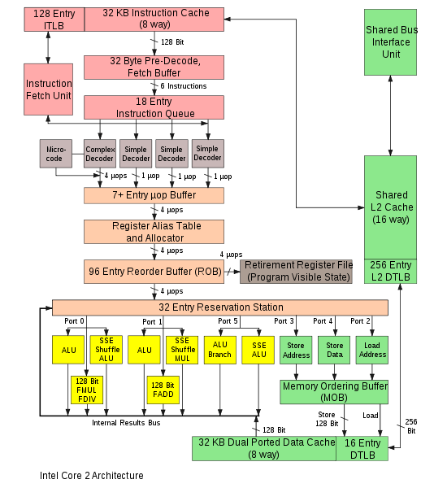
Core2 Architecture (2006): UG machines

Slide 11
UG Machines CPU Core Arch. Features
64-bit instructions
Deeply pipelined
  14 stages
  Branches are predicted
Superscalar
  Can issue multiple instructions at the same time
  Can issue instructions out-of-order

Slide 12
Core 2 Memory Hierarchy
L1/L2 cache: 64 B blocks
6 MB
~4 GB
~500 GB
L1
I-cache
L2 unified cache
Main Memory
Disk
32 KB
C
P
U
R
e
g
L1
D-cache
Latency:
3 cycles
16 cycles
100 cycles
10s of millions
8-way
associative!
16-way
associative!
Reminder: Conflict misses are not an issue nowadays
Staying within on-chip cache capacity is key
Notes:
8 way associative is almost as good as fully associative
64B blocks, 32 KB = 512 Blocks
8 way associative = 64 sets

Slide 13
Get Memory System Details: lstopo
Run lstopo on UG machine, gives:
Machine (3829MB) + Socket #0
L2 #0 (6144KB)
L1 #0 (32KB)+Core #0+PU #0 (phys=0)
L1 #1 (32KB)+Core #1+PU #1 (phys=1)
L2 #1 (6144KB)
L1 #2 (32KB) + Core #2 + PU #2 (phys=2)
L1 #3 (32KB) + Core #3 + PU #3 (phys=3)
4GB RAM
2X 6MB L2 cache
2 cores per L2
32KB L1 cache per core

Slide 14
Get More Cache Details: L1 dcache
ls /sys/devices/system/cpu/cpu0/cache/index0
  coherency_line_size: 64 // 64B cache lines
  level: 1 // L1 cache
  number_of_sets
  physical_line_partition
  shared_cpu_list
  shared_cpu_map
  size:
  type: data // data cache
  ways_of_associativity: 8 // 8-way set associative

Slide 15
Get More Cache Details: L2 cache
ls /sys/devices/system/cpu/cpu0/cache/index2
  coherency_line_size: 64 // 64B cache lines
  level: 2 // L2 cache
  number_of_sets
  physical_line_partition
  shared_cpu_list
  shared_cpu_map
  size: 6144K
  type: Unified // unified cache, means instructions and data
  ways_of_associativity: 24 // 24-way set associative

Slide 16
Access Hardware Counters: perf
The tool ‘perf’ allows you to access performance counters
  way easier than it used to be
To measure L1 cache load misses for program foo, run:
perf stat -e L1-dcache-load-misses foo
7803 L1-dcache-load-misses # 0.000 M/sec
To see a list of all events you can measure:
perf list
Note: you can measure multiple events at once

Slide 17
Prefetching
ORIGINAL CODE:
CODE WITH PREFETCHING:
inst1
inst1
inst2
prefetch X
inst3
inst2
inst4
inst3
Cache miss latency
load X (misses cache)
inst4
Cache miss latency
load X (hits cache)
inst5 (load value is ready)
inst5 (must wait for load value)
inst6
inst6
Basic idea:
  Predicts which data will be needed soon (might be wrong)
  Initiates an early request for that data (like a load-to-cache)
  If effective, can be used to tolerate latency to memory

Slide 18
Prefetching is Difficult
Prefetching is effective only if all of these are true:
  There is spare memory bandwidth to begin with
    Otherwise prefetches could make things worse
  Prefetches are accurate
    Only useful if you prefetch data you will soon use
  Prefetches are timely
    Ie., prefetch the right data, but not early enough
  Prefetched data doesn’t displace other in-use data
    Eg: bad if PF replaces a cache block about to be used
  Latency hidden by prefetches outweighs their cost
    Cost of many useless prefetches could be significant
Ineffective prefetching can hurt performance!

Slide 19
Hardware Prefetching
A simple hardware prefetcher:
  When one block is accessed prefetch the adjacent block
  i.e., behaves like blocks are twice as big
A more complex hardware prefetcher:
  Can recognize a “stream”: addresses separated by a “stride”
  Eg1: 0x1, 0x2, 0x3, 0x4, 0x5, 0x6... (stride = 0x1)
  Eg2: 0x100, 0x300, 0x500, 0x700, 0x900… (stride = 0x200)
  Prefetch predicted future addresses
    Eg., current_address + stride*4

Slide 20
Core 2 Hardware Prefetching
L1/L2 cache: 64 B blocks
L2->L1 inst prefetching
6 MB
~4 GB
~500 GB (?)
L1
I-cache
L2 unified cache
Main Memory
Disk
32 KB
CPU
Reg
L1
D-cache
L2->L1 data prefetching
Mem->L2
data prefetching
Includes next-block prefetching and multiple streaming prefetchers
They will only prefetch within a page boundary
(details are kept vague/secret)

Slide 21
Software Prefetching
Hardware provides special prefetch instructions:
  Eg., intel’s prefetchnta instruction
Compiler or programmer can insert them into the code:
  Can PF patterns that hardware wouldn’t recognize (non-strided)
void
process_list(list_t *head){
list_t *p = head;
while (p){
process(p);
p = p->next;
}
}
void
process_list_PF(list_t *head){
list_t *p = head;
list_t *q;
while (p){
q = p->next;
prefetch(q);
process(p);
p = q;
}
}
Assumes process() is long enough to hide the prefetch latency
Notes:
http://stackoverflow.com/questions/1380000/how-to-determine-sse-prefetch-instruction-size

Slide 22
Memory Optimizations: Review
Caches
  Conflict Misses:
    Less of a concern due to high-associativity (8-way L1, 16-way L2)
  Cache Capacity:
    Main concern: keep working set within on-chip cache capacity
    Focus on either L1 or L2 depending on required working-set size
Virtual Memory:
  Page Misses:
    Keep “big-picture” working set within main memory capacity
  TLB Misses: may want to keep working set #pages < TLB #entries
Prefetching:
  Try to arrange data structures, access patterns to favor sequential/strided access
  Try compiler or manual-inserted prefetch instructions

