Slide 1
Architecture Basics ECE 454 Computer Systems Programming
Cristiana Amza
Topics:
  Basics of Computer Architecture
  Pipelining, Branches, Superscalar, Out of order Execution

Slide 2
Motivation: Understand Loop Unrolling
j = 0;
while (j < 100){
a[j] = b[j+1];
j += 1;
}
j = 0;
while (j < 99){
a[j] = b[j+1];
a[j+1] = b[j+2];
j += 2;
}
reduces loop overhead
  Fewer adds to update j
  Fewer loop condition tests
enables more aggressive instruction scheduling
  more instructions for scheduler to move around

Slide 3
Motivation: Understand Pointer vs. Array Code
Array Code
Pointer Code
Performance
  Array Code: 4 instructions in 2 clock cycles
  Pointer Code: Almost same 4 instructions in 3 clock cycles
.L24: # Loop:
addl (%eax,%edx,4),%ecx # sum += data[i]
incl %edx # i++
cmpl %esi,%edx # i:length
jl .L24 # if < goto Loop
.L30: # Loop:
addl (%eax),%ecx # sum += *data
addl $4,%eax # data ++
cmpl %edx,%eax # data:dend
jb .L30 # if < goto Loop

Slide 4
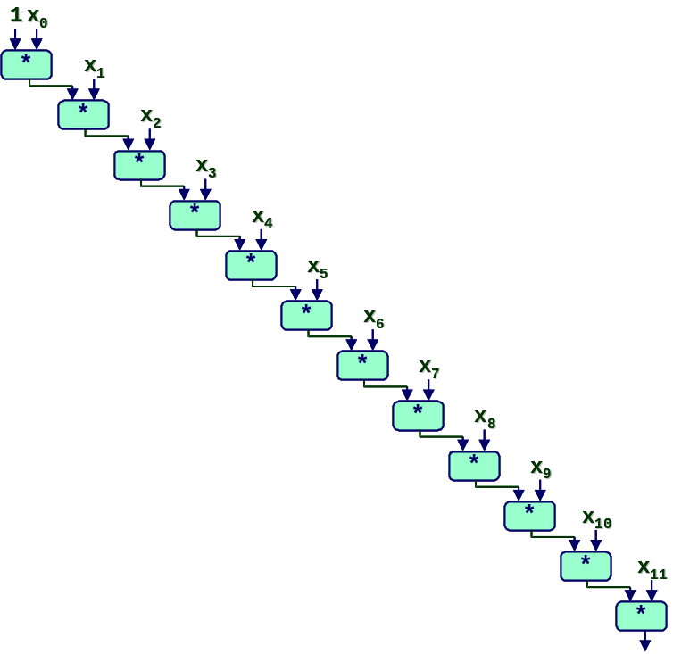
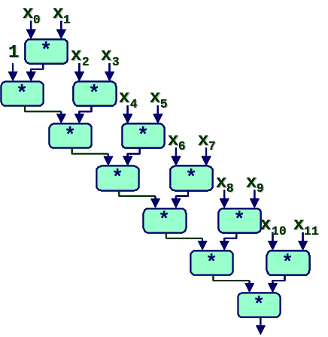
Motivation:Understand Parallelism
/* Combine 2 elements at a time */
for (i = 0; i < limit; i+=2) {
x = (x * data[i]) * data[i+1];
}
  All multiplies performed in sequence
/* Combine 2 elements at a time */
for (i = 0; i < limit; i+=2) {
x = x * (data[i] * data[i+1]);
}
  Multiplies overlap

Slide 5
Modern CPU Design
Instruction Control
Fetch
Control
Address
Retirement
Unit
Instruction
Cache
Register
File
Instruction
Decode
Instrs.
Operations
Register
Updates
Prediction
OK?
Execution
Functional
Units
Integer/
Branch
General
Integer
FP
Add
FP
Mult/Div
Load
Store
Operation Results
Addr.
Addr.
Data
Data
Data
Cache

Slide 6
RISC and Pipelining
1980: Patterson (Berkeley) coins term RISC
RISC Design Simplifies Implementation
  Small number of instruction formats
  Simple instruction processing
RISC Leads Naturally to Pipelined Implementation
  Partition activities into stages
  Each stage simple computation

Slide 7
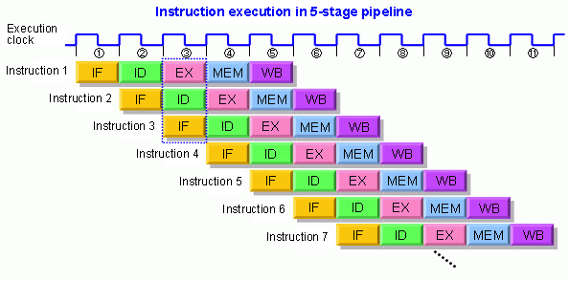
RISC pipeline
Reduce CPI from 5 → 1 (ideally)
Notes:
Pipeline: also reduce cycles. But previous instructions also took multiple cycles to complete.

Slide 8
Pipelines and Branch Prediction
BNEZ R3, L1
Which instr. should we fetch here?
Must wait/stall fetching until branch direction known?
Solutions? Predict branch e.g., BNEZ taken or not taken.
Notes:
branch decision is resolved in ID stage

Slide 9
Pipelines and Branch Prediction
Wait/stall?
Pipeline:
Insts fetched
Branch directions computed
How bad is the problem? (isn’t it just one cycle?)
  Branch instructions: 15% - 25%
  Pipeline deeper: branch not resolved until much later
Misprediction penalty larger!
  Multiple instruction issue (superscalar)
    Flushing & refetching more instructions
  Object-oriented programming
    More indirect branches which are harder to predict by compiler
Notes:
Q: why on deeper pipeline, we do not resolve the branch earlier.
register renaming: internal register number is much larger than external ones, so they will do renaming, which takes time.
Out-of-order scheduling, and other examples…
branch prediction is effective

Slide 10
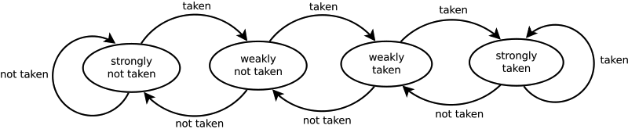
Branch Prediction: solution
Solution: predict branch directions: branch prediction
  Intuition: predict the future based on history
  Local prediction for each branch (only based on your own history)
  Problem?

Slide 11

Branch Prediction: solution
if (a == 2)
a = 0;
if (b == 2)
b = 0;
if (a != b)
.. ..
Only depends on the history
of itself?
Global predictor
  Intuition: predict based on the both the global and local history
  (m, n) prediction (2-D table)
    An m-bit vector storing the global branch history (all executed branches)
    The value of this m-bit vector will index into an n-bit vector – local history
BP is important: 30K bits is the standard size
of prediction tables on Intel P4!

Slide 12
Instruction-Level Parallelism
1
1
1
2
instructions
2
3
4
5
2
3
3
6
4
Execution
Time
4
7
8
application
5
9
5
6
6
7
7
8
8
9
9
single-issue
superscalar

Slide 13
Data dependency: obstacle to perfect pipeline
DIV F0, F2, F4 // F0 = F2/F4
ADD F10, F0, F8 // F10 = F0 + F8
SUB F12, F8, F14 // F12 = F8 – F14
DIV F0,F2,F4
STALL: Waiting for F0 to be written
STALL: Waiting for F0 to be written
ADD F10,F0,F8
SUB F12,F8,F14
Necessary?

Slide 14
Out-of-order execution: solving data-dependency
DIV F0, F2, F4 // F0 = F2/F4
ADD F10, F0, F8 // F10 = F0 + F8
SUB F12, F8, F14 // F12 = F8 – F14
DIV F0,F2,F4
SUB F12,F8,F14
☞
Not wait (as
long as it’s
safe)
STALL: Waiting for F0 to be written
ADD F10,F0,F8

Slide 15
Out-of-Order exe. to mask cache miss delay
IN-ORDER:
OUT-OF-ORDER:
inst1
inst1
inst2
load (misses cache)
inst3
inst2
inst4
inst3
Cache miss latency
load (misses cache)
inst4
inst5 (must wait for load value)
Cache miss latency
inst6
inst5 (must wait for load value)
inst6

Slide 16
Out-of-order execution
In practice, much more complicated
Reservation stations for keeping instructions until operands available and can execute
Register renaming, etc.

Slide 17
Instruction-Level Parallelism
1
1
1
2
1
2
6
instructions
2
3
4
5
3
4
5
2
3
3
6
7
8
4
Execution
Time
4
7
8
9
application
5
9
5
6
6
7
7
8
8
9
9
out-of-order
single-issue
superscalar
super-scalar

Slide 18
The Limits of Instruction-Level Parallelism
1
2
6
1
2
6
Execution
Time
3
4
5
3
4
5
7
8
7
8
9
9
out-of-order
wider OOO
super-scalar
super-scalar
diminishing returns for wider superscalar

Slide 19
Multithreading The “Old Fashioned” Way
1
1
1
2
6
2
2
3
4
5
3
3
Execution
Time
7
8
4
4
9
Application 1
Application 2
1
2
6
5
5
6
6
3
4
5
7
7
7
8
8
8
9
9
9
Fast context
switching

Slide 20
Simultaneous Multithreading (SMT)
(aka Hyperthreading)
1
2
6
1
2
1
3
4
5
2
6
6
Execution
Time
Execution
Time
7
8
3
3
5
9
4
4
5
1
2
6
7
8
7
3
4
5
9
8
7
8
9
9
Fast context
hyperthreading
switching
SMT: 20-30% faster than context switching

Slide 21
A Bit of History for Intel Processors
Year
Processor
Tech.
CPI
1971
4004
no pipeline
n
1985
386
pipeline
close to 1
branch prediction
closer to 1
1993
Pentium
Superscalar
< 1
1995
PentiumPro
Out-of-Order exe.
<< 1
1999
Pentium III
Deep pipeline
shorter cycle
2000
Pentium IV
SMT
< 1?

Slide 22
32-bit to 64-bit Computing
Why 64 bit?
  32b addr space: 4GB; 64b addr space: 18M * 1TB
    Benefits large databases and media processing
  OS’s and counters
    64bit counter will not overflow (if doing ++)
  Math and Cryptography
    Better performance for large/precise value math
Drawbacks:
  Pointers now take 64 bits instead of 32
    Ie., code size increases
unlikely to go to 128bit

Slide 23
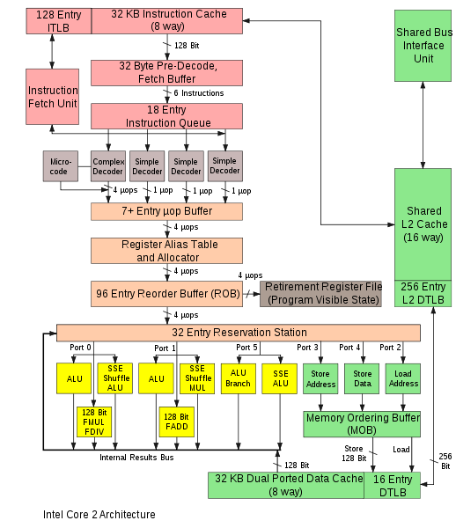
Core2 Architecture (2006): UG machines!

Slide 24
Summary (UG Machines CPU Core Arch. Features)
64-bit instructions
Deeply pipelined
  14 stages
  Branches are predicted
Superscalar
  Can issue multiple instructions at the same time
  Can issue instructions out-of-order

