Slide 1
Machine Independent Optimizations
Topics
    Code motion
    Reduction in strength
    Common subexpression sharing

Slide 2
Great Reality
There’s more to performance than asymptotic complexity
Constant factors matter too!
  Easily see 10:1 performance range depending on how code is written
  Must optimize at multiple levels:
    algorithm, data representations, procedures, and loops
Must understand system to optimize performance
  How programs are compiled and executed
  How to measure program performance and identify bottlenecks
  How to improve performance without destroying code modularity and generality

Slide 3
Machine-Independent Optimizations
  Optimizations you should do regardless of processor / compiler
Code Motion
  Reduce frequency with which computation performed
    If it will always produce same result
    Especially moving code out of loop
for (i = 0; i < n; i++)
for (j = 0; j < n; j++)
a[n*i + j] = b[j];

Slide 4
Reduction in Strength
  Replace costly operation with simpler one
  Shift, add instead of multiply or divide
    16*x --> x << 4
    Utility machine dependent
    Depends on cost of multiply or divide instruction
    On Pentium II or III, integer multiply only requires 4 CPU cycles
  Recognize sequence of products
for (i = 0; i < n; i++)
for (j = 0; j < n; j++)
a[n*i + j] = b[j];

Slide 5
Make Use of Registers
  Reading and writing registers much faster than reading/writing memory
Limitation
  Compiler not always able to determine whether variable can be held in register
  Possibility of Aliasing

Slide 6
Machine-Independent Opts. (Cont.)
Share Common Subexpressions
  Reuse portions of expressions
  Compilers often not very sophisticated in exploiting arithmetic properties
/* Sum neighbors of i,j */
up = val[(i-1)*n + j];
down = val[(i+1)*n + j];
left = val[i*n + j-1];
right = val[i*n + j+1];
sum = up + down + left + right;
3 multiplications: i*n, (i–1)*n, (i+1)*n
1 multiplication:

Slide 7
Assume Vector ADT
length
0
1
2
length–1
data
• • •
Procedures
  vec_ptr new_vec(int len)
    Create vector of specified length
  int get_vec_element(vec_ptr v, int index, int *dest)
    Retrieve vector element, store at *dest
    Return 0 if out of bounds, 1 if successful
  int *get_vec_start(vec_ptr v)
    Return pointer to start of vector data
  Similar to array implementations in Java
    E.g., always do bounds checking

Slide 8
Optimization Example
void combine1(vec_ptr v, int *dest)
{
int i;
*dest = 0;
for (i = 0; i < vec_length(v); i++) {
int val;
get_vec_element(v, i, &val);
*dest += val;
}
}
Procedure
  Compute sum of all elements of integer vector
  Store result at destination location
  Vector data structure and operations defined via abstract data type
Pentium II/III Performance: Clock Cycles / Element
  42.06 (Compiled -g) 31.25 (Compiled -O2)

Slide 9
Optimization Example
void combine1(vec_ptr v, int *dest)
{
int i;
*dest = 0;
for (i = 0; i < vec_length(v); i++) {
int val;
get_vec_element(v, i, &val);
*dest += val;
}
}
Procedure
  Compute sum of all elements of vector
  Store result at destination location

Slide 10
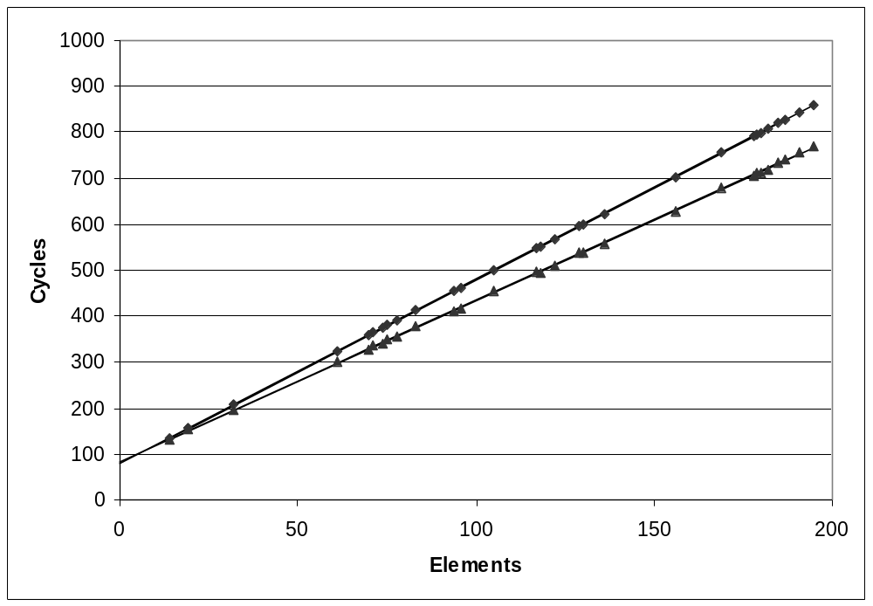
Reminder: Cycles Per Element
  Convenient way to express performance of program that operators on vectors or lists
  Length = n
  T = CPE*n + Overhead
vsum1
Slope = 4.0
vsum2
Slope = 3.5

Slide 11
Optimization Example
void combine1(vec_ptr v, int *dest)
{
int i;
*dest = 0;
for (i = 0; i < vec_length(v); i++) {
int val;
get_vec_element(v, i, &val);
*dest += val;
}
}
Procedure
  Compute sum of all elements of integer vector
  Store result at destination location
  Vector data structure and operations defined via abstract data type
Pentium II/III Performance: Clock Cycles / Element
  42.06 (Compiled -g) 31.25 (Compiled -O2)

Slide 12
void combine2(vec_ptr v, int *dest)
{
int i;
*dest = 0;
for (i = 0; i < vec_length(v); i++) {
int val;
get_vec_element(v, i, &val);
*dest += val;
}
}
Optimization
  CPE: 20.66 (Compiled -O2)
    vec_length requires only constant time, but significant overhead

Slide 13
Code Motion Example #2
Procedure to Convert String to Lower Case
void lower(char *s)
{
int i;
for (i = 0; i < strlen(s); i++)
if (s[i] >= 'A' && s[i] <= 'Z')
s[i] -= ('A' - 'a');
}

Slide 14
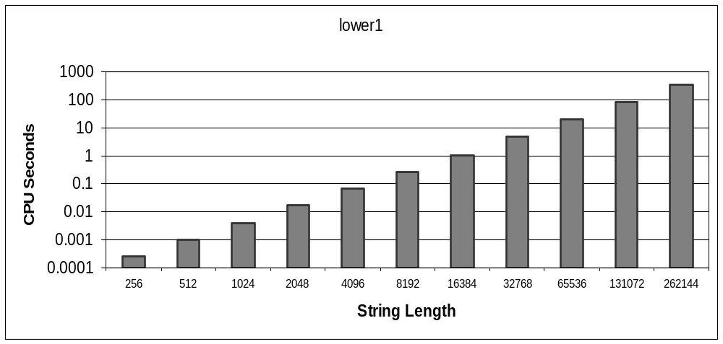
Lower Case Conversion Performance
  Time quadruples when double string length
  Quadratic performance

Slide 15
Improving Performance
void lower(char *s)
{
int i;
int len = strlen(s);
for (i = 0; i < len; i++)
if (s[i] >= 'A' && s[i] <= 'Z')
s[i] -= ('A' - 'a');
}
  Move call to strlen outside of loop
  Since result does not change from one iteration to another
  Form of code motion

Slide 16
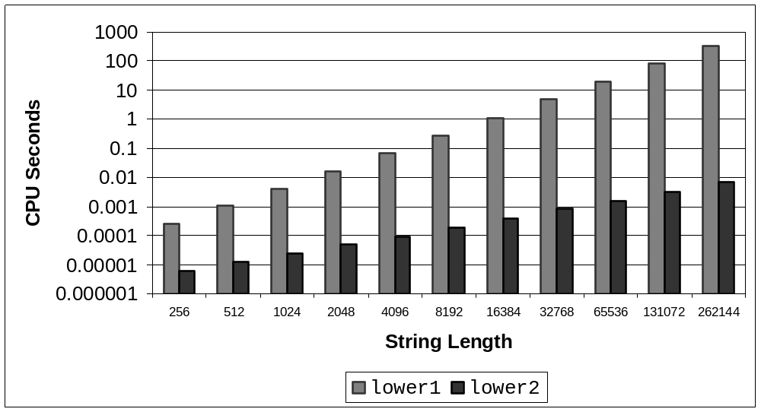
Lower Case Conversion Performance
  Time doubles when double string length
  Linear performance

Slide 17
Optimization Blocker: Procedure Calls
Why couldn’t the compiler move vec_len or strlen out of the inner loop?
  Procedure may have side effects
    Alters global state each time called
  Function may not return same value for given arguments
    Depends on other parts of global state
Why doesn’t compiler look at code for vec_len or strlen?
  Linker may overload with different version
    Unless declared static
  Interprocedural optimization is not used extensively due to cost
Warning:
  Compiler treats procedure call as a black box
  Weak optimizations in and around them

Slide 18
Reduction in Strength
void combine3(vec_ptr v, int *dest)
{
int i;
int length = vec_length(v);
int *data = get_vec_start(v);
}
Optimization
  CPE: 6.00 (Compiled -O2)
    Procedure calls are expensive!
    Bounds checking is expensive

Slide 19
Eliminate Unneeded Memory Refs
void combine4(vec_ptr v, int *dest)
{
int i;
int length = vec_length(v);
int *data = get_vec_start(v);
}
Optimization
  Don’t need to store in destination until end
  Local variable sum held in register
  Avoids 1 memory read, 1 memory write per cycle
  CPE: 2.00 (Compiled -O2)
    Memory references are expensive!

Slide 20
Detecting Unneeded Memory Refs.
Combine3
Combine4
.L18:
movl (%ecx,%edx,4),%eax
addl %eax,(%edi)
incl %edx
cmpl %esi,%edx
jl .L18
.L24:
addl (%eax,%edx,4),%ecx
incl %edx
cmpl %esi,%edx
jl .L24

Slide 21
Optimization Blocker: Memory Aliasing
Aliasing
  Two different memory references specify single location
Example
Observations
  Easy to have happen in C
    Since allowed to do address arithmetic
    Direct access to storage structures
  Get in habit of introducing local variables
    Accumulating within loops
    Your way of telling compiler not to check for aliasing

Slide 22
Machine-Independent Opt. Summary
Code Motion
  Compilers are good at this for simple loop/array structures
  Don’t do well in presence of procedure calls and memory aliasing
Reduction in Strength
  Shift, add instead of multiply or divide
    compilers are (generally) good at this
    Exact trade-offs machine-dependent
  Keep data in registers rather than memory
    compilers are not good at this, since concerned with aliasing
Share Common Subexpressions
  compilers have limited algebraic reasoning capabilities

