Slide 1
Code Optimization II:
Machine Dependent Optimization
Topics
  Machine-Dependent Optimizations
    Unrolling
    Enabling instruction level parallelism

Slide 2
Previous Best Combining Code
void combine4(vec_ptr v, int *dest)
{
int i;
int length = vec_length(v);
int *data = get_vec_start(v);
int sum = 0;
for (i = 0; i < length; i++)
sum += data[i];
*dest = sum;
}
Task
  Compute sum of all elements in vector
  Vector represented by C-style abstract data type
  Achieved CPE of 2.00
    Cycles per element

Slide 4
General Forms of Combining
void abstract_combine4(vec_ptr v, data_t *dest)
{
int i;
int length = vec_length(v);
data_t *data = get_vec_start(v);
data_t t = IDENT;
for (i = 0; i < length; i++)
t = t OP data[i];
*dest = t;
}

Slide 5
Pointer Code
void combine4p(vec_ptr v, int *dest)
{
int length = vec_length(v);
int *data = get_vec_start(v);
int *dend = data+length;
int sum = 0;
while (data < dend) {
sum += *data;
data++;
}
*dest = sum;
}
Optimization
  Use pointers rather than array references
  CPE: 3.00 (Compiled -O2)
    Oops! We’re not making progress here!
  Warning: Some compilers do better job optimizing array code

Slide 6
Pointer vs. Array Code Inner Loops
Array Code
Pointer Code
Performance
  Array Code: 4 instructions in 2 clock cycles
  Pointer Code: Almost same 4 instructions in 3 clock cycles
.L24: # Loop:
addl (%eax,%edx,4),%ecx # sum += data[i]
incl %edx # i++
cmpl %esi,%edx # i:length
jl .L24 # if < goto Loop
.L30: # Loop:
addl (%eax),%ecx # sum += *data
addl $4,%eax # data ++
cmpl %edx,%eax # data:dend
jb .L30 # if < goto Loop

Slide 7
Modern CPU Design
Instruction Control
Fetch
Control
Address
Retirement
Unit
Instruction
Cache
Register
File
Instruction
Decode
Instrs.
Operations
Register
Updates
Prediction
OK?
Execution
Functional
Units
Integer/
Branch
General
Integer
FP
Add
FP
Mult/Div
Load
Store
Operation Results
Addr.
Addr.
Data
Data
Data
Cache

Slide 8
CPU Capabilities of Pentium III
Multiple Instructions Can Execute in Parallel
  1 load
  1 store
  2 integer (one may be branch)
  1 FP Addition
  1 FP Multiplication or Division
Some Instructions Take > 1 Cycle, but Can be Pipelined
  Instruction Latency Cycles/Issue
  Load / Store 3 1
  Integer Multiply 4 1
  Double/Single FP Multiply 5 2
  Double/Single FP Add 3 1

Slide 9
CPU Capabilities of Pentium III
Multiple Instructions Can Execute in Parallel
  1 load
  1 store
  2 integer (one may be branch)
  1 FP Addition
  1 FP Multiplication or Division
Some Instructions Take > 1 Cycle, but Can be Pipelined
  Instruction Latency Cycles/Issue
  Load / Store 3 1
  Integer Multiply 4 1
  Double/Single FP Multiply 5 2
  Double/Single FP Add 3 1
  Integer Divide 36 36
  Double/Single FP Divide 38 38

Slide 10
Visualizing Operations
%edx.0
Operations
  Vertical position denotes time at which executed
    Cannot begin operation until operands available
  Height denotes latency
load
incl
%edx.1
cmpl
cc.1
%ecx.0
jl
t.1
imull
Time
%ecx.1

Slide 11
Visualizing Operations (cont.)
%edx.0
Operations
  Same as before, except that add has latency of 1
load
load
incl
%edx.1
%ecx.i +1
cmpl
cc.1
%ecx.0
jl
Time
t.1
addl
%ecx.1

Slide 12
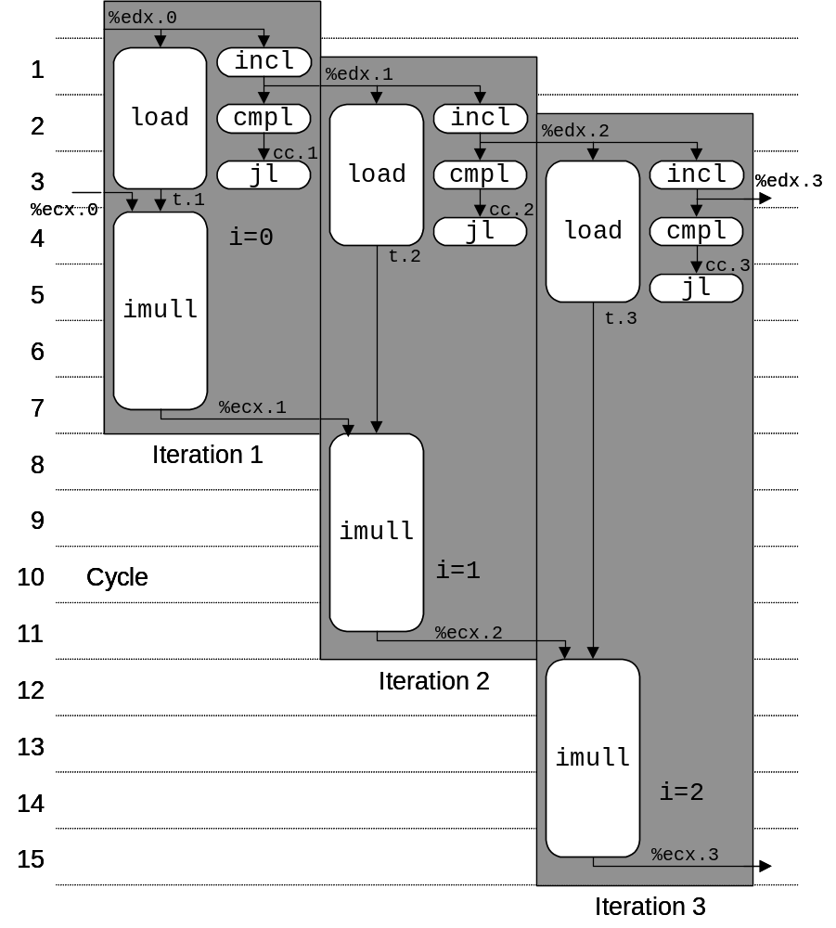
3 Iterations of Combining Product
Unlimited Resource Analysis
  Assume operation can start as soon as operands available
  Operations for multiple iterations overlap in time
Performance
  Limiting factor becomes latency of integer multiplier
  Gives CPE of 4.0

Slide 13
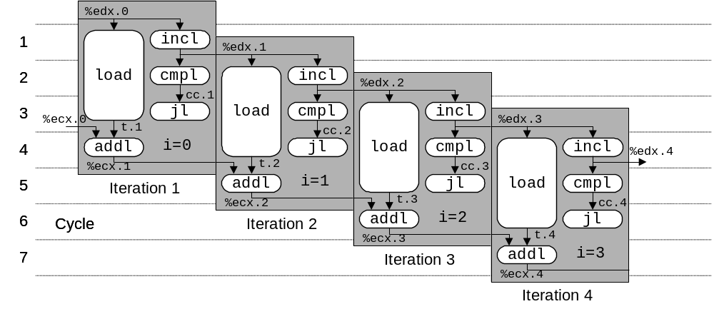
4 Iterations of Combining Sum
4 integer ops
Unlimited Resource Analysis
Performance
  Can begin a new iteration on each clock cycle
  Should give CPE of 1.0
  Would require executing 4 integer operations in parallel

Slide 14
Combining Sum: Resource Constraints
  Only have two integer functional units
  Some operations delayed even though operands available
Performance
  Sustain CPE of 2.0

Slide 15
Loop Unrolling
void combine5(vec_ptr v, int *dest)
{
int length = vec_length(v);
int limit = length-2;
int *data = get_vec_start(v);
int sum = 0; int i;
}
Optimization
  Combine multiple iterations into single loop body
  Amortizes loop overhead across multiple iterations
  Finish extras at end
  Measured CPE = 1.33

Slide 16
Visualizing Unrolled Loop
  Loads can pipeline, since don’t have dependencies
  Only one set of loop control operations
%edx.0
load
addl
%edx.1
load
%ecx.i +1
cmpl
cc.1
load
jl
%ecx.0c
t.1a
addl
%ecx.1a
t.1b
Time
addl
%ecx.1b
t.1c
addl
%ecx.1c

Slide 17
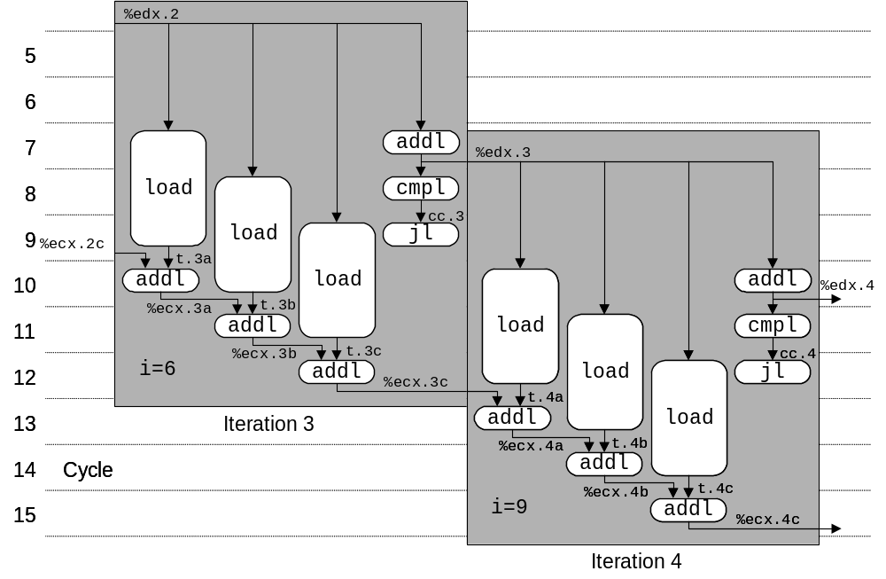
Executing with Loop Unrolling
  Predicted Performance
    Can complete iteration in 3 cycles
    Should give CPE of 1.0
  Measured Performance
    CPE of 1.33
    One iteration every 4 cycles

Slide 18
Effect of Unrolling
Unrolling Degree |  | 1 | 2 | 3 | 4 | 8 | 16
Integer | Sum | 2.00 | 1.50 | 1.33 | 1.50 | 1.25 | 1.06
Integer | Product | 4.00
FP | Sum | 3.00
FP | Product | 5.00
  Only helps integer sum for our examples
    Other cases constrained by functional unit latencies
  Effect is nonlinear with degree of unrolling
    Many subtle effects determine exact scheduling of operations

Slide 19
Serial Computation
1
x₀
*
x₁
Computation
  ((((((((((((1 * x₀) * x₁) * x₂) * x₃) * x₄) * x₅) * x₆) * x₇) * x₈) * x₉) * x₁₀) * x₁₁)
Performance
  N elements, D cycles/operation
  N*D cycles
*
x₂
*
x₃
*
x₄
*
x₅
*
x₆
*
x₇
*
x₈
*
x₉
*
x₁₀
*
x₁₁
*

Slide 20
Parallel Loop Unrolling
void combine6(vec_ptr v, int *dest)
{
int length = vec_length(v);
int limit = length-1;
int *data = get_vec_start(v);
int x0 = 1;
int x1 = 1;
int i;
}
*dest = x0 * x1;
}
Code Version
  Integer product
Optimization
  Accumulate in two different products
    Can be performed simultaneously
  Combine at end
Performance
  CPE = 2.0
  2X performance

Slide 21
Dual Product Computation
Computation
  ((((((1 * x₀) * x₂) * x₄) * x₆) * x₈) * x₁₀) *
  ((((((1 * x₁) * x₃) * x₅) * x₇) * x₉) * x₁₁)
Performance
  N elements, D cycles/operation
  (N/2+1)*D cycles
  ~2X performance improvement

Slide 22
Requirements for Parallel Computation
Mathematical
  Combining operation must be associative & commutative
    OK for integer multiplication
    Not strictly true for floating point
      OK for most applications
Hardware
  Pipelined functional units
  Ability to dynamically extract parallelism from code

Slide 23
Visualizing Parallel Loop
  Two multiplies within loop no longer have data dependency
  Allows them to pipeline
%edx.0
load
addl
%edx.1
load
cmpl
cc.1
%ecx.0
jl
t.1a
%ebx.0
imull
t.1b
imull
Time
%ecx.1
%ebx.1

Slide 24
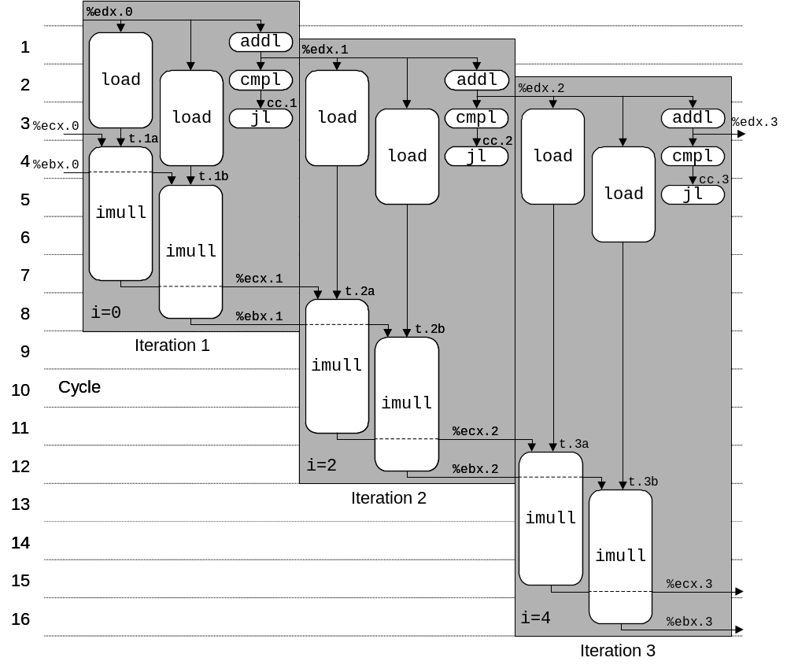
Executing with Parallel Loop
  Predicted Performance
    Can keep 4-cycle multiplier busy performing two simultaneous multiplications
    Gives CPE of 2.0

Slide 25
Parallel Unrolling: Method #2
void combine6aa(vec_ptr v, int *dest)
{
int length = vec_length(v);
int limit = length-1;
int *data = get_vec_start(v);
int x = 1; int i;
}
Code Version
  Integer product
Optimization
  Multiply pairs of elements together
  And then update product
Performance
  CPE = 2.5

Slide 26
Method #2 Computation
Computation
  ((((((1 * (x₀ * x₁)) * (x₂ * x₃)) * (x₄ * x₅)) * (x₆ * x₇)) * (x₈ * x₉)) * (x₁₀ * x₁₁))
Performance
  N elements, D cycles/operation
  Should be (N/2+1)*D cycles
    CPE = 2.0
  Measured CPE worse
Unrolling | CPE (measured) | CPE (theoretical)
2 | 2.50 | 2.00
3 | 1.67 | 1.33
4 | 1.50 | 1.00
6 | 1.78 | 1.00

Slide 27
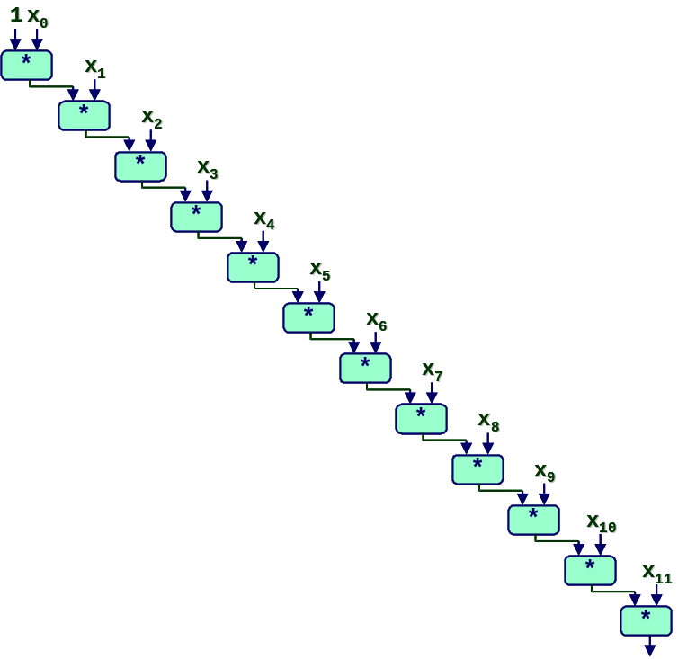
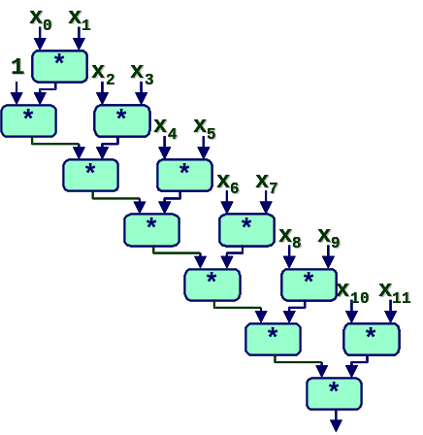
Understanding Parallelism
/* Combine 2 elements at a time */
for (i = 0; i < limit; i+=2) {
x = (x * data[i]) * data[i+1];
}
  CPE = 4.00
  All multiplies performed in sequence
/* Combine 2 elements at a time */
for (i = 0; i < limit; i+=2) {
x = x * (data[i] * data[i+1]);
}
  CPE = 2.50
  Multiplies overlap

Slide 28
Limitations of Parallel Execution
Need Lots of Registers
  To hold sums/products
  Only 6 usable integer registers
    Also needed for pointers, loop conditions
  8 FP registers
  When not enough registers, must spill temporaries onto stack
    Wipes out any performance gains
  Not helped by renaming
    Cannot reference more operands than instruction set allows
    Major drawback of IA32 instruction set

Slide 29
Machine-Dependent Opt. Summary
Pointer Code
  Look carefully at generated code to see whether helpful
Loop Unrolling
  Some compilers do this automatically
  Generally not as clever as what can achieve by hand
Exposing Instruction-Level Parallelism
  Very machine dependent (GCC on IA32/Linux not very good)
Warning:
  Benefits depend heavily on particular machine
  Do only for performance-critical parts of code

