Slide 1
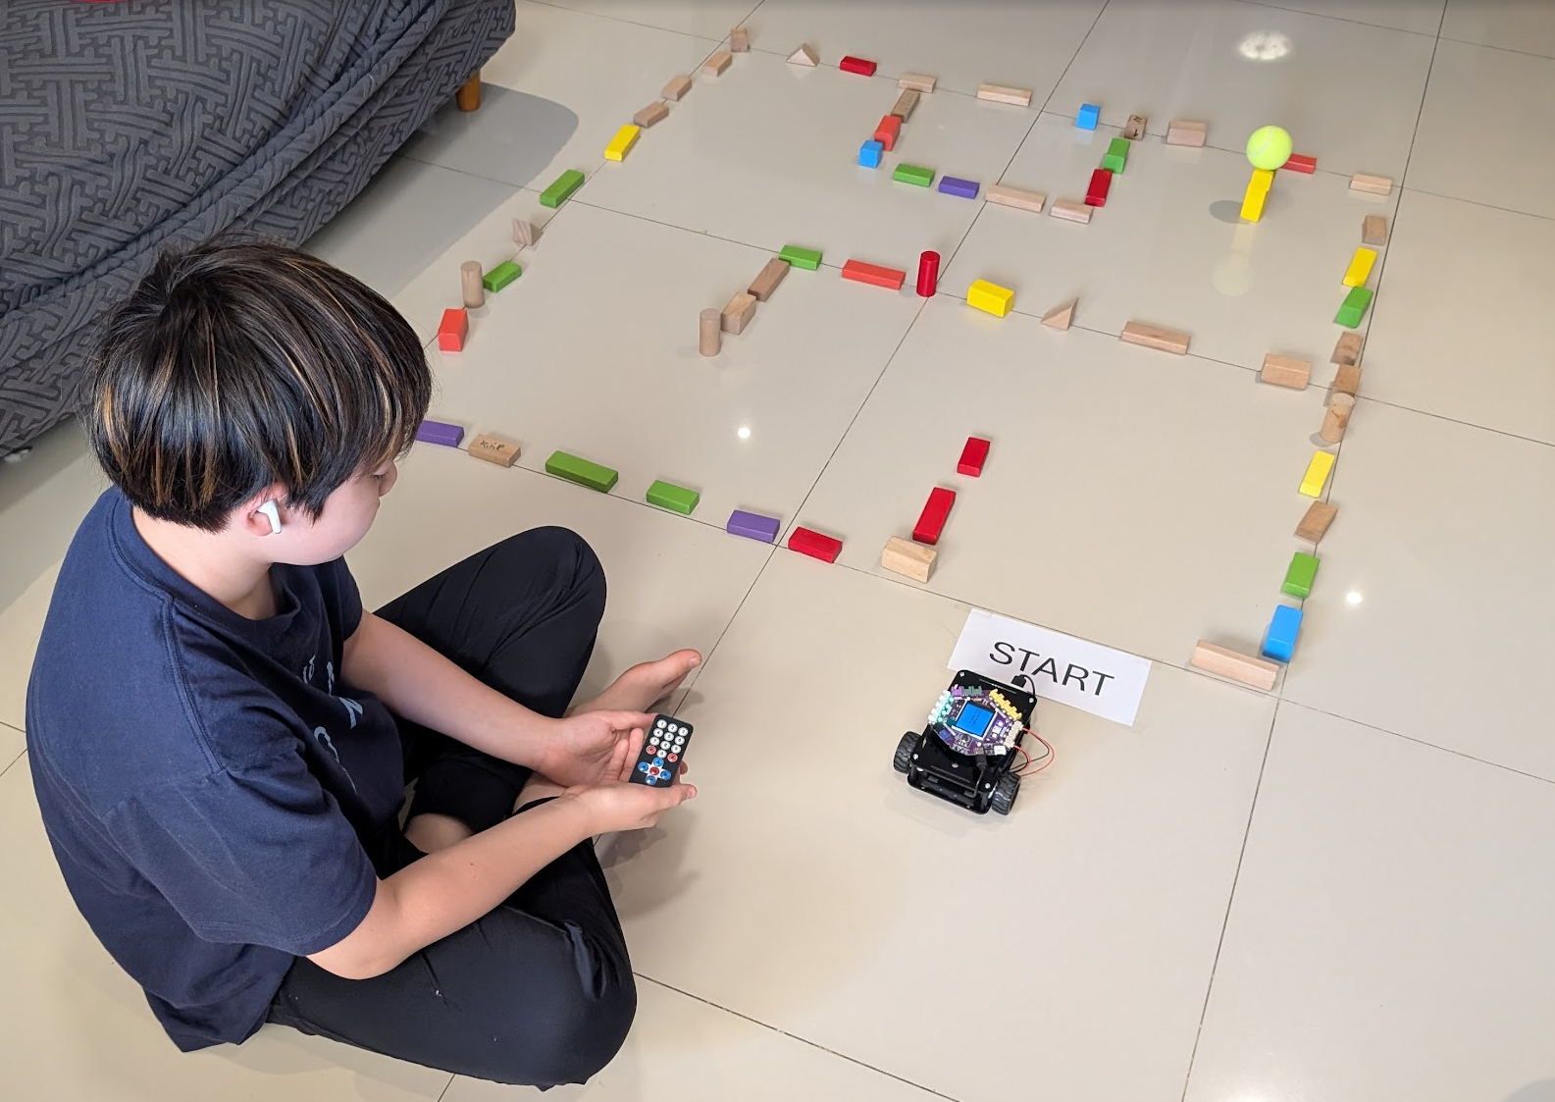
SESSION 1: NAVIGATE THE MAZE — BY HAND
Chapter 1 — What is Coding?
Today: We become robot programmers
▸ Give commands to a robot
▸ Watch it follow our instructions
▸ Can we make it navigate a maze?
Activity 1.1
Time: 60 minutes
Materials: Robot car, IR remote, maze materials, target
No computers needed

Slide 2
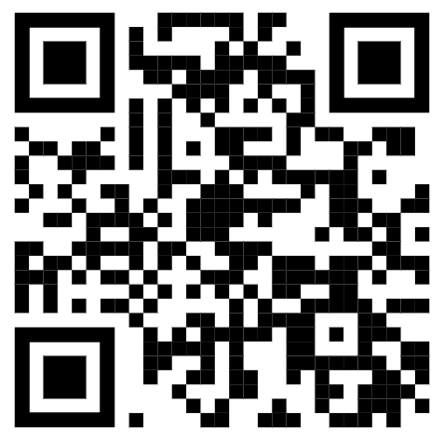
Robot Setup Check
▸ Is the robot configured? (Teacher should have done this)
▸ Does the IR remote work? Test the arrow buttons
▸ If not configured: scan the QR code or go to d.gogoboard.org/robot-setup
Activity 1.1 — Session 1: Navigate the Maze — by Hand
2
Notes:
If robots are not yet configured, allocate 2 min per robot. Connect via USB, open pgc.gogoboard.org, follow the 4 steps, click "Configure Robot".

Slide 3
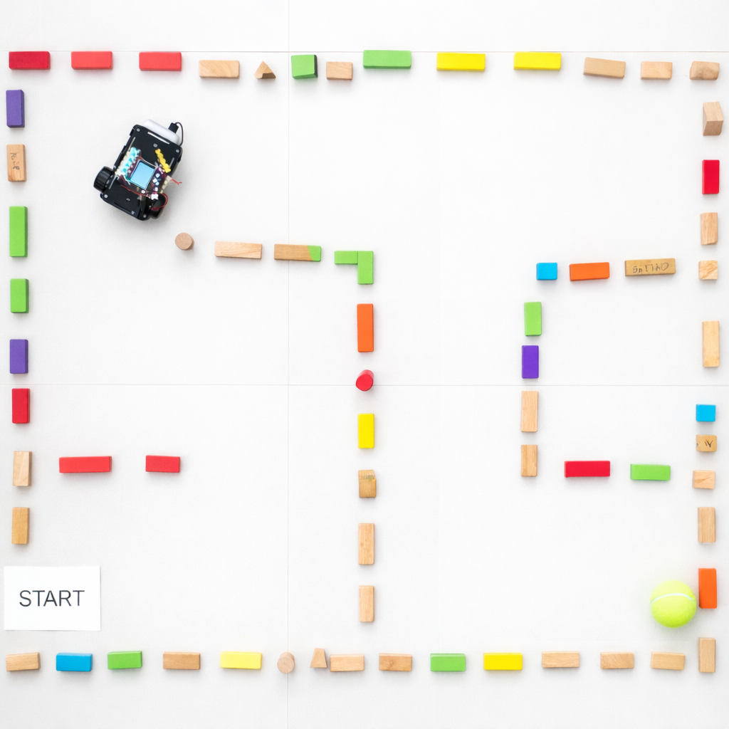
The Challenge
Program the robot to navigate a maze and knock over a target
▸ Build a maze with 2-3 turns
▸ Place a target at the end (something easy to knock over)
▸ Record a program so the robot does it automatically
Activity 1.1 — Session 1: Navigate the Maze — by Hand
3

Slide 4
Build the Maze (10 min)
Use blocks, chairs, books, or boxes as walls
▸ Mark a clear starting position
▸ Place a target at the end
▸ Include at least 2-3 turns
▸ Make sure the target falls easily when touched
Activity 1.1 — Session 1: Navigate the Maze — by Hand
4
Notes:
Have 3-4 mazes set up. If time is short, pre-build mazes and let students adjust them.

Slide 5
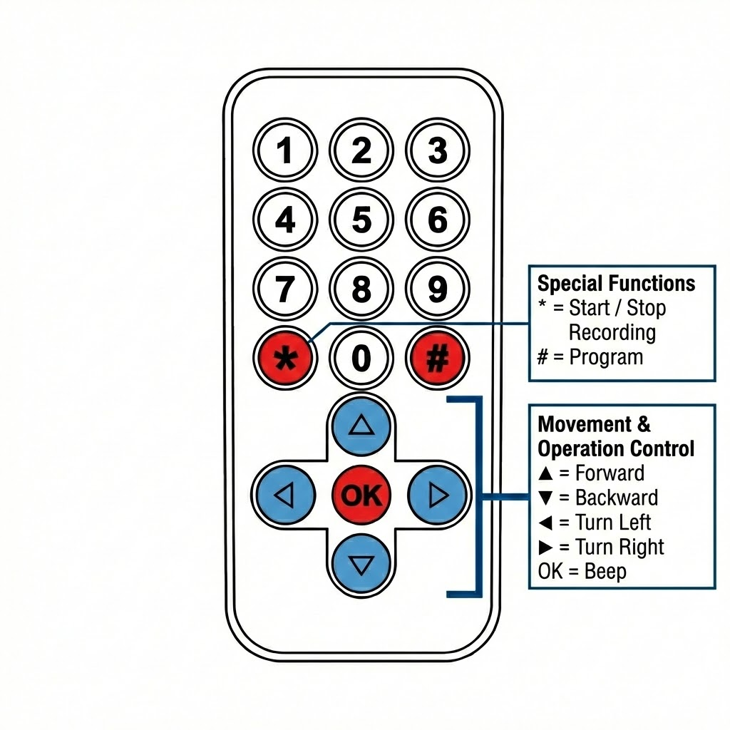
Practice Run (5 min)
Place the car at the starting position
1
Use the arrow buttons on the IR remote to drive through the maze
2
Try to knock over the target
3
Do NOT press * yet — this is practice only!
4
Activity 1.1 — Session 1: Navigate the Maze — by Hand
5
Notes:
Let every student try driving. Make sure remotes work and students understand the buttons.

Slide 6
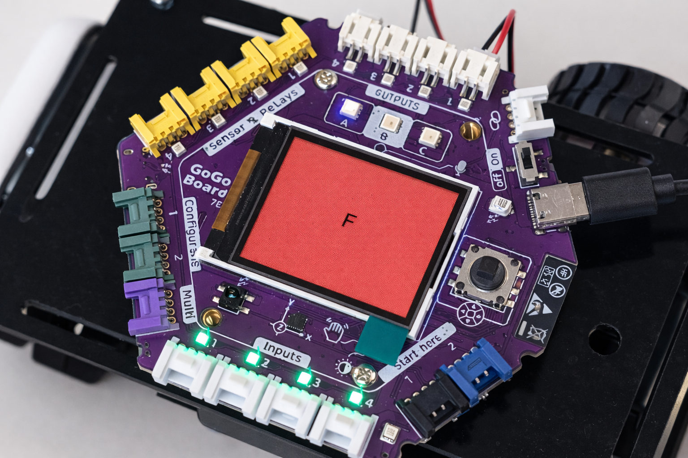
Record the Program (10 min)
Now let's make the robot do it automatically!
Place car at start
1
Press * to start recording
2
Drive through the maze, knock over target
3
Press * again to stop recording
The screen turns red during recording
4
Activity 1.1 — Session 1: Navigate the Maze — by Hand
6

Slide 7
Test the Program (15 min)
Place the car at the EXACT same starting position. Reset the target.
1
Press # to replay the program
2
Try 3 times — record results in your workbook
3
✎ Workbook — Fill in the table in Activity 1.1 — "Test the Program"
Activity 1.1 — Session 1: Navigate the Maze — by Hand
7

Slide 8
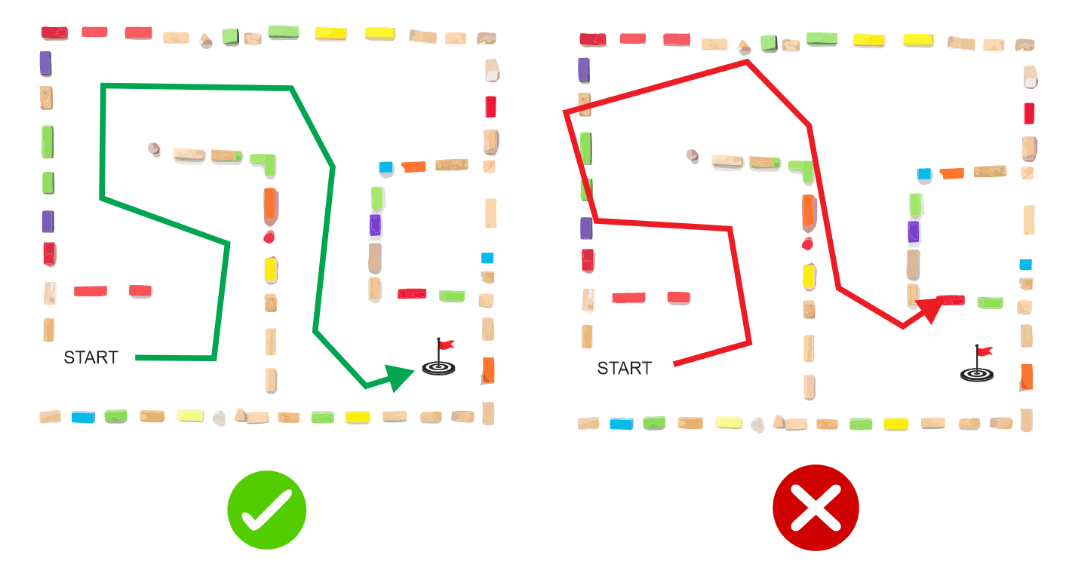
What If We Change the Start?
Experiment:
▸ Place the robot at a slightly different start position — what happens?
▸ Place the robot facing a different direction — what happens?
✎ Workbook — Fill in the experiment table in Activity 1.1
Activity 1.1 — Session 1: Navigate the Maze — by Hand
8

Slide 9
KEY TAKEAWAY
Same program + different starting position = different result
▸ A program is a sequence of commands that runs in order
▸ The program doesn't "see" — it just follows instructions
▸ Starting conditions matter!
Activity 1.1 — Session 1: Navigate the Maze — by Hand
9

Slide 10
Reflection
✎ Workbook — Answer the two reflection questions in Activity 1.1
1. Why does starting position matter?
2. What is the difference between driving manually and using a program?
Activity 1.1 — Session 1: Navigate the Maze — by Hand
10

Slide 11
Challenge — Competition!
Which group can reach the target the fastest?
✎ Workbook — Write down your group's time in Activity 1.1 — "Challenge: Competition"
▸ Time each group's program
▸ Record your time in the workbook
Activity 1.1 — Session 1: Navigate the Maze — by Hand
11

