Slide 1
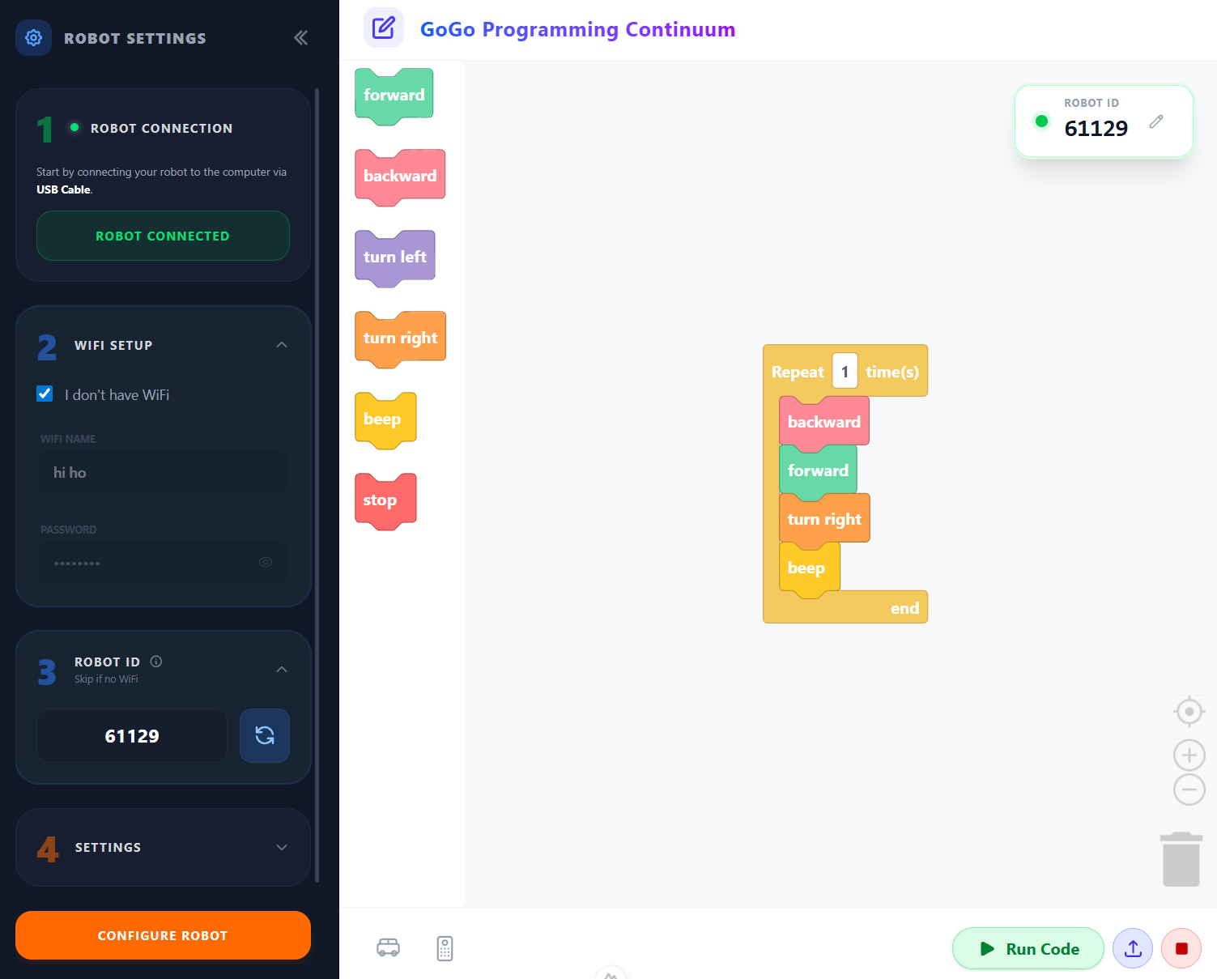
SESSION 2: NAVIGATE THE MAZE — WITH CODE
Today's Goal
View the maze program as blocks and simplify it
▸ See what the program looks like as code
▸ Learn to combine repeated blocks
Activity 1.2
Time: 45 minutes
Materials: Computer, robot, maze from Session 1
Webapp: pgc.gogoboard.org

Slide 2
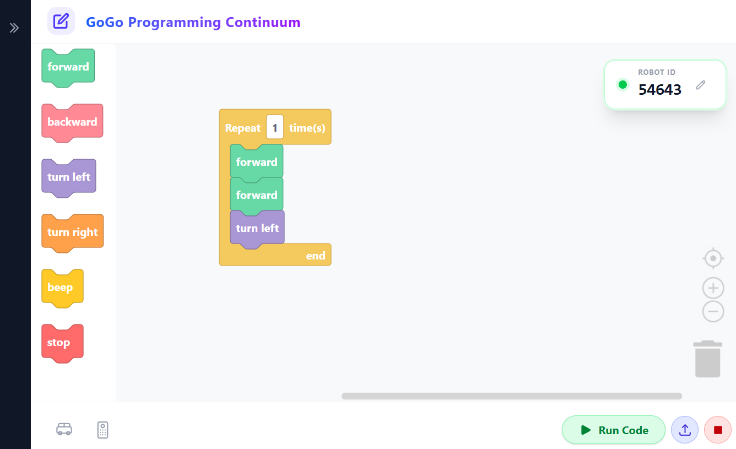
Connect to the Webapp (15 min)
Open pgc.gogoboard.org in the browser
1
Check that the Robot ID on the upper right matches the ID on the robot's screen
2
Place robot at Start, press *, navigate the maze, press * to stop
3
The program appears as blocks automatically
4
Activity 1.2 — Session 2: Navigate the Maze — with Code
2
Notes:
Demo this on the projector first. If blocks don't appear, click "Upload". Make sure WiFi is working.

Slide 3
Reading the Blocks
Look at the blocks that appeared
▸ Which blocks are "forward"?
▸ Which blocks are "turn"?
▸ Can you read what the program will do just by looking at the blocks?
Activity 1.2 — Session 2: Navigate the Maze — with Code
3
Notes:
Walk around and check that each group can identify block types.

Slide 4
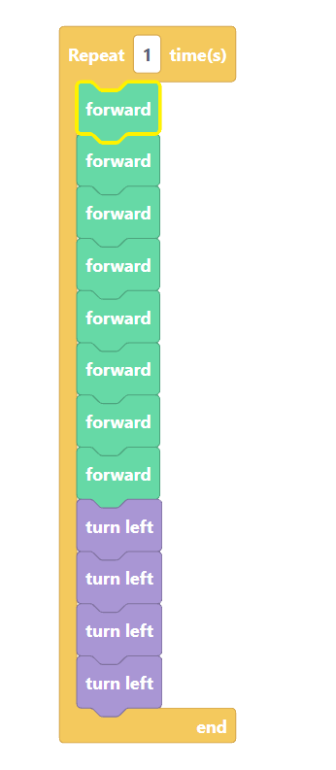
Too Many Blocks!
Count the blocks in your program
▸ Many repeated blocks make the program hard to read
▸ What if we could simplify?
✎ Workbook — Answer the questions in "Too Many Blocks" — how many blocks? Which blocks repeat?
Activity 1.2 — Session 2: Navigate the Maze — with Code
4

Slide 5
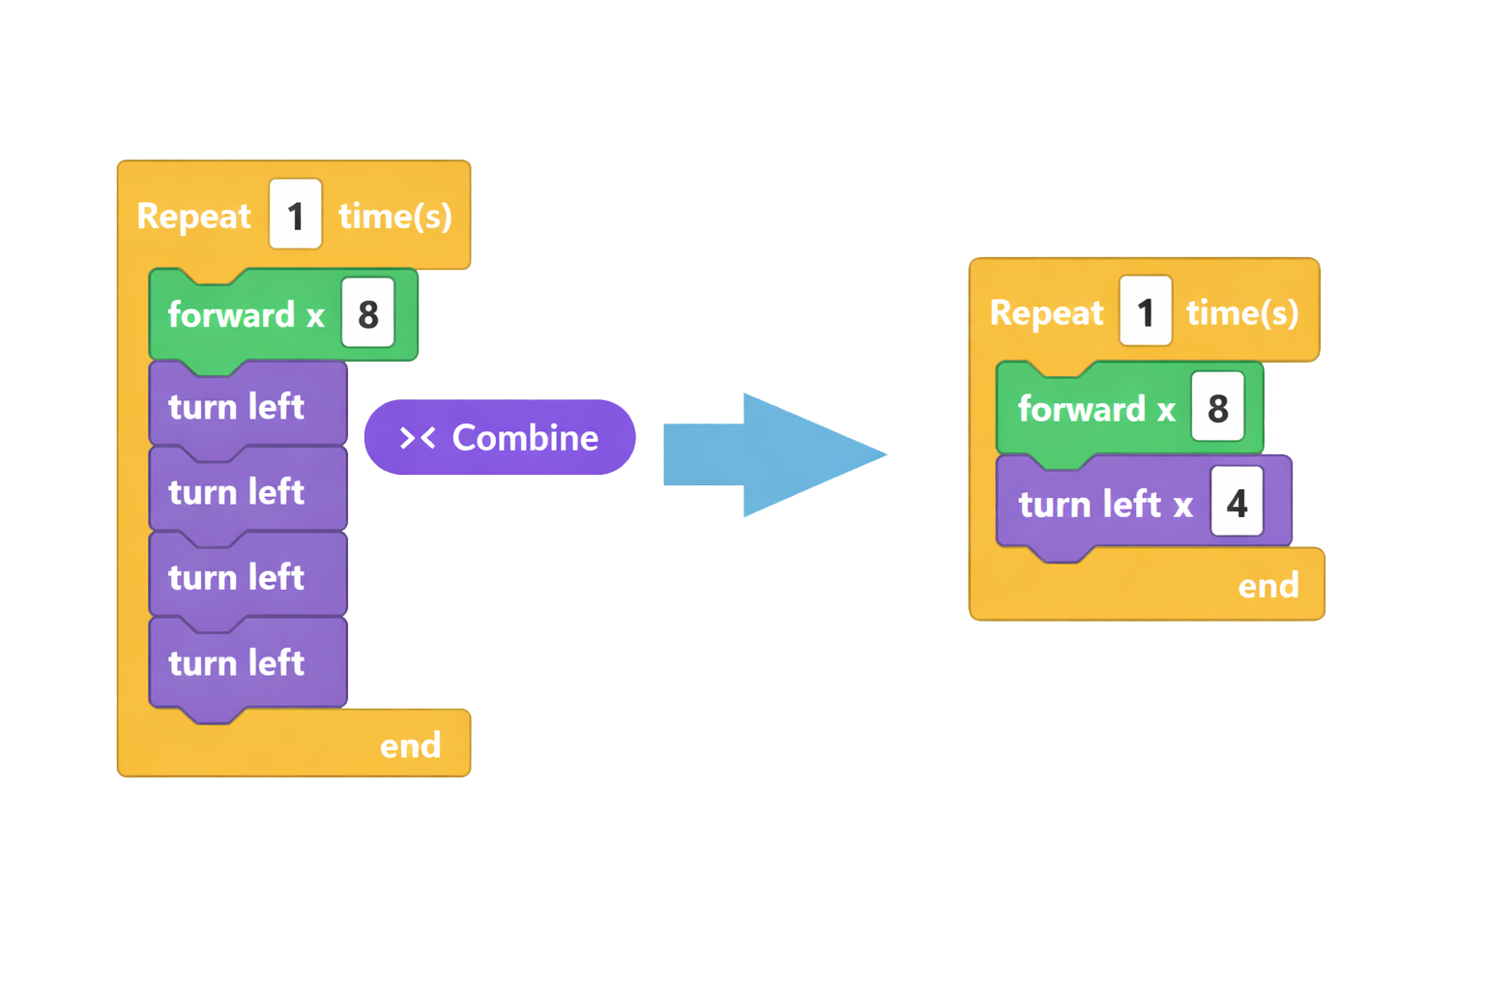
Combine Repeated Blocks (15 min)
Click on repeated blocks — a popup menu appears
1
Click Combine
2
Repeat for all groups of repeated blocks
3
Click Run Code to test — does it still work?
4
✎ Workbook — Fill in the before/after table in "Combine Repeated Blocks"
Activity 1.2 — Session 2: Navigate the Maze — with Code
5

Slide 6
WHY COMBINE?
forward forward forward forward forward → forward(5)
▸ Easier to read
▸ Easier to change
▸ Same behavior
Activity 1.2 — Session 2: Navigate the Maze — with Code
6

Slide 7
Webapp Buttons Reference
Button / Shortcut | Function
Upload | Fetch program from robot
Run Code | Send program to robot and run
Stop | Stop the robot
Ctrl-Z | Undo last change
Activity 1.2 — Session 2: Navigate the Maze — with Code
7

Slide 8
Reflection
✎ Workbook — Answer the two reflection questions in Activity 1.2
1. Why is forward(5) better than 5 separate forward blocks?
2. If the program needs to change, which version is easier to edit?
Activity 1.2 — Session 2: Navigate the Maze — with Code
8

