Slide 1
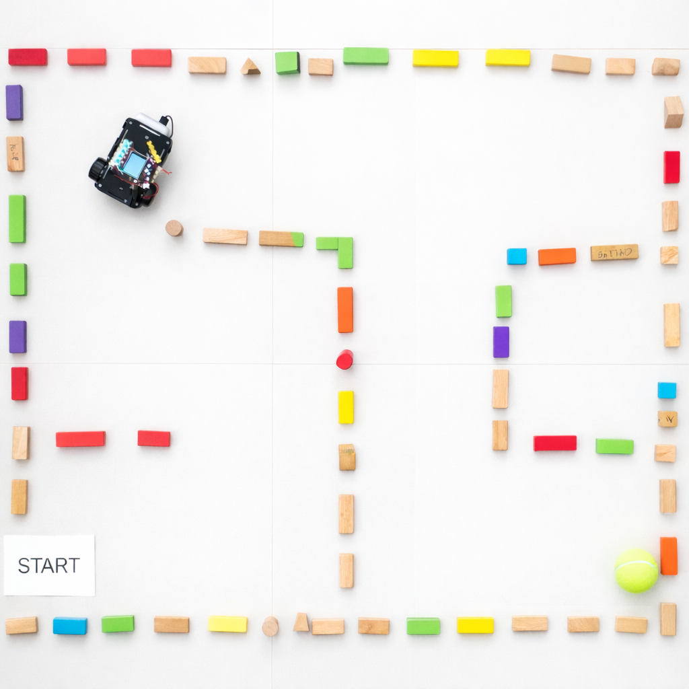
SESSION 3: FIX THE CODE WHEN THE MAZE CHANGES
Today's Goal
The maze changed — can we fix the program without recording again?
▸ Learn to edit code blocks directly
▸ Practice the debugging cycle
Activity 1.3
Time: 45 minutes
Materials: Computer, robot, maze from Session 1

Slide 2
Change the Maze (5 min)
Try changing the maze
▸ Move a wall
▸ Add an obstacle
▸ Move the target
▸ Change only ONE spot — don't change too much at once
✎ Workbook — Write down what you changed in Activity 1.3
Activity 1.3 — Session 3: Fix the Code When the Maze Changes
2

Slide 3
Test the Old Program
Run the old program. What happens?
▸ The old program doesn't work anymore
▸ We need to fix (debug) the program
✎ Workbook — Write the result in Activity 1.3
Activity 1.3 — Session 3: Fix the Code When the Maze Changes
3

Slide 4
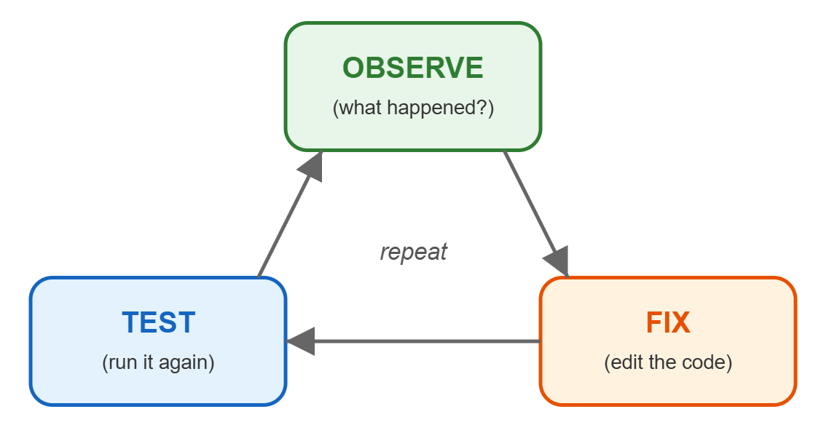
The Debugging Cycle
Observe → Edit → Test — repeat until it works
▸ Run the program
▸ Observe what went wrong
▸ Edit the code
▸ Test again
Activity 1.3 — Session 3: Fix the Code When the Maze Changes
4
Notes:
Write this cycle on the board. Students will refer to it throughout the session.

Slide 5
How to Edit Blocks
Important: change only ONE thing at a time
Action | How
Delete a block | Drag to trash
Add a block | Drag from toolbox
Move a block | Click and drag
Change a number | Click on the number, type new value
Activity 1.3 — Session 3: Fix the Code When the Maze Changes
5

Slide 6
Debug Time! (30 min)
Run the program — observe where it goes wrong
1
Edit ONE thing in the code
2
Test again
3
Repeat until the robot reaches the target
4
✎ Workbook — Track your debug cycles in the table in Activity 1.3
Activity 1.3 — Session 3: Fix the Code When the Maze Changes
6
Notes:
Encourage students to use Ctrl-Z if they change too much. Remind them: ONE change at a time. Walk around and ask "What did you observe? What will you change?"

Slide 7
Reflection
✎ Workbook — Answer the reflection questions in Activity 1.3
1. What was the hardest part of the debugging process? Why?
2. How many cycles did it take to fix the program?
Activity 1.3 — Session 3: Fix the Code When the Maze Changes
7
Notes:
Have students share their debugging experience. Normalize that debugging is what professional programmers do every day.

