Slide 1
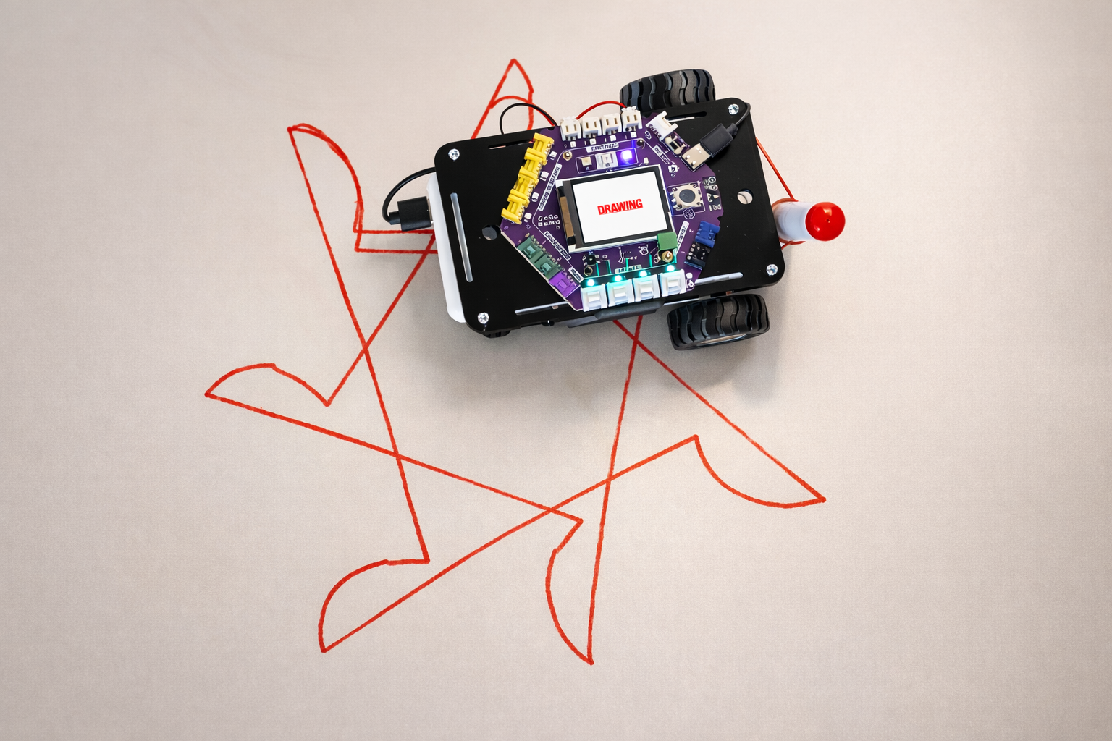
SESSION 4: DRAW PATTERNS WITH CODE
Today's Goal
Use loops to make the robot draw patterns
▸ Attach a pen to the robot
▸ Use the Repeat block to create patterns
▸ Design your own pattern
Activity 1.4
Time: 45 minutes
Materials: Robot, computer, pen, rubber band, paper

Slide 2
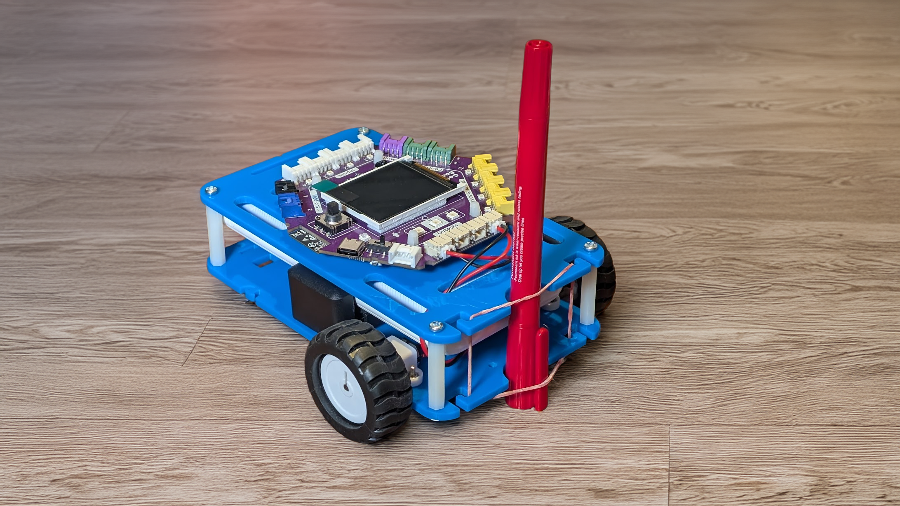
Attach a Pen (5 min)
▸ Find a marker or whiteboard pen
▸ Use a rubber band to attach it to the robot
▸ Make sure the pen tip touches the floor
▸ Place paper on the floor (or use a whiteboard pen on a light-colored floor)
Activity 1.4 — Session 4: Draw Patterns with Code
2

Slide 3
The Repeat Block
Until now, Repeat = 1 — the program runs once. Now we change it
▸ The Repeat block runs the entire program multiple times
▸ Try setting it to 4, 6, 8, or other numbers
Activity 1.4 — Session 4: Draw Patterns with Code
3

Slide 4
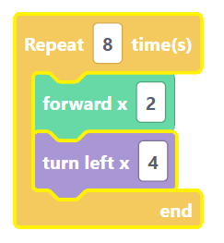
Demo — Forward + Turn + Repeat
What shape will the robot draw?
Delete any old blocks
1
Add blocks: forward (~30 cm) + turn (~90 degrees)
2
Set Repeat = 4
3
Press Run Code
4
Activity 1.4 — Session 4: Draw Patterns with Code
4

Slide 5
Try Different Repeat Numbers (10 min)
Repeat Number | What Pattern?
4 | ?
6 | ?
8 | ?
✎ Workbook — Fill in the table in Activity 1.4
Activity 1.4 — Session 4: Draw Patterns with Code
5

Slide 6
Design Your Own Pattern (20 min)
Choose a base movement (2-4 blocks)
1
Experiment with different repeat numbers
2
Pick your favorite
3
✎ Workbook — Record your base movement, repeat count, and what it looks like in Activity 1.4
Activity 1.4 — Session 4: Draw Patterns with Code
6

Slide 7
Share with the Class (5 min)
Show your pattern
▸ What is the base movement?
▸ What repeat count worked best?
▸ Why does it look the way it does?
✎ Workbook — Write down which group's pattern you liked most and why
Activity 1.4 — Session 4: Draw Patterns with Code
7

Slide 8
Reflection
✎ Workbook — Answer the reflection questions in Activity 1.4
1. How does changing the repeat number change the pattern?
2. Why is repetition useful in programming?
Activity 1.4 — Session 4: Draw Patterns with Code
8

