Slide 1
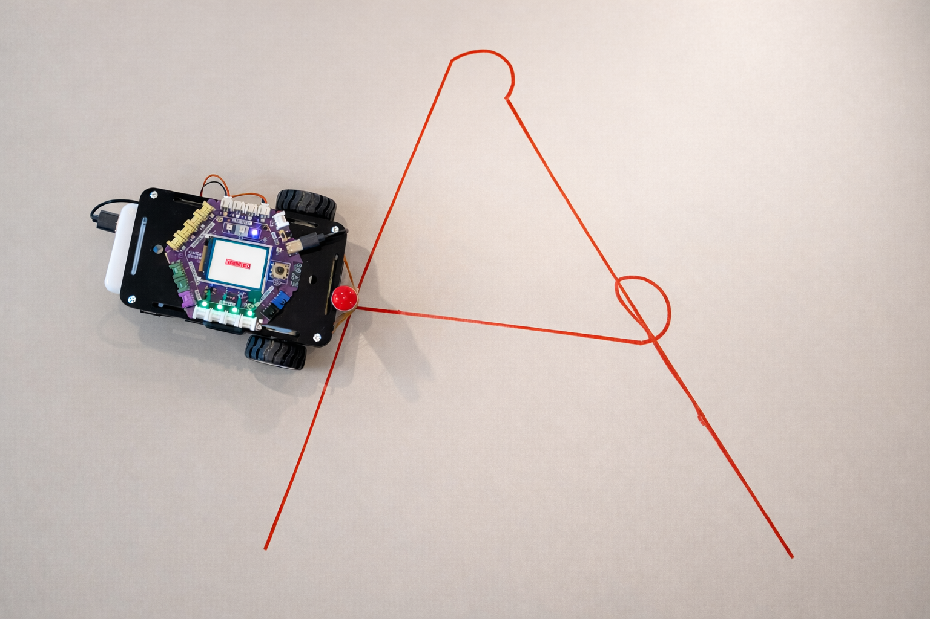
SESSION 5: ASSESSMENT — DRAW A LETTER
The Challenge
Program the robot to draw a letter from your initials
Assessment
Time: 30-45 minutes
Materials: Robot, computer, pen, paper

Slide 2
Rules
▸ Use straight lines only (no curves needed)
▸ Use the fewest blocks possible — combine all repeated commands
▸ The letter must be recognizable
Assessment — Session 5: Assessment — Draw a Letter
2

Slide 3
Checklist
Before presenting, make sure you can check all of these
☐ Plan the movements for the letter
☐ Create and test the program
☐ Combine repeated blocks (no duplicates)
☐ Explain the program to someone
▸ Suggested letters: L, T, E, F, H, A
Assessment — Session 5: Assessment — Draw a Letter
3
Notes:
Easier letters: L, T, I. Harder letters: E, F, H, A. Let students choose based on their confidence.

Slide 4
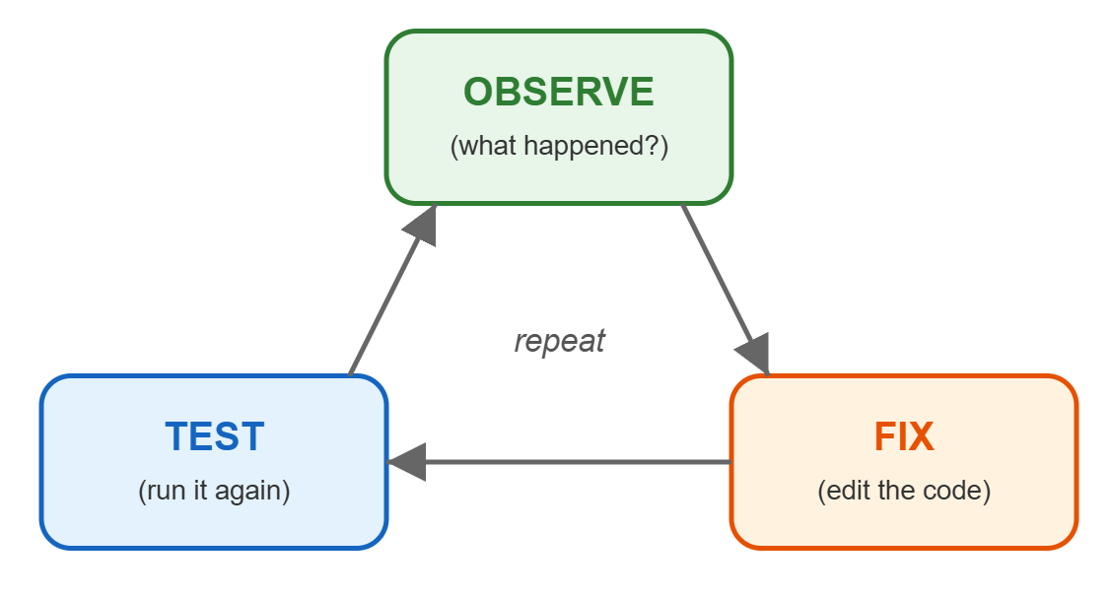
Work Time (20-25 min)
Plan, code, test, debug
▸ Remember the debugging cycle: Observe → Edit → Test
▸ Change one thing at a time
▸ Test after every change
Assessment — Session 5: Assessment — Draw a Letter
4
Notes:
Walk around and observe debugging strategies. Note students who are systematic vs. random. This informs the rubric scoring.

Slide 5
Presentations (5-10 min)
Show the class
Run your program — draw the letter
1
Explain: What blocks did you use? How many?
2
What was the hardest part?
3
Assessment — Session 5: Assessment — Draw a Letter
5

Slide 6
Chapter Reflection
Write your answers on the task sheet
1. What was the most challenging part of this chapter?
2. What was surprising about programming?
Assessment — Session 5: Assessment — Draw a Letter
6

Slide 7
Chapter 1 Summary — What We Learned
1. Programs are sequences — Commands run in order
2. Code can be viewed and edited — Visual blocks we can read and change
3. Debugging is normal — Observe, Edit, Test — repeat until correct
4. Combining blocks makes code efficient — forward(5) instead of 5 blocks
5. Programming is creative — Many solutions exist
Assessment — Session 5: Assessment — Draw a Letter
7

Slide 8
Skills Checklist
Can you do all of these?
☐ Record a program using * and replay using #
☐ Connect robot to the webapp and view programs as blocks
☐ Combine repeated blocks into one
☐ Edit code blocks when conditions change (debugging cycle)
☐ Use the repeat number to create patterns
Assessment — Session 5: Assessment — Draw a Letter
8

