Slide 1
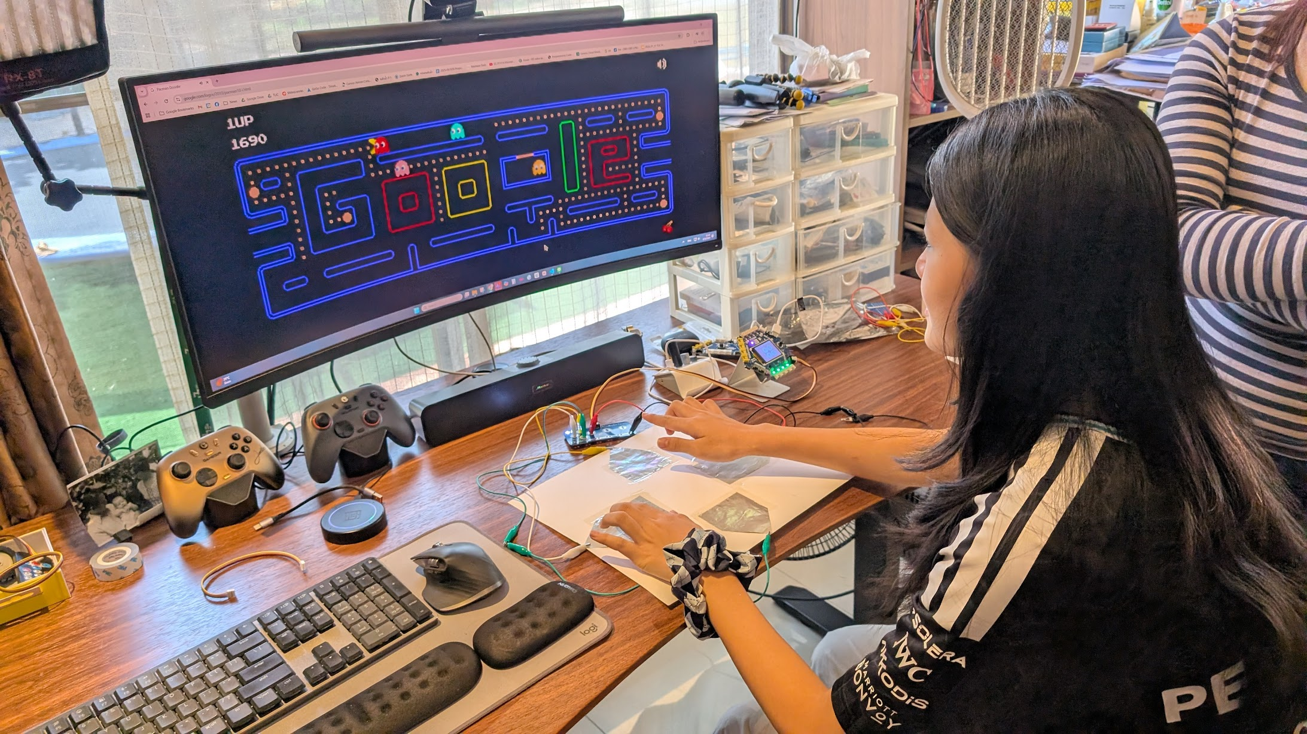
SESSION 1: EXPLORING SENSORS AND ACTUATORS
Chapter 2 — Sensors and Conditions
This chapter: play real games with sensors we build ourselves
▸ Sensors detect the real world
▸ Actuators create actions
▸ Today: explore both — no code needed
Activity 2.1
Time: 35 minutes
Materials: GoGo Board, button sensor, brightness sensor, LED, DC motor
No computers needed

Slide 2
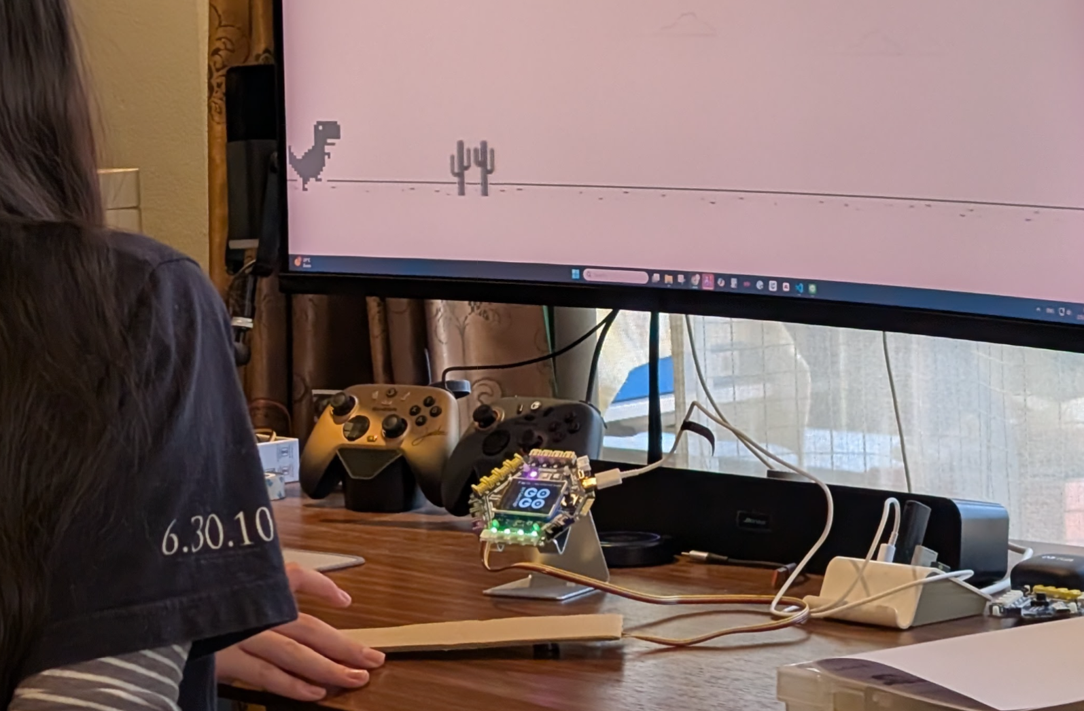
Watch This
Tap the cardboard — the dinosaur jumps
▸ A sensor is playing a real game
▸ This is what we will build in this chapter
Activity 2.1 — Session 1: Exploring Sensors and Actuators
2
Notes:
Demo the finished vibration-sensor controller for 30 seconds. No explanation needed — just let students see what they are working toward.

Slide 3
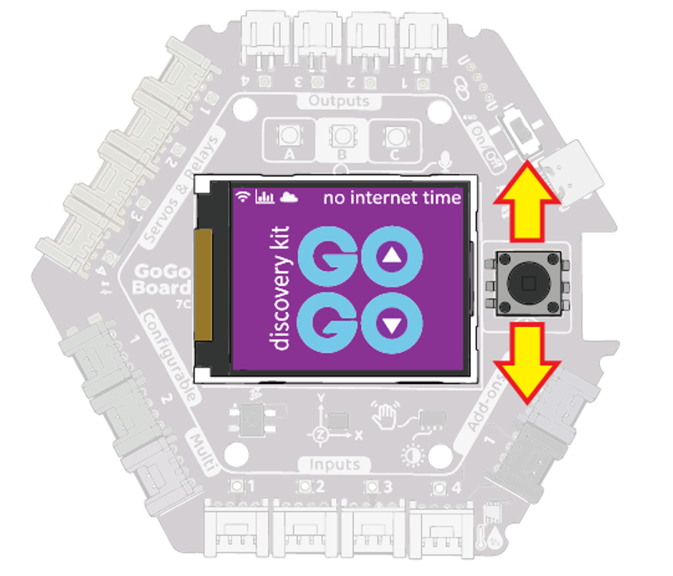
Navigating the LCD Screen (5 min)
Press up or down on the joystick to switch screens
1
Press left or right to browse items within a screen
2
Press the joystick button (straight down) to select
3
After the last screen, it loops back to the first
4
Activity 2.1 — Session 1: Exploring Sensors and Actuators
3
Notes:
Walk through the joystick navigation once as a class before students try on their own — this is the most common stumbling point.

Slide 4
The Key Screens
Screen | What It Shows
Input | Bar graphs for the 4 input ports (external sensors)
Integrated Sensors | Built-in sensors: accelerometer, lux, temperature, humidity
Outputs | Controls for the 4 output ports (motors, LEDs)
Activity 2.1 — Session 1: Exploring Sensors and Actuators
4

Slide 5
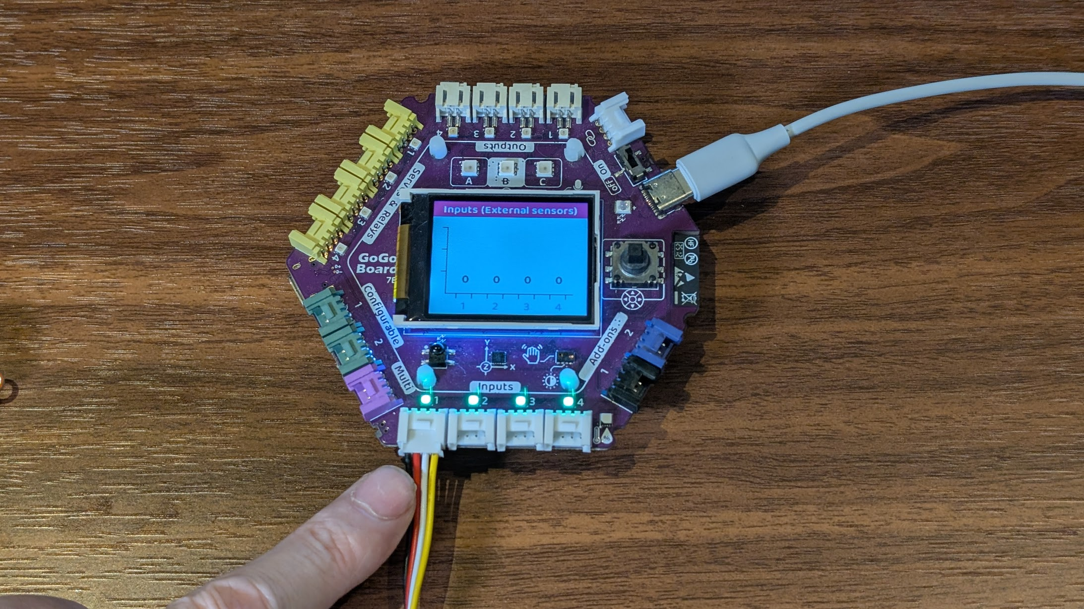
Exploring External Sensors (10 min)
Plug a button sensor into an input port
1
Navigate to the "Input" screen on the LCD
2
Press the button and watch the bar graph change
3
Now try the brightness sensor — cover it with a hand, then shine a light
4
✎ Workbook — Record the sensor values in Activity 2.1 — before/after pressing, bright/covered
Activity 2.1 — Session 1: Exploring Sensors and Actuators
5

Slide 6
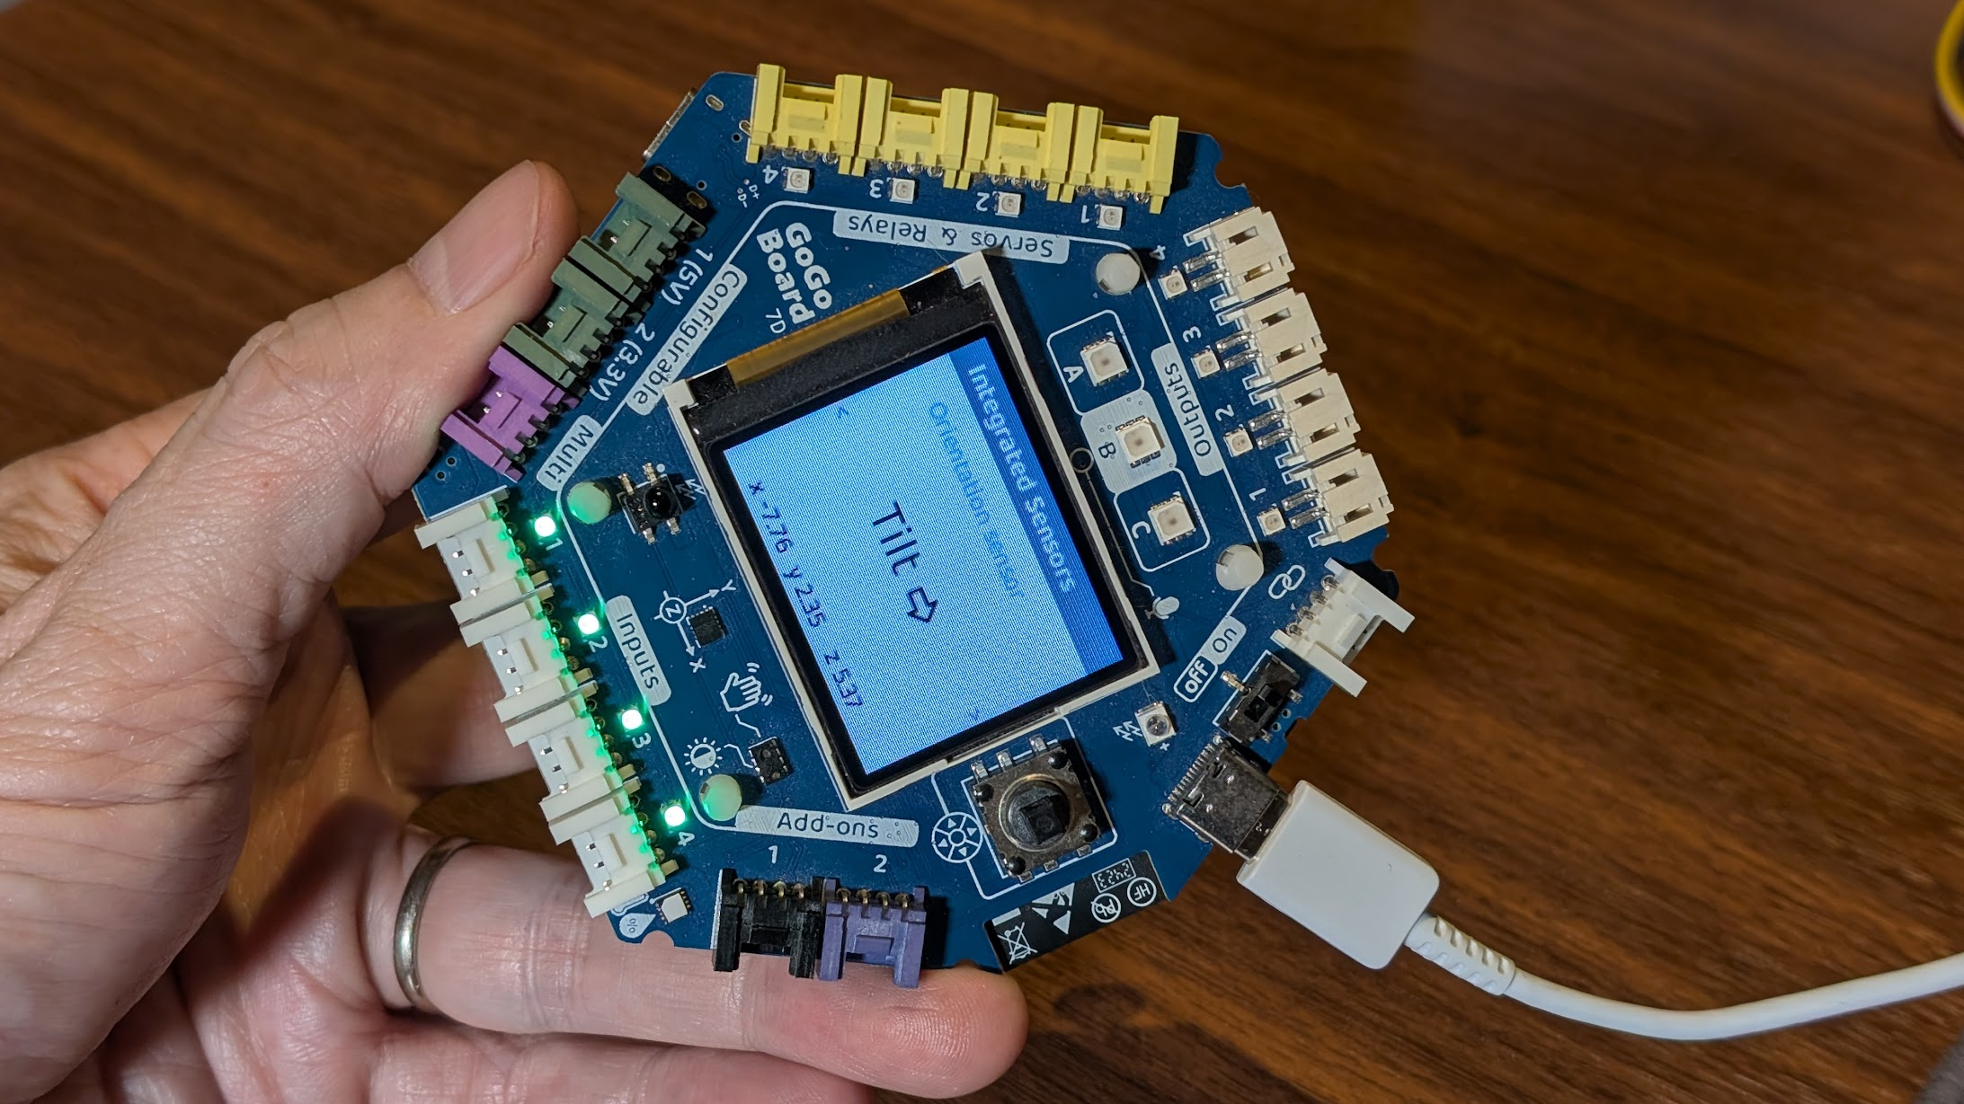
Exploring Built-in Sensors (5 min)
Some sensors are built right into the board
▸ Navigate to the "Integrated Sensors" screen
▸ Accelerometer — tilt the board left and right
▸ Lux sensor — cover the board, then shine a light
▸ Temperature — press a thumb on the sensor
✎ Workbook — Fill in the built-in sensors table in Activity 2.1
Activity 2.1 — Session 1: Exploring Sensors and Actuators
6

Slide 7
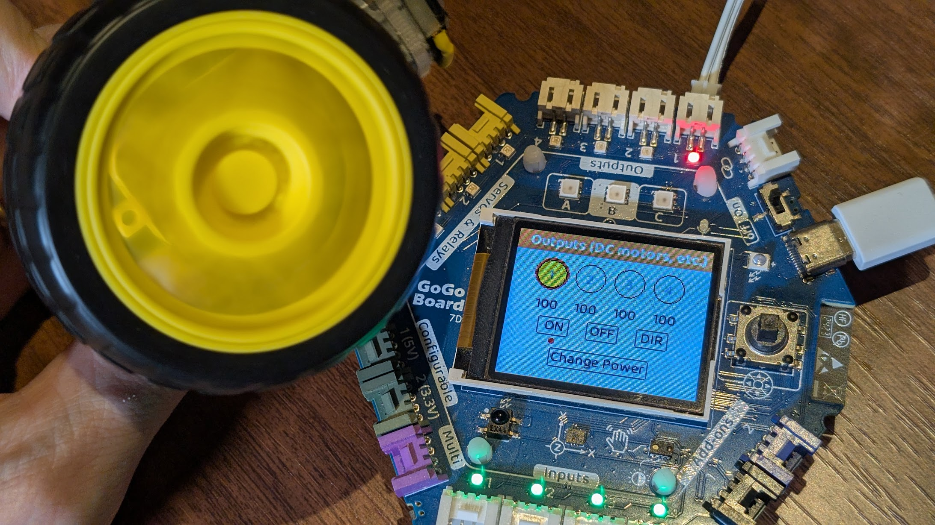
Exploring Actuators (10 min)
Connect a DC motor to an output port
1
Navigate to the "Outputs" screen
2
Move the selector to the motor's port, then select "ON" and "OFF"
3
Try "DIR" (direction) and "Change Power" (speed)
4
Now connect an LED to another output port
5
Activity 2.1 — Session 1: Exploring Sensors and Actuators
7
Notes:
Actuators are the opposite of sensors — instead of reading the world, they act on it.

Slide 8
KEY TAKEAWAY
Sensors turn the real world into numbers. Actuators turn commands into actions.
▸ The button jumps to 1023 when pressed — did you expect that?
▸ Sensors don't always behave the way we expect
▸ Observe first, then build
Activity 2.1 — Session 1: Exploring Sensors and Actuators
8

Slide 9
Reflection
✎ Workbook — Answer the two reflection questions in Activity 2.1
1. One sensor and one actuator from everyday life?
2. What did the bar graph show when a sensor value changed?
Activity 2.1 — Session 1: Exploring Sensors and Actuators
9

