Slide 1
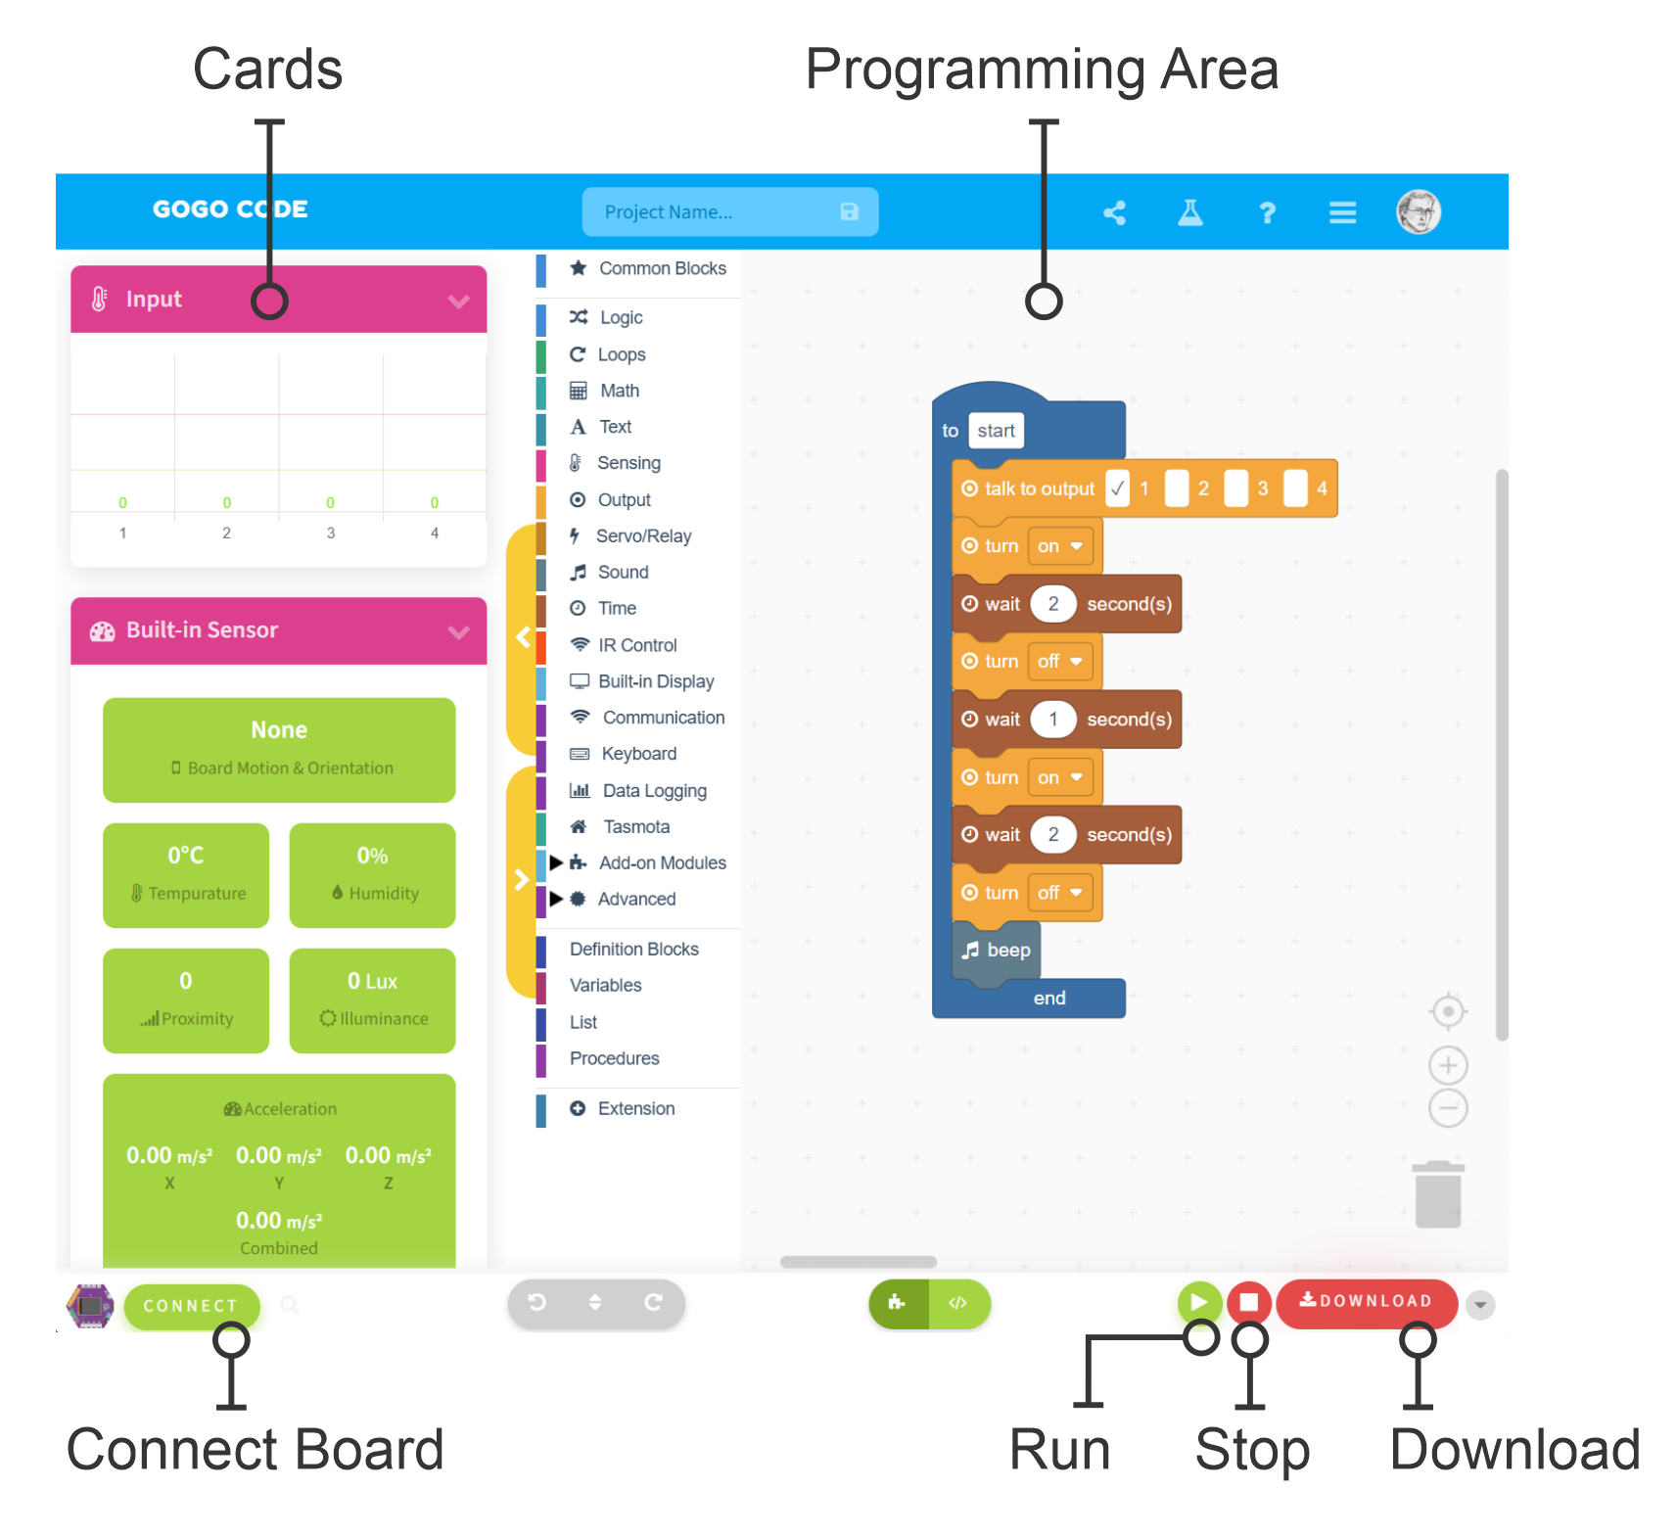
SESSION 2: OUR FIRST PROGRAM
Today's Goal
Write and run our first program
▸ A new webapp: code.gogoboard.org
▸ Learn the Download → Run workflow
Activity 2.2
Time: 30 minutes
Materials: GoGo Board, DC motor, USB cable, computer
Webapp: code.gogoboard.org

Slide 2
A New Tool
Goodbye pgc.gogoboard.org — hello code.gogoboard.org
▸ In Chapter 1 we recorded programs with the remote
▸ From now on we write programs ourselves
▸ code.gogoboard.org is our main tool from here on
▸ Connection is by USB cable — no WiFi needed
Activity 2.2 — Session 2: Our First Program
2

Slide 3
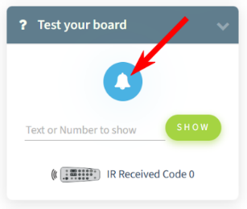
Connect to the Webapp (10 min)
Open code.gogoboard.org in the browser
1
Connect the GoGo Board with the USB cable
2
Press the connect button, choose "Wired (USB)", select "GoGo Board 7"
3
Find the "Test your board" card and press the bell symbol — hear a beep?
4
Activity 2.2 — Session 2: Our First Program
3
Notes:
Demo on the projector first. If there is no beep, reconnect and select "GoGo Board 7" again. Check that USB cables support data transfer.

Slide 4
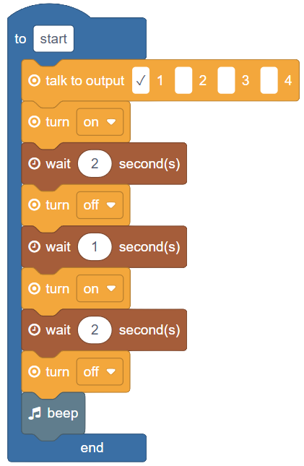
The Program
Motor on 2s → off 1s → on 2s → off → beep
▸ Connect the DC motor to output port 1
▸ Drag the blocks to build this program
▸ Blocks live in the Output, Time, and Sound categories
✎ Workbook — The block table in Activity 2.2 shows which category each block is in
Activity 2.2 — Session 2: Our First Program
4

Slide 5
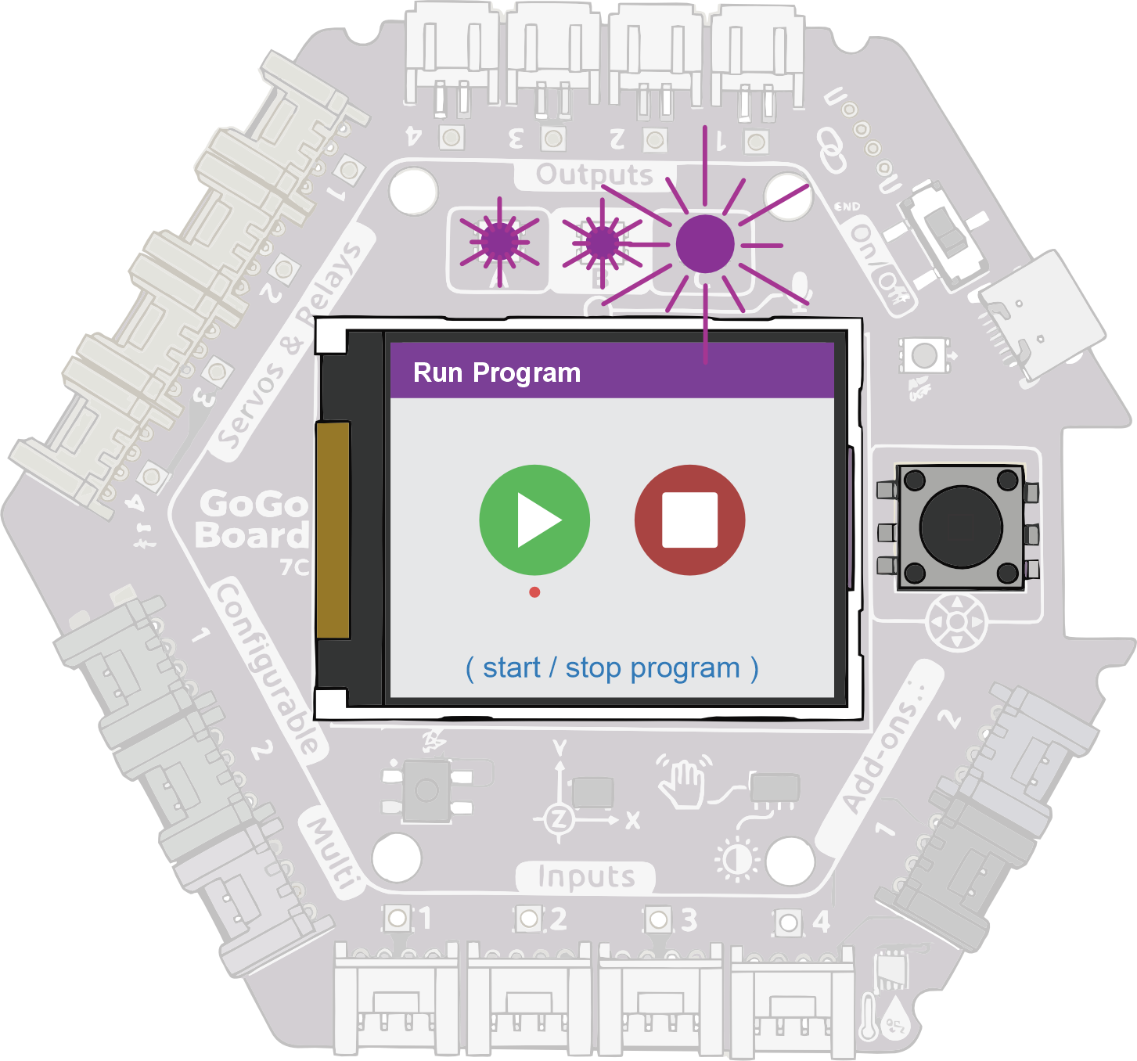
Download and Run (15 min)
Press Download to send the program to the GoGo Board
1
Press Run — go to the "Run Program" screen on the LCD
2
Watch: the 3 purple LEDs above the LCD light up
3
The motor spins 2s, pauses 1s, spins 2s, then beeps
4
Activity 2.2 — Session 2: Our First Program
5
Notes:
Download only sends the program — nothing happens until Run. This trips up many groups.

Slide 6
Experiment
Make the program yours
▸ Change the wait times — what happens?
▸ Add more steps
▸ Challenge: can the motor do a short-long-short pattern?
✎ Workbook — Record your experiment in Activity 2.2
Activity 2.2 — Session 2: Our First Program
6

Slide 7
WHY CODE?
Code gives us precise control over timing and sequence
▸ The LCD menu can turn things on and off
▸ Code says: "on for exactly 2 seconds, then beep"
▸ We decide exactly what happens, and when
Activity 2.2 — Session 2: Our First Program
7

Slide 8
Reflection
✎ Workbook — Answer the reflection question in Activity 2.2
1. When is using code more useful than controlling through the LCD menu?
Activity 2.2 — Session 2: Our First Program
8

