Slide 1
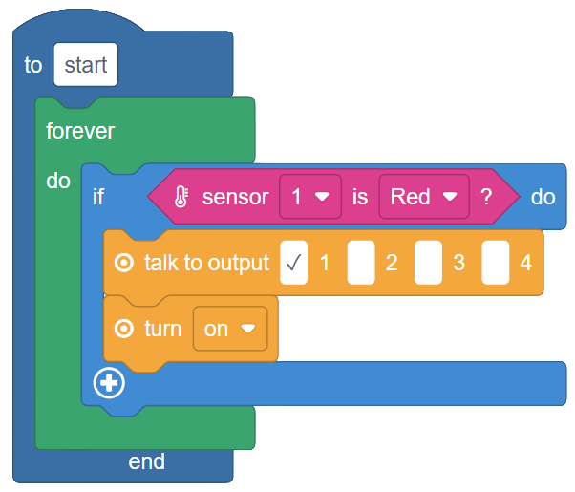
SESSION 3: MAKING DECISIONS WITH THE IF BLOCK
Today's Goal
Make programs that respond to sensors
▸ So far, our programs run the same way every time
▸ Today they learn to decide
Activity 2.3
Time: 50 minutes
Materials: GoGo Board, button sensor, brightness sensor, LED, computer
Webapp: code.gogoboard.org

Slide 2
Conditions
If [condition is true] then [do this action]
▸ A condition is a check that is true or false
▸ The If block runs its action only when the condition is true
▸ Real life: IF it rains, THEN take an umbrella
Activity 2.3 — Session 3: Making Decisions with the If Block
2

Slide 3
Sensor Color Zones
Remember the bar graph colors on the LCD? Code uses the same zones
Color | Value Range | Meaning
Green | 0–350 | Low values
Yellow | 351–700 | Medium values
Red | 701–1023 | High values
Activity 2.3 — Session 3: Making Decisions with the If Block
3
Notes:
The "sensor is" block checks which color zone a sensor is in — a simple yes/no answer, perfect for the If block. Pressing the button sends the value to 1023 (Red zone).

Slide 4
Build It — If Button Then LED (20 min)
Build: If sensor 1 is Red then turn on LED
1
Put it inside a forever loop — it keeps checking over and over
2
Download and Run
3
Press the button sensor — what happens?
4
✎ Workbook — Record what the LED does when pressed and released — Activity 2.3
Activity 2.3 — Session 3: Making Decisions with the If Block
4

Slide 5
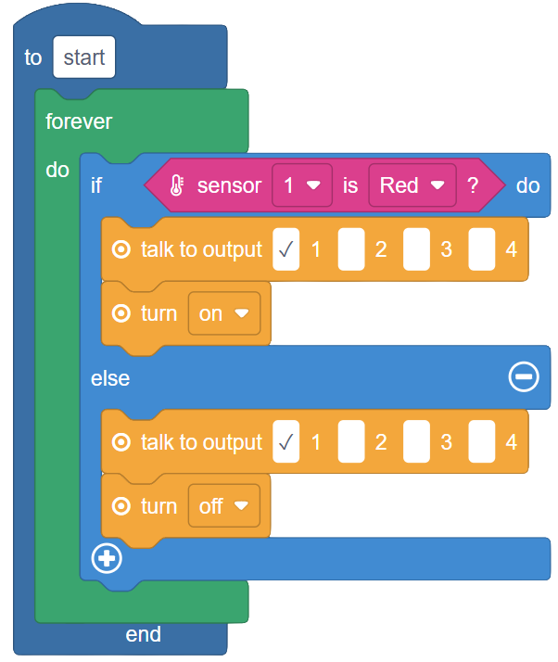
The LED Never Turns Off!
We never told it to turn off
▸ Press "+" at the bottom of the If block to reveal else
▸ Put the LED off block in the else section
▸ Download and test again
Activity 2.3 — Session 3: Making Decisions with the If Block
5
Notes:
Students who forget the forever loop will see the code work only once — a productive mistake. Ask: "How often does your program check the sensor?"

Slide 6
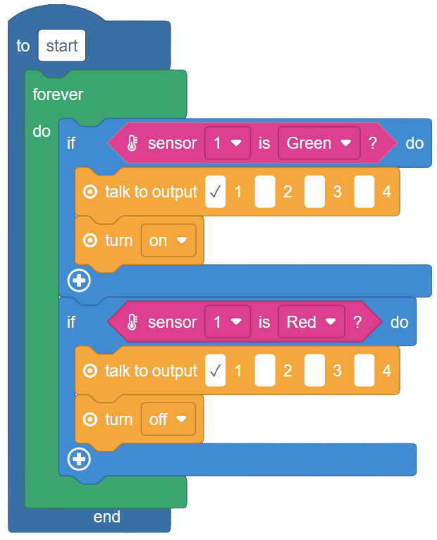
Three Experiments (15 min)
Button → Beep — swap the action (beep block is in Sound)
1
Automatic nightlight — brightness sensor + two If blocks: Green (dark) LED on, Red (bright) LED off
2
Button → Motor — use the "not" block (Logic) to reverse a condition
3
✎ Workbook — Record the results of each experiment in Activity 2.3
Activity 2.3 — Session 3: Making Decisions with the If Block
6

Slide 7
KEY TAKEAWAY
Programs can make decisions
▸ This is what makes them different from a fixed sequence
▸ Sensor + condition + action = a program that responds to the world
Activity 2.3 — Session 3: Making Decisions with the If Block
7

Slide 8
Reflection
✎ Workbook — Answer the two reflection questions in Activity 2.3
1. How is the If block useful?
2. Give one example of a real-world condition — something that checks before acting
Activity 2.3 — Session 3: Making Decisions with the If Block
8

