Slide 1
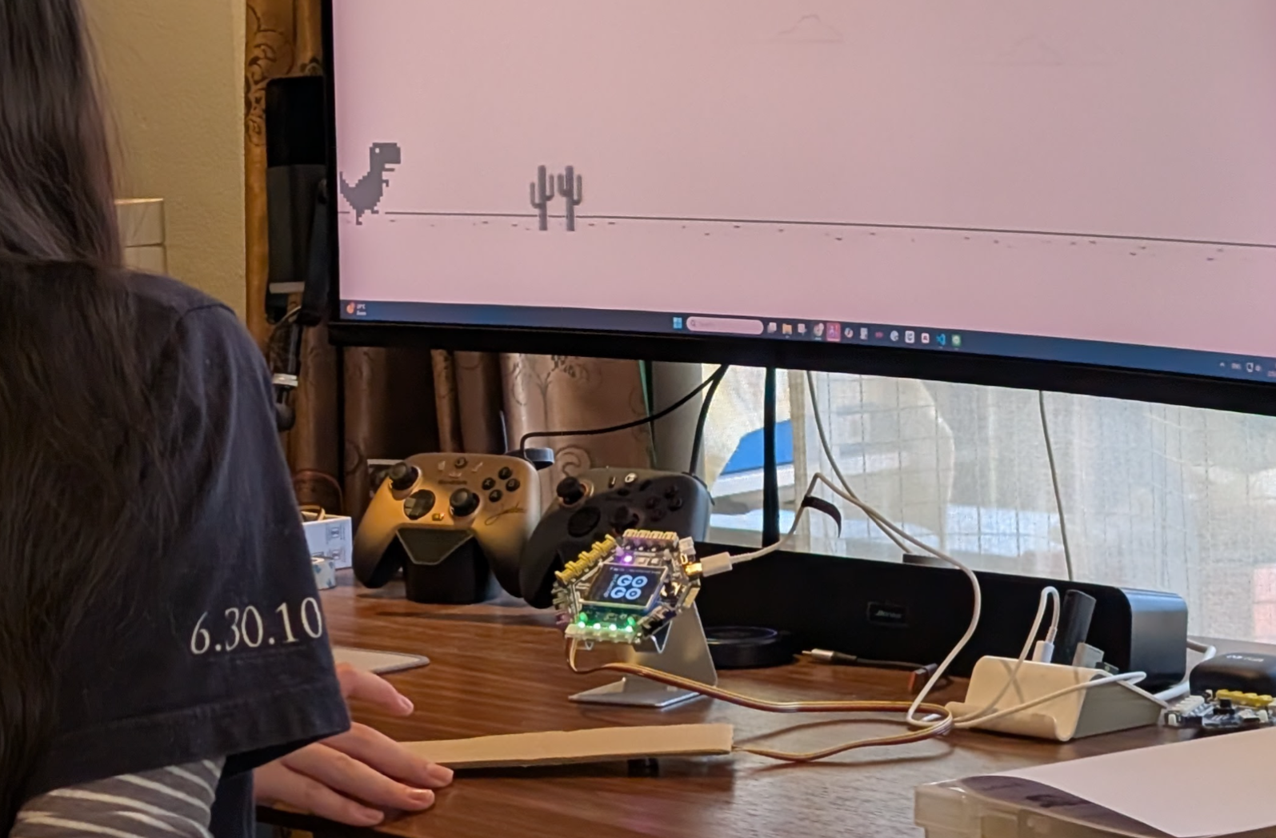
SESSION 4: BUILDING A GAME CONTROLLER
Today's Goal
Build a controller that plays a real computer game
▸ Tap the cardboard → the dinosaur jumps
▸ Our sensor becomes a game controller
Activity 2.4
Time: 60 minutes
Materials: GoGo Board, vibration sensor, cardboard, tape, computer
Game: d.gogoboard.org/dino

Slide 2
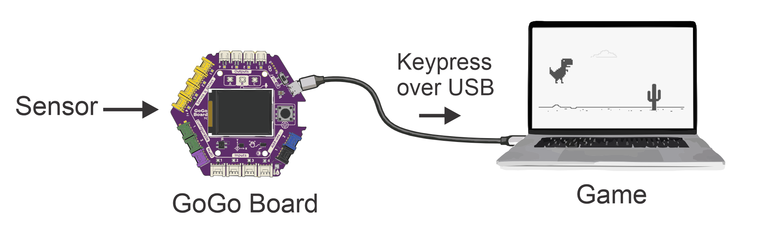
The Chain
Sensor → If block → keyboard key → game reacts
▸ Connected via USB, the GoGo Board can act like a keyboard
▸ Sending a key press is just another output — like turning on an LED
▸ If [sensor detects something] then [send keyboard key]
Activity 2.4 — Session 4: Building a Game Controller
2

Slide 3
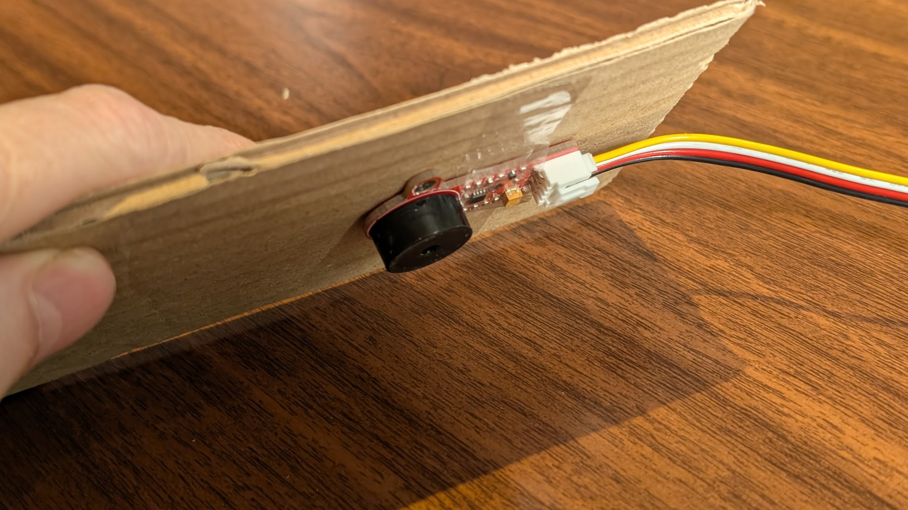
Build the Tap Pad (10 min)
Connect the vibration sensor to Input port 1
1
Tape the sensor to a piece of cardboard
2
Flip the cardboard so the sensor faces down on the desk
3
Tap and watch the values on the LCD — tap offset from the sensor, without pressing directly on it
4
✎ Workbook — Record the idle value and the tap value in Activity 2.4
Activity 2.4 — Session 4: Building a Game Controller
3

Slide 4
Choose a Threshold (10 min)
A threshold is a boundary value we choose ourselves
▸ Color zones give 3 fixed zones — a threshold can be any value
▸ Use the halfway point between idle and tap values
▸ Example: idle = 0, tap = 600 → threshold = 300
✎ Workbook — Write your threshold value in Activity 2.4
Activity 2.4 — Session 4: Building a Game Controller
4

Slide 5
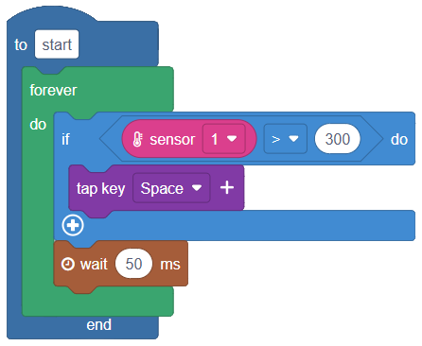
Code It (15 min)
Build: If vibration is detected then send the Space key
1
Keep the wait block after the If block — it stops one tap from sending many keys
2
Use a forever loop
3
Download and Run
4
Activity 2.4 — Session 4: Building a Game Controller
5
Notes:
If the dinosaur jumps repeatedly from one tap, ask the group what their wait time is.

Slide 6
Test, Then Play
Test the key first, then open the game
Open Notepad or keyboard-test.space — does tapping send a Space?
1
Open the Dinosaur Game: d.gogoboard.org/dino
2
Click on the game window, then tap the cardboard
3
The dinosaur jumps!
4
Activity 2.4 — Session 4: Building a Game Controller
6
Notes:
Testing in a text editor first separates "does the key arrive?" from "is the game hard?".

Slide 7
Try Built-in Sensors (10 min)
The board's built-in sensors can be controllers too — blocks in the Sensing category
Sensor | How to Use It | Condition
Accelerometer | Tilt or shake the board | accelerometer > or < threshold
Lux sensor | Cover the board | illuminance < threshold
✎ Workbook — Which sensor works best as a controller? Record it in Activity 2.4
Activity 2.4 — Session 4: Building a Game Controller
7

Slide 8
KEY TAKEAWAY
To the computer, our sensor is now a keyboard
▸ Any program that listens to keys can be controlled by our sensor
▸ More one-key games: Flappy Bird, Geometry Dash — d.gogoboard.org/games
Activity 2.4 — Session 4: Building a Game Controller
8

Slide 9
Reflection
✎ Workbook — Answer the two reflection questions in Activity 2.4
1. Describe the chain from sensor to game action — list each step
2. What makes a good game controller? What makes one hard to use?
Activity 2.4 — Session 4: Building a Game Controller
9

