Slide 1
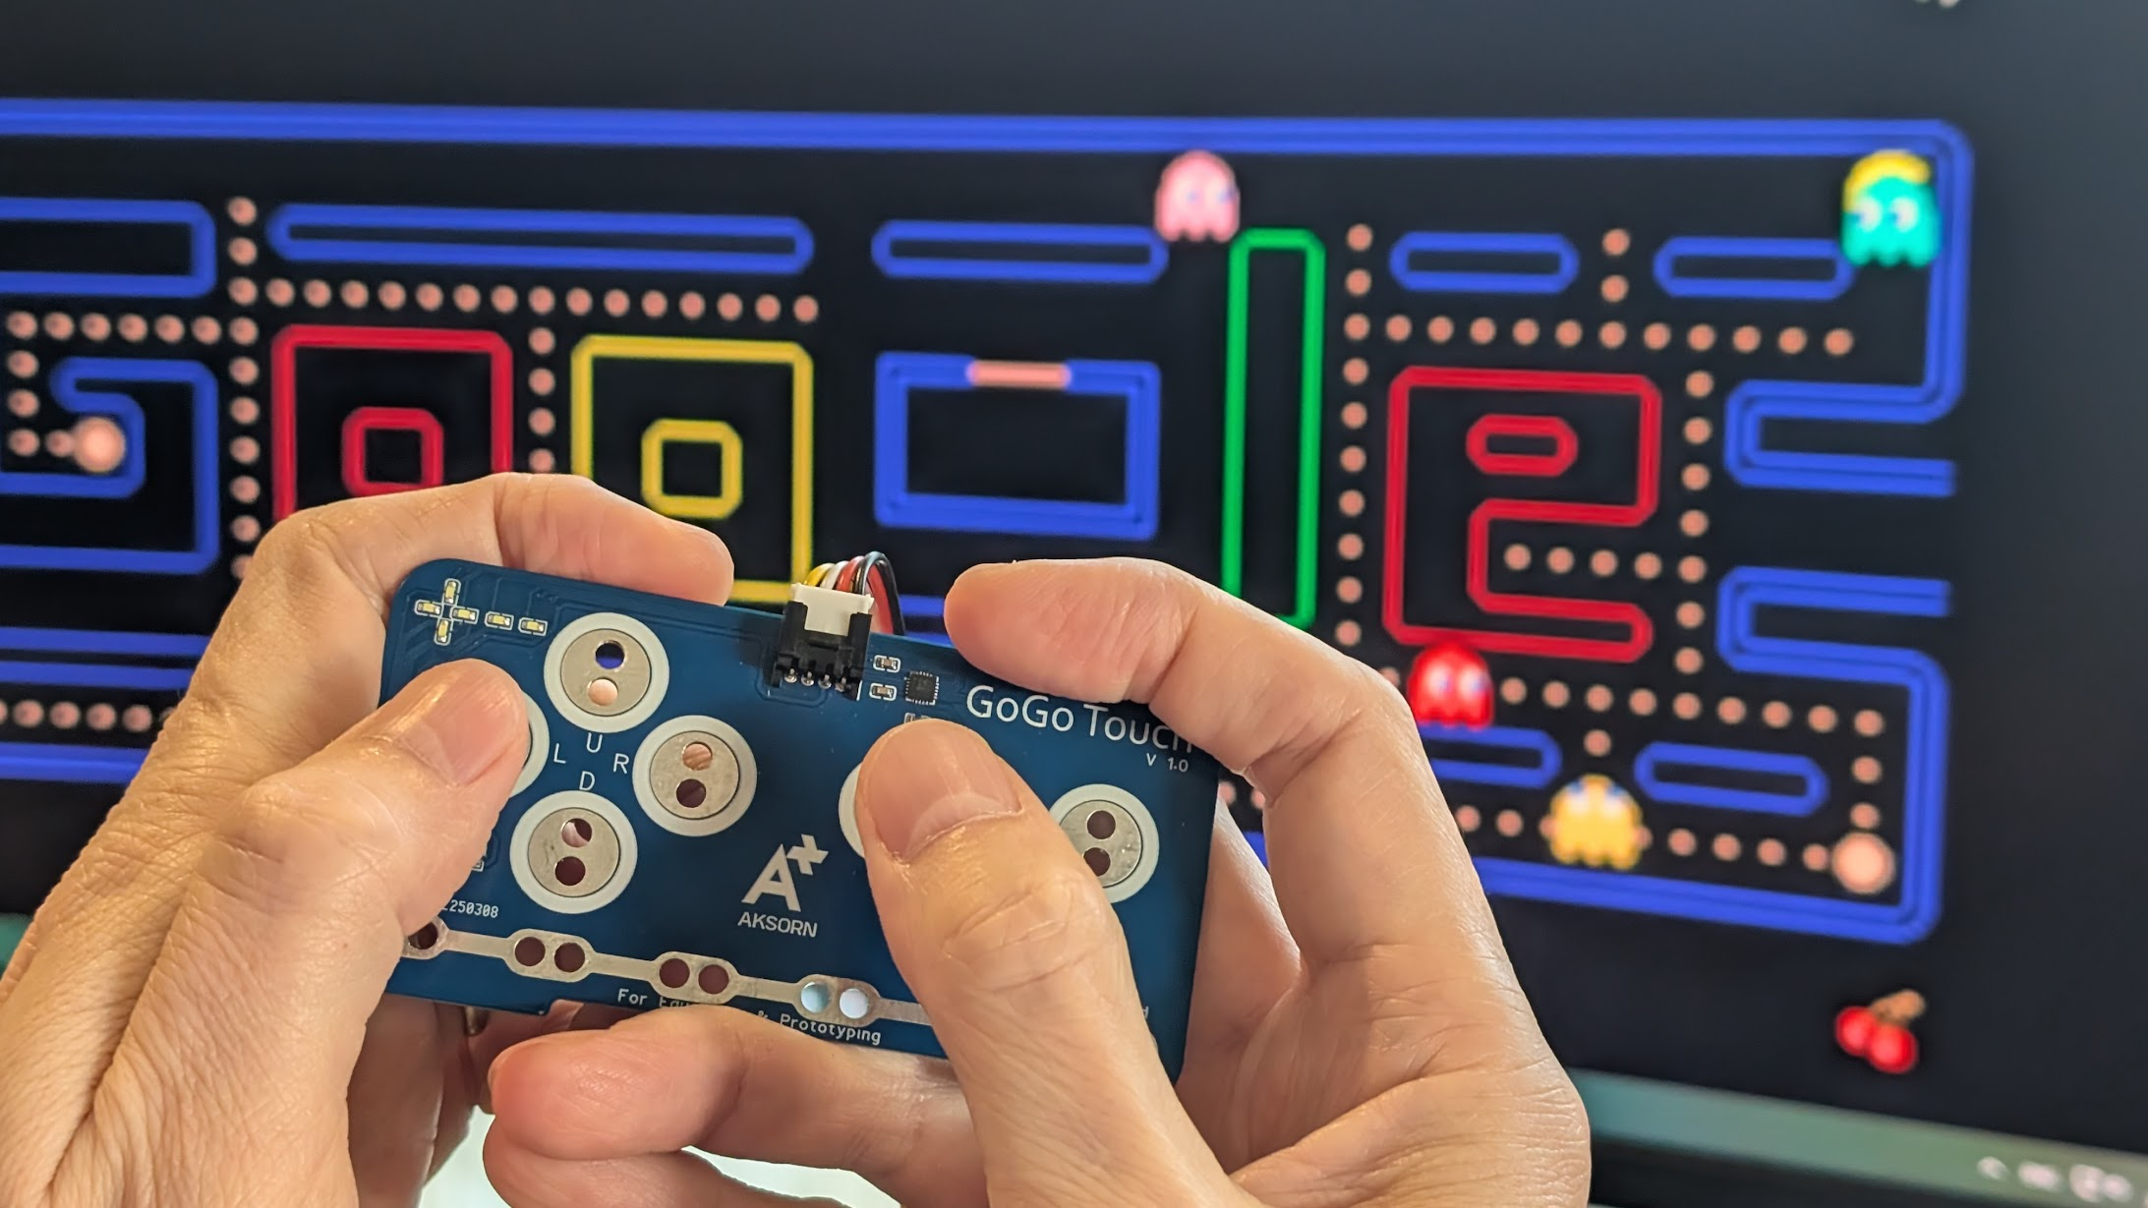
SESSION 5: GOGO TOUCH CONTROLLER
Today's Goal
A controller with more than one key
▸ Our vibration controller sends only one key
▸ Many games need more — Pac-Man needs 4 directions
▸ Meet the GoGo Touch
Activity 2.5
Time: 60 minutes
Materials: GoGo Board, GoGo Touch, alligator clips, conductive materials, computer

Slide 2
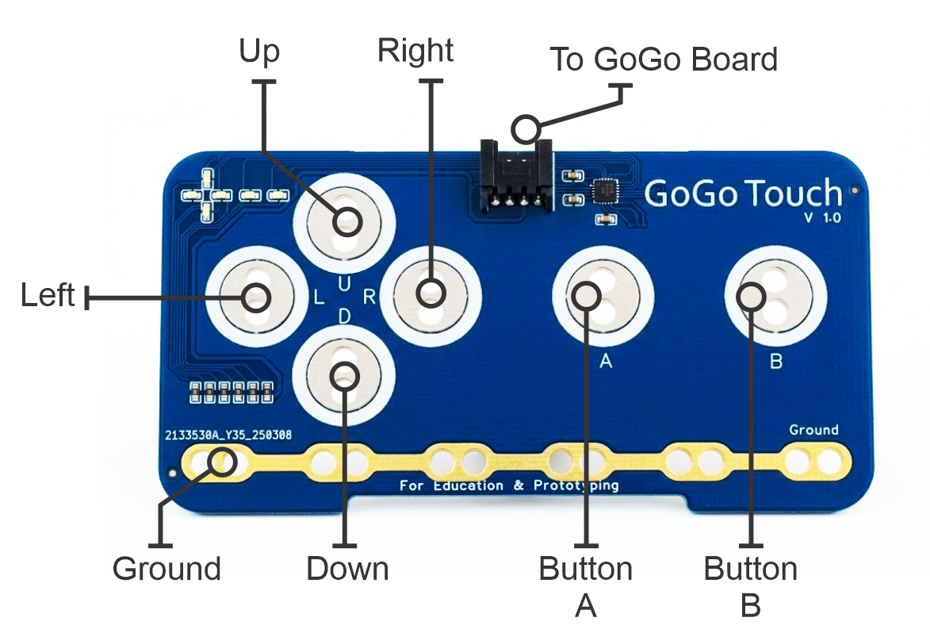
Meet the GoGo Touch
6 touch inputs on one module
▸ 4 directional pads: Up, Down, Left, Right
▸ 2 buttons: A and B
▸ Connects to Add-ons port 1 (the black port)
▸ Capacitive touch — same technology as a phone screen
Activity 2.5 — Session 5: GoGo Touch Controller
2

Slide 3
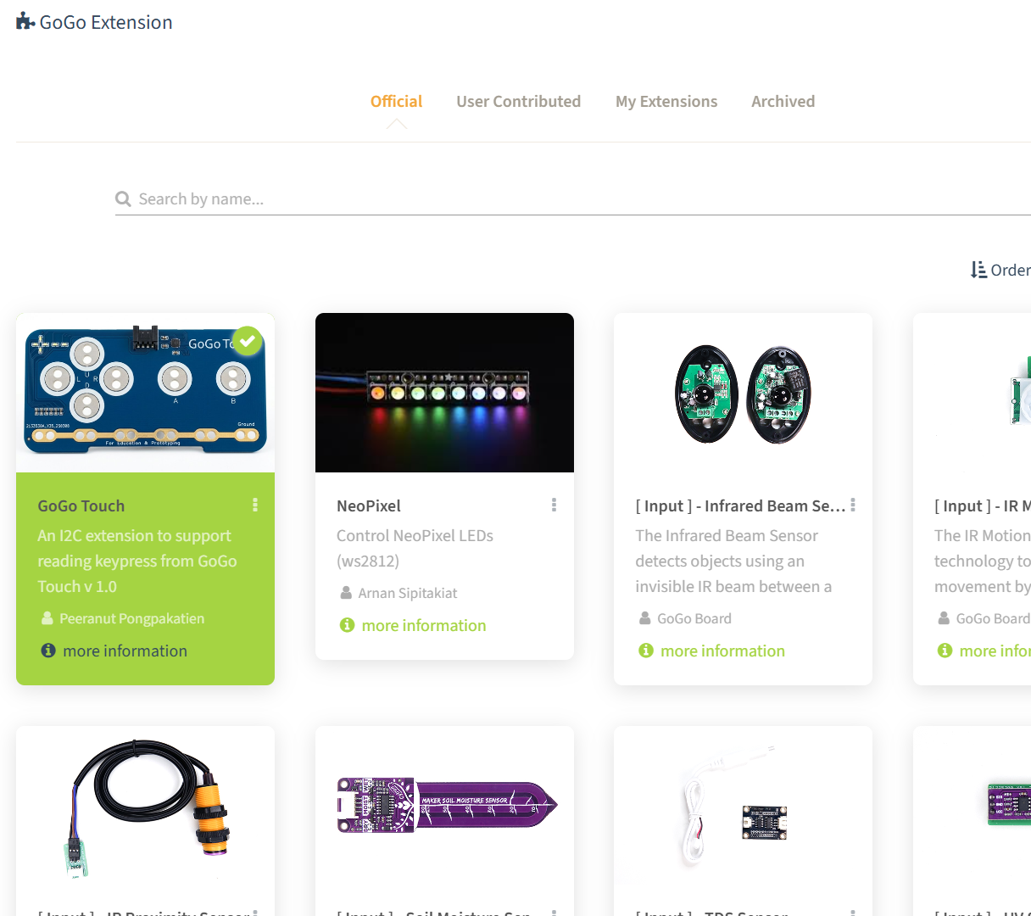
Load the Extension
In code.gogoboard.org, select the Extension category
1
Click the GoGo Touch card
2
New blocks appear in a GoGo Touch category
3
Activity 2.5 — Session 5: GoGo Touch Controller
3
Notes:
Extensions add support for extra hardware — this is how the webapp grows new capabilities.

Slide 4
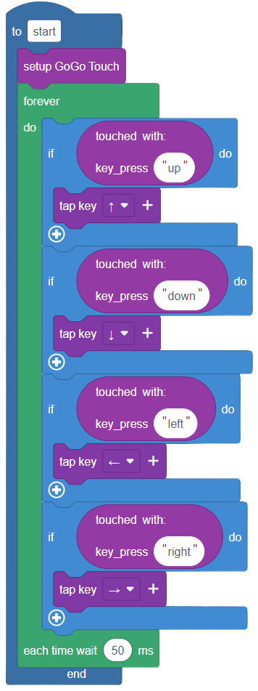
The Pac-Man Program (20 min)
Start with the "setup GoGo Touch" block — do NOT touch any pads while it runs
1
Add a forever loop with 4 If blocks — one per direction
2
Each: If touched "up" then tap key Up Arrow (and so on)
3
The "each time wait 50 ms" stops keys from flooding
4
Activity 2.5 — Session 5: GoGo Touch Controller
4
Notes:
Touching pads during setup confuses the calibration — the most common cause of a "broken" controller. Stop and re-run to fix.

Slide 5
Test, Then Play Pac-Man
Download and Run
1
Touch each pad — does the right arrow key arrive?
2
Open d.gogoboard.org/ch2-pacman
3
Play with the controller we built
4
✎ Workbook — Fill in the pad test table in Activity 2.5
Activity 2.5 — Session 5: GoGo Touch Controller
5

Slide 6
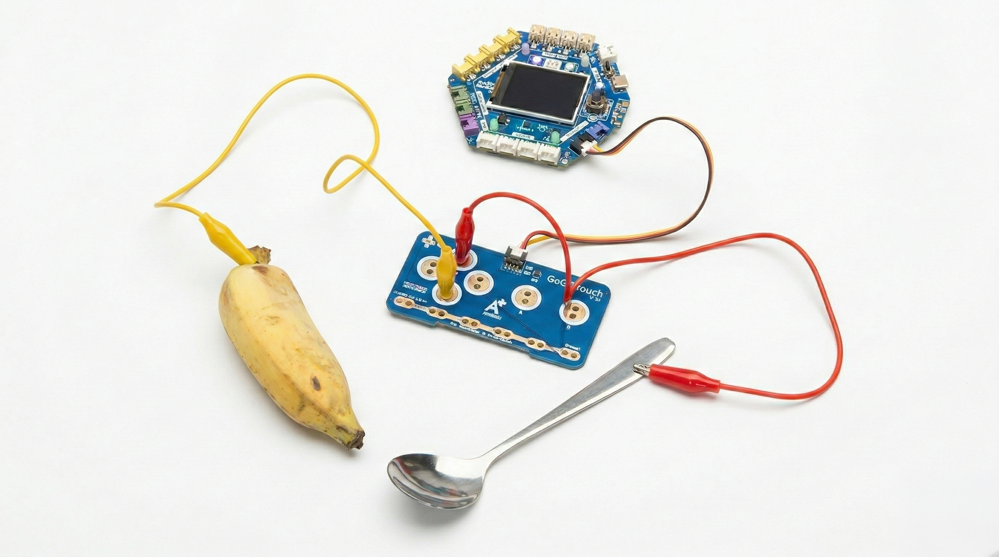
Mission 2 — Creative Controller (30 min)
Extend the pads to everyday objects
▸ Alligator clips connect pads to conductive materials
▸ Fruits, aluminum foil, play-doh, even water
▸ Touching the material = touching the pad
▸ The signal flows: pad → material → body → ground
Activity 2.5 — Session 5: GoGo Touch Controller
6
Notes:
Pad + ground = circuit. A missing ground connection is the most common problem.

Slide 7
Design Your Controller
Plan before you build
▸ Choose a game — which keys does it need?
▸ Pick a material for each key
▸ Connect all materials BEFORE running the program
▸ Not working? Check ground, check the material is conductive
✎ Workbook — Fill in the game plan and material table in Activity 2.5
Activity 2.5 — Session 5: GoGo Touch Controller
7

Slide 8
Share
Try another group's controller
Swap stations with another group
1
Play their game with their controller
2
Which material is the most creative?
3
✎ Workbook — Record the group, game, and most creative material in Activity 2.5
Activity 2.5 — Session 5: GoGo Touch Controller
8

Slide 9
KEY TAKEAWAY
The physical design matters as much as the code
▸ "Key touched" gives a yes/no — no threshold needed
▸ Different sensors give different kinds of answers
▸ Technology can be creative and playful
Activity 2.5 — Session 5: GoGo Touch Controller
9

Slide 10
Reflection
✎ Workbook — Answer the two reflection questions in Activity 2.5
1. The "Key touched" block gives a yes or no answer — how is this different from a threshold?
2. What was the most creative material you saw? Why?
Activity 2.5 — Session 5: GoGo Touch Controller
10

