Slide 1
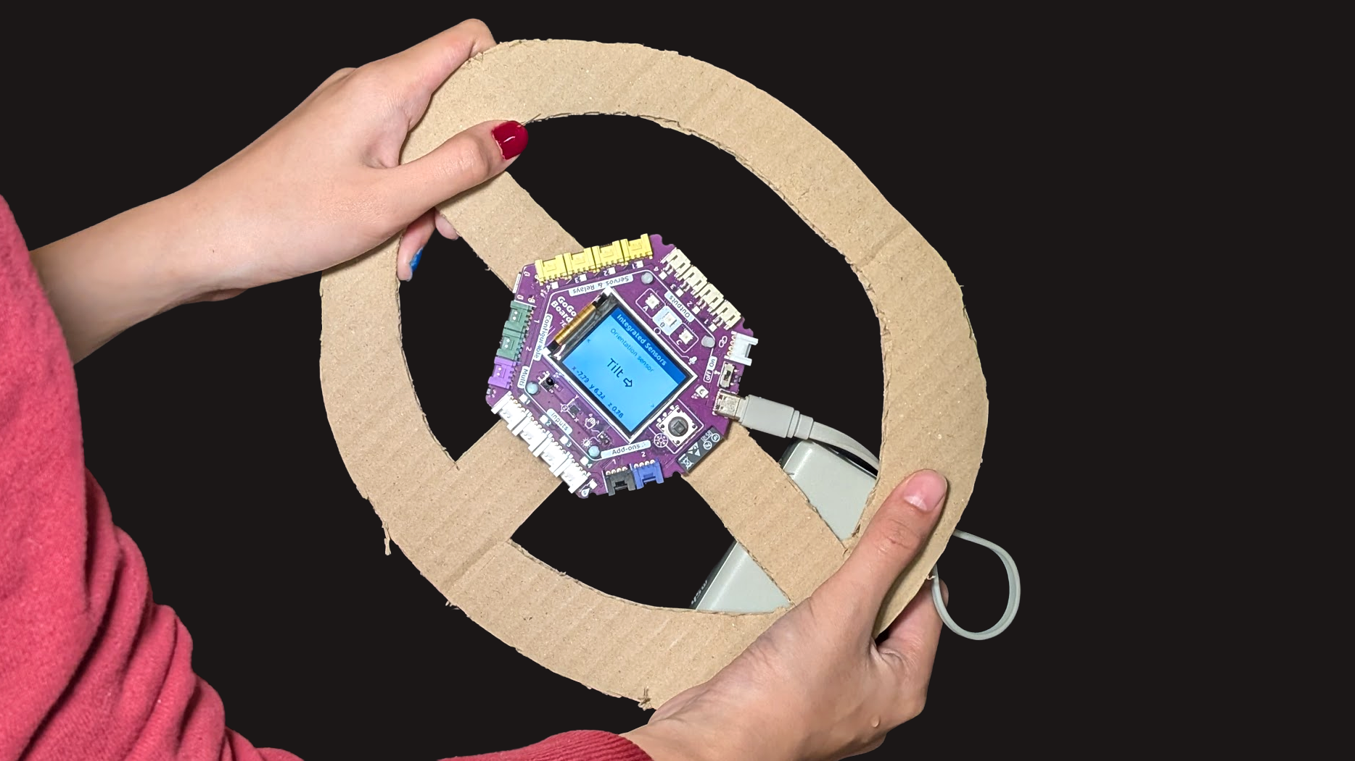
SESSION 6: ASSESSMENT — TILT CONTROLLER
The Challenge
Build a game controller that works by tilting the board
▸ Use the built-in accelerometer
▸ No extra sensors needed
Assessment
Time: 45-60 minutes
Materials: GoGo Board, USB cable, computer

Slide 2
How It Works
Tilt the board to send arrow keys
▸ Tilt left → send the left arrow key
▸ Tilt right → send the right arrow key
▸ Optional: tilt forward / backward → up / down arrow keys
Assessment — Session 6: Assessment — Tilt Controller
2

Slide 3
Getting Started
Observe first — just like the vibration sensor
▸ The accelerometer block is in the Sensing category
▸ Watch the value on the LCD while tilting left and right
▸ Find the value when the board is flat — that is the middle point
▸ Choose a threshold on each side
▸ Remember the forever loop
Assessment — Session 6: Assessment — Tilt Controller
3
Notes:
If the "Try Built-in Sensors" section in Activity 2.4 was skipped, demo the accelerometer values on the LCD before students start — this may be their first time seeing it.

Slide 4
Checklist
Before presenting, make sure you can check all of these
☐ Write the program with If blocks for left and right tilt
☐ Test and find the right threshold values
☐ Play the game using tilt controls
☐ Optional: add up and down for 4-direction control
☐ Explain the program
▸ Game ideas: Pac-Man, Snake, Tetris, Breakout — d.gogoboard.org/games
Assessment — Session 6: Assessment — Tilt Controller
4

Slide 5
Work Time (30-35 min)
Observe, choose thresholds, code, test
▸ Observe the tilt values before choosing thresholds
▸ Test after every change
▸ Adjust thresholds until the controls feel right
Assessment — Session 6: Assessment — Tilt Controller
5
Notes:
Observe who tests systematically — observing values before choosing thresholds — and who guesses. This informs the rubric scoring.

Slide 6
Presentations (5-10 min)
Show the class
Play your game — tilt to control
1
Explain: how many If blocks? What thresholds did you choose?
2
What did you adjust along the way?
3
Assessment — Session 6: Assessment — Tilt Controller
6

Slide 7
Chapter Reflection
Write your answers on the task sheet
1. How is the tilt controller different from the button and sensor controllers we built before?
2. Why does the threshold value matter for the accelerometer?
Assessment — Session 6: Assessment — Tilt Controller
7

Slide 8
Chapter 2 Summary — What We Learned
1. Sensors detect the real world — turning touch, light, movement into numbers
2. Actuators affect the real world — motors spin, LEDs light up
3. Code gives precise control — exactly what happens, and when
4. The If block makes decisions — programs check conditions before acting
5. Color zones and thresholds — two ways to make conditions from sensor values
6. USB keyboard bridges physical and digital — the GoGo Board sends key presses
7. Extensions add new capabilities — like the GoGo Touch
Assessment — Session 6: Assessment — Tilt Controller
8

Slide 9
Skills Checklist
Can you do all of these?
☐ Read sensor values and control actuators using the LCD
☐ Write and run programs in code.gogoboard.org
☐ Use the If block to connect sensors to output control
☐ Use the USB keyboard to send key presses to a computer
☐ Set up and use the GoGo Touch module
☐ Build a creative game controller with conductive materials
Assessment — Session 6: Assessment — Tilt Controller
9

