Slide 1
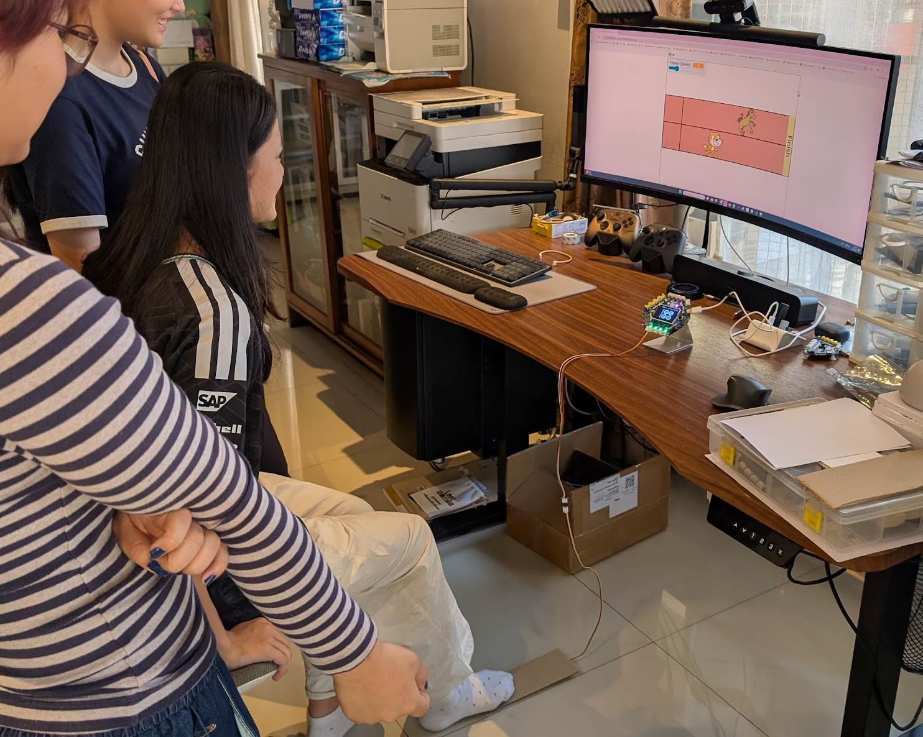
SESSION 1: HANDS-ON WITH SCRATCH
Chapter 3 — We Become Game Creators
This chapter: build games in Scratch, controlled by GoGo Board sensors
▸ Design games in Scratch
▸ Control them with sensors
▸ Today: learn Scratch itself
Activity 3.1
Time: 45 minutes
Materials: Computer, Scratch account
Webapp: scratch.mit.edu

Slide 2
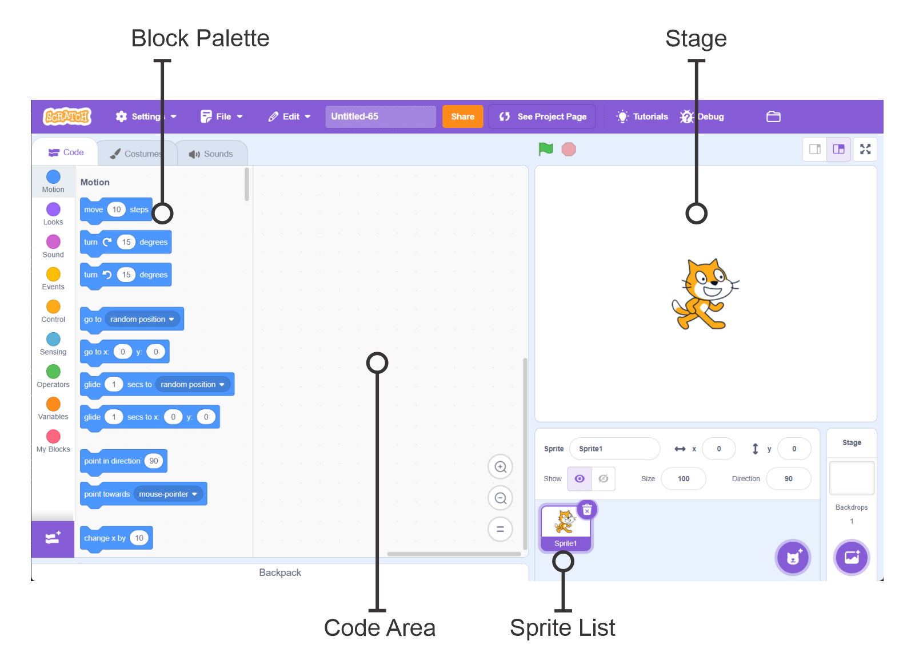
Opening Scratch (5 min)
Open scratch.mit.edu in the browser
1
Sign in (or create a free account) — projects only save when signed in
2
Click Create to start a new project
3
Activity 3.1 — Session 1: Hands-on with Scratch
2
Notes:
Decide the account approach beforehand. Without sign-in, work is lost when the tab closes.

Slide 3
The Scratch Interface
Area | What It Does
Stage | Where the program output is displayed
Sprite list | All the characters in the project
Block palette | All programming blocks, organized by category
Code area | Where blocks are put together into a program
Activity 3.1 — Session 1: Hands-on with Scratch
3

Slide 4
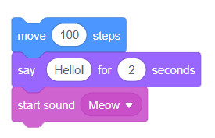
Explore Sprites and Blocks (15 min)
Try move 10 steps (Motion) — click the block to run it
1
Try say "Hello!" (Looks) and play sound Meow (Sound)
2
Now stack blocks — drag one under another
3
Click the stack — blocks run from top to bottom
4
✎ Workbook — Which block was most interesting? Record it in Activity 3.1
Activity 3.1 — Session 1: Hands-on with Scratch
4

Slide 5
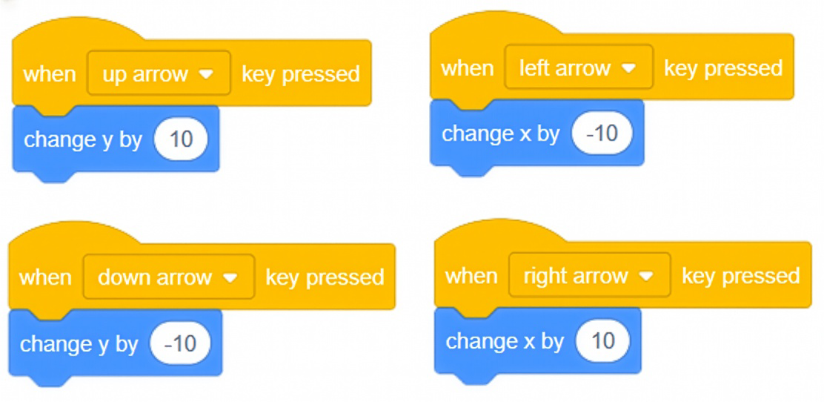
The "When Key Pressed" Event (15 min)
From Events, drag "when key pressed" — choose Up Arrow
1
From Motion, attach "change y by 10" underneath
2
Press the up arrow — the sprite moves up (click the Stage first!)
3
Repeat for all four arrow keys, then test all directions
4
✎ Workbook — How many "when key pressed" blocks did we use? — Activity 3.1
Activity 3.1 — Session 1: Hands-on with Scratch
5

Slide 6
Add Looks and Sound (5 min)
Make the sprite more interesting
▸ Add a "say" block so the sprite speaks when it moves
▸ Add a "play sound until done" block for sound effects
▸ Try the Costumes tab to change the sprite's appearance
▸ Combine at least two of these with a "when key pressed" block
Activity 3.1 — Session 1: Hands-on with Scratch
6

Slide 7
KEY TAKEAWAY
Events make programs interactive
▸ The program doesn't run once, top to bottom — it waits
▸ Every time the event happens, the code runs again
▸ Just like forever + If on the GoGo Board
Activity 3.1 — Session 1: Hands-on with Scratch
7

Slide 8
Reflection
✎ Workbook — Answer the two reflection questions in Activity 3.1
1. What does the "when key pressed" block do?
2. How is programming in Scratch similar to programming on the GoGo Board?
Activity 3.1 — Session 1: Hands-on with Scratch
8

