Slide 1
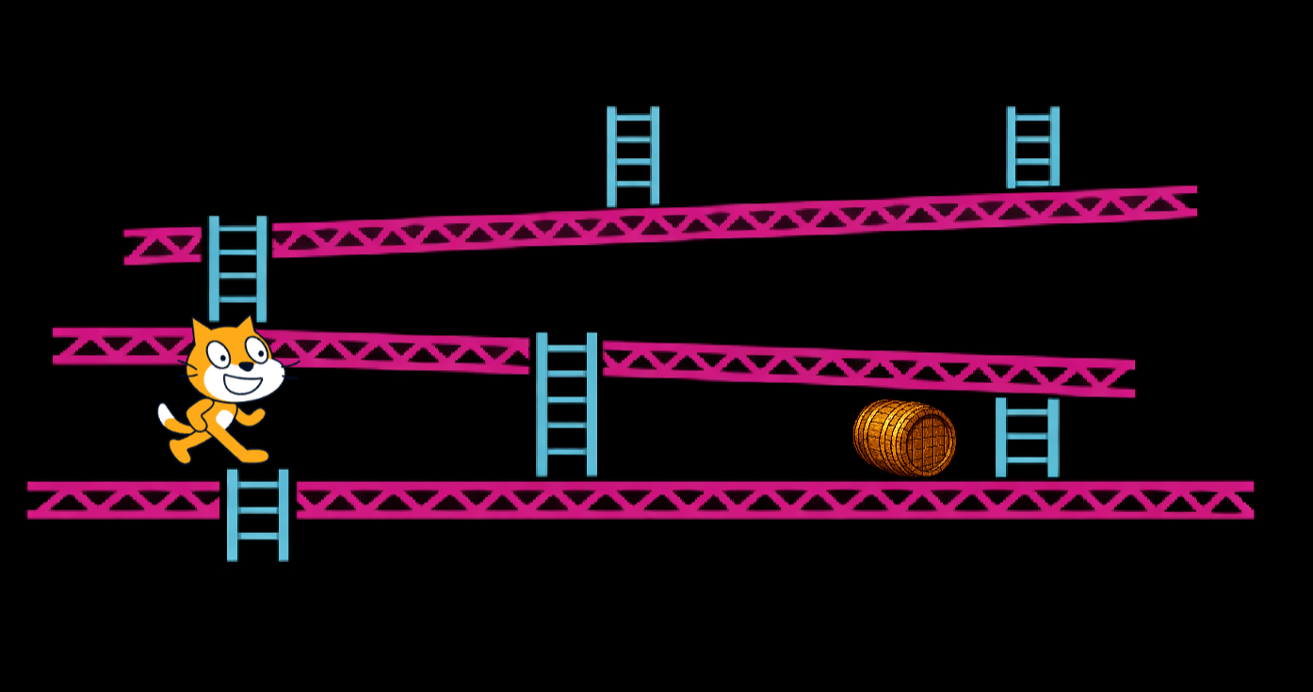
SESSION 2: CONNECTING GOGO BOARD TO SCRATCH
Today's Goal
Make our sensor control a Scratch game
▸ In Chapter 2 we controlled existing games
▸ Today we build the game side too
Activity 3.2
Time: 45 minutes
Materials: GoGo Board, button sensor, USB cable, computer
Template: d.gogoboard.org/ch3-jump-game

Slide 2
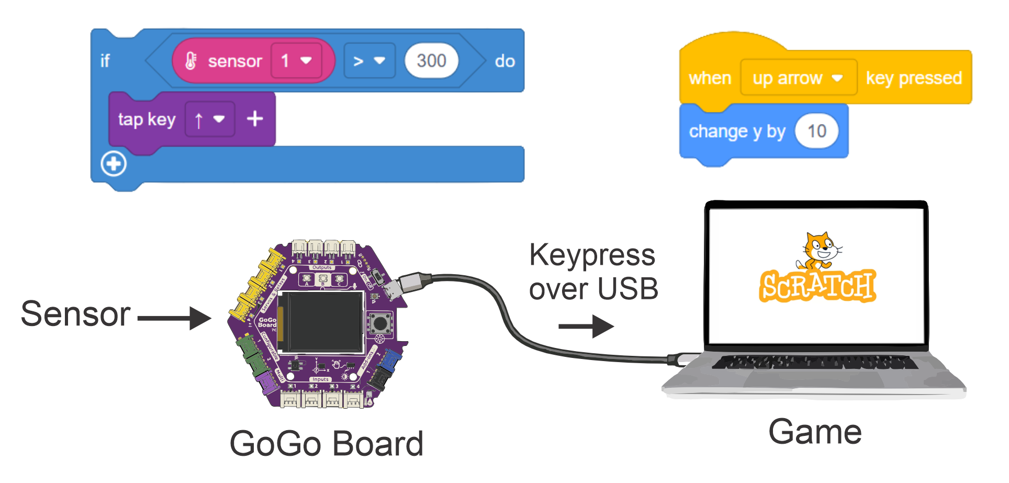
Two Systems, One Game
Sensor → key → event → action
▸ GoGo Board side: sensor detects something → sends a keyboard key
▸ Scratch side: "when key pressed" → game action
▸ We program both sides
Activity 3.2 — Session 2: Connecting GoGo Board to Scratch
2

Slide 3
Setting Up (10 min)
Connect the GoGo Board via USB
1
Open code.gogoboard.org in one browser tab
2
Connect a button sensor to an input port — check its value changes when pressed
3
Open scratch.mit.edu in a second tab
4
Activity 3.2 — Session 2: Connecting GoGo Board to Scratch
3
Notes:
Two programs run at the same time, so two tabs. Sensor values can be read on the LCD or in code.gogoboard.org.

Slide 4
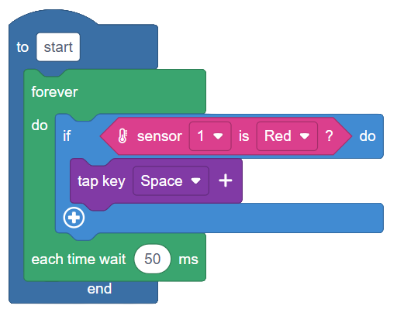
The GoGo Board Side (10 min)
Build: If button is pressed then send the Space key
1
Download and Run
2
Test in a text editor — does pressing the sensor type a space?
3
Activity 3.2 — Session 2: Connecting GoGo Board to Scratch
4
Notes:
Same program as Chapter 2. Testing in a text editor FIRST separates GoGo Board problems from Scratch problems.

Slide 5
The Scratch Side (15 min)
Open the jump game: d.gogoboard.org/ch3-jump-game — then "See Inside"
1
Click the cat sprite (not the barrel)
2
Build: when space key pressed → change y by 50 → wait 0.5 → change y by -50
3
Test with the keyboard — does the cat jump?
4
Green flag to start the game, then jump over the barrel with the sensor
✎ Workbook — Record the test results in Activity 3.2
Activity 3.2 — Session 2: Connecting GoGo Board to Scratch
5

Slide 6
If It Doesn't Work
Test in order — the order tells you which side is broken
▸ Key arrives in a text editor? → GoGo Board side is fine
▸ Keyboard jump works in Scratch? → Scratch side is fine
▸ Both work but sensor doesn't jump? → Click the Scratch window — keys go to the window in focus
Activity 3.2 — Session 2: Connecting GoGo Board to Scratch
6
Notes:
Window focus is the #1 problem of this whole chapter. Repeat it until it sticks.

Slide 7
KEY TAKEAWAY
One game, two programs
▸ The GoGo Board translates the physical world into keys
▸ Scratch translates keys into game action
▸ Each program is simple — the power is in connecting them
Activity 3.2 — Session 2: Connecting GoGo Board to Scratch
7

Slide 8
Reflection
✎ Workbook — Answer the two reflection questions in Activity 3.2
1. Describe the chain from sensor press to the cat jumping
2. Why do we need programs on BOTH the GoGo Board and in Scratch?
Activity 3.2 — Session 2: Connecting GoGo Board to Scratch
8

