Slide 1
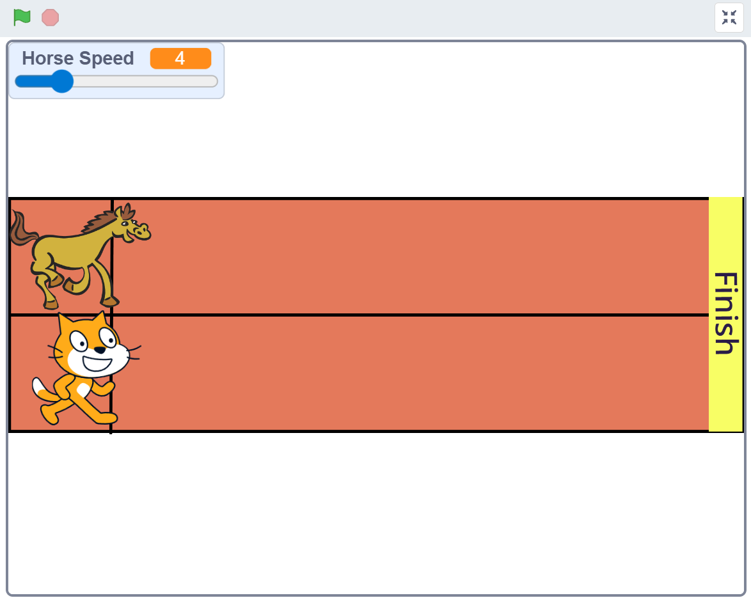
SESSION 3: THE RUNNING RACE GAME
Today's Goal
Turn a one-player game into a two-player race
▸ Player 1: stomps on a step sensor → the Cat runs
▸ Player 2: shouts into the microphone → the Horse runs
Activity 3.3
Time: 60 minutes
Materials: GoGo Board, vibration sensor, cardboard, computer with microphone

Slide 2
The Game (5 min)
Open d.gogoboard.org/ch3-race-game
1
Press the green flag — the Horse runs, the Cat does not
2
Try the Horse Speed slider — what changes?
3
Ask: why doesn't the Cat move?
4
Click "See Inside" — the Cat has no code yet. That is our job
✎ Workbook — Answer the two questions about the template in Activity 3.3
Activity 3.3 — Session 3: The Running Race Game
2

Slide 3
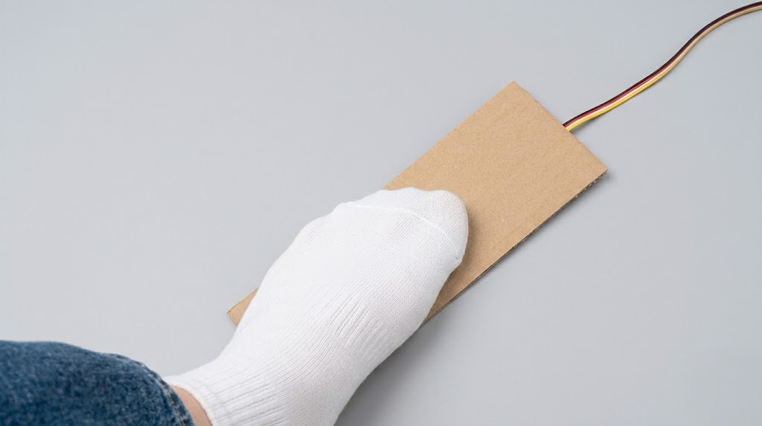
Part 1 — The Step Sensor (25 min)
Connect the vibration sensor to an input port
1
Tape it to the underside of the cardboard, sensor facing down (like Activity 2.4)
2
GoGo Board program: If vibration detected then send Space
3
Download, Run, test — step on the cardboard, not the sensor!
4
Activity 3.3 — Session 3: The Running Race Game
3
Notes:
Reuse the pads from Chapter 2 if they survived. Test the space key in a text editor before Scratch.

Slide 4
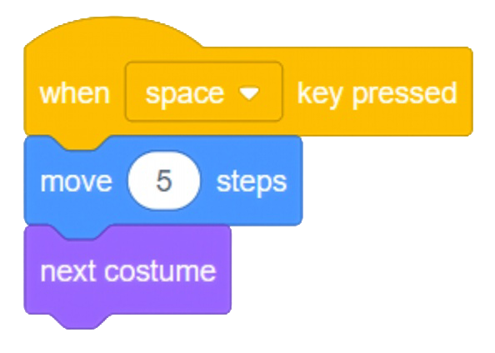
The Cat's Program
Click the Cat sprite, then build:
▸ when space key pressed
▸ move 5 steps
▸ next costume — running animation
✎ Workbook — Try move = 10, then 2. What value works best? Record it in Activity 3.3
Activity 3.3 — Session 3: The Running Race Game
4

Slide 5
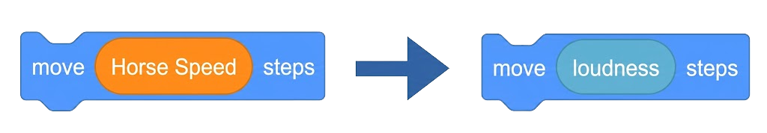
Part 2 — The Microphone (20 min)
Click the Horse sprite — find the move block inside the repeat until loop
1
From Sensing, drag loudness on top of the Horse Speed value
2
Green flag, then shout or clap — the Horse moves on sound
3
Browser asks for microphone permission → click Allow
4
Activity 3.3 — Session 3: The Running Race Game
5
Notes:
loudness reads the microphone: 0 (silent) to 100 (very loud). This part needs a working microphone.

Slide 6

Make the Race Fair
The Horse is too fast — scale it down
▸ Use the divide (÷) block from Operators
▸ Put loudness on the left, 2 on the right
▸ Drop the whole thing into the move block
▸ Increase the divisor until the race feels fair
✎ Workbook — What divisor worked best? Record it in Activity 3.3
Activity 3.3 — Session 3: The Running Race Game
6

Slide 7
Race!
The two-player race
▸ Player 1: stomps the cardboard → the Cat (via GoGo Board)
▸ Player 2: shouts, claps, makes noise → the Horse (via microphone)
▸ Fastest to the finish line wins
Activity 3.3 — Session 3: The Running Race Game
7
Notes:
Expect noise — it is part of the lesson. If groups interfere with each other, test microphones one group at a time.

Slide 8
KEY TAKEAWAY
We built on someone else's program without breaking the existing system
▸ Read the code first, change only what you need
▸ The microphone is a sensor too — Scratch reads it directly
▸ Input can come from different sources and meet in one game
Activity 3.3 — Session 3: The Running Race Game
8

Slide 9
Reflection
✎ Workbook — Answer the three reflection questions in Activity 3.3
1. The Cat is controlled by...? The Horse is controlled by...?
2. What is the same about both inputs?
3. What is different about how they receive input?
Activity 3.3 — Session 3: The Running Race Game
9

