Slide 1
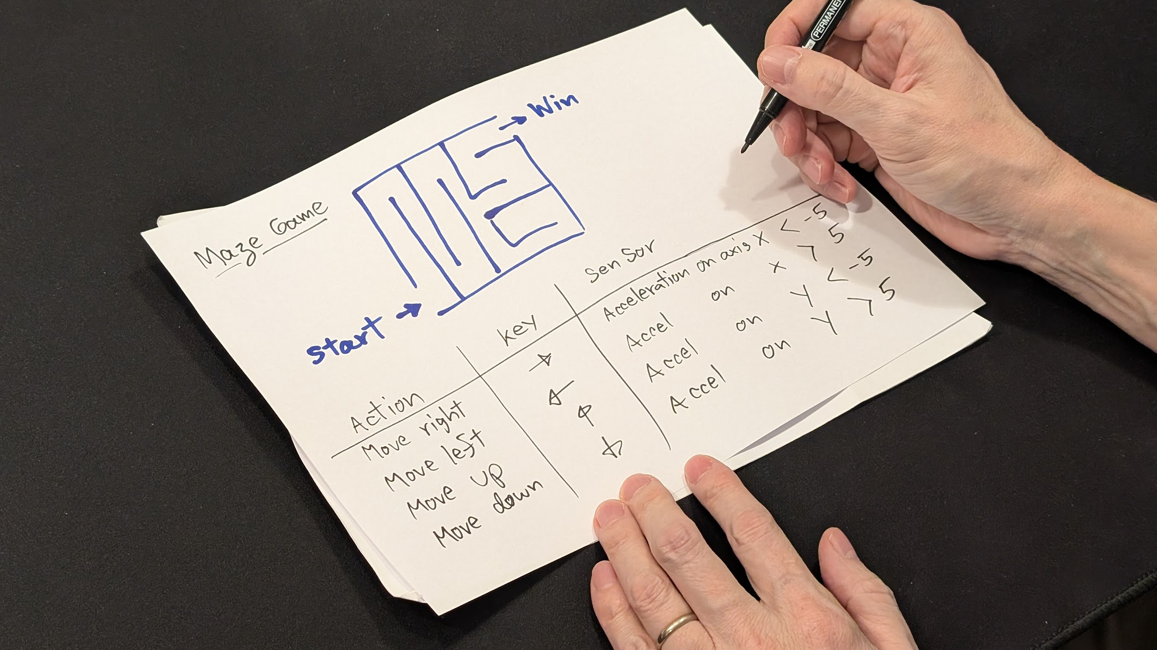
SESSION 4: DESIGN OUR OWN GAME
Today's Goal
Design and build our own sensor-controlled game
▸ Today in class: plan
▸ Building: homework or extra class time
Activity 3.4
Time: 20 minutes in class + build time
Materials: GoGo Board, 2-4 sensors, paper and pen, computer

Slide 2
Two Ways to Start
Remix, or build from scratch
▸ Option 1 — Remix: search Scratch for "arrow keys game", click See Inside, then Remix. Replace keyboard controls with sensors
▸ Option 2 — New game: catching game, maze, whack-a-mole, racing game
▸ Either way: sign in first so the project saves
Activity 3.4 — Session 4: Design Our Own Game
2
Notes:
Remixing is not the lesser option — reading and modifying existing code is its own skill, and often the faster route to a fun game.

Slide 3
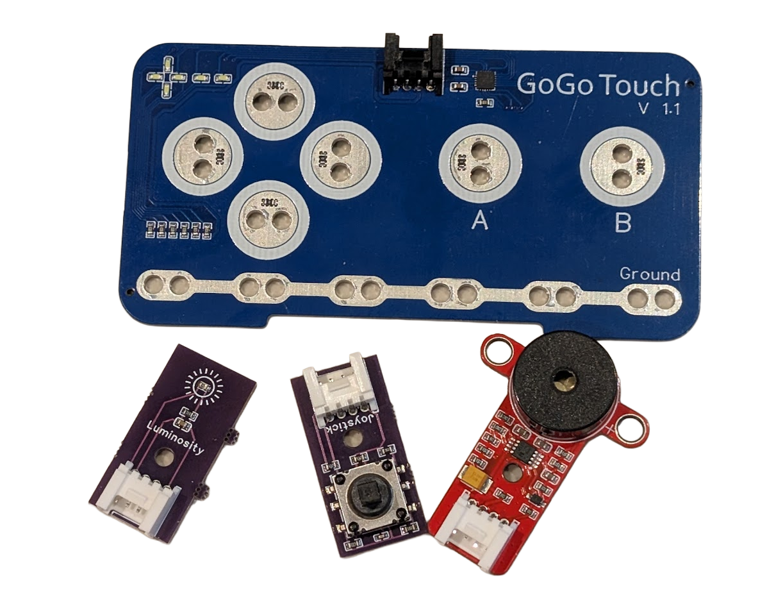
Available Sensors
Mix and match — aim for 1-3 sensors
▸ Button, limit switch, vibration sensor
▸ Brightness sensor, potentiometer (dial)
▸ GoGo Touch module (Chapter 2)
▸ Built-in: accelerometer, lux sensor
Activity 3.4 — Session 4: Design Our Own Game
3
Notes:
Keep scope tight: playable and explainable in about 2 minutes.

Slide 4
Plan on Paper (15 min)
Fill in the mapping table: game action ← key ← sensor ← how it's used
1
Sketch the game screen — where are the sprites, what happens on each key?
2
Show the plan to the teacher before building
3
✎ Workbook — The planning table and sketch space are in Activity 3.4
Activity 3.4 — Session 4: Design Our Own Game
4

Slide 5
Build and Test
GoGo Board side first, then Scratch
One If block per sensor — each sends a different key
1
Test in a text editor: every sensor sends the right key
2
Build the Scratch side — test with the keyboard first
3
Connect the two — sensors last
4
Activity 3.4 — Session 4: Design Our Own Game
5
Notes:
This is the discipline from Session 2: test each side separately, so failures point to one side.

Slide 6
KEY TAKEAWAY
Plan before you build
▸ The mapping table IS the game design
▸ Clear on paper → buildable in code
▸ Fuzzy on paper → fuzzy in code
Activity 3.4 — Session 4: Design Our Own Game
6

Slide 7
Reflection
✎ Workbook — Answer the two reflection questions in Activity 3.4
1. Why is it important to plan the game on paper before building it?
2. If we had more time, what would we add or change?
Activity 3.4 — Session 4: Design Our Own Game
7

