Slide 1
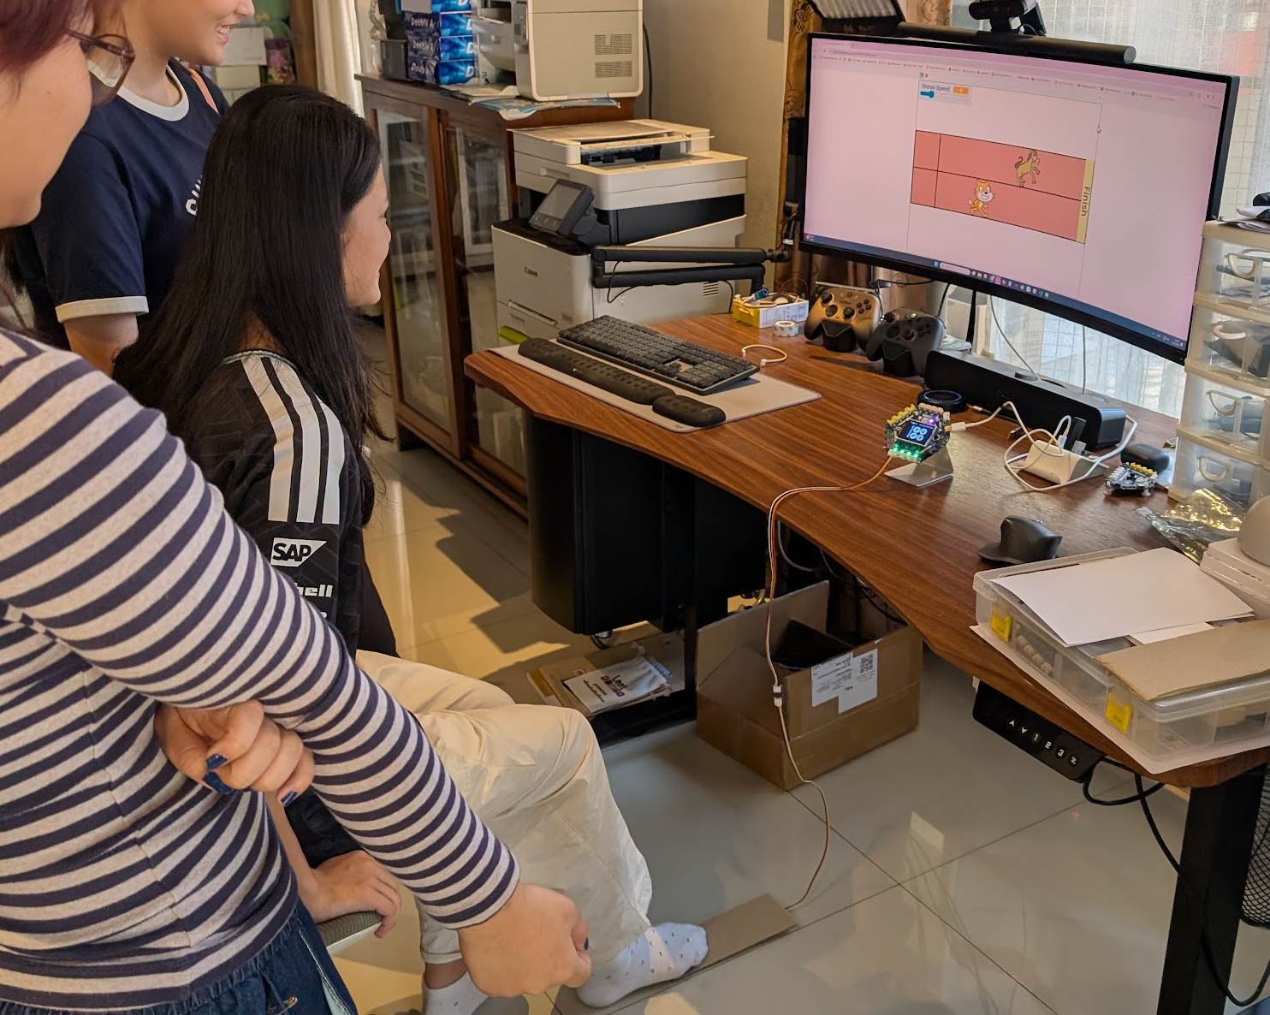
SESSION 5: GAME SHOWCASE
Showcase Day
Present our games, play everyone else's
▸ Set up a game station
▸ Play 2-3 other games and give feedback
▸ 30-second pitch, then voting
Activity 3.5
Time: 45 minutes
Materials: Completed games, GoGo Board, sensors, computer

Slide 2
Setup (5 min)
Get the station ready
Connect the GoGo Board and attach the sensors
1
Open the Scratch game
2
One test run — does everything work?
3
✎ Workbook — Game ready to play? Check it off in Activity 3.5
Activity 3.5 — Session 5: Game Showcase
2

Slide 3
Play Testing (20 min)
Visit 2-3 other stations
Play the group's game
1
Fill in the feedback form: sensors used, what we liked
2
Write one suggestion for improvement — specific and actionable
3
Activity 3.5 — Session 5: Game Showcase
3
Notes:
Model one feedback example first: "the jump felt slow when the barrel sped up — maybe a shorter wait" beats "it's good".

Slide 4
The 30-Second Pitch (10 min)
Each group presents to the class
▸ Game name
▸ How the sensors work
▸ The hardest part
▸ Unfinished games present too: what was planned, what works so far
Activity 3.5 — Session 5: Game Showcase
4
Notes:
Keep the 30 seconds strict — a timer helps. It keeps things moving and makes presenting low-stakes.

Slide 5
Voting (5 min)
Three categories
▸ Most creative sensor use
▸ Most fun to play
▸ Best game design
✎ Workbook — Record the votes in Activity 3.5
Activity 3.5 — Session 5: Game Showcase
5

Slide 6
KEY TAKEAWAY
Every game here is the same pattern
▸ Sensor → key → event → action
▸ What differs is how each group builds on it creatively
▸ Explaining the reasoning behind our decisions matters too
Activity 3.5 — Session 5: Game Showcase
6

Slide 7
Reflection
✎ Workbook — Answer the two reflection questions in Activity 3.5
1. What did we learn from playing other groups' games?
2. What is the dual-system pattern we used throughout this chapter?
Activity 3.5 — Session 5: Game Showcase
7

