Slide 1
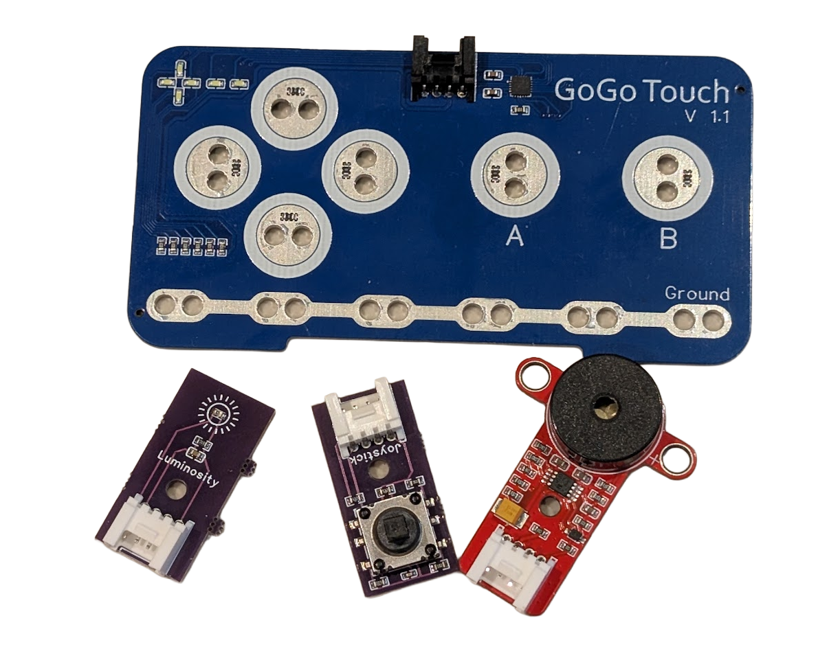
SESSION 6: ASSESSMENT — MUSICAL INSTRUMENT
The Challenge
Build a musical instrument controlled by sensors
▸ Each sensor plays a different sound in Scratch
▸ Same dual-system pattern — completely different purpose
Assessment
Time: 45-60 minutes
Materials: GoGo Board, 3+ sensors, USB cable, computer

Slide 2
Requirements
What the instrument must do
▸ At least 3 sensors, each sending a different key
▸ GoGo Board: one If block per sensor
▸ Scratch: a "when key pressed" for each key — each plays a different sound
▸ Visual feedback when a sound plays (costume or color change)
▸ Perform a short melody or rhythm for the class
Assessment — Session 6: Assessment — Musical Instrument
2

Slide 3
Where the Sounds Live
Scratch has a whole instrument library
▸ Click the Sounds tab to browse and add sounds — drums, guitar, piano, bass
▸ Use "play sound [name] until done" for a full sound per key press
▸ Pick a different sound for each key
Assessment — Session 6: Assessment — Musical Instrument
3
Notes:
"until done" plays the whole sound; the plain "play sound" block can cut off. Let students discover the difference if they ask.

Slide 4
Optional — GoGo Touch Instrument
Want more keys?
▸ The GoGo Touch (Activity 2.5) has 6 touch inputs
▸ Extend the pads with alligator clips to conductive materials
▸ Fruit drums, foil piano keys, play-doh buttons
Assessment — Session 6: Assessment — Musical Instrument
4
Notes:
Offer this to groups that finish the 3-sensor requirement early.

Slide 5
Work Time (30-35 min)
Plan, build both sides, test, debug
Plan the mapping: sensor → key → sound
1
GoGo Board side: one If block per sensor — test in a text editor
2
Scratch side: when key pressed → play sound + visual feedback
3
Debug like Session 2: test each side separately
4
Assessment — Session 6: Assessment — Musical Instrument
5
Notes:
Watch who tests the key in a text editor before blaming Scratch — that two-sided debugging discipline is a rubric criterion.

Slide 6
Perform (5-10 min)
Show the class
Perform a short melody or rhythm
1
Explain: which sensor plays which sound?
2
What was the hardest part?
3
Assessment — Session 6: Assessment — Musical Instrument
6

Slide 7
Chapter Reflection
Write your answers on the task sheet
1. How is building a musical instrument similar to building a game?
2. What is the same pattern used in both the game and the instrument?
Assessment — Session 6: Assessment — Musical Instrument
7

Slide 8
Chapter 3 Summary — What We Learned
1. Scratch uses events — "when key pressed" waits for a key before running
2. GoGo Board and Scratch communicate through keys — USB keyboard meets Scratch events
3. Dual-system programming — two programs, two systems, working together
4. Input comes from many sources — physical sensors, and the microphone Scratch reads directly
5. Game design starts with planning — the sensor-key-action map on paper comes first
Assessment — Session 6: Assessment — Musical Instrument
8

Slide 9
Skills Checklist
Can you do all of these?
☐ Use "when key pressed" to make a sprite respond to the keyboard
☐ Program the GoGo Board to send keys that control Scratch
☐ Connect two systems into a working game
☐ Modify an existing Scratch game with sensor and microphone input
☐ Plan and build an original dual-system project
☐ Present a project and give constructive feedback
Assessment — Session 6: Assessment — Musical Instrument
9

