Slide 1
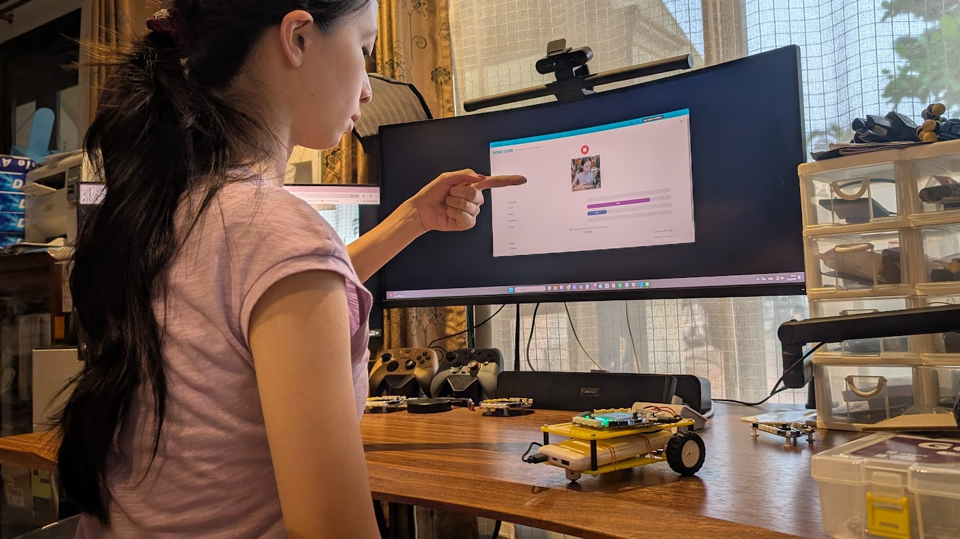
SESSION 1: WHAT IS AI? + ROCK–PAPER–SCISSORS
Chapter 4 — Using AI to Control a Robot
This chapter: train our own AI and control the robot car with gestures
▸ What is AI, really?
▸ Today: play with an AI — and watch it fail
Intro + Activity 4.1
Time: 55 minutes
Materials: Computer with webcam
Game: d.gogoboard.org/rps

Slide 2
What Is AI?
AI finds patterns in data and uses them to produce results
▸ Generative AI — creates new things: text, images, music (chatbots, image generators)
▸ Classification AI — puts inputs into known groups: face recognition, license plates, song identification
▸ This chapter: classification AI — it looks at webcam images and decides which class they belong to
Intro + Activity 4.1 — Session 1: What Is AI? + Rock–Paper–Scissors
2

Slide 3
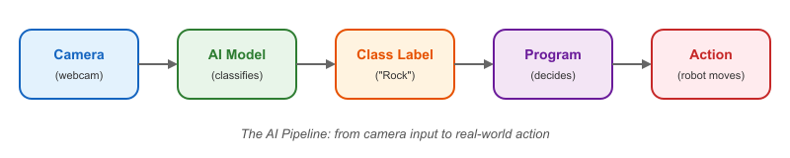
The AI Pipeline
Camera → AI model → class label → program → action
▸ The webcam captures an image
▸ The model classifies it into a label ("Rock")
▸ The program reads the label and acts
Intro + Activity 4.1 — Session 1: What Is AI? + Rock–Paper–Scissors
3

Slide 4
Limitations of AI
AI does not understand meaning
▸ To the AI, a "hand" is just colored dots arranged in a shape
▸ It can only classify what it was trained on
▸ Change the angle, background, or lighting — and it may fail
▸ When AI makes mistakes, the training data was not comprehensive enough
Intro + Activity 4.1 — Session 1: What Is AI? + Rock–Paper–Scissors
4

Slide 5
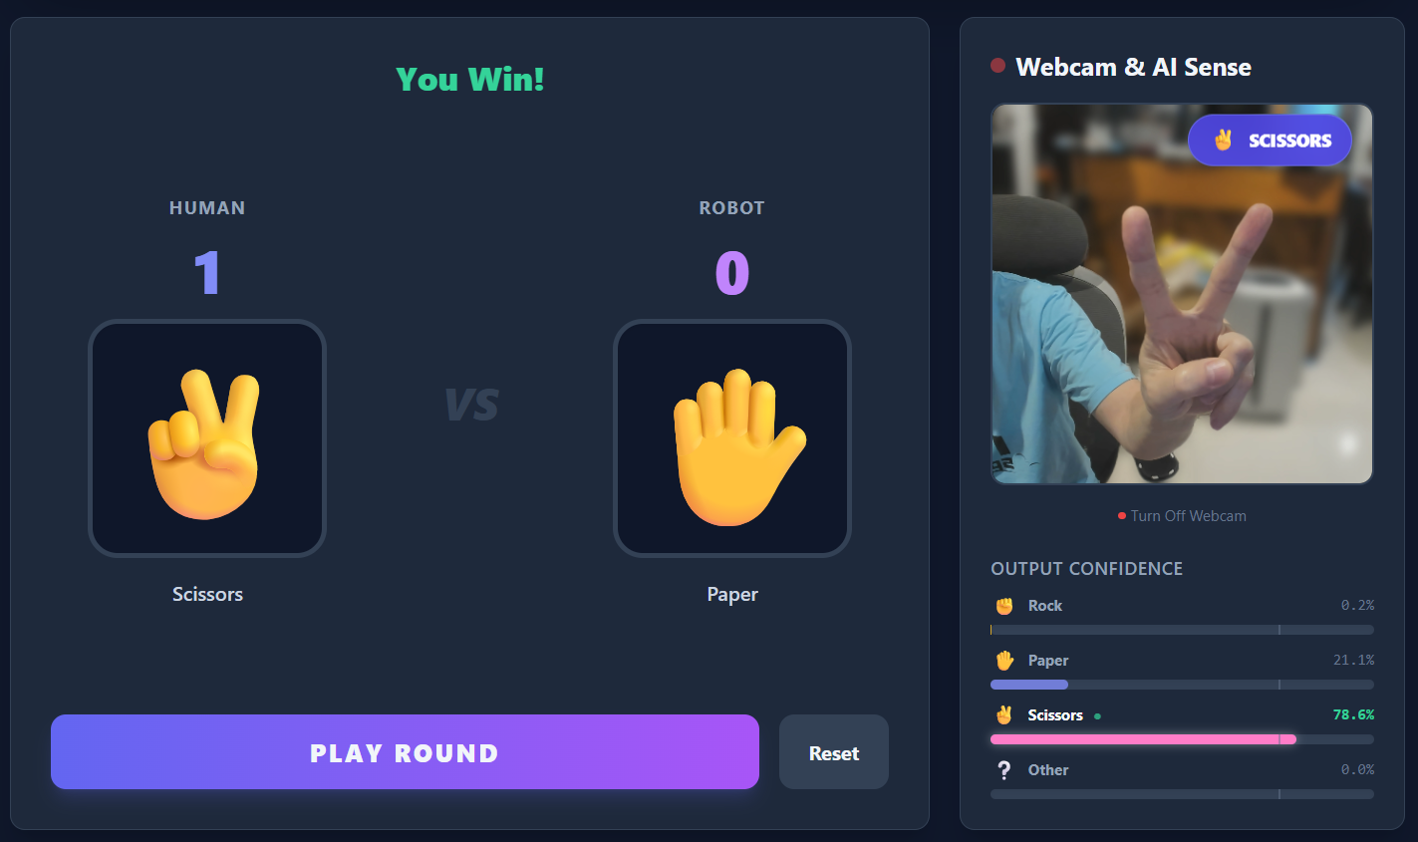
Play the Game (15 min)
Open d.gogoboard.org/rps
1
Allow the browser to access the webcam
2
Show Rock, Paper, Scissors to the camera
3
Does the AI recognize them correctly?
4
Intro + Activity 4.1 — Session 1: What Is AI? + Rock–Paper–Scissors
5
Notes:
The game WILL misclassify — this is intentional. Don't fix it today; 4.2 fixes it by training our own model.

Slide 6
Observe the Problems (15 min)
Count the mistakes
Show each gesture 5 times
1
Record correct vs. wrong in the workbook table
2
Compare with classmates — same gesture, different results?
3
✎ Workbook — Fill in the error-count table in Activity 4.1
Intro + Activity 4.1 — Session 1: What Is AI? + Rock–Paper–Scissors
6

Slide 7

Why Does It Fail?
This model was trained by someone else
▸ Their hands, their camera, their room lighting
▸ It has never seen OUR hands, camera, or lighting
▸ The training images look like this — different from our classroom
Intro + Activity 4.1 — Session 1: What Is AI? + Rock–Paper–Scissors
7

Slide 8
KEY TAKEAWAY
AI does not think — it matches patterns from its training examples
▸ When AI fails, don't ask "why is it stupid?"
▸ Ask: "what was it trained on?"
▸ Next session: we train our own
Intro + Activity 4.1 — Session 1: What Is AI? + Rock–Paper–Scissors
8

Slide 9
Reflection
✎ Workbook — Answer the three reflection questions in Activity 4.1
1. What does the AI use to decide if a gesture is Rock, Paper, or Scissors?
2. Why does the pre-trained AI not work well for us?
3. How could we make the AI work better?
Intro + Activity 4.1 — Session 1: What Is AI? + Rock–Paper–Scissors
9

