Slide 1
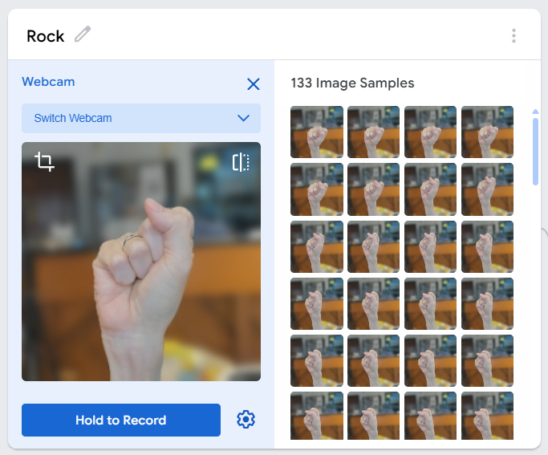
SESSION 2: TRAINING OUR OWN AI MODEL
Today's Goal
Train our own AI model — and beat the pre-trained one
▸ Last time the AI failed us
▸ Today we train it on OUR hands, in OUR room
Activity 4.2
Time: 75 minutes
Materials: Computer with webcam
Webapp: teachablemachine.withgoogle.com

Slide 2
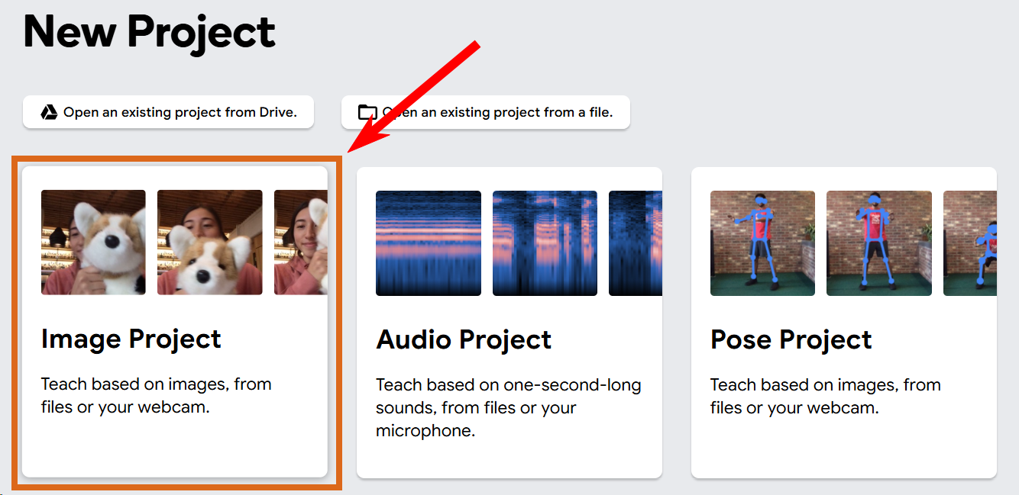
Open Teachable Machine (5 min)
Open teachablemachine.withgoogle.com
1
Select Image Project
2
Choose Standard Image Model
3
Activity 4.2 — Session 2: Training Our Own AI Model
2
Notes:
No account needed. Training happens in the browser — webcam images stay on the computer; only the trained model gets uploaded later.

Slide 3
Create Four Classes (5 min)
A class is a group the AI learns to recognize
Class Name | Gesture
Rock | Closed fist
Paper | Open hand
Scissors | Two fingers out
Other | Background, no hand
Activity 4.2 — Session 2: Training Our Own AI Model
3
Notes:
Other matters: without it, the AI forces every frame into Rock/Paper/Scissors — even an empty background. Class names are case-sensitive and will be typed again later.

Slide 4
Record Training Images (20 min)
Click the Webcam button next to a class
1
Hold the gesture and click Record (hold for continuous capture)
2
Collect 100-200 images per class
3
Vary the angle and position; keep the room's real lighting and background
4
✎ Workbook — Record how many images per class in Activity 4.2
Activity 4.2 — Session 2: Training Our Own AI Model
4

Slide 5
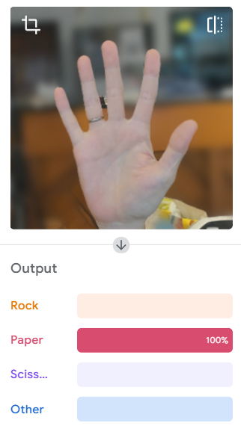
Train and Test (20 min)
Click Train Model — do NOT switch tabs while it runs
1
Watch the live preview: confidence bars show how sure the AI is
2
Show each gesture — correct? confident?
3
Mistakes or low confidence → collect more images for that class, train again
4
✎ Workbook — Fill in the confidence table in Activity 4.2
Activity 4.2 — Session 2: Training Our Own AI Model
5

Slide 6
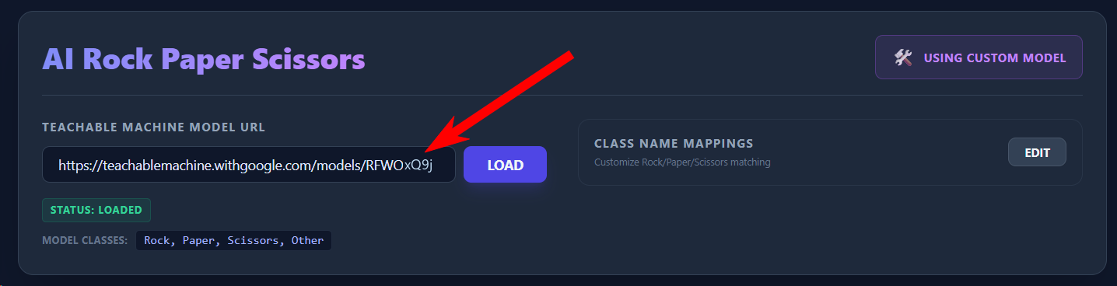
Export and Load Into the Game (10 min)
Click Export Model → Upload my model
1
Copy the link from "Your sharable link"
2
Back in d.gogoboard.org/rps: paste into the MODEL URL box, press Load
3
Class names must match exactly — Rock, Paper, Scissors
4
Activity 4.2 — Session 2: Training Our Own AI Model
6
Notes:
The model must be UPLOADED, not just exported. Loading takes a moment — that's normal.

Slide 7
Compare — and Try to Break It (15 min)
Play with our model, then compare to Activity 4.1
▸ Fill in the confidence comparison table
▸ Which model works better in our classroom? Why?
▸ Try to make it fail: what gesture, background, or lighting breaks even OUR model?
✎ Workbook — Comparison table + "what made our model fail?" in Activity 4.2
Activity 4.2 — Session 2: Training Our Own AI Model
7

Slide 8
KEY TAKEAWAY
Training data quality is the most important factor
▸ More images, more variety, matching conditions
▸ Our model fails the same WAY the pre-trained one did — just in fewer situations
Activity 4.2 — Session 2: Training Our Own AI Model
8

Slide 9
Reflection
✎ Workbook — Answer the four reflection questions in Activity 4.2
1. What are the steps of training a classification AI?
2. Why 100-200 images per class instead of 5-10?
3. What is the difference between the pre-trained model and ours?
4. If we moved to a different classroom, what would we need to do?
Activity 4.2 — Session 2: Training Our Own AI Model
9

