Slide 1
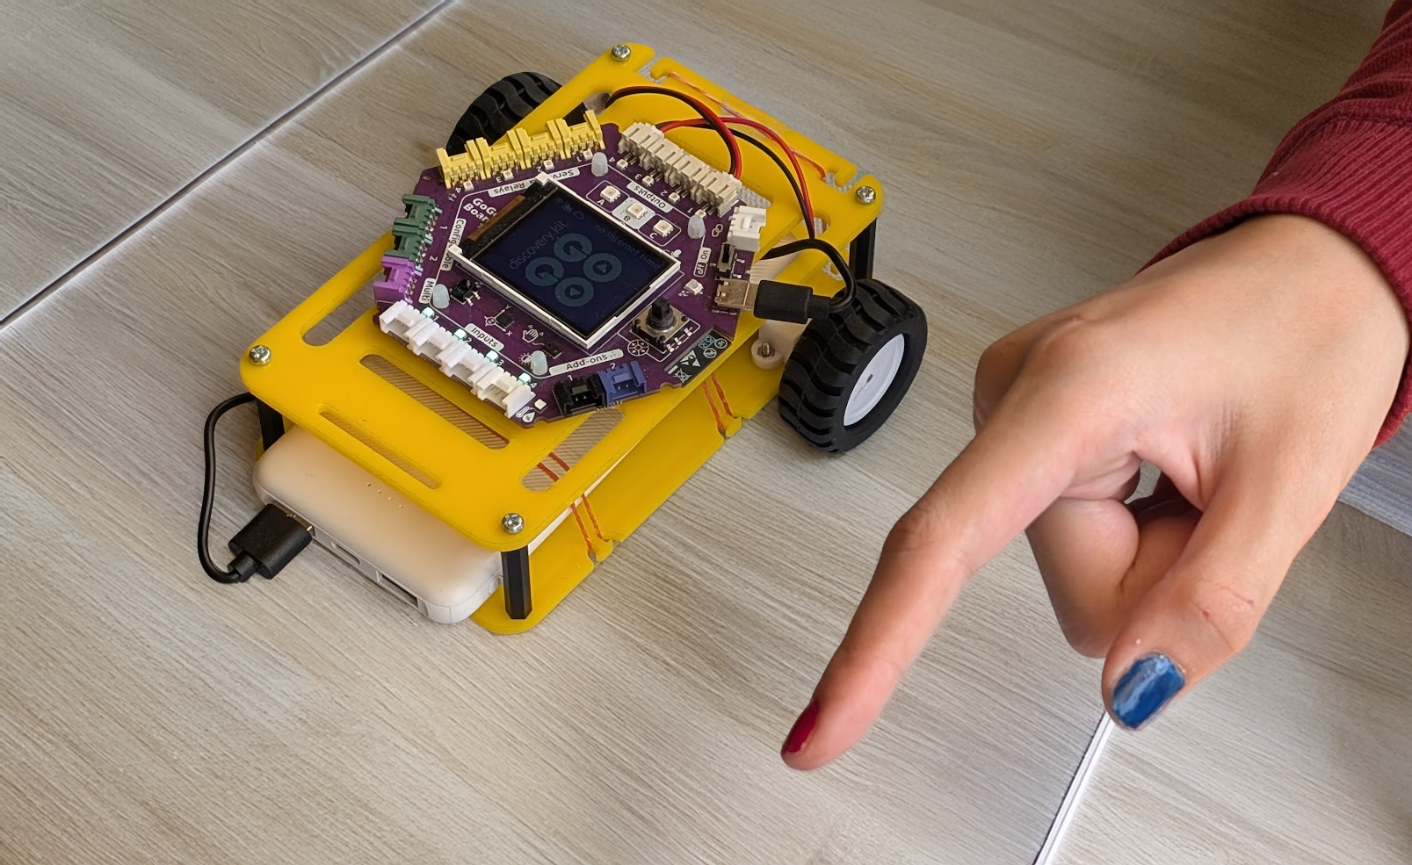
SESSION 3: GESTURE-CONTROLLED ROBOT CAR
Today's Goal
Control the robot car with body gestures
▸ In Chapter 1: IR remote. Today: AI
▸ Needs WiFi — check the board's WiFi icon is green
Activity 4.3
Time: 90 minutes
Materials: Robot car, computer with webcam, WiFi
Template: d.gogoboard.org/car

Slide 2
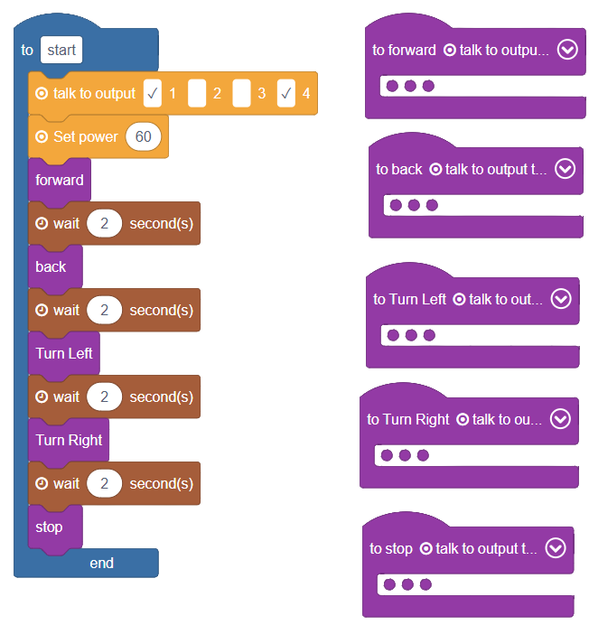
Getting Reacquainted with the Car (10 min)
Open the template: d.gogoboard.org/car
1
It has 5 movement procedures: Forward, Back, Turn Left, Turn Right, Stop — plus a demo program
2
Download and Run — the car runs the demo
3
Try rearranging the demo blocks
4
Activity 4.3 — Session 3: Gesture-Controlled Robot Car
2
Notes:
A procedure is a named group of blocks. The "Set power" block runs the motors at 60% — changing it changes the speed.

Slide 3
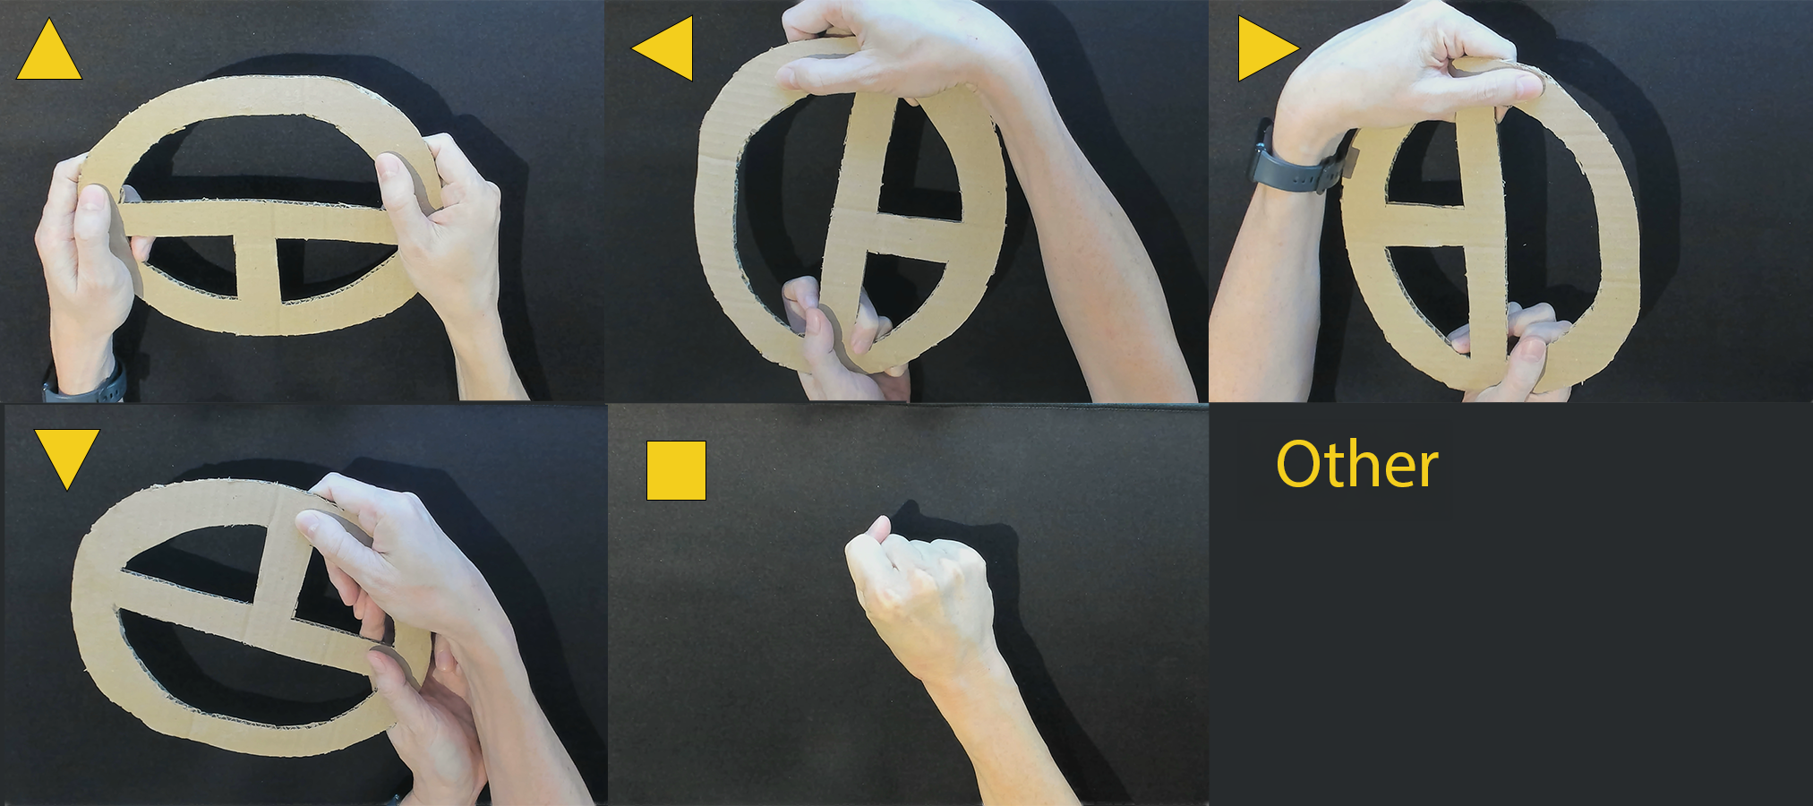
Plan the Gestures (5 min)
Six classes to control the car
▸ Forward, Back, Left, Right, Stop
▸ Other — no gesture, just the background
▸ One rule: gestures must look very different from each other
✎ Workbook — Draw or describe each gesture in Activity 4.3
Activity 4.3 — Session 3: Gesture-Controlled Robot Car
3

Slide 4
Train the Model (15 min)
Same process as Activity 4.2 — new classes
1
New Image Project → Standard Image Model
2
Create the 6 classes: Forward, Back, Left, Right, Stop, Other
3
Record 100-200 images per class, then Train
4
Test in the preview, then Export and copy the link
✎ Workbook — Record the image counts and confidence in Activity 4.3
Activity 4.3 — Session 3: Gesture-Controlled Robot Car
4

Slide 5
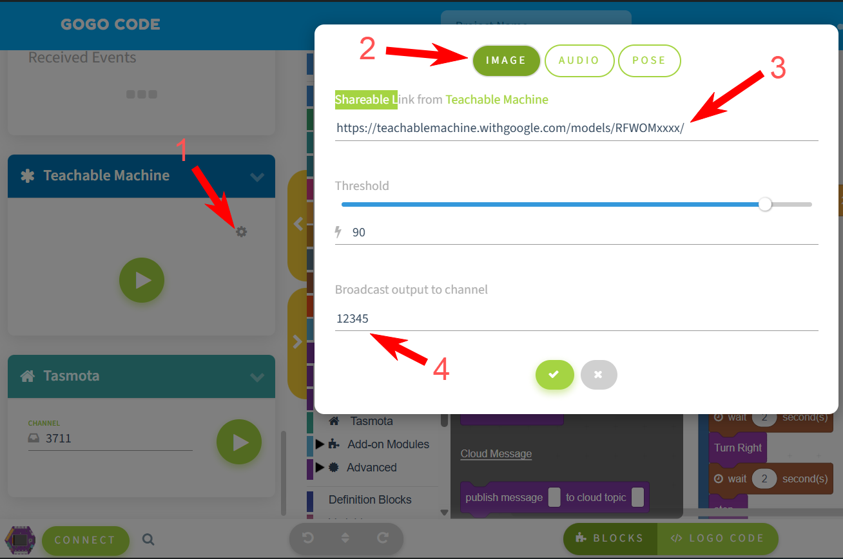
Set Up the Teachable Machine Card (15 min)
In code.gogoboard.org, find the Teachable Machine card and click the gear
1
Select IMAGE as the class type
2
Paste the model link into the URL field
3
Set Broadcast output to channel to an easy number (e.g., 123) — remember it
4
Activity 4.3 — Session 3: Gesture-Controlled Robot Car
5
Notes:
A broadcast channel is a group chat with a number for a name. Each group MUST use a different number — two groups on one channel will control each other's cars.

Slide 6
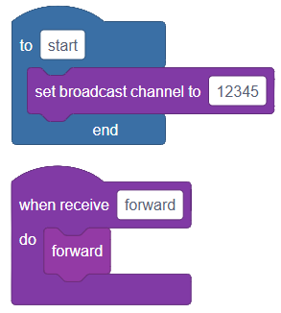
Program the Board (15 min)
Delete the demo — keep all the movement procedures
1
Set broadcast channel (same number) as the FIRST block — not inside a loop
2
When receive "Forward" do → call the Forward procedure
3
Repeat for Back, Left, Right, Stop — no block needed for Other
4
Activity 4.3 — Session 3: Gesture-Controlled Robot Car
6
Notes:
Class names in the When-receive blocks are case-sensitive — they must match the model exactly.

Slide 7
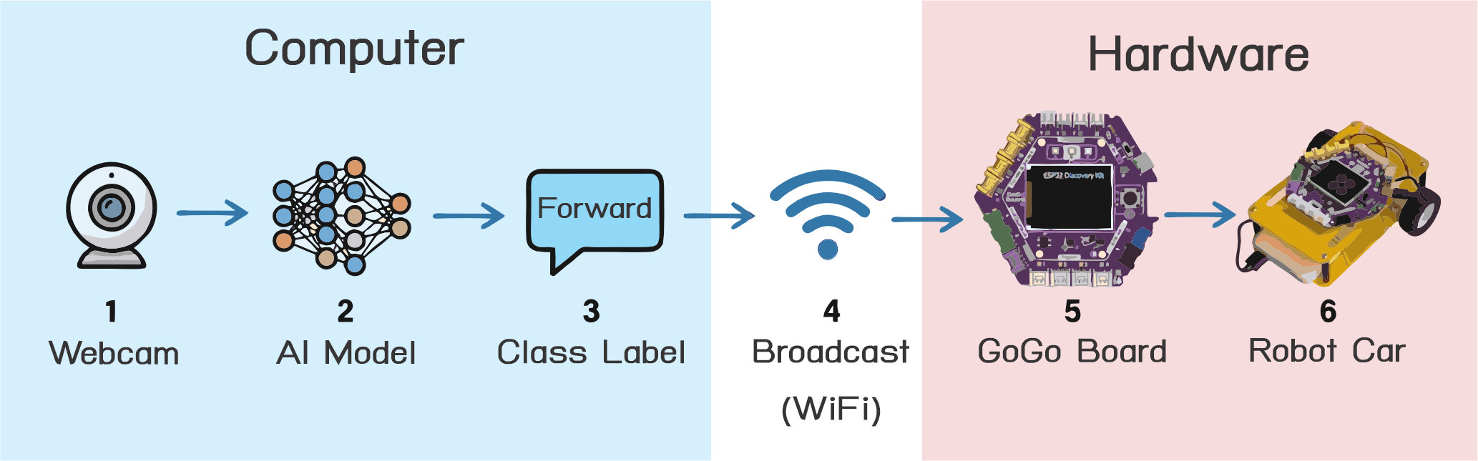
WiFi, Then Test
The AI result travels over WiFi, not USB
▸ WiFi icon on the board must be green
▸ Not green? Use the Network Configuration card
▸ Download, Run, then gesture at the camera
▸ Misclassified? More training images → re-train → re-export → re-load
✎ Workbook — Fill in the gesture test table in Activity 4.3
Activity 4.3 — Session 3: Gesture-Controlled Robot Car
7

Slide 8
KEY TAKEAWAY
This project brings together everything we've learned
▸ Camera → AI model → label → broadcast → robot
▸ Procedures, WiFi, events — and our own trained AI on top
Activity 4.3 — Session 3: Gesture-Controlled Robot Car
8

Slide 9
Reflection
✎ Workbook — Answer the three reflection questions in Activity 4.3
1. Describe the system from gesture to robot movement — every step
2. How is AI control different from the IR remote in Chapter 1?
3. Could this kind of AI control a real vehicle on the road? Why or why not?
Activity 4.3 — Session 3: Gesture-Controlled Robot Car
9

