Slide 1
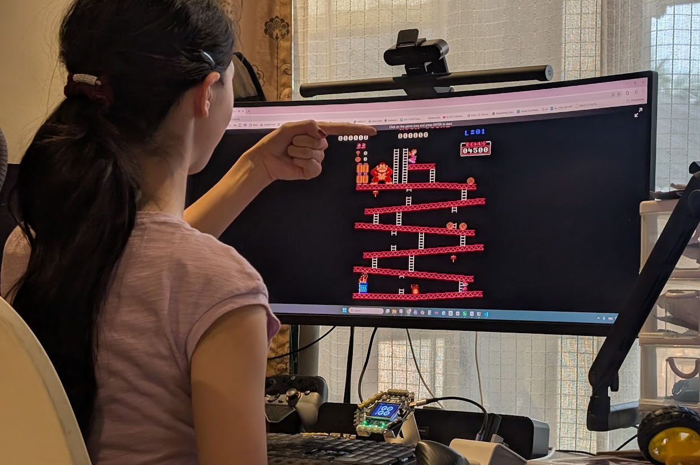
SESSION 4: ASSESSMENT — AI GAME CONTROLLER
The Challenge
Build a game controller powered by AI
▸ In Chapter 2: sensors sent the keys
▸ Now: AI classes send the keys
Assessment
Time: 60-90 minutes
Materials: Computer with webcam, GoGo Board, USB cable

Slide 2
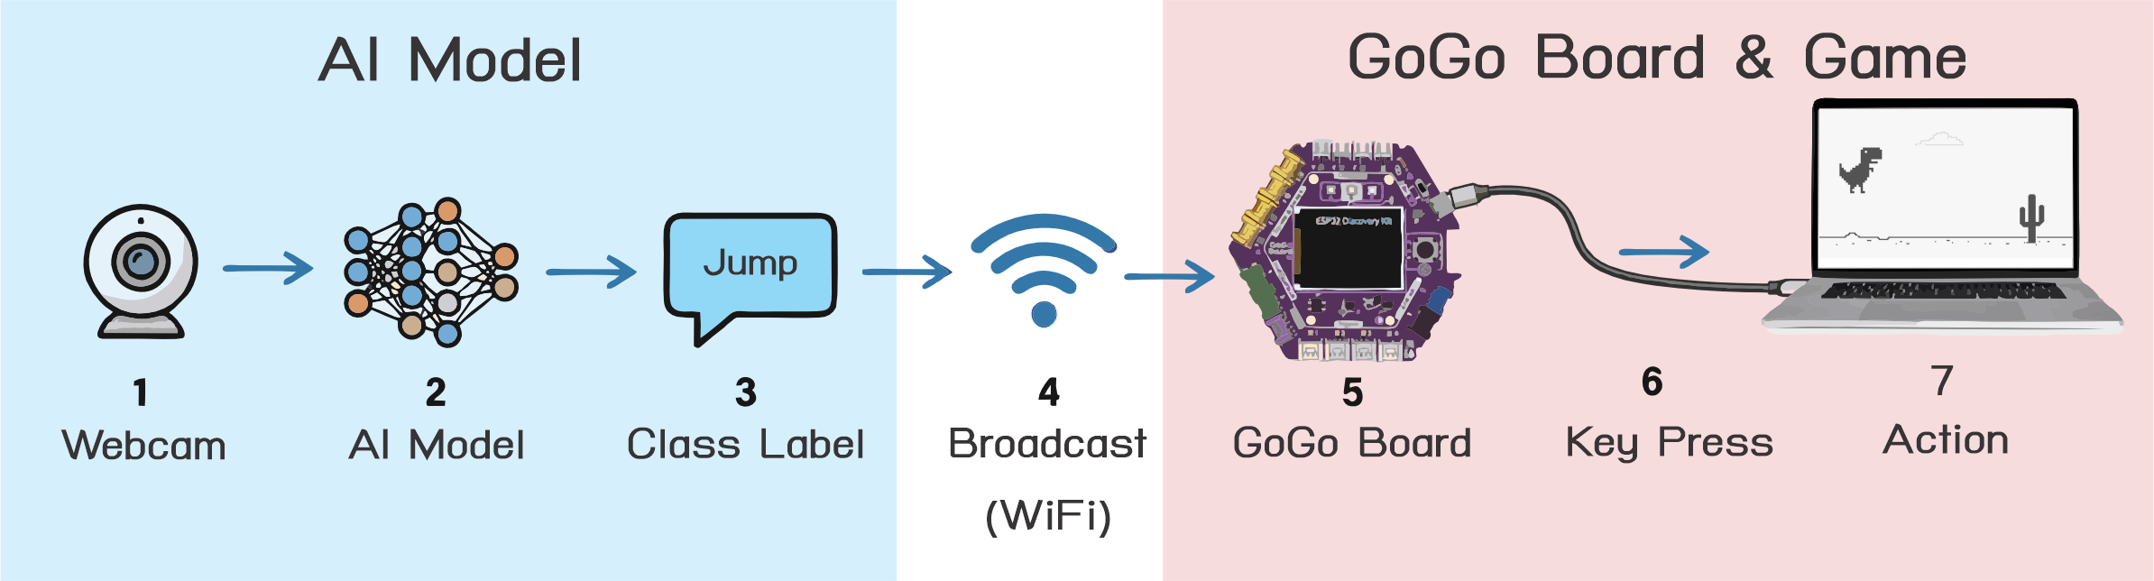
The Pipeline
Camera → AI model → label → broadcast → GoGo Board → key → game
▸ The Teachable Machine card from Activity 4.3
▸ When-receive blocks that send keyboard keys (Chapter 2 skills)
▸ Any game with keyboard controls works
Assessment — Session 4: Assessment — AI Game Controller
2

Slide 3
Project Ideas
Pick one — or invent your own
▸ Gesture-controlled game: lean left or right to steer, raise hands to jump
▸ Facial expression game: happy / sad / surprised → each sends a key
▸ Object controller: pen, eraser, notebook — everyday items become buttons
▸ Bonus: try an AUDIO or POSE model instead of IMAGE
▸ Games with keys: d.gogoboard.org/games
Assessment — Session 4: Assessment — AI Game Controller
3

Slide 4
The Steps
Choose a game — which keys does it use?
1
Plan at least 3 classes — what the AI sees, which key each sends
2
Train (100+ images per class), test in the preview
3
Teachable Machine card + program: Set broadcast channel, When-receive → send key
4
Test the full pipeline, then find one weakness and fix it
5
Assessment — Session 4: Assessment — AI Game Controller
4
Notes:
The improvement step is required — it separates rubric levels better than whether the game works on the first try.

Slide 5
Checklist
Before presenting, make sure you can check all of these
☐ Game chosen and its keys identified
☐ At least 3 AI classes, each mapped to a game key
☐ Model trained with 100+ images per class
☐ Teachable Machine card + GoGo Board program set up
☐ Full pipeline tested: gesture → AI → GoGo Board → game
☐ One weakness found and fixed
☐ Ready to present
Assessment — Session 4: Assessment — AI Game Controller
5

Slide 6
Work Time (40-60 min)
Debug one stage at a time
▸ Model wrong? → check the preview in Teachable Machine
▸ Keys wrong? → test in a text editor
▸ Game ignoring keys? → click the game window (focus!)
Assessment — Session 4: Assessment — AI Game Controller
6
Notes:
Watch who isolates the failing stage — model preview, then text editor, then game. That discipline is a rubric criterion.

Slide 7
Presentations (10-15 min)
Show the class
Play your game with the AI controller
1
Explain the classes and the keys they send
2
What weakness did you find, and how did you fix it?
3
Assessment — Session 4: Assessment — AI Game Controller
7

Slide 8
Chapter Reflection
Write your answers on the task sheet
1. Why is this AI called classification AI?
2. What is the most important thing to get right when training an AI model?
3. If we trained this AI in one classroom and used it in another, what might happen? Why?
Assessment — Session 4: Assessment — AI Game Controller
8

Slide 9
Chapter 4 Summary — What We Learned
1. Classification AI sorts inputs into defined classes — it does not "think"; it matches patterns from training data
2. Pre-trained models have limits — they work best in the conditions they were trained in
3. Training data quality is the most important factor — quantity, variety, and matching conditions
4. The same AI technique works for different tasks — a game, a robot car, a game controller
Assessment — Session 4: Assessment — AI Game Controller
9

Slide 10
Skills Checklist
Can you do all of these?
☐ Use a classification AI and observe when it fails
☐ Create classes and collect training images in Teachable Machine
☐ Train, test, and improve a classification AI model
☐ Export a model and load it into a web application
☐ Compare a pre-trained model with a custom-trained model
☐ Connect an AI model to the GoGo Board to control a robot car
Assessment — Session 4: Assessment — AI Game Controller
10

