Slide 1
Sustainable Heating Solutions in Cold Regions: A Case Study of Þórshöfn, Iceland
Arnar Gylfi Haraldsson
June 11 2025
Reykjavík University
Mechanical Engineering MSc

Slide 2
Agenda
1
Motivation
2
Background
6
Methods
7
Results and Findings
8
Conclusions and Future Directions

Slide 3
Motivation
Most towns in Iceland use cheap geothermal heating
Þórshöfn doesn’t have access to geothermal, relies on electrical heating
Power lines are maxed out — limiting growth
Oil is burned during fish season
Gov’t pays ~2.5 billion ISK/year in subsidies
Wind turbines already being considered (separate from this study)
Goal: Can wind + heat pumps + storage be a better solution?

Slide 4
Background

Slide 5
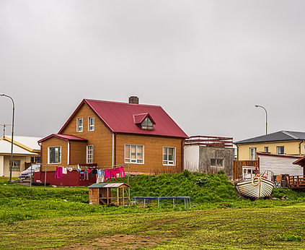
Þórshöfn
Located far north-east
Population 345
Lacks geothermal heat
Electric radiators / water heaters
6 MW transfer limit – fully utilized
Electricity demand increased by ~ 19 MW during pelagic fishing season
Oil burned to bridge the gap
Growth is constrained
Þórshöfn, Einar Páll Svavarsson, hiticeland.com

Slide 6
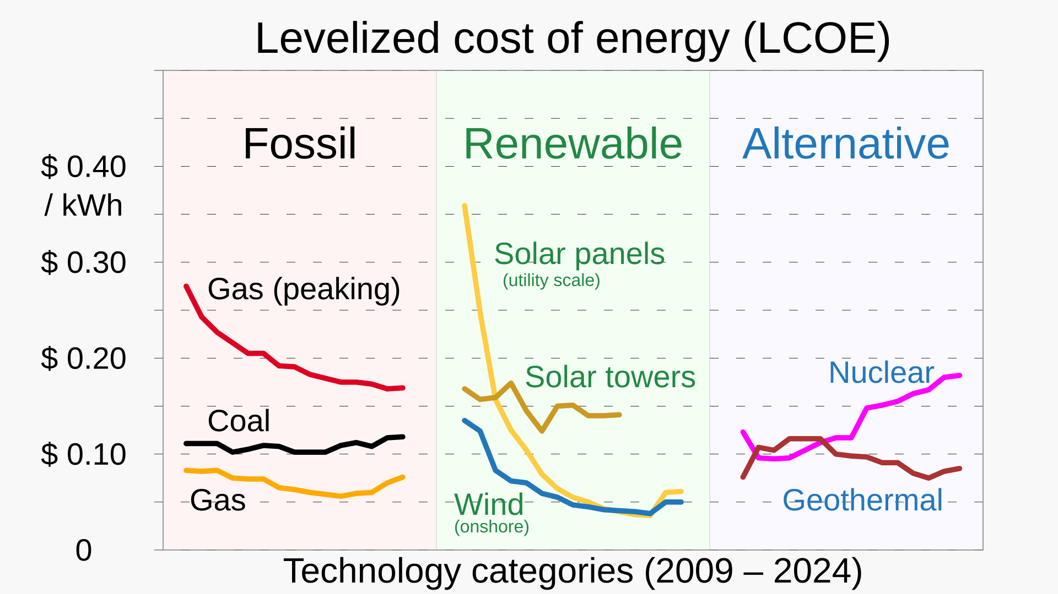


Wind Energy
Low levelized cost of energy (LCOE)
In Þórshöfn:
Suitable wind conditions
Suitable geological conditions
Not much rain $^{1}$
Levelized cost of energy for various sources, Lazard LCOE
${}^{1}$ https://www.langanesbyggd.is/static/files/Skipulagsmal/Vindmyllur2020/beislun-vindorku-i-langanesbyggd-kynning-17112021.pdf
Notes:
LCOE – cost per unit of energy, accounting for capital expenditure, operation and maintenance, transmission etc.

Slide 7
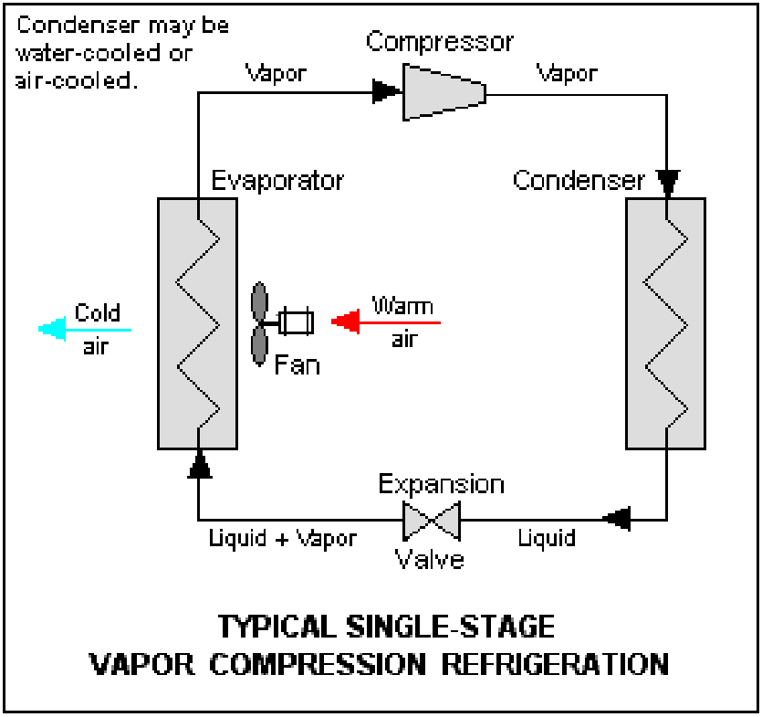
Heat Pumps
Transfers heat
High coefficient of performance, often 3-5
Rising in popularity, particularly in Scandinavia
Different types:
Air source
Ground source – Vertical / Horizontal
Water
Refrigeration cycle, Keenan Pepper

Slide 8
Thermal Storage
Allows the storage of thermal energy for later use
Balance demand between periods of high demand and low demand
Aquifer thermal energy storage
Aquifier thermal energy storage
Borehole Thermal energy storage
Storage tanks
Notes:
Aquifier – dependent on hydrogeological conditions
Borehole – hole filled with grout, paired with a u-shaped heat exchanger – handles high temperatures. Expensive
Storage tanks Can be buried underground to offer structural support and better insulation.

Slide 9
Data & Methodology
Notes:
Python was used for everything, numpy, pandas and matplotlib

Slide 10
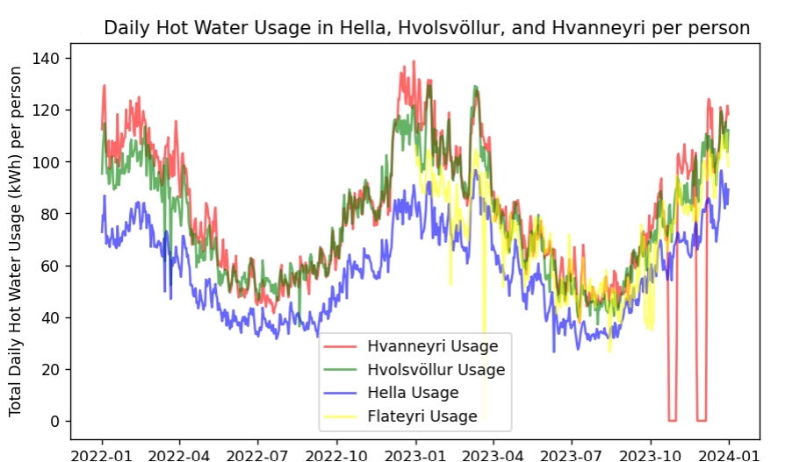

Hot water demand model
Use wind speed and temperature to predict hot water demand
Focus on small towns with centralized hot water supply (Hvanneyri, Flateyri, Hella, and Hvolsvöllur)
Data for windspeeds and temperature from Veðurstofan
Data for water supply temperature and flow rate from Veitur for Hvanneyri, Hella and Hvolsvöllur
Data for power input to central electric boiler for Flateyri from Orkubú Vestfjarða
$Q=mc∆T$
Notes:
So, to simulate hot water demand, instead of calculating heat loss factors from buildings… ármann kom með hugmynd um að….
This method captures heat loss as well as. pipe losses, domestic hot water usage, andhot water usage for swimming pools, among other fact

Slide 11
Linear Regression
Q = aV+bT+C
Q = Hot water demand [kW]
V = Wind speed [m/s]
T = Temperature [°C]
a, b, c = Constants acquired by minimizing the error between aV+bT+c and measured Q
Flateyri data selected for the model.
Closed loop heating system – no need for return temperatures.
Notes:
Linear regression provides a simple and interpretable result – no reason to assume nonlinear effects
The data from Flateyri is selected for the linear regression model because Flateyri operates a closed-loop district heating system, where the return flow is reheated at close to 100% efficiency. This means the measured boiler wattage closely matches the actual heating demand, without requiring assumptions or estimates about the return temperature.
Also from analysing areal photographs

Slide 12

Wind Energy Potential in Þórshöfn
Vestas V136-4.5MW wind turbine used as a reference turbine
Wind speeds at 94 meters are extrapolated based on readings at 25 meters using wind profile power law $V_{1}=V_{2}{\left(\frac{z_{1}}{z_{2}}\right)}^{α}$
Theoretical wind turbine power: $P=\frac{1}{2}C_{p}ρAv^{3}$, $C_{p}=42\%$
10.5% of energy into blade heating during winter months
Combine everything to get power output

Slide 13

Thermal storage capacity
Predicted hot water demand subtracted from hot water generation each timestep.
Minimum thermal storage capacity must equal worst-case cumulative energy deficit
Account for thermal losses, assume 2% each day or 0.084% per hour
Implement following algorithm:
Let $f$ denote hourly thermal loss factor from storage,
$ΔE$ be hot water generation minus hot water load
The required stored energy at hour $i$, $C_{i}$ is computed as follows
$C_{0}=0$
$C_{i}=C_{i−1}−ΔE$ Expand storage to cover energy deficit, contract when there’s a surplus
$C_{i}=\frac{C_{i}}{1−f}$ Expand storage to account for thermal losses
$C_{i}=max⁡(C_{i},0)$ Storage cannot be negative
Notes:
Mention that you also do this in reverse – a normal tank simulation to verify results

Slide 14

Cost optimization
Avoid oversizing heat pump / storage
→Minimum storage capacity computed as a function of heat pump capacity
Preliminary underground water tank cost as a function of volume.
- Based on excavation and steel tank costs
$2000 + 11.7V$ [K ISK]
Preliminary heat pump cost as a function of capacity, sublinear to reflect economy of scale.
$2000 +220 P^{0.8}$ [K ISK]
Cost minimized

Slide 15
Results

Slide 16
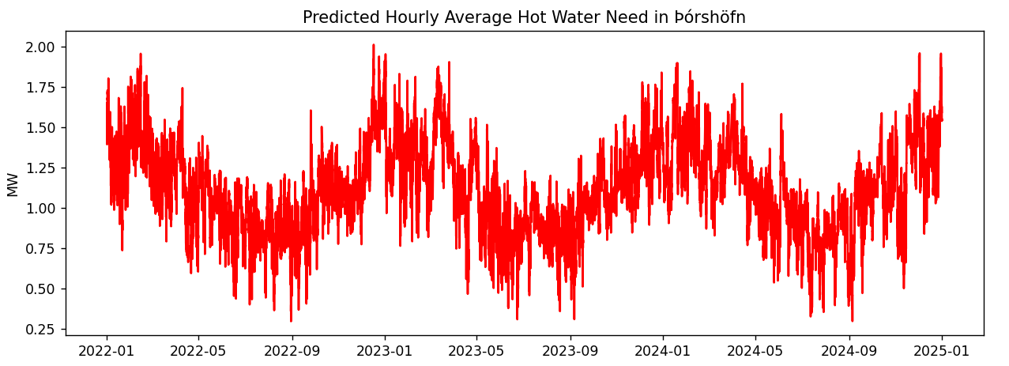
Hot water demand model
Q = 3.251 + 0.064V – 0.130T
1.1 MW average
Model is applied to Hvanneyri, Hella, and Hvolsvöllur
Notes:
Model is applied to Hvanneyri…. To see model accuracy, and if can be applied to different towns.

Slide 17
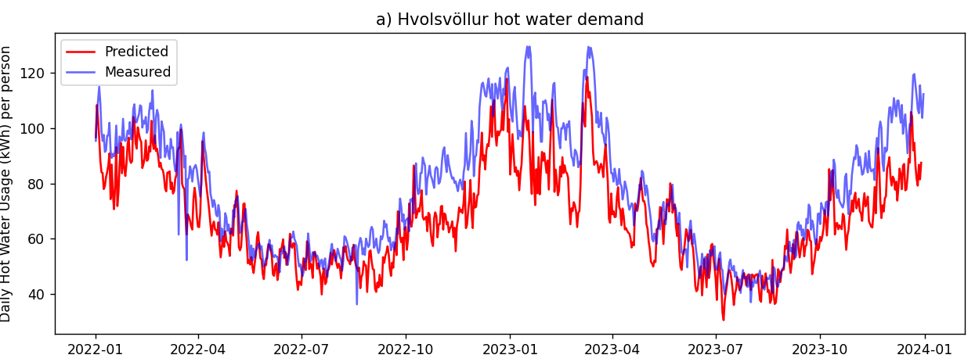
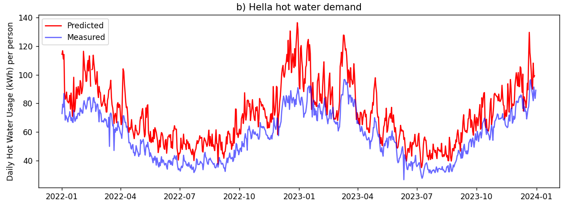
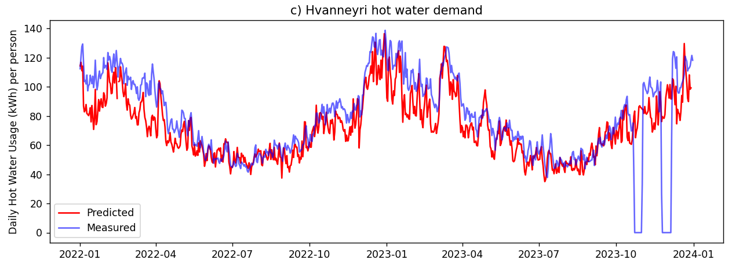
Town | Mean Absolute Error
Hella | 28%
Hvolsvöllur | 13%
Hvanneyri | 13%

Slide 18
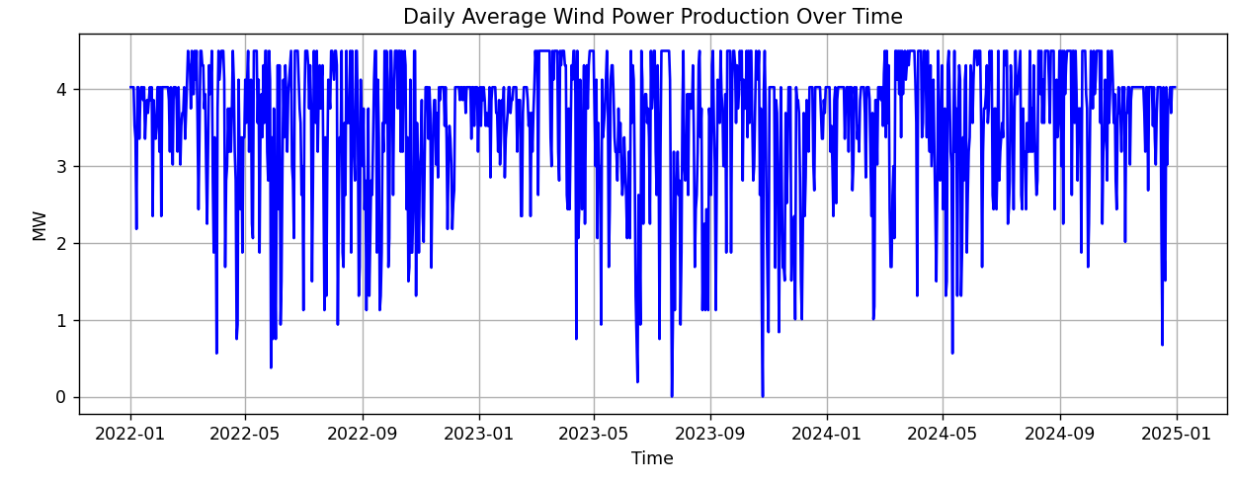
Wind Power
Average 3.86 MW – 86% of rated power

Slide 19
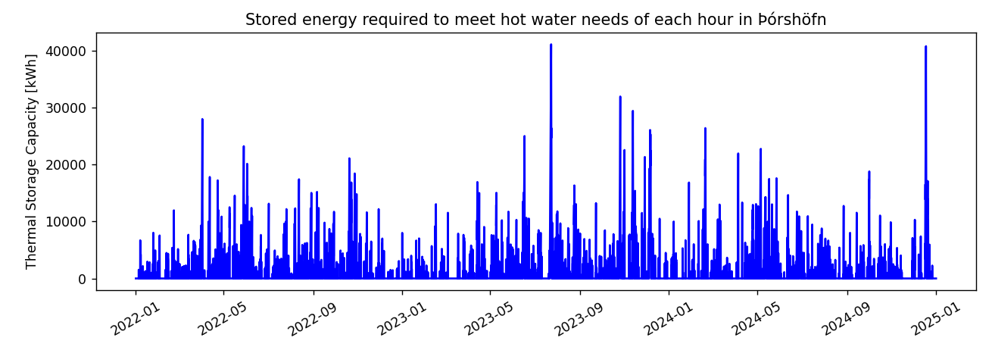
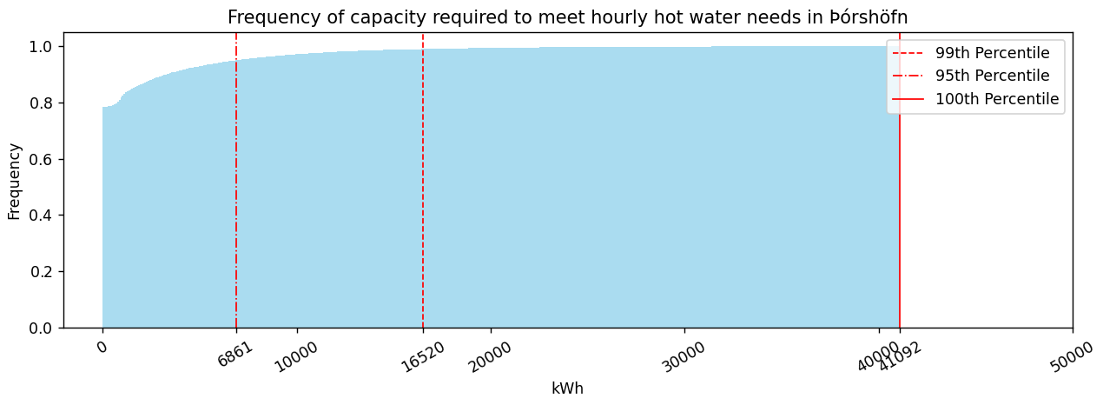
Thermal storage
First assuming all wind power gets converted to hot water 1:1

Slide 20
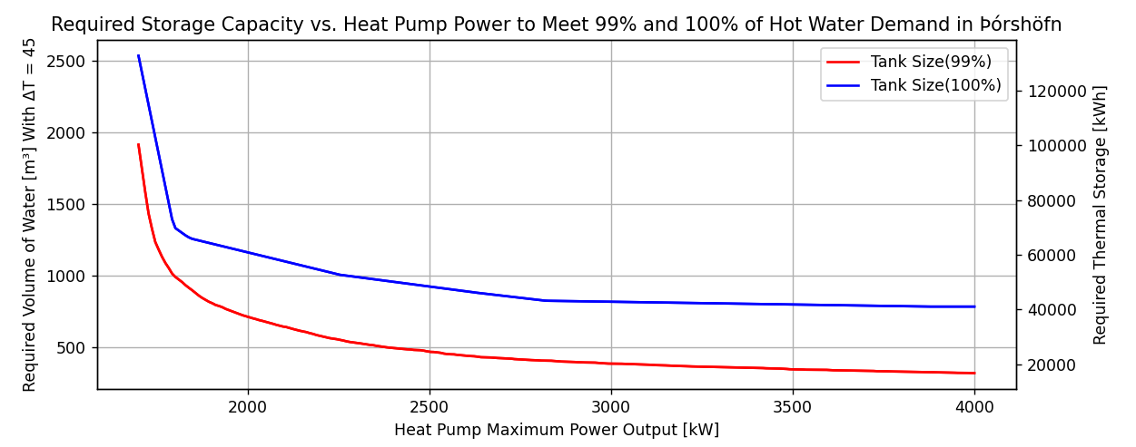
Thermal storage / Heat pump capacity

Slide 21
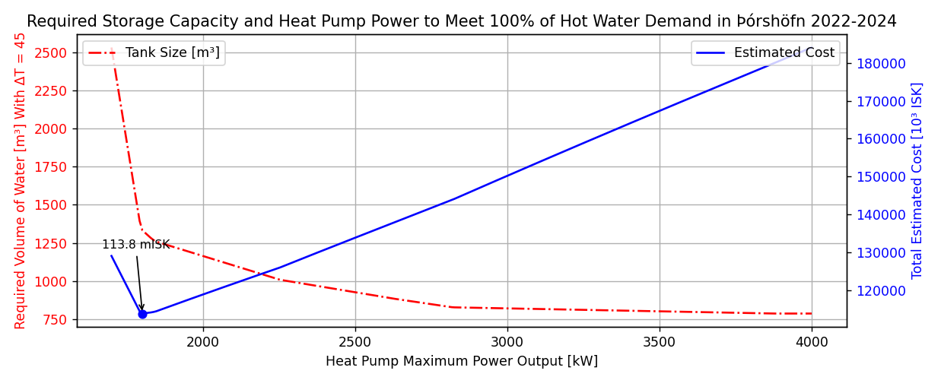
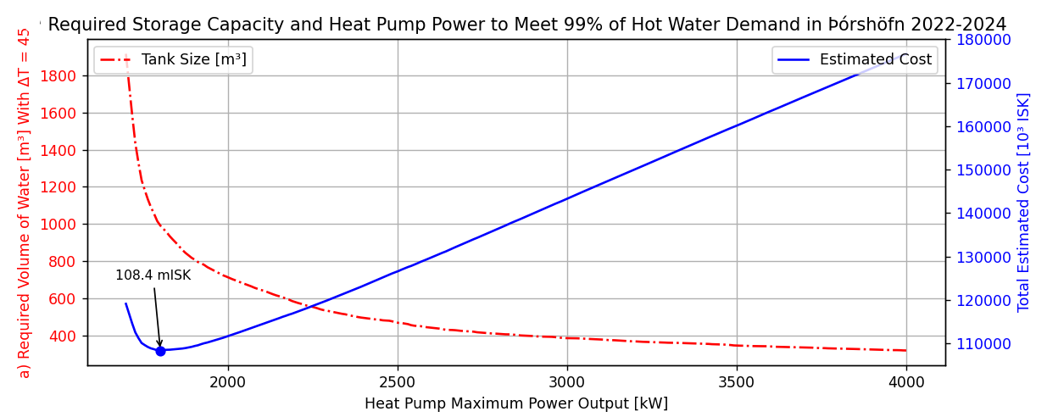

Slide 22

Recommendation/25y total cost comparisons
Recommend 100% coverage system (small extra cost vs 99%)
$1332 m^{3}$ tank + 1801 kW heat pump = 113.8 million ISK
Hot water distribution pipes = 150 M ISK – Total 264 million ISK
Current system
Total projected 25 year heating & hot water demand = 367 GWh
Electricity price in Þórshöfn = 17.73 kr / kWh
Estimated total cost over 25 years = 6.52 billion ISK
Proposed system
Wind energy LCOE: 5.8 kr/kWh
Demand adjusted for COP = 3 and thermal losses:
Capital cost of heat pump, thermal storage and piping included:
860 million ISK ~ 33% of current system

Slide 23
Conclusion
Wind + heat pump + storage is a feasible alternative for Þórshöfn
System could reduce heating costs by 67% over 25 years
Worth serious consideration for Þórshöfn
Concept could enhance energy independence and sustainability
in various communities, e.g., in Canada or Scandinavia
Future analysis should get a more accurate cost estimate of distribution piping network, thermal storage and heat pumps
Include operational expenditure of heat pumps and thermal storage.

Slide 24
Questions?

