Slide 1
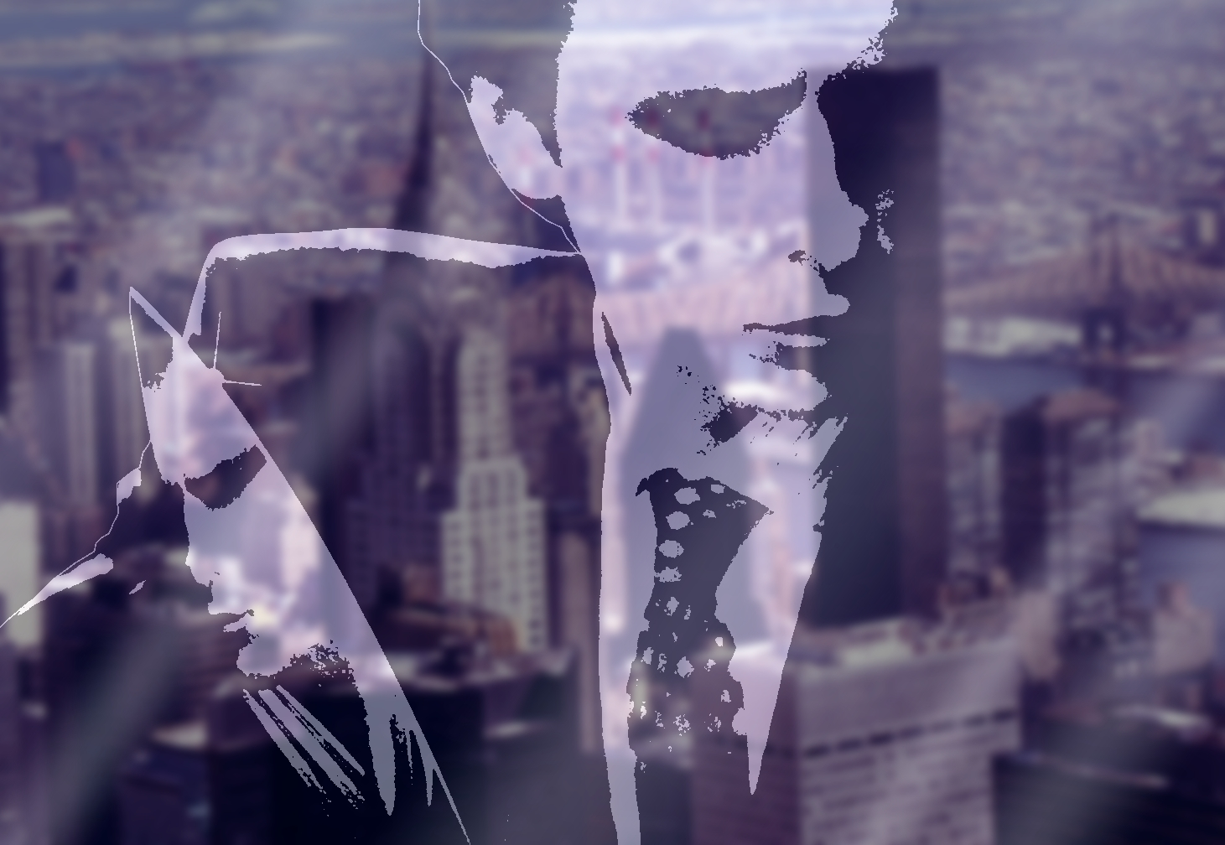

Slide 2
American Psycho
« Monsters are real »

Slide 3
I : General presentation
  About the movie
  Detailed synopsis
  References
II : Analysis
  A superficial society
  Reality or fantasy ?
  Movie posters

Slide 4
I : General presentation

Slide 5
About the movie
Released on a novel by
Directed by bret easton Ellis
Main actor : christian Bale, Jared Leto, Willem Dafoe
Awards and nominations in international festival

Slide 6
Detailled synopsis
A typical American yuppie
Hatred turns into aggressiveness
The beginning of insanity

Slide 7
References
Own personal crime method
  His « criminal mask »
  A killing routine
The Texas Chainsaw Massacre
  The same urge to kill as in the movie
  Influenced by his circle of acquaintances

Slide 8
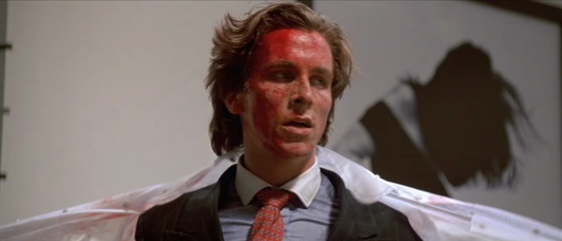
The blood mask

Slide 9
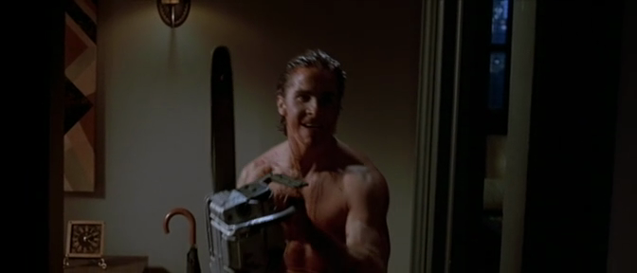
Chase with the chainsaw

Slide 10
II : Analysis

Slide 11
A superficial society
Appearance : the only thing that matters
  Body care
  The finest restaurants (Dorsia)
  Expensive suits
  Always looking for the best

Slide 12
A superficial society
Complete indifference
  Mistaking colleagues for others
  Jokes denigrating people
  Hatred of homosexuals, homeless people, women, animals

Slide 13
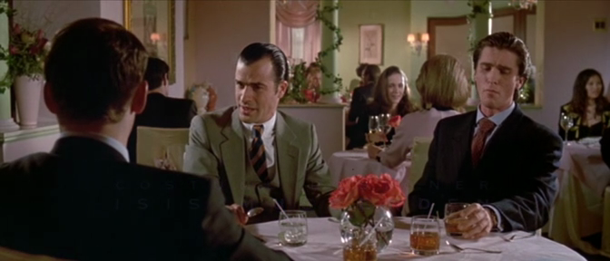
In a luxury restaurant

Slide 14
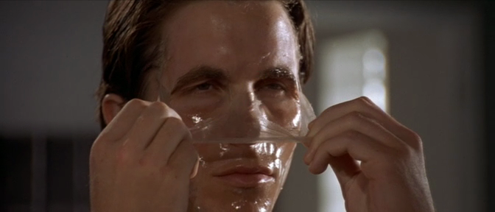
removal of his face mask

Slide 15
Reality or fantasy ?
An ambiguous ending
Two theories about what he really did
A deep criticism

Slide 16
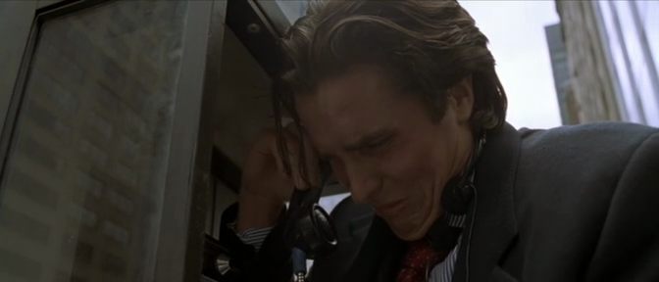
Crying after his nightmare

Slide 17
Movie posters
3 different posters for 3 countries
The main character
Differences and similarities

Slide 18
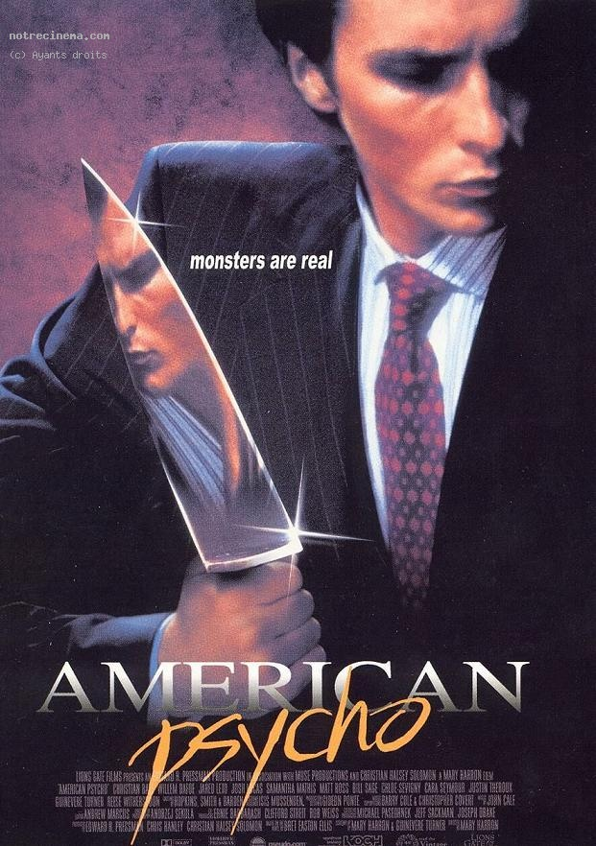
American version
The knife is a mirror
  His other personality
« psycho » handwritten
  His insanity
Looking away
  Denial of who he is

Slide 19

French version
Cold & direct look
  Show his assassin face
The bloodstain
  His bloodthirst, his mask
A lonely man
  His « dark passenger »

Slide 20
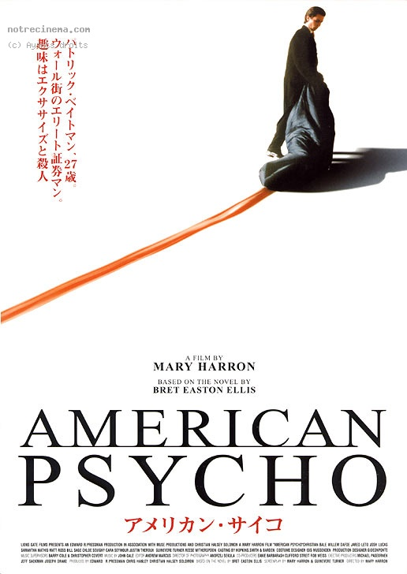
Japanese version
The blood trail
  His main crime
White / red contrast
  Purity / blood
A lonely man
  No-one else there

Slide 21
Acting
(scenes from the movie)

Slide 22
The business cards
A meeting room discussion
The characters' obsession for details
The competition between them

Slide 23
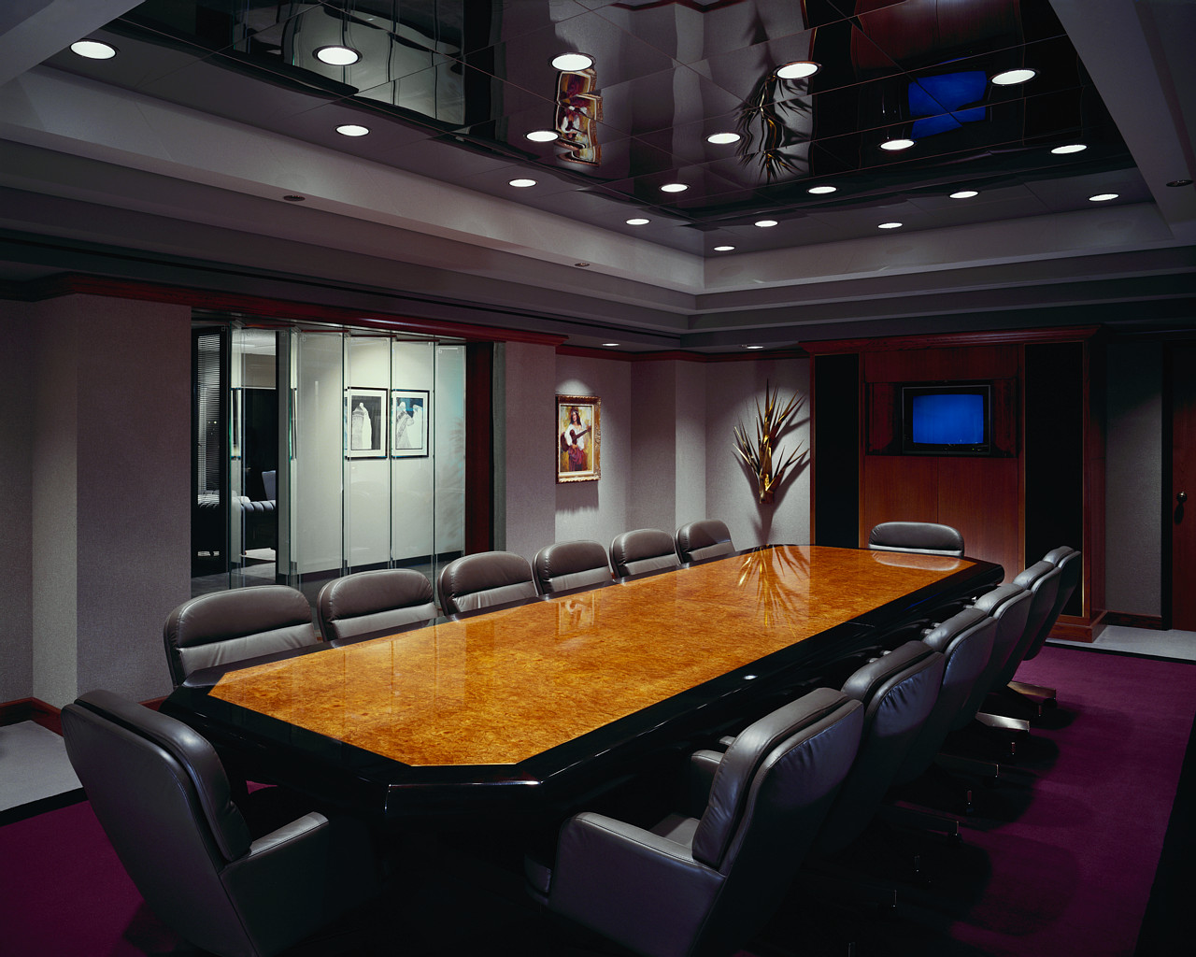

Slide 24
At the restaurant with the detective
After many murders
The third meeting with Donald Kimball
Bateman's obvious anguish

Slide 25


