Slide 1
I’ve built what was missing in PSRemoting
Arnaud Charles

Slide 2
Many thanks to our sponsors:

Slide 3







Arnaud Charles
Born in 1992, on Windows since Win95, employee in IT since 2015
Helpdesk → Sysadmin → Cloud Engineer → Devops → SRE
Joined Worldline end of 2023
🇧🇪
Expert in nothing, versatile generalist like a multitool
Came to PSConf in 2024 and 2025
https://www.linkedin.com/in/arnaudcharles
https://github.com/arnaudcharles

Slide 4

How it started
PSConf 2024: Lost and impressed

Slide 5

How it started
PSConf 2025: Changed my mind. Think different

Slide 6
The need that create the idea
💡 I’m missing a simple way to edit file remotely
📌 Requirements :
- No dependency
- WinRM over HTTPS
Easy to operate
✔️ Internal PowerShell module
✔️ PCI DSS Compliant
✔️ No need to add external apps that add risk
✔️ No licenses or justification to provide to auditor
✔️ Keep working with AD DS Tier Model
✔️ Doesn’t need approval or big changes
✔️ No PSEdit with ISE
✔️ No Get-Content / Set-Content
✔️ No need RDP with notepad

Slide 7

PSBITE is born
"PowerShell Buffer Insert Text Editor"
VIM-like text editor
Provides a familiar VIM interface with NORMAL and INSERT modes
Character operations, and real-time remote synchronization.
> Install-PSResource -Name PSBITE
> Import-Module -Name PSBITE
Start-PSBite -FilePath "C:\scripts\remote.ps1" -ComputerName "server01"
Edit-RemoteFile -ComputerName "server01" -RemotePath "C:\Scripts\test.ps1" -Dual

Slide 8
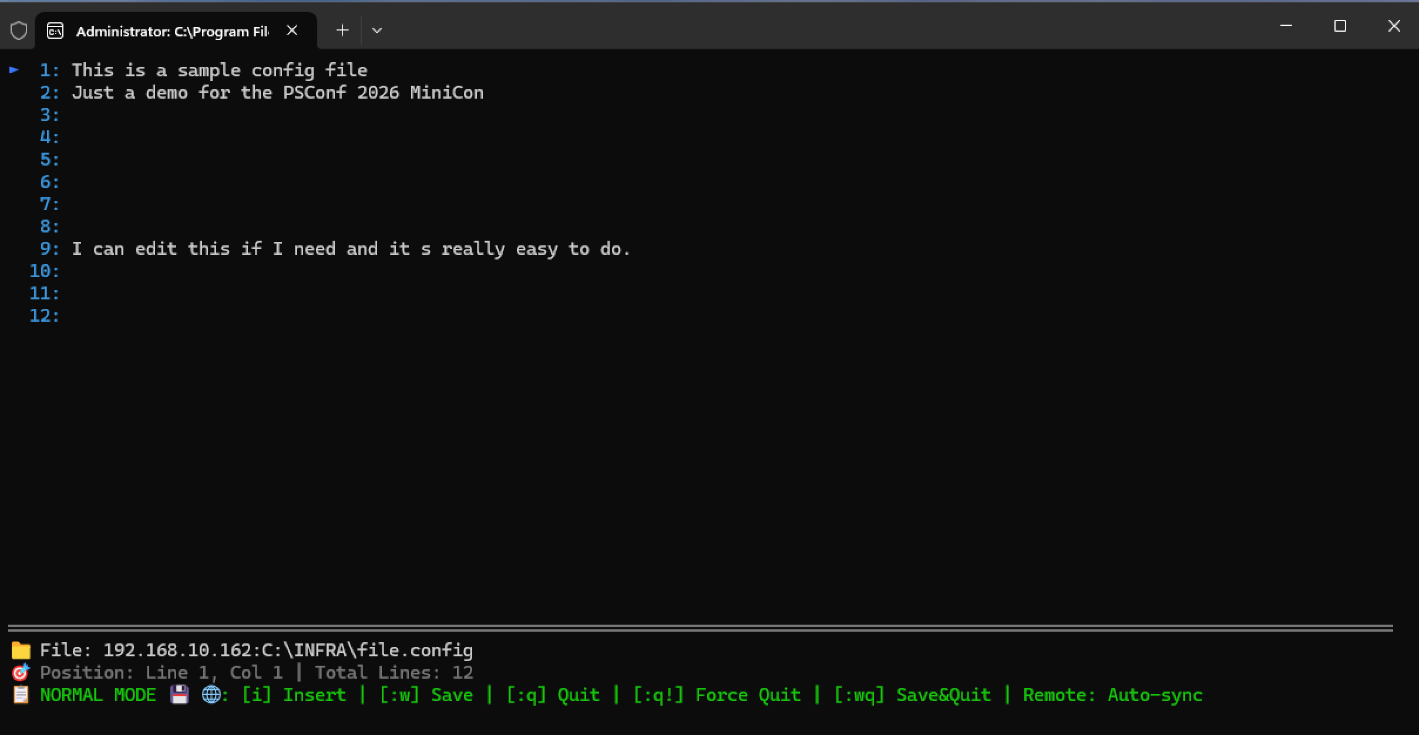

- i : Enter INSERT mode
- Esc : Enter NORMAL mode
- y : Yank (copy) line
- dd : Delete line
- p : Paste line
- :w : Save file
- :q : Quit
- :q! : Quit without saving
- :wq : Save and quit
What’s the path again ?

Slide 9

PSWEE came in
"PowerShell WinRM Emulated Explorer"
🔗 No dependency | 🔒 Secure | ⌨️ Keyboard only | 📝 PSBite integration | 🫧 Lightweight
> Install-PSResource -Name PSWEE
> Import-Module -Name PSWEE
Start-PSWEE -ComputerName "server01.mydomain.io"

Slide 10
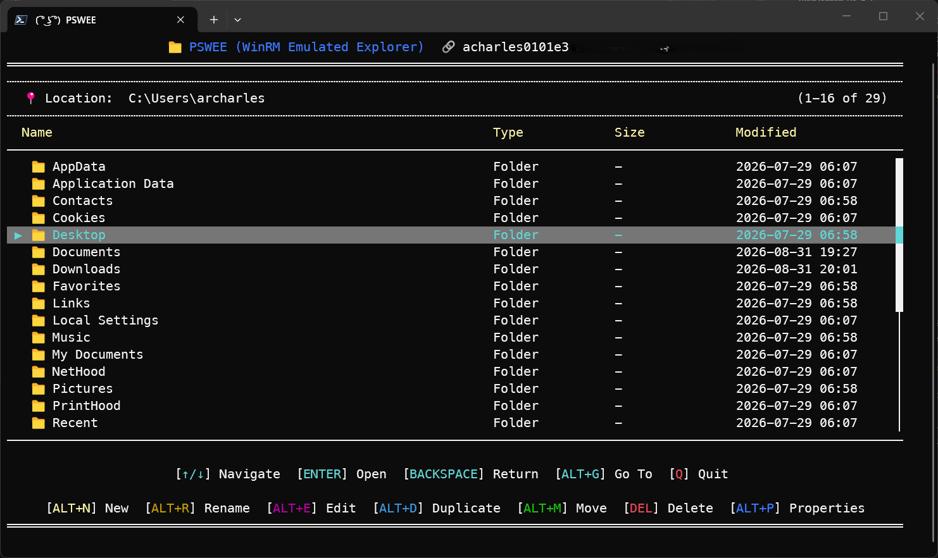

Slide 11
Demos
We love Demos!

Slide 12
Q&A
15 minutes

