Slide 1
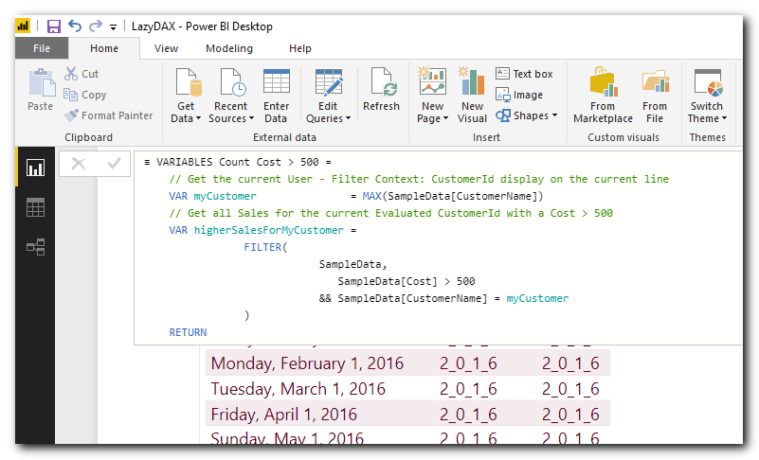

LazyDAX
Learn DAX from examples

Slide 2
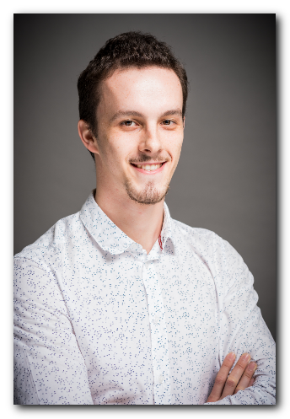
About us
Mathieu Ricour
Business Intelligence consultant
Mathieu is a young graduated with a Bachelor in E-Business.
He has a wide variety of skills related to computer sciences.
He tries everyday to master the deep mechanism of DAX language, Power BI and Analysis services.
He is also a real team player with a Scrum Master certification.
His goal is to keep focus on the Microsoft Data platform products.
Linkedin

Slide 3

About us
Arnaud GASTELBLUM
Business Intelligence Consultant, Microsoft Data Platform Specialist
Arnaud is a technical architect specialized in the Microsoft Data Platform. As a consultant, it is his main goal to make sure his clients get the most out of their data. In his 10+ years of experience, he has gained a lot of expertise in the Microsoft BI stack, specializing mostly in SQL Server, Integration Services, Analysis Services and the Power BI suite. He also loves to share his knowledge with others, making him a great consultant and coach. He has a passion for Data Modeling and always strives to find the right solution for any problem he is faced with. Specialties: Microsoft SQL Server, Analysis Services (Tabular, Multidimensional), Integration Services, Power BI, SSDT, DAX, Data Modeling, Azure, C# Some colleagues and friends motivated him to share his knowledge and BI discoveries to a bigger network. That’s why he started a blog: www.lazysnail.net
Linkedin
Twitter

Slide 4
LazyDax
1. Most Common Functions

Slide 5
A
The Dataset

Slide 6
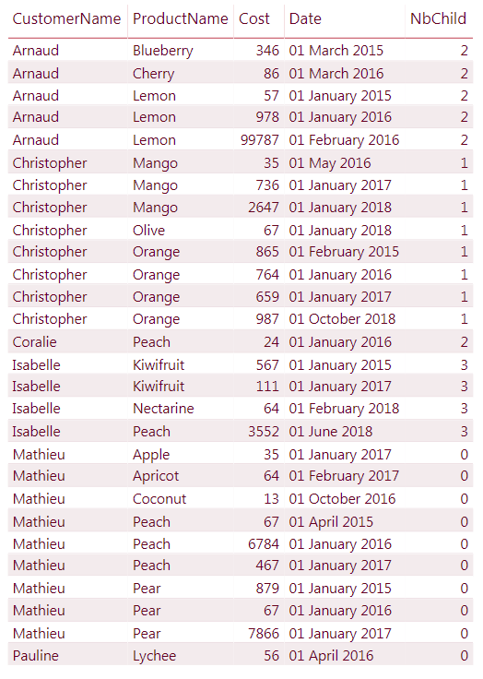
Most common functions
Sample Data
Download our PBI Example file
All our scripts and (many more) examples are available in a Power BI Desktop file. Feel free to download It on www.lazysnail.net
Please send us your changes, corrections or evolutions! We will be happy to improve it! ☺
The dataset
Our examples are based on a small and simple dataset (CFR screenshot below)
Multiple customers present multiple times in the same year
Multiple products for the same customers
Multiple customers with the same product
Customers buying or not from years to years

Slide 7
B
Basic Calculation

Slide 8

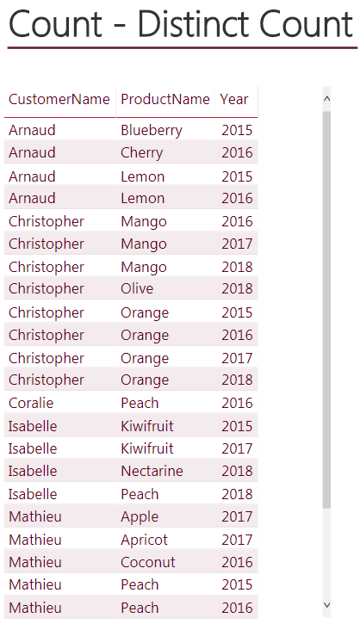
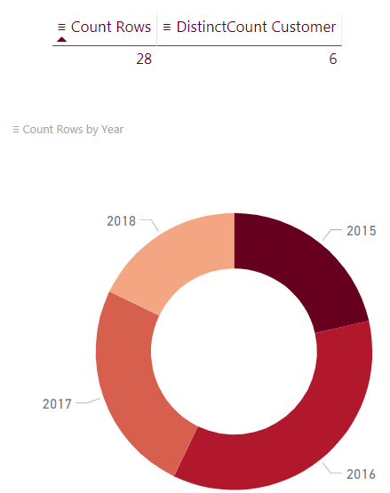

Most common functions
Basic calculation
Count: Number of customers
Distinctcount: Distinct number of customers

Slide 9
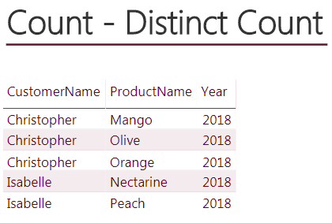
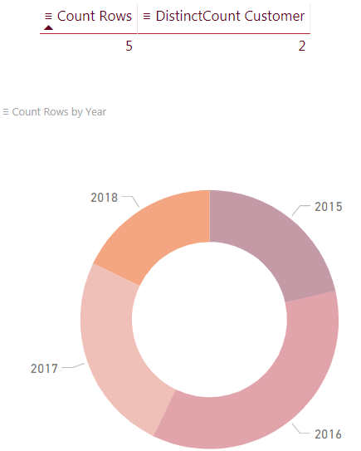
Most common functions
Basic calculation
Count: Number of customers
Distinctcount: Distinct number of customers

Slide 10
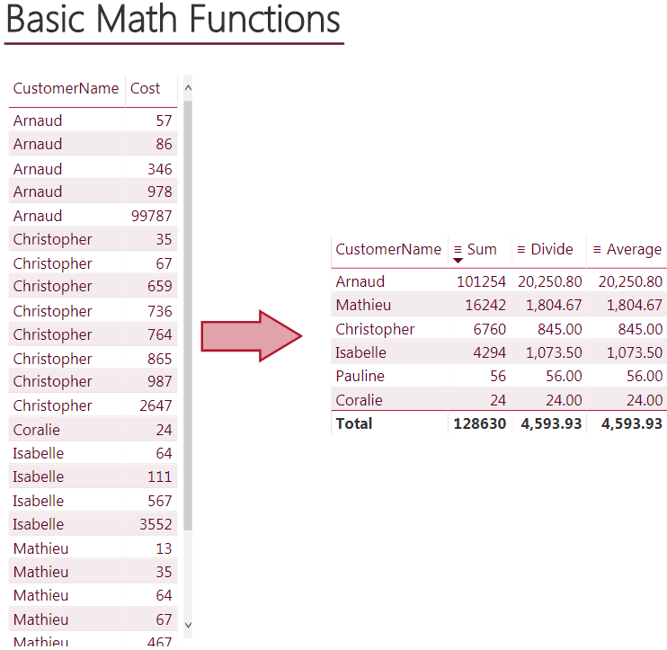

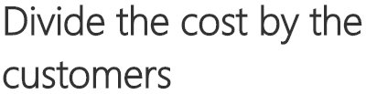
Most common functions
Basic calculation
Sum
Divide
Average

Slide 11
C
Calculate & Filter

Slide 12
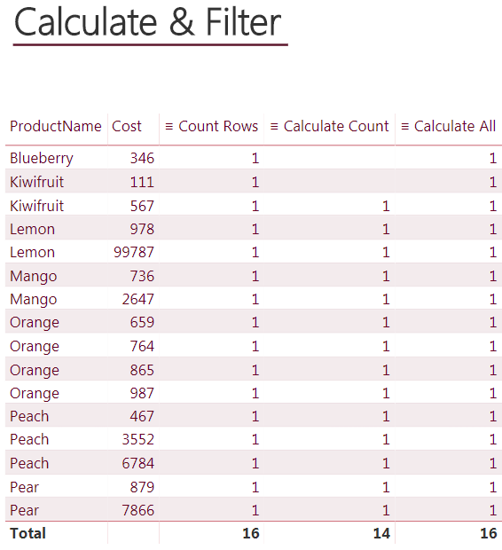
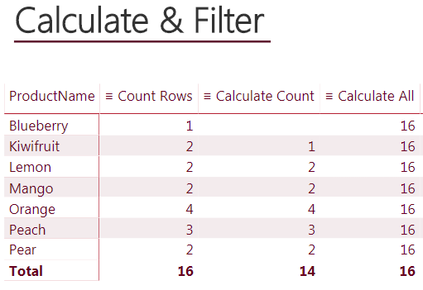
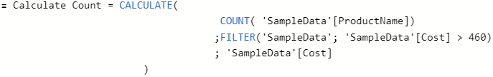

Most common functions
Calculate & Filter
Calculate Count
Number of products with cost greater than 460
Calculate All
Remove all filters even the context filter and display the total
number of products on each rows

Slide 13
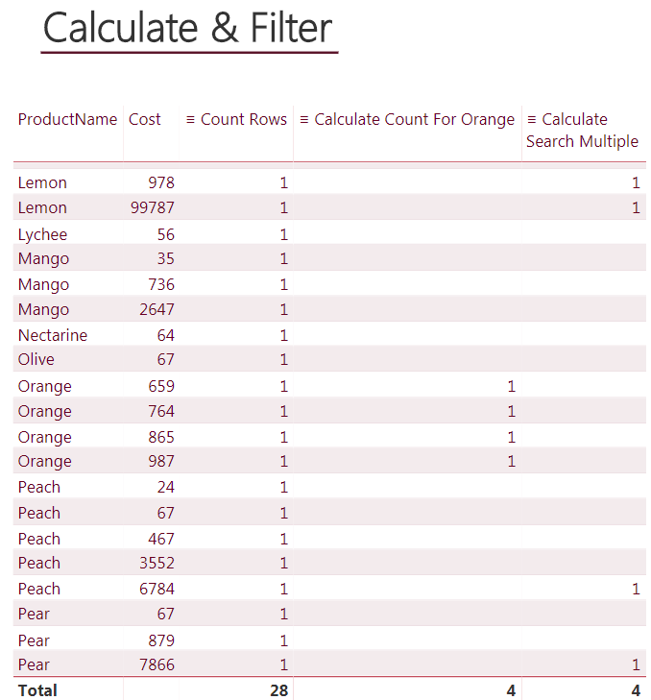

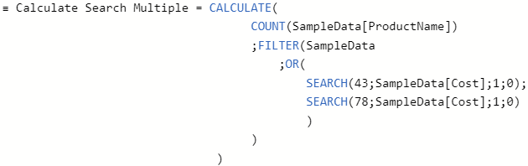
Most common functions
Calculate & Filter
Calculate Count Filter
Count the number of products “Orange”
Calculate Search Multiple
Count the number of products with a cost containing “43” or “78”

Slide 14
D
Time Intelligence

Slide 15
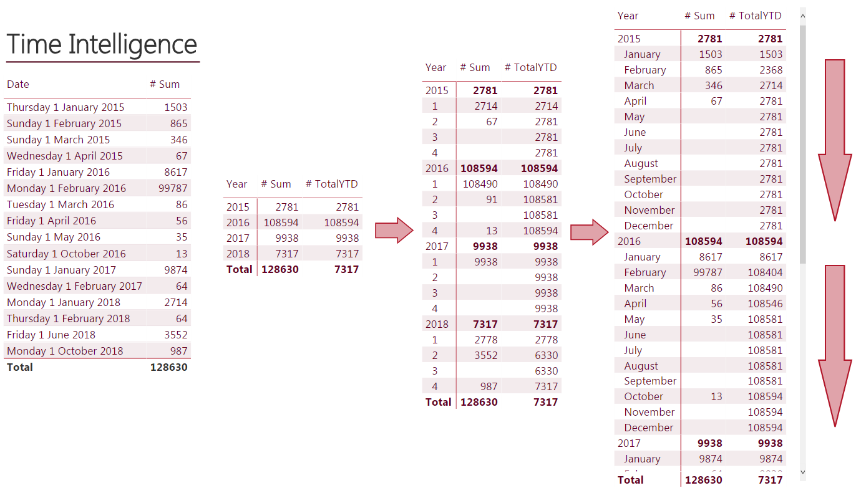

Most common functions
Time intelligence
TotalYTD
Cumulative amount of costs for each year

Slide 16
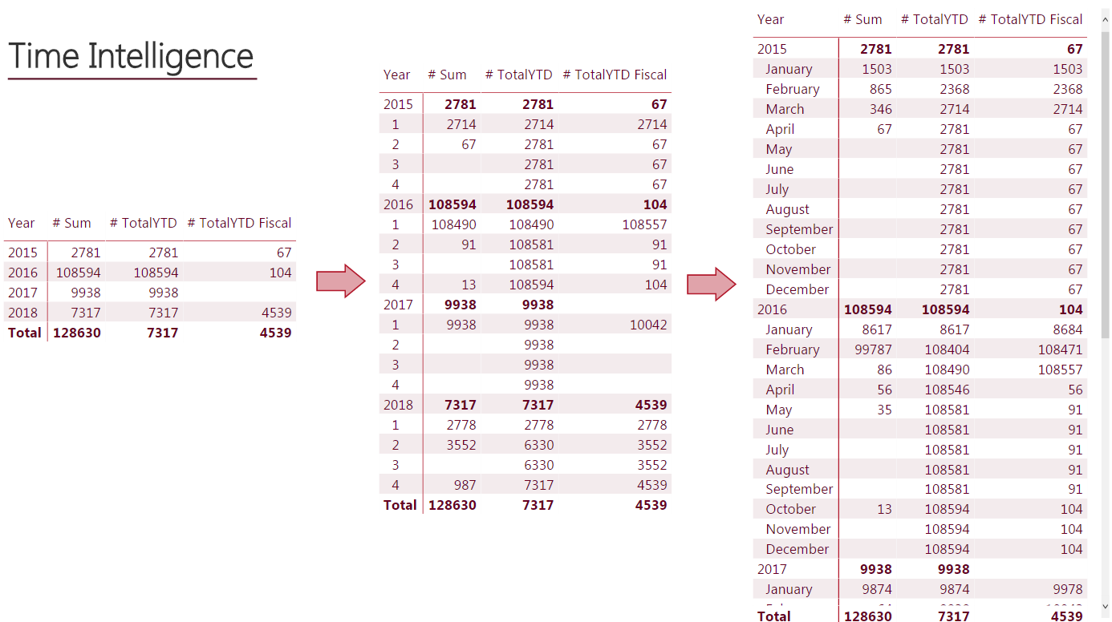
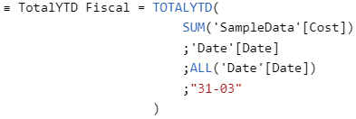
Most common functions
Time intelligence
TotalYTD Fiscal
Cumulative amount of costs for each year
(Start in April)

Slide 17
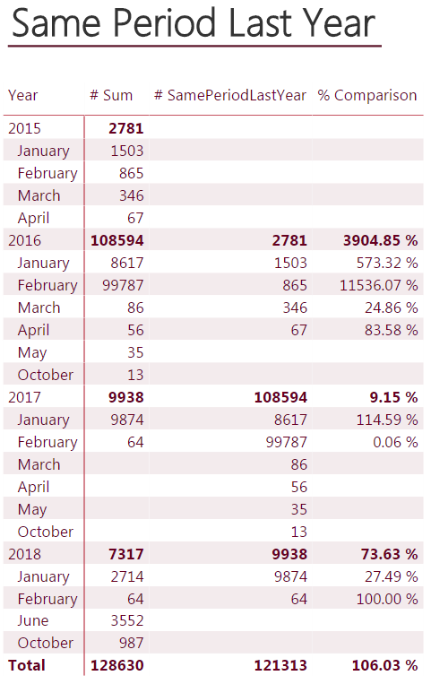
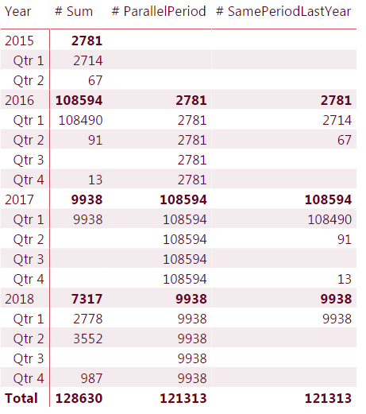

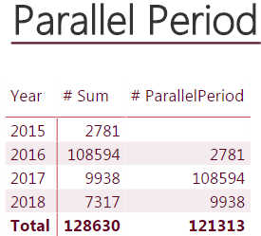

Most common functions
Time intelligence
SamePeriodLastYear (Dynamic)
ParallelPeriod (Not dynamic)

Slide 18
E
If / Elsif

Slide 19
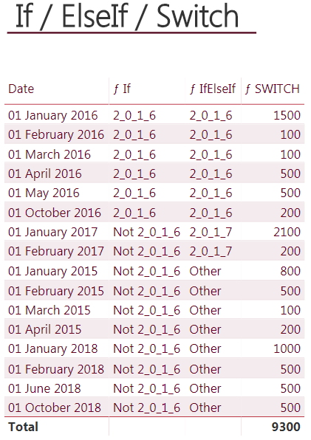
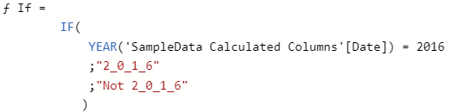
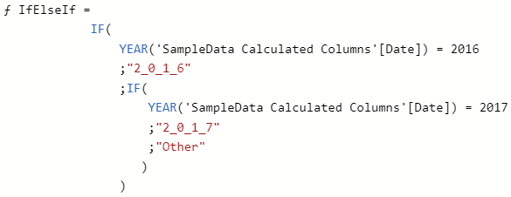
Most common functions
If / Elsif
If
Conditional column with 2_0_1_6 for the year 2016
ElseIf
Conditional column with multiple conditions

Slide 20
F
GroupBy

Slide 21
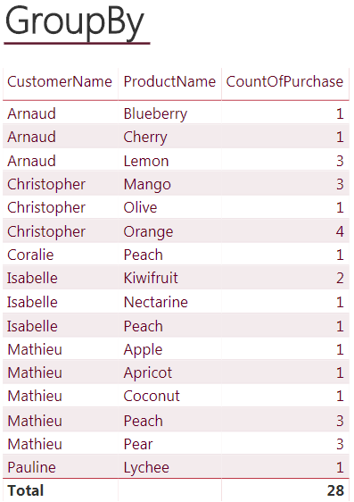
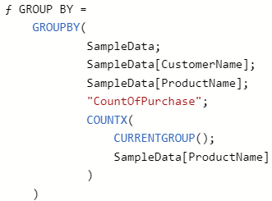

Most common functions
GroupBy
GroupBy
New table with data grouped by CustomerName

Slide 22
G
Earlier

Slide 23
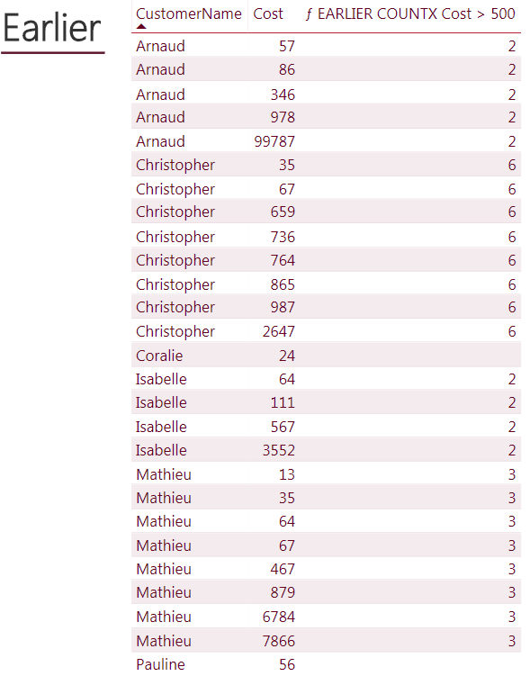
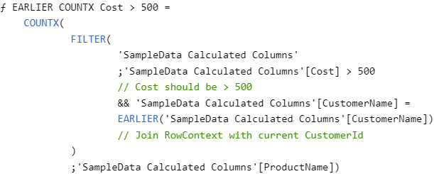
Most common functions
Earlier
Earlier
Count the number of cost > 500 by customer

Slide 24
LazyDax
2. Retention/Churn Rate

Slide 25





Practical Case
Retention Rate
2017
2018

Slide 26
Practical Case
Retention Rate
2017
2018

Slide 27

Practical Case
Retention Rate
2017
2018
50% = 2 / 4
 | #Customer | #New Customer | #Old Customer | #Previous Customer | % Retention
2017 | 4 | / | / | / | /
2018 | 3 | 1 | 2 | 4 | 50% = 2 / 4

Slide 28
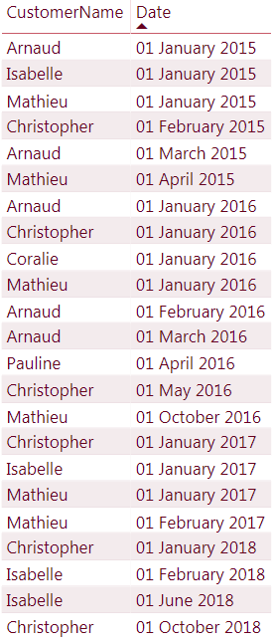
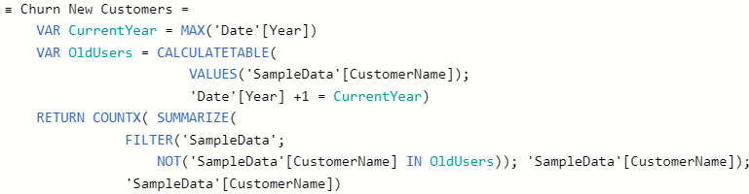
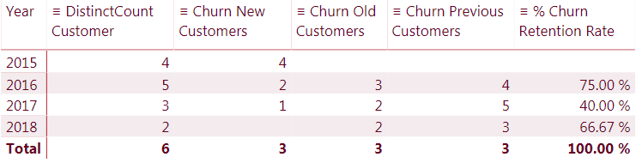
Most common functions
Churn/Retention rate
Churn / Retention

Slide 29
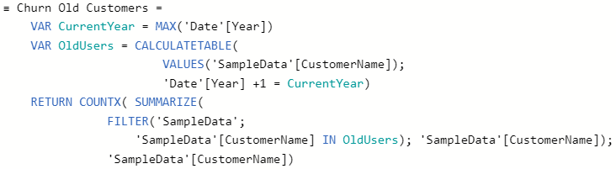
Most common functions
Churn/Retention rate
Churn / Retention

Slide 30
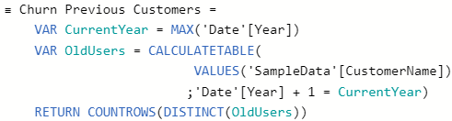
Most common functions
Churn/Retention rate
Churn / Retention

Slide 31
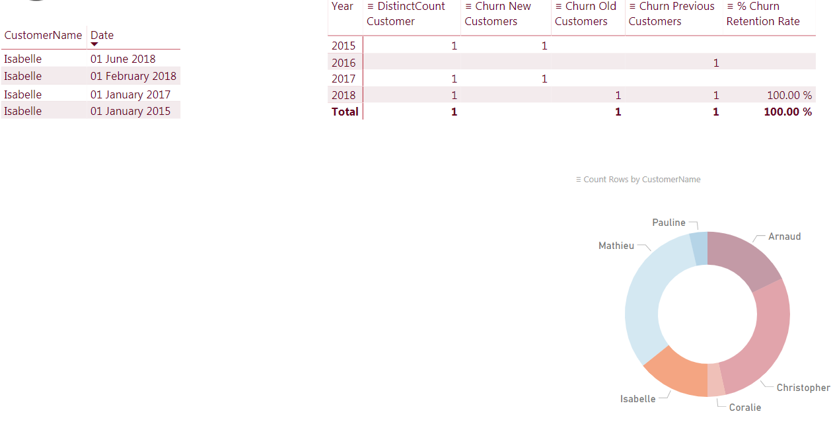
Most common functions
Churn/Retention rate

Slide 32
Thanks for watching

Slide 33
License terms
we share our projects under creative commons License
Link to Creative commons License.
Licensees may copy, distribute, display and perform the work and make derivative works and remixes based on it only if they give the author or licensor the credits (attribution) in the manner specified by these.
So, We kindly encourage you to use, change it, share it! But do not forget to add us a small smile.

